Slide 1

Learning Analytics Final presentation (D-Math, ETH)
De la Cruz Oliver‎
Krishna Vaibhav
Scherrer Michael

Slide 2

AGENDA
Objective of the project
Data sources
Model selection
Conclusion

Slide 3
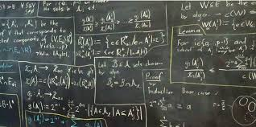
Objective
Using interaction data and exam performance to improve flipped-classroom didactics.

Slide 4
Data Sources
Moodle - Quiz
Cours Progress
Solved exercises
Demographic data
Age
Group rolls (psychological data)
Start of semester
…
Moodle - Log
Click based actions
Final exam
Exercise results
Grade
End of semester
Sex
…
Department
Dataset 1
211 Datapoints
Dataset 2
122 Datapoints

Slide 5
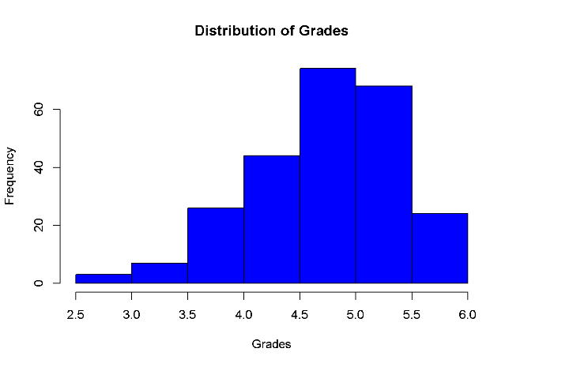

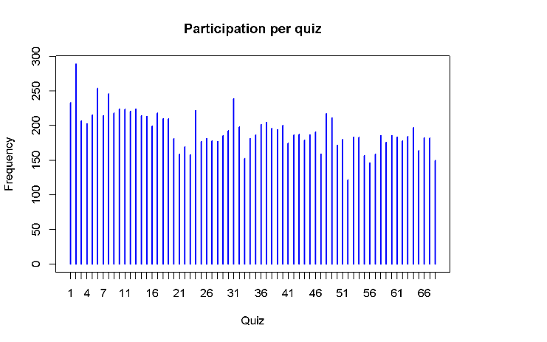
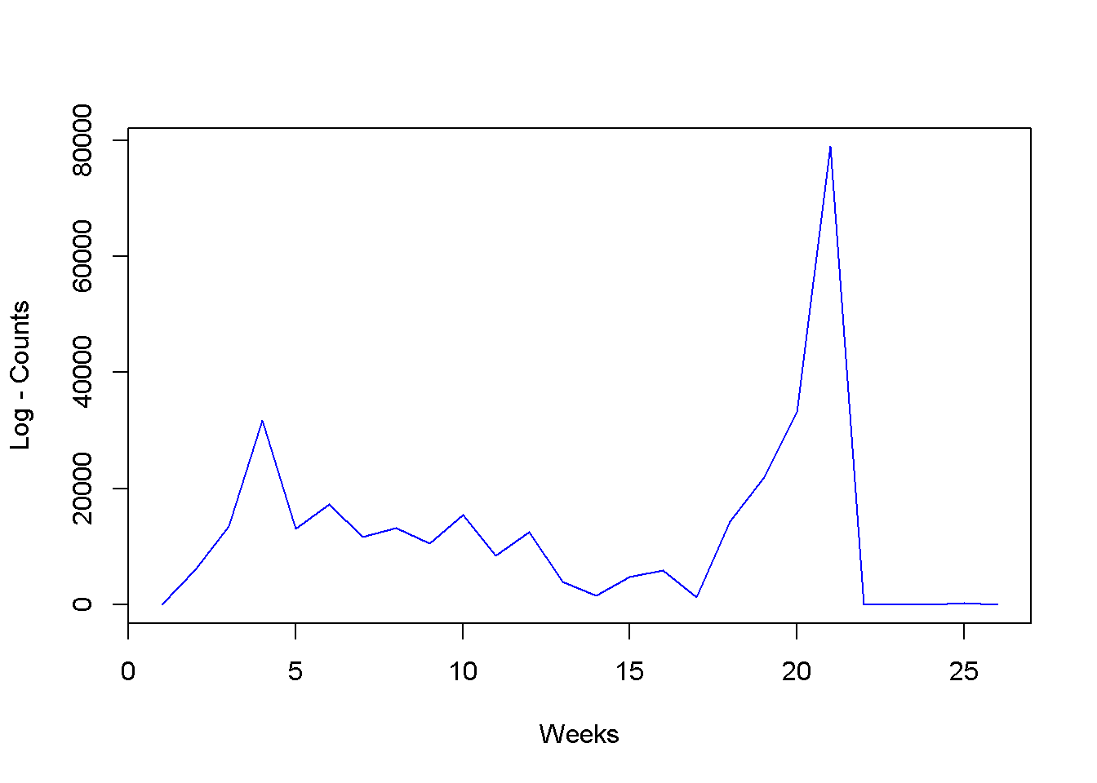
Exploratory Data Analysis
Marginal distribution of grades
Participation per quizz
Interactions with moodle

Slide 6
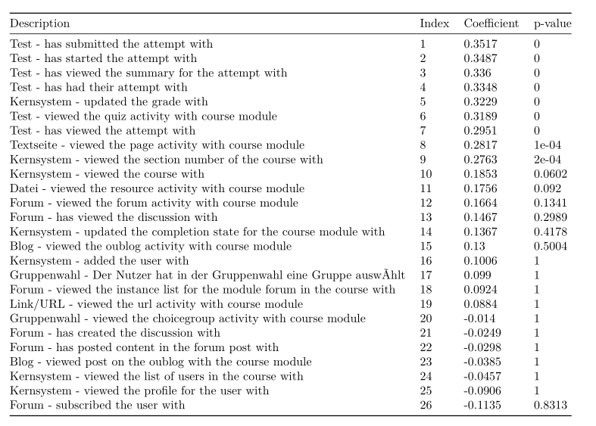
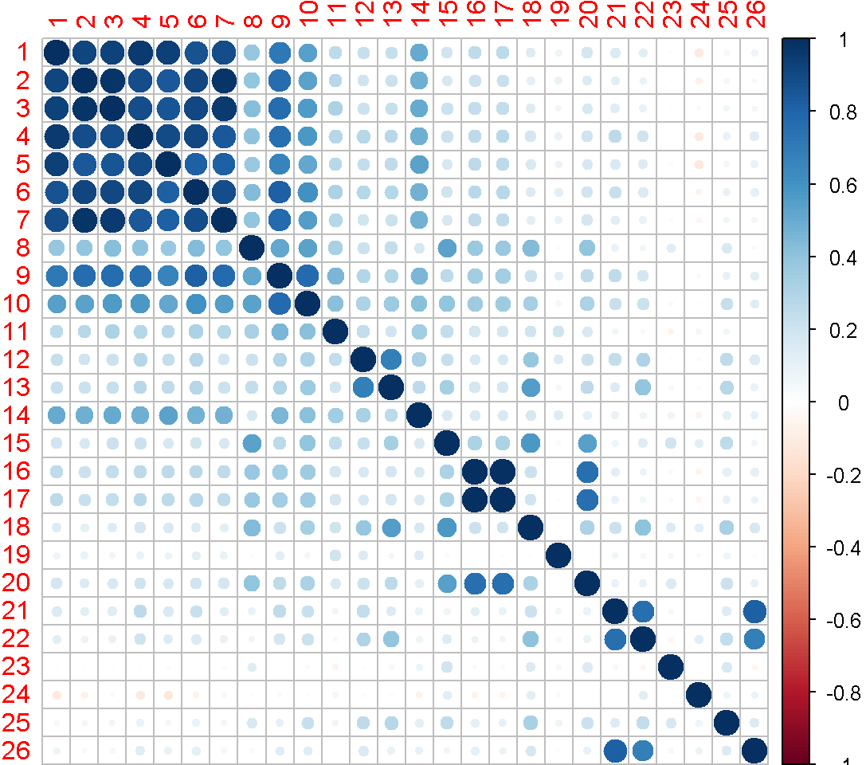
Exploratory Data Analysis
Measuring correlation between log files attributes (counts) and performance

Slide 7
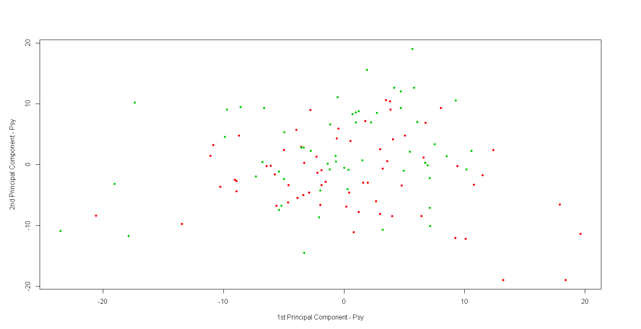
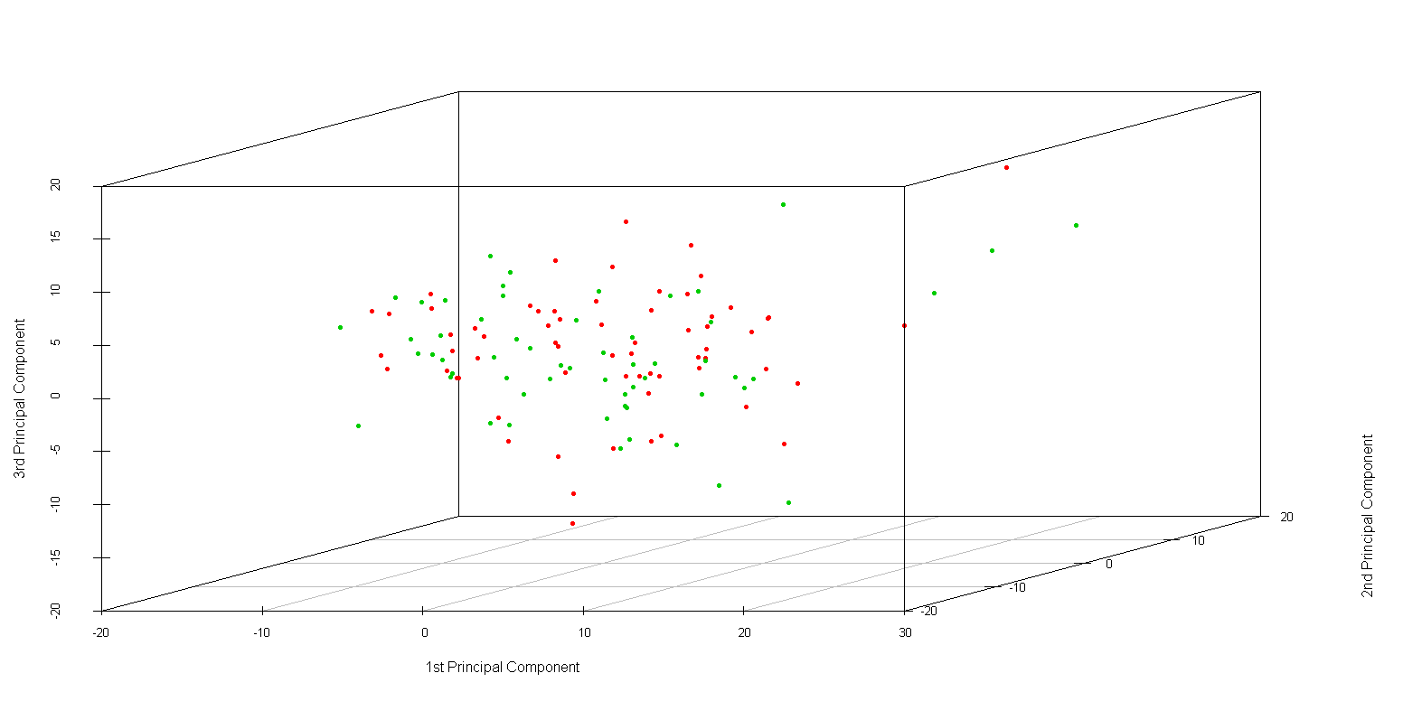
Assessment of psychological tests
Perform matrix reduction on pyscological variables by using PCA
2D
3D
< 5.0
>= 5.0
No apparent subgroups

Slide 8
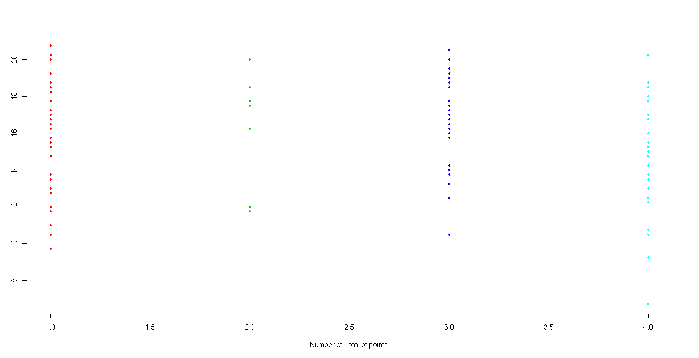
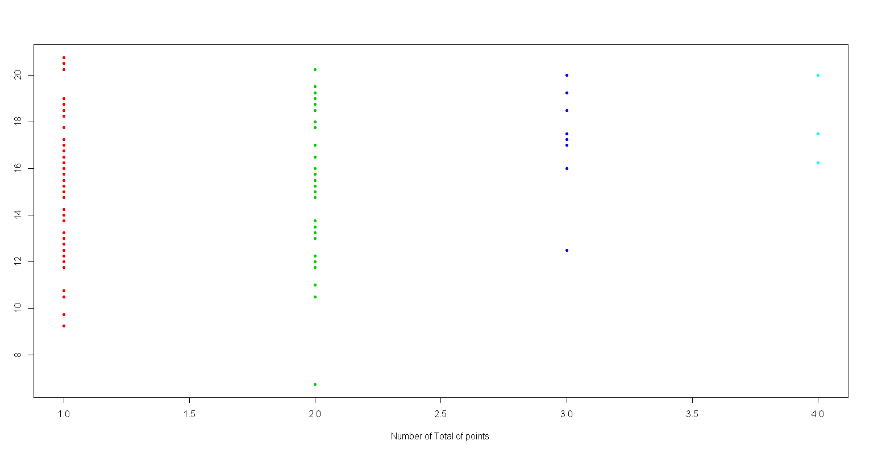
Assessment of psychological tests
Clustering analysis
K-means – No relationship between clusters and total points
Gaussian mixture model – Weak association

Slide 9
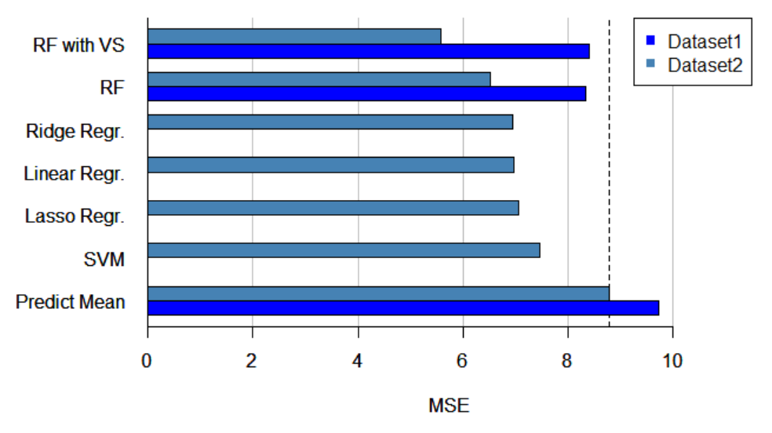
Supervised Learning
Model selection by 10 fold cross-validated mean squared error

Slide 10
Supervised Learning
Data 1 (211)
Linear Regression: 6.4134
SVM – Linear Kernel: 6.5040
SVM – Gaussian Kernel: 6.7291
Lasso : 6.7059
Ridge: 6.4134
Data 2 (122)
Linear Regression: 5.3227
SVM – Linear Kernel: 5.3561
SVM – Gaussian Kernel: 6.0266
Ridge: 5.3227
Lasso: 5.4060

Slide 11
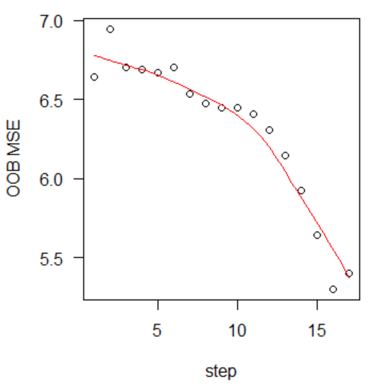
Random Forest with variable selection as proposed by Diaz-Uriarte, R., Alvarez de Anders, S., 2006
Compute RF variable importance
Stepwise eliminate 5 variables having the smallest importance and build new forest
Choose set of variables with the lowest OOB MSE

Slide 12
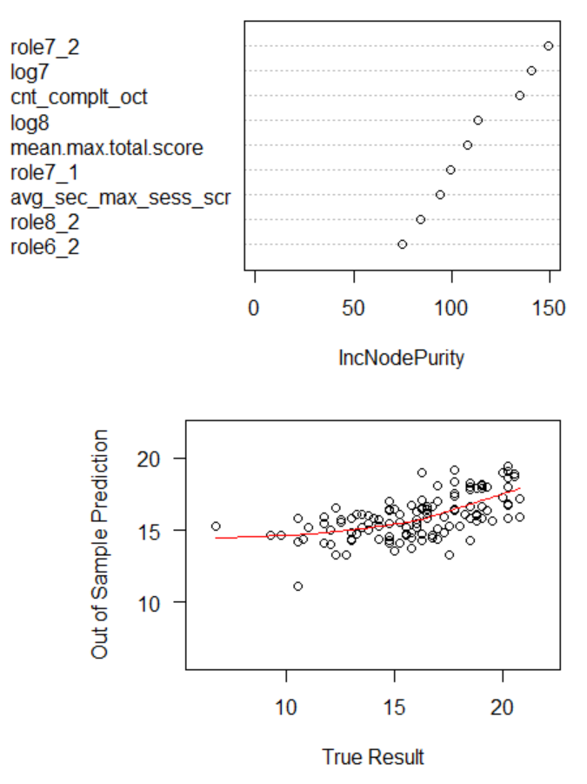
Random Forest with variable selection as proposed by Diaz-Uriarte, R., Alvarez de Anders, S., 2006,

Slide 13
Random Forest with variable selection as proposed by Diaz-Uriarte, R., Alvarez de Anders, S., 2006,
Role7_2:
Log7:
Cnt_compl_oct:
Log8:
Mean.max.total.score: mean(max score per quiz nr)
Role7_1
Avg_sec_max_sess_score
Role8_2:
Role6_2:

Slide 14
Conclusion
Causal inference is not possible
Psychological data correlates with the exam scores
Demographic data does not have an influence at all

Slide 15
Thank You…

