Slide 1
Login page
Student
Teacher
Admin
Set location
Timetable view
Switch view options
Manual update
Automatic update
Public view
Analysis view
Class view/register
Global data view
SQL commands
Common pre-set queries
Export data
Change student details

Slide 2
Database
Interactions
Request data
Execute command
Tables
Returns list
Returns Boolean value of success
Accounts
Alterations
Events
Locations
Remember me
Student Info
Subjects
Timetable
UserID
FirstName
LastName
SchoolEmail
HomeEmail
Gender
RoleID
Password
Image
AlterationID
UserID
LocationID
Start
End
Day
Week
Title
EventID
EventID
Types
LocationID
LocationName
Token
UserID
Expiry date
Roles
RoleID
RoleName
UserID
Form
House
TimetableID
AlterationID
Year
SubjectID
Name
UserID
EventID
TimetableID
LocationID
SubjectID
Start
End
Day
Week

Slide 3
WEBPAGE
Main.py
Enc.py
DB_interface.py
templates
404.Html
adminPage.html
Login.html
studentPage.html
teacherPage.html
Sub
adminAddAccount.html
adminRemoveAccount.html
adminSQLqury.html
teacherTiles.html
teacherList.html
Static
Img
js
style-(all html pages).css
Change password
Get location
None.png
Faces
Pupil img

Slide 4
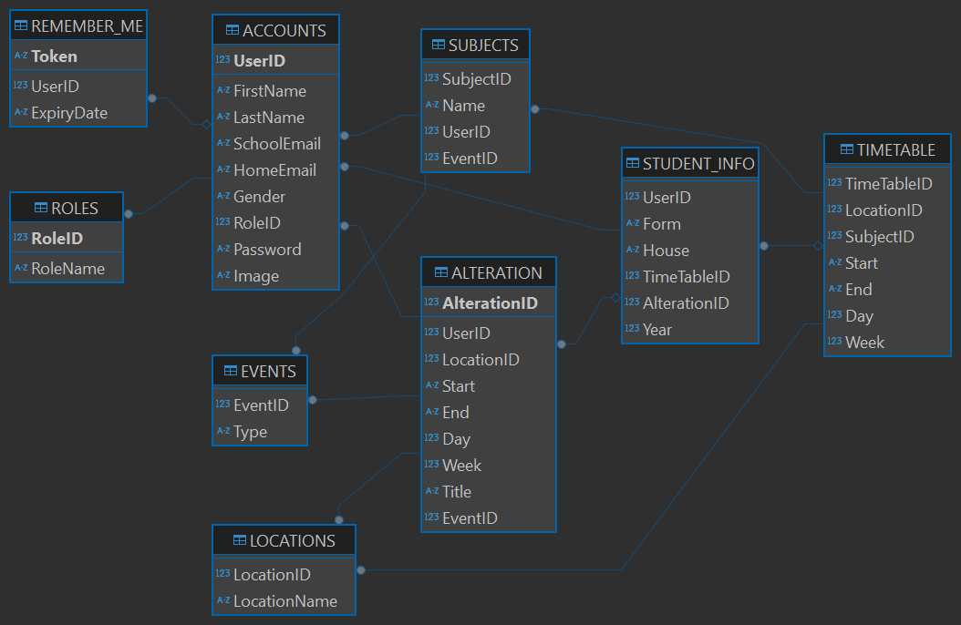

Slide 5
UserID
FirstName
LastName
SchoolEmail
HomeEmail
Password
Gender
Image
RoleName
Form
House
Year
Alteration
Subject Name
Teacher
Lesson Type
LocationName
Start
End
Day
Week
Token
ExpiraryDate

Slide 6

Filter Name
House
Form
View limit
House 1
House 2
House 3
House 4
House 5
Form A
Form B
Form C
Form D
Form E
View all
View 100
View 50
View 20
image
name
image
name
image
name
image
name
location
location
location
location
image
image
name
image
image
name
name
name
location
location
location
location
image
name
image
name
image
name
image
name
location
location
location
location

Slide 7

School sign in system
Login
Email
[ ]
Password
[ ]
Remember me [ ] [Login]

