Slide 1


Slide 2
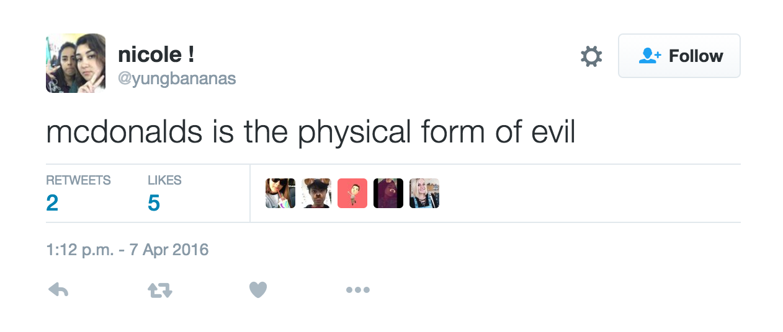
Notes:
http://www.conecomm.com/stuff/contentmgr/files/0/286c351989671ae74994fec139863bb2/files/2011_cone_online_influence_trend_tracker_release_and_fact_sheet.pdf
“4 out of 5 consumers reverse purchase based on online reviews”

Slide 3
6,000
Tweets
Notes:
There are lots of tweets

Slide 4
6,000
Tweets
Every Second
Notes:
Far too many to deal with in any manner which isn’t digital
Source:
http://www.internetlivestats.com/twitter-statistics/

Slide 5
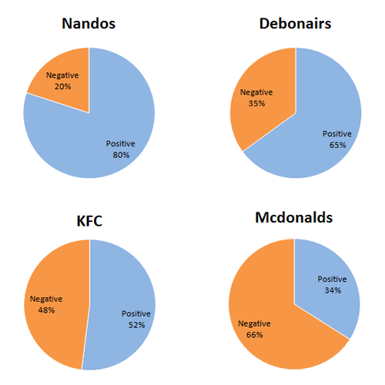
Notes:
Most approaches to dealing with this data are aggregate, an algorithm analyzes the tweets and sums up the statistics
Source:
http://www.mobenzi.com/intelligence/index.php/tag/tasktypes/

Slide 6
Notes:
But this is really dumb,
Even if this data were accurate, it gives you very few hints of how to change your approach. At best its just another metric…
... And at worst its directly misleading

Slide 7
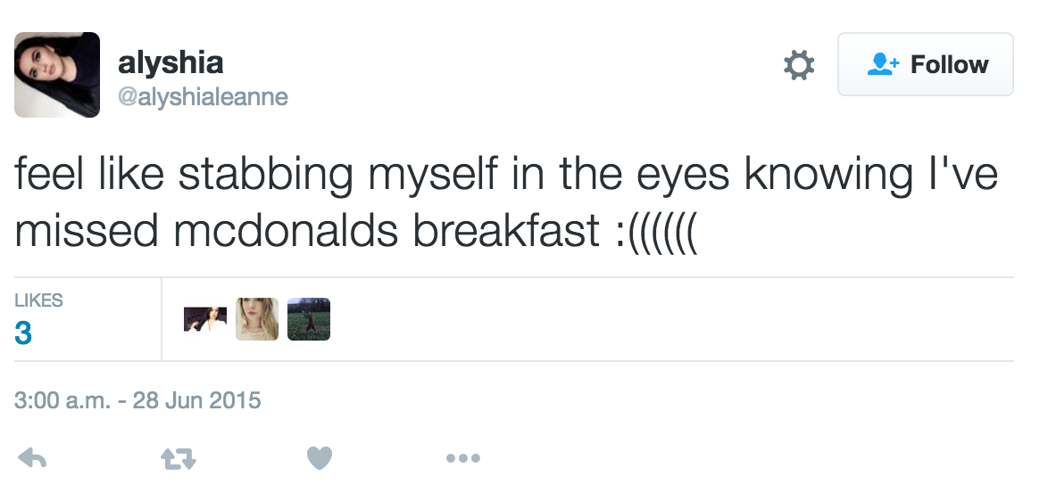
Notes:
Sometimes a negative sentiment is a good thing.
More often than not it contains key information on something you can improve.

Slide 8
What do people think about me?
What do they want from me?
How can I change their minds?
Notes:
Three things we’d like to know

Slide 9
What do people think about me?
What do they want from me?
How can I change their minds?
Notes:
One of those we’ve discussed already

Slide 10
What do people think about me?
What do they want from me?
How can I change their minds?
Notes:
And this last one is the jackpot

Slide 11
Notes:
And so, we’d like to introduce to you

Slide 12
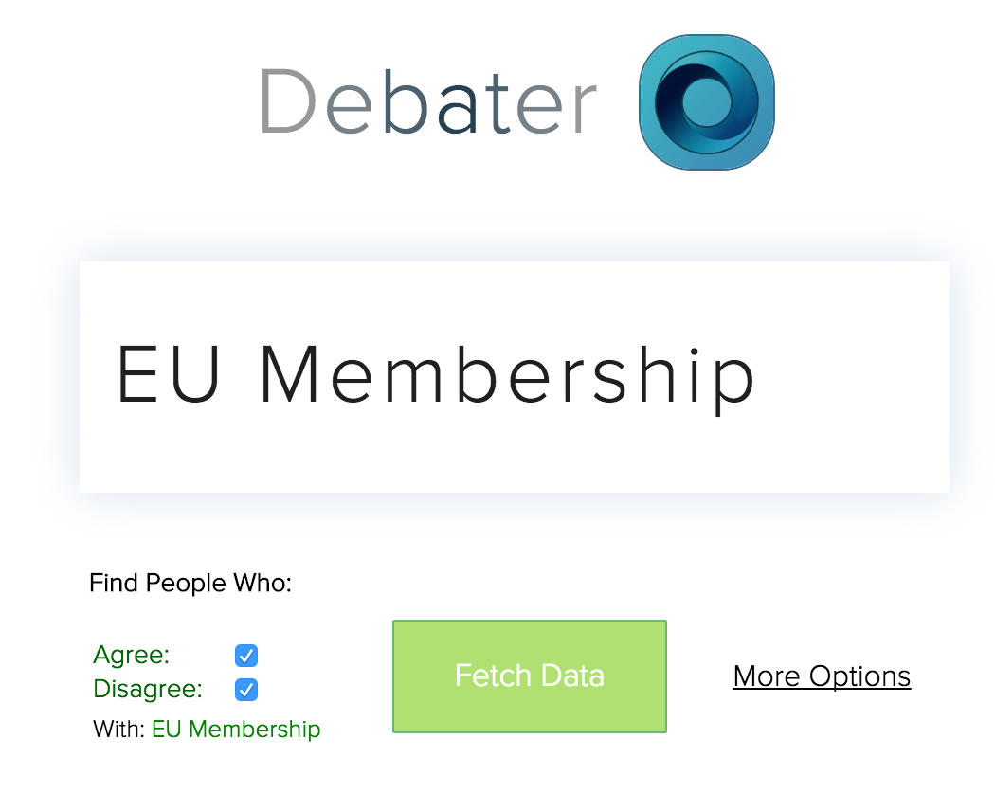
Notes:
To the Debater search box

Slide 13
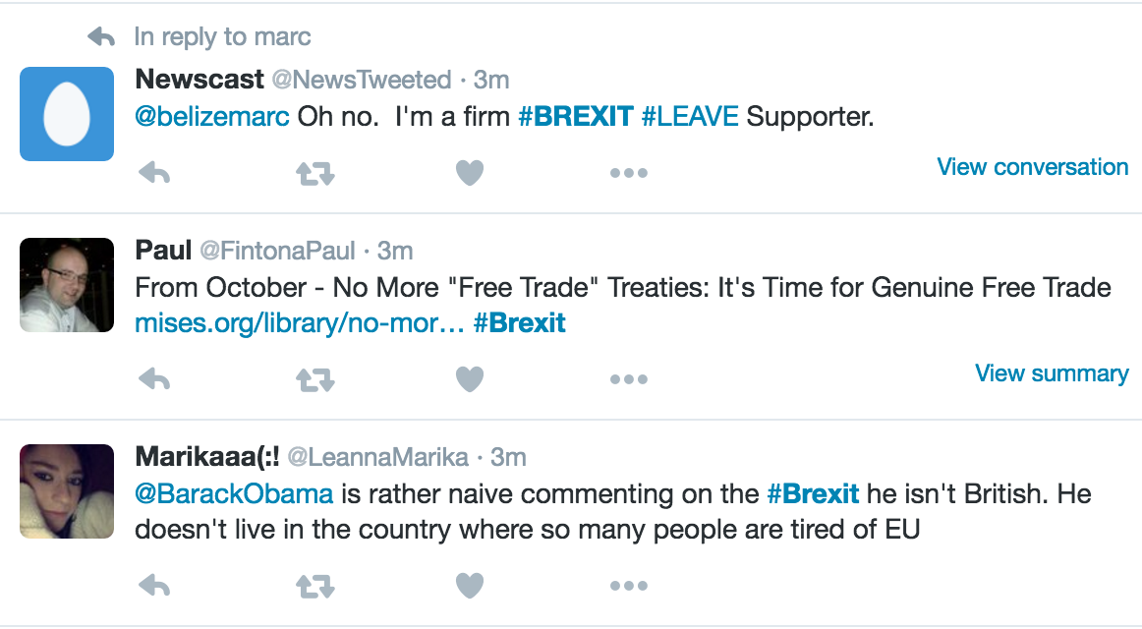
Notes:
It can give you an annotated list of live tweets,
Which you can immediately reply to inline

Slide 14
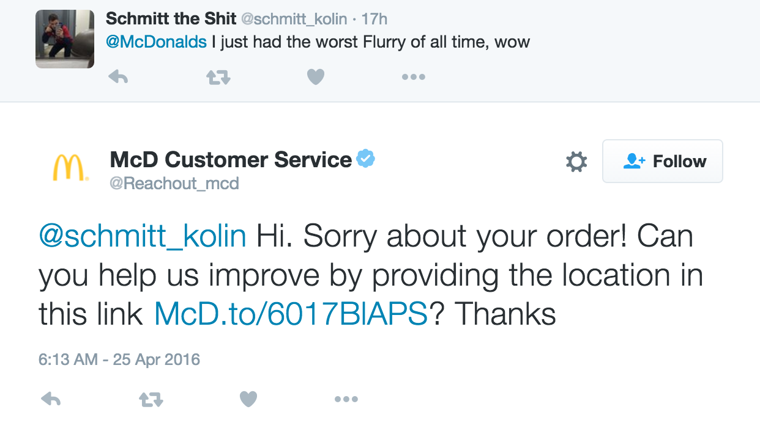
Notes:
At the moment, large companies like McDonalds can only reply to tweets made directly to them.
But we can grab tweets which just mention your company’s name or product, without relying on hash-tags or mentions

Slide 15
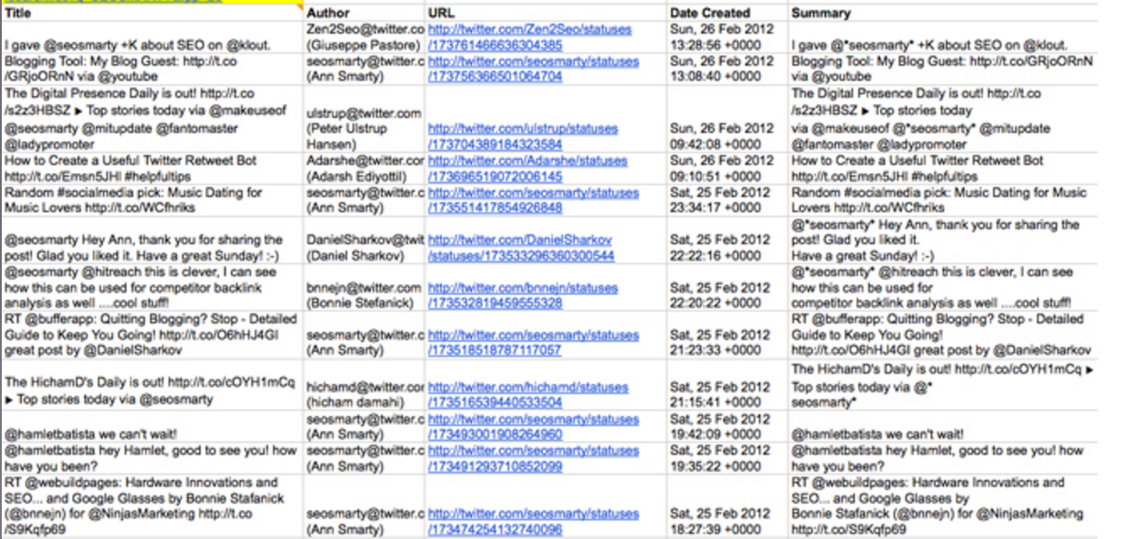
Notes:
We can even output the tweets to a spreadsheet, lifting a list of individual users for you to reach out to

Slide 16
88,000 unique accounts
A team of over 40 people
Notes:
Do people already do this?
Yes, but they do it in a really stupid way:
Source:
http://time.com/money/4022979/mcdonalds-twitter-all-day-breakfast/

Slide 17
Just one person with a laptop
Notes:
And what takes a team of over 40 people can by done by just one person with a laptop

