Slide 1
Dining Philosophers
By: Oliver and Jason

Slide 2
The Problem
Consider five philosophers who spend their lives thinking and eating. The philosophers share a circular table surrounded by five chairs, each belonging to one philosopher. In the center of the table is a bowl of rice, and the table is laid with five single chopsticks. When a philosopher thinks, she does not interact with her colleagues. From time to time, a philosopher gets hungry and tries to pick up the two chopsticks that are closest to her (the chopsticks that are between her and her left and right neighbors). A philosopher may pick up only one chopstick at a time. Obviously, she cannot pick up a chopstick that is already in the hand of a neighbor. When a hungry philosopher has both her chopsticks at the same time, she eats without releasing the chopsticks. When she is finished eating, she puts down both chopsticks and starts thinking again.

Slide 3
Our Solution

Slide 4
Challenges faced

Slide 5
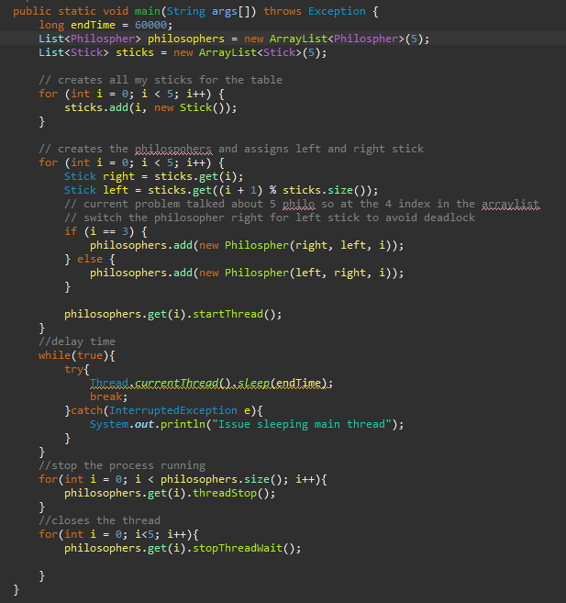
Main Method

Slide 6
Main Method Explained
Runs Everything
Starts the Philosophers
Creates the sticks
Assigns the sticks

Slide 7
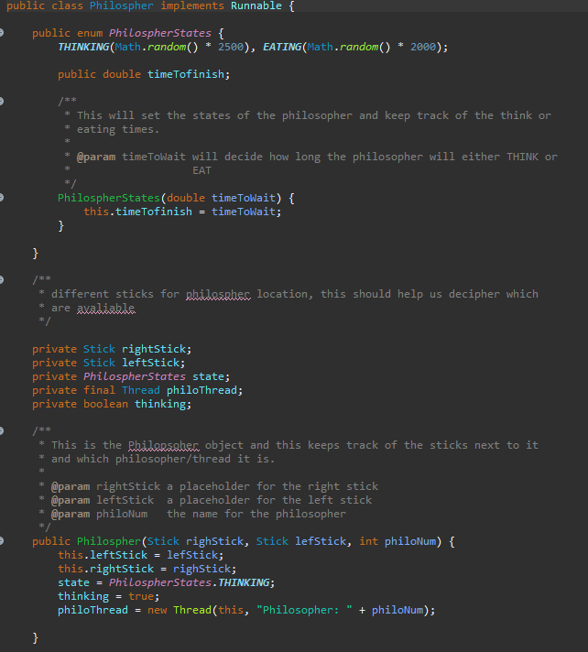
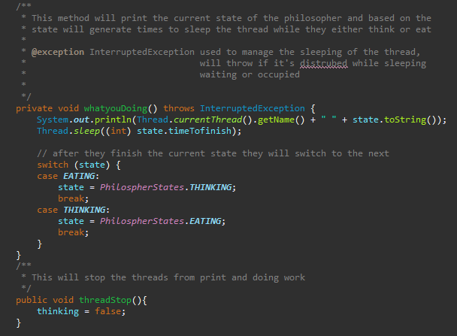
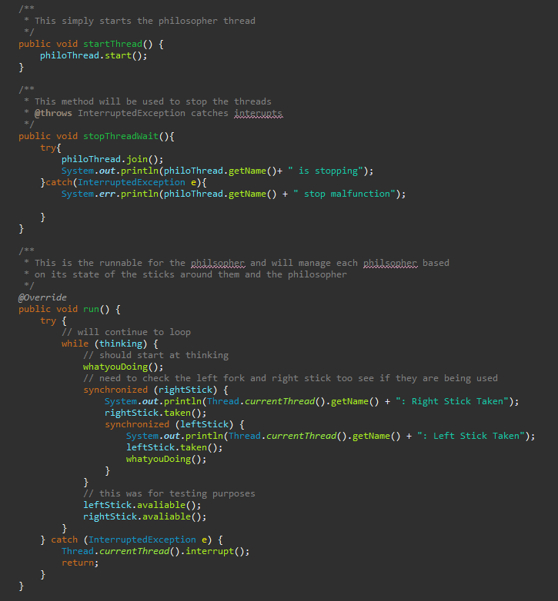
Philosopher Class

Slide 8
Philosopher Class explained
Creates the Philosophers
Creates the Sticks
Sets states for philosopher

Slide 9
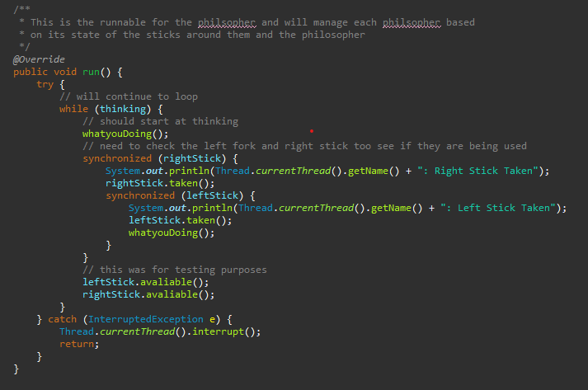
Philosopher class - run

Slide 10
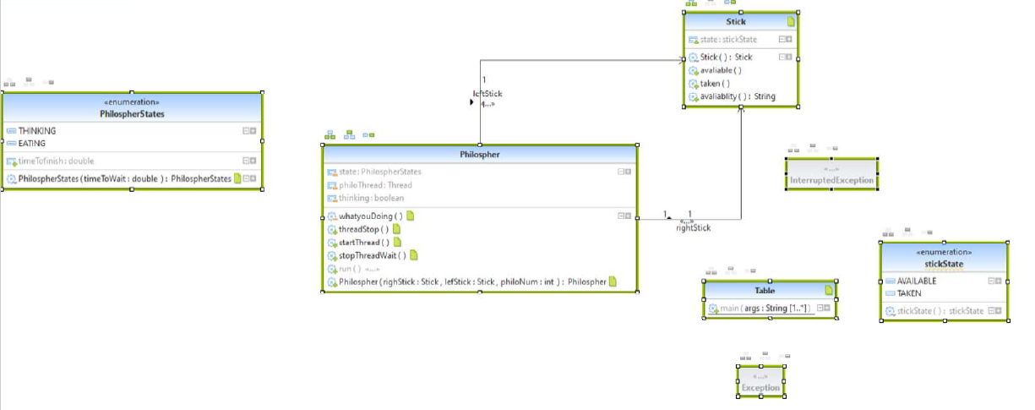
UML

Slide 11


