Slide 1
Dining Philosophers
By: Oliver and Jason

Slide 2
Our Solution

Slide 3
Main Method

Slide 4
Main Method Explained

Slide 5
Philosopher Class

Slide 6
Philosopher Class explained

Slide 7
Philosopher class - run

Slide 8
Challenges faced

Slide 9
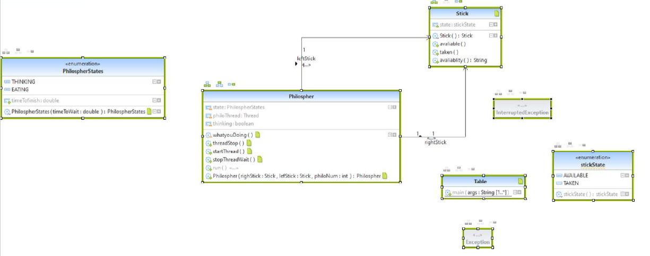
UML

Slide 10
Flow Charts

Slide 11
