Slide 1
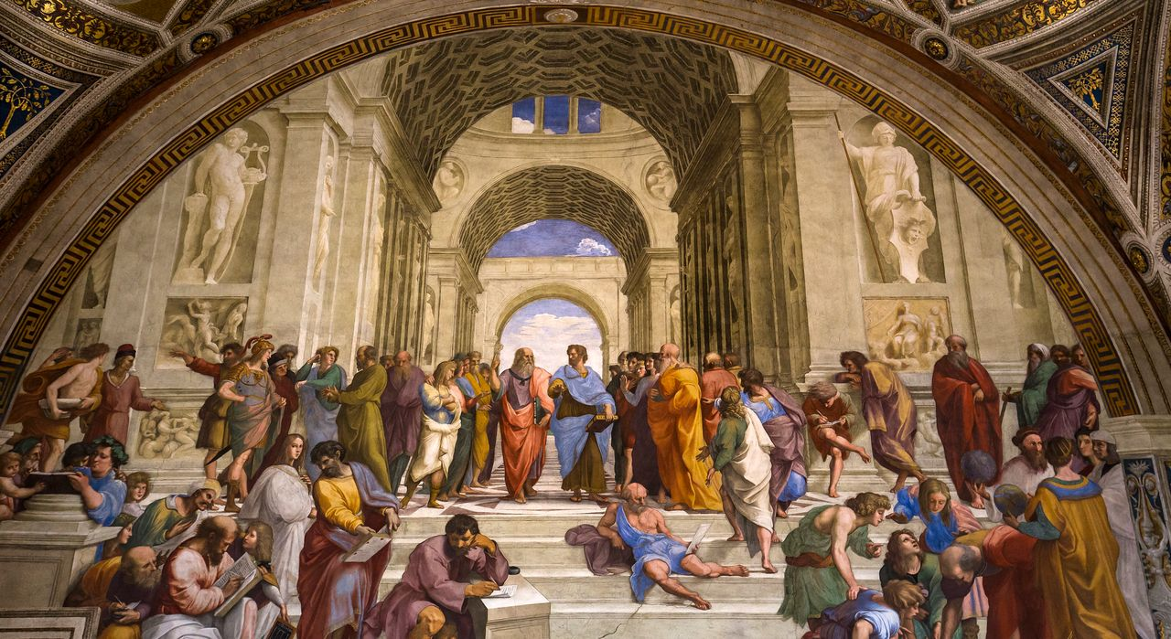
Dining Philosophers
By: Oliver and Jason

Slide 2

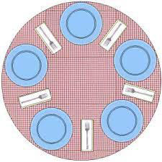
The Problem
In the problem there are five philosophers that alternate between eating and thinking. On the table there are five sticks, when a philosopher wants to eat is must pick up the stick to his left and right when they are available. He then must eat and then set them down and begin to think again.

Slide 3
Our Solution

Slide 4
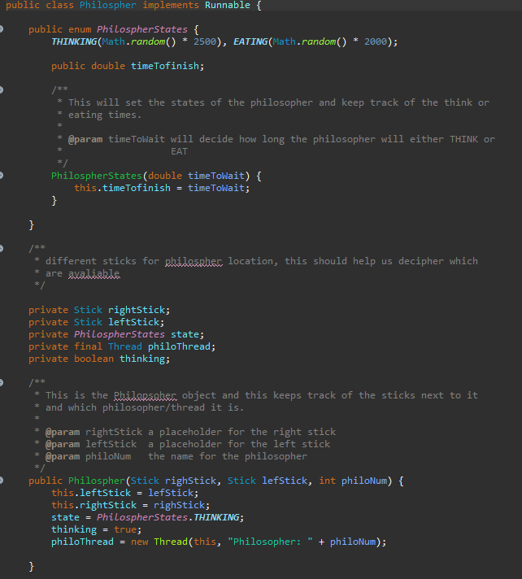
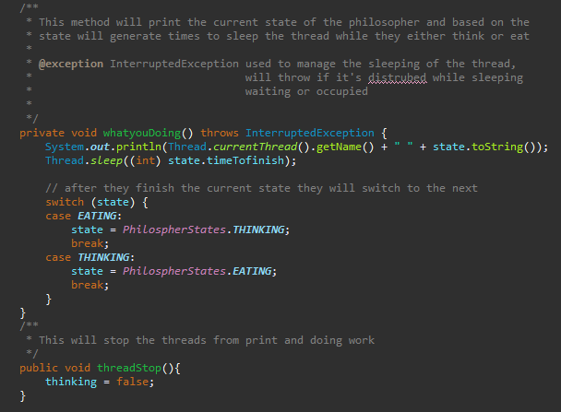
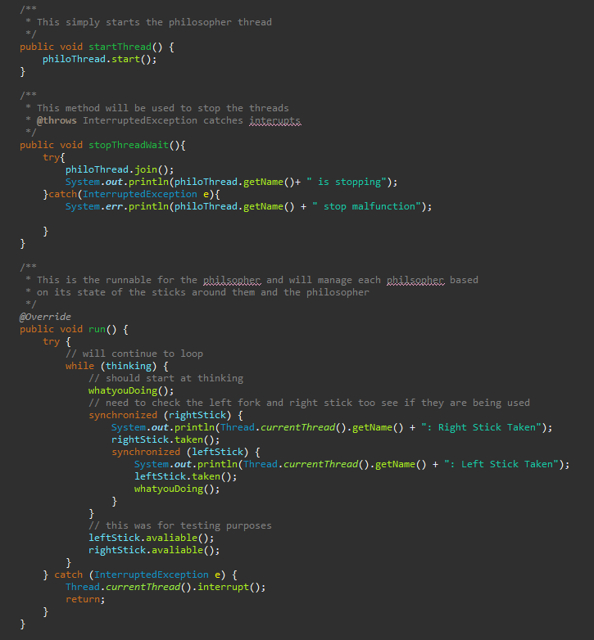
Philosopher Class

Slide 5
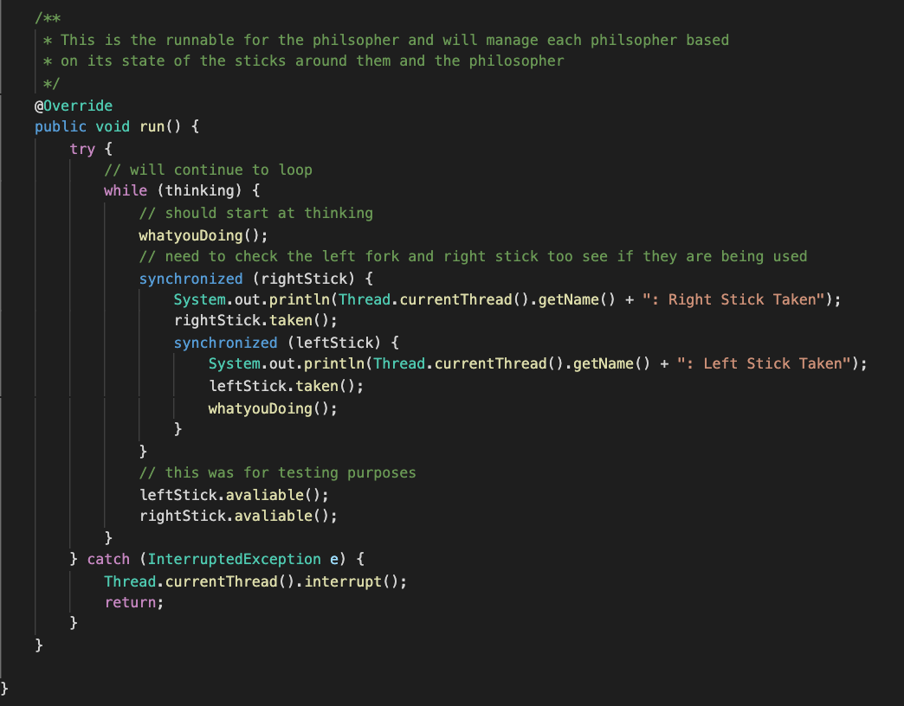
The RUN Method

Slide 6
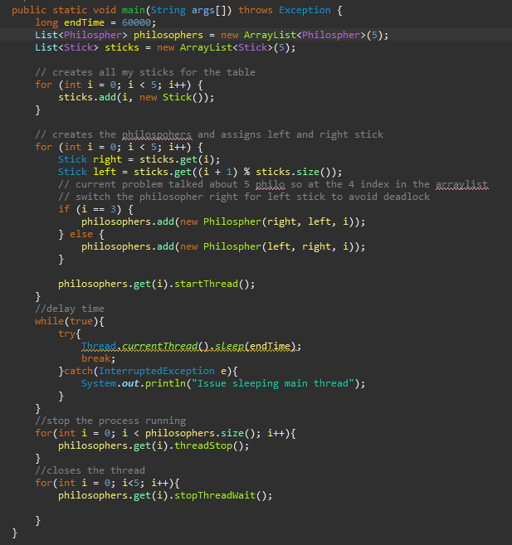
Main Method

Slide 7
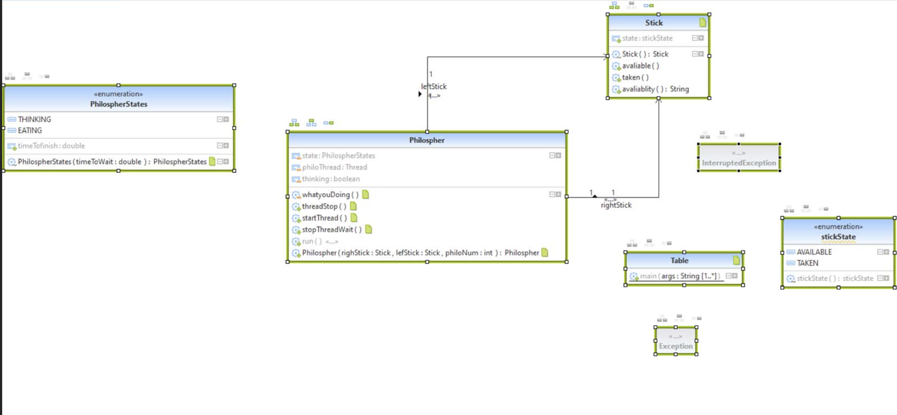
UML

Slide 8
Challenges faced

Slide 9


