Slide 1
Chartview
A Fast VSRG (Vertically Scrolling Rhythm Game) chart viewer
by Oliver Pitkänen

Slide 2
Project Idea
Preview charts before importing into the game
Export charts to a different format when necessary

Slide 3
Motivation
Some friends asked for it
I was bored

Slide 4
Fulfillments
Lightweight program
Automatic format conversion
Many popular formats supported

Slide 5
Development
Started simple in Python with PyGame
Pivoted to making it in Go instead, and to be translated to C#
Using raylib for rendering and raygui for menu elements

Slide 6
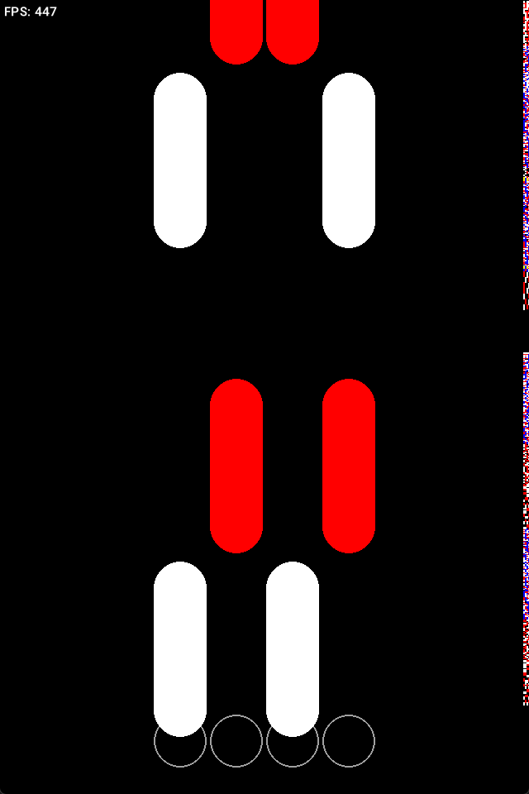
Previous version
Simplistic
Terrible performance
Out of sync audio
Limited features
No configurability

Slide 7
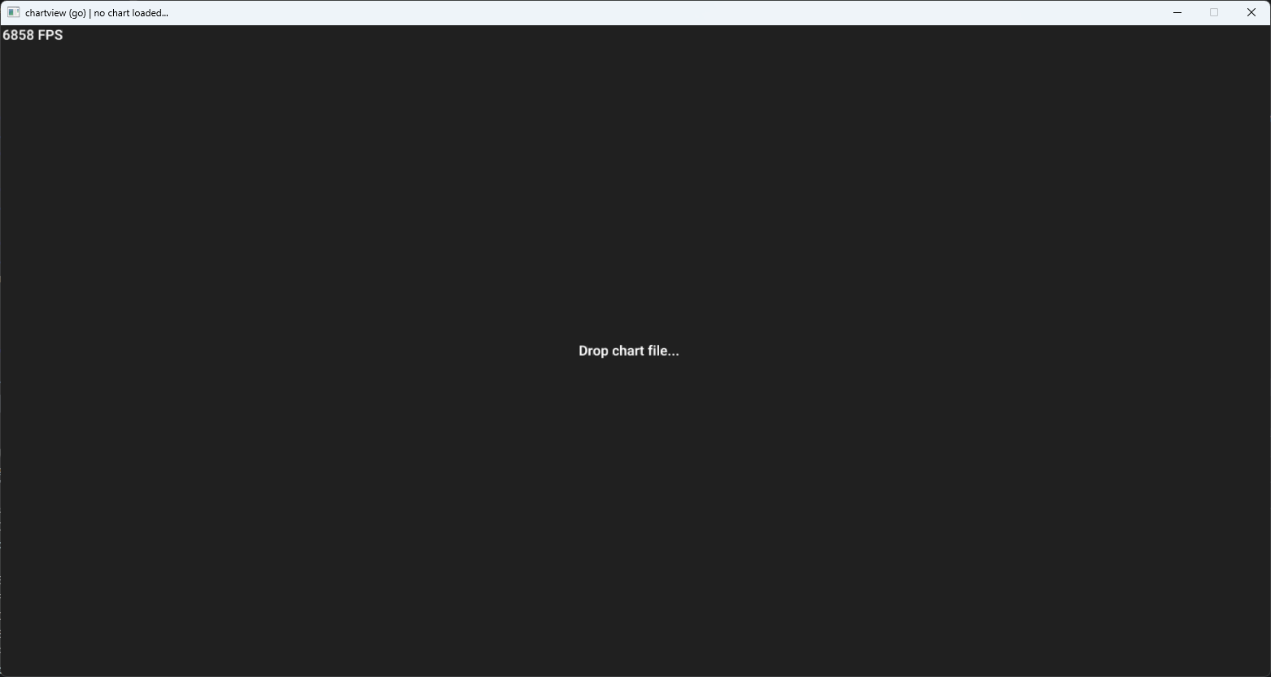
Functionality

Slide 8
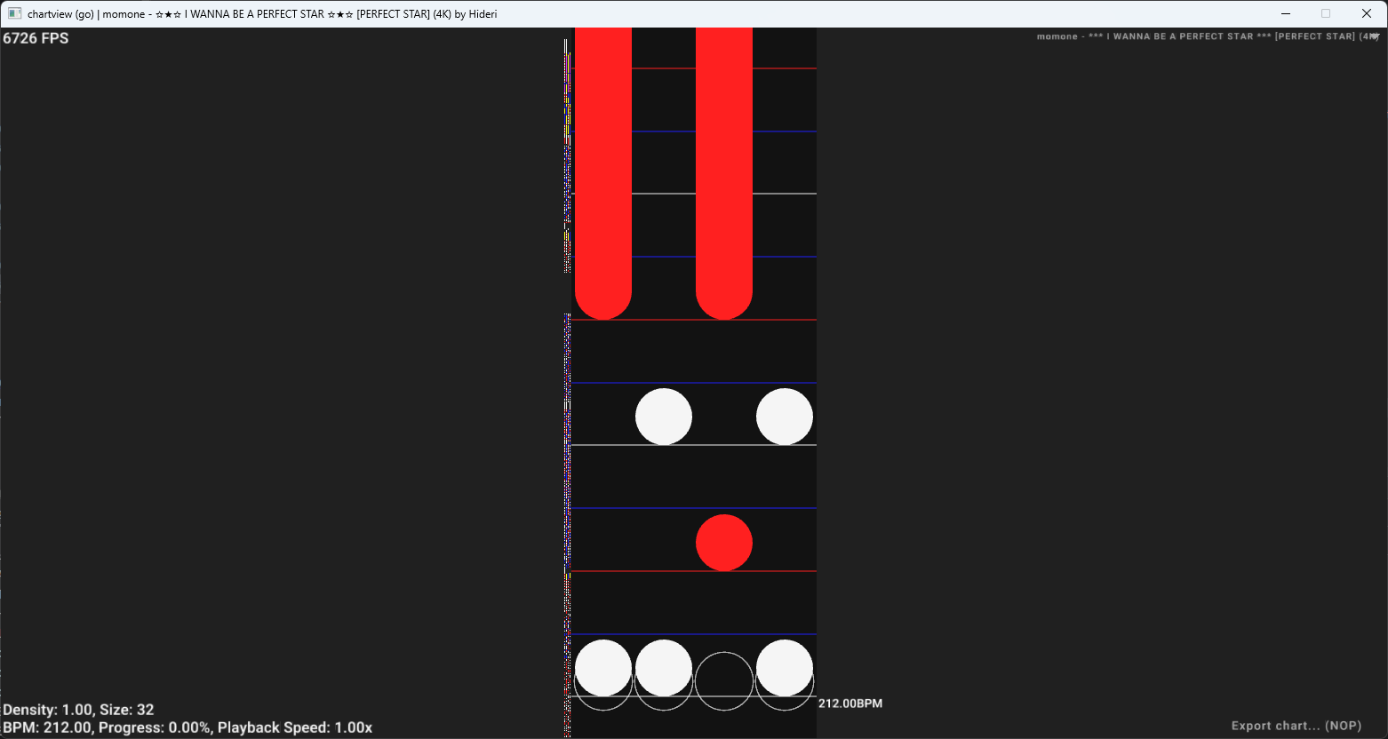
Functionality

Slide 9
Functionality
The lanes

Slide 10
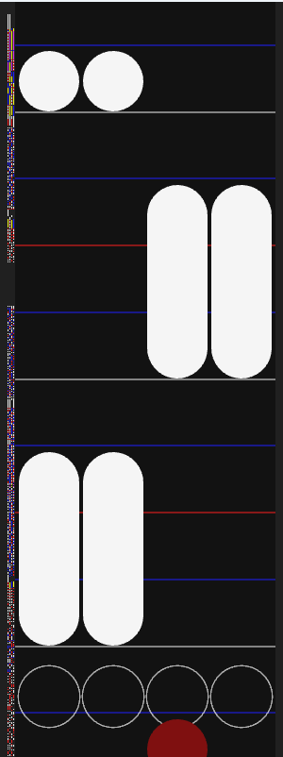
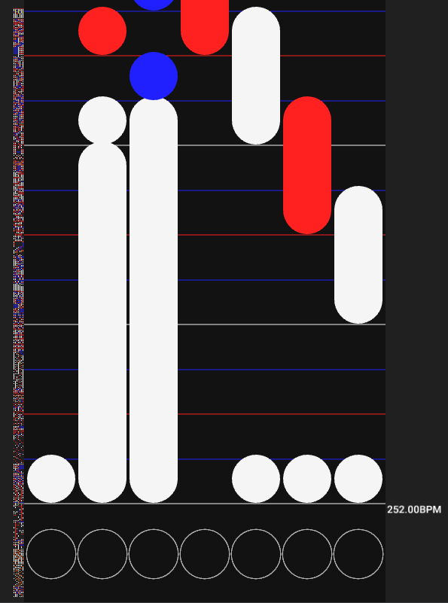
Functionality
4 lanes (4K)
7 lanes (7K)

Slide 11
Functionality
Hit object (hold)
Hit object

Slide 12
Functionality
Timing point (tempo change)

Slide 13
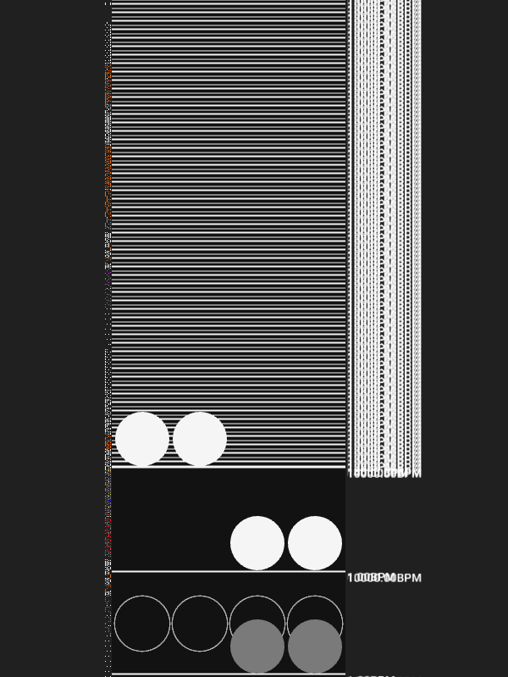
Functionality
???

Slide 14
Functionality
Time signature (1/2)
Time signature (1/4)
1/1 1/2 1/3 (+ 1/6 & 1/12)
1/4 1/8 1/16
Time signature (1/1)
Color depending on signature

Slide 15
Functionality
Minimap

Slide 16
Functionality
Info

Slide 17
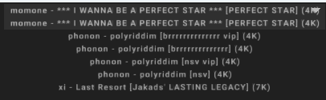
Functionality
Chart selector

Slide 18
Functionality
Export

Slide 19
Reflection
Would start by using a more performant language

Slide 20
Conclusion
Viewer / simulator for rhythm game chart files
Allows exporting imported files to different formats to use in different games

Slide 21
References
None

