Slide 1
Digital Business Environments Week 5 (timetable week 23) Lecture 5 Digital Business Strategy

Slide 2
Directed Reading
Chaffey 6th Edition Chapter 5
Forbes.com (24th November 2014) eBay Through The Lens Of Porter's Five Forces available at http://www.forbes.com/sites/greatspeculations/2014/11/24/ebay-through-the-lens-of-porters-five-forces/
Porter, M (2001) "Strategy and the Internet," Harvard Business Review, Vol. 79, No. 3, March available at: https://hbswk.hbs.edu/item/strategy-and-the-internet
Porter’s Generic Strategies. available at http://www.mindtools.com/pages/article/newSTR_82.htm

Slide 3
Industry News!
What’s happened in Digital Business since the last lecture?

Slide 4
Lecture Outcomes
Understand the role of ‘strategy process models’ for digital business
Apply tools to generate and select digital business strategies
Outline alternative (to process models) strategic approaches for digital start-ups

Slide 5
If I was a manager…
How does digital business strategy differ from traditional business strategy?
How should we integrate digital business strategy with existing business and information systems strategy?
How should we evaluate our investment priorities and returns from digital business?

Slide 6
If I was launching a digital start-up….
What does my business look like in the digital economy – and what is the potential for growth?
How ‘universal’ is my business?
What is the likely frequency of use?

Slide 7
Strategy
The direction and scope of an organization over the long-term: which achieves advantage for the organization through its configuration of resources within a changing environment to meet the needs of markets and to fulfil stakeholder expectations
Johnson and Scholes (2006)
An organisation’s sense of purpose – but plans and actions also needed
Larger organisations have more than one strategy….

Slide 8
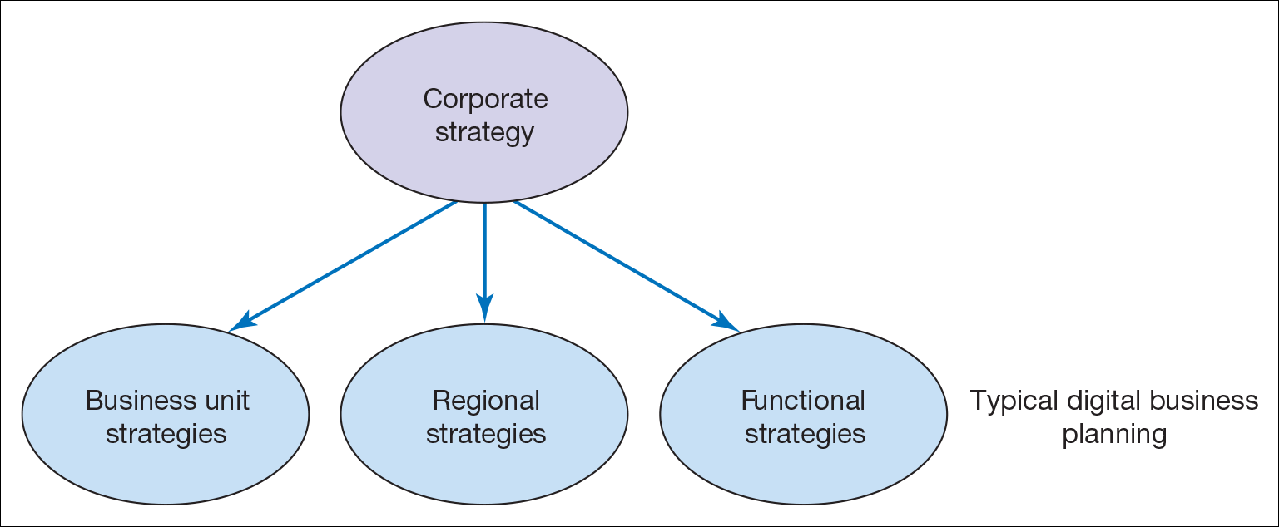
Different levels of organisational strategy

Slide 9
Levels of strategy – for Apple
Corporate strategy – overall purpose/scope of the organisation, Apple Inc., Apple Park, Cupertino, California
Business unit strategy – how to compete in a particular market, e.g. Tablets
Regional strategy – how to compete in a particular territory, e.g. China
Functional strategies – how to carry out business functions like managing the supply chain, marketing plans etc
also - Operational strategies – how to achieve the corporate and business unit strategies

Slide 10
Where does Digital Strategy fit?

Slide 11
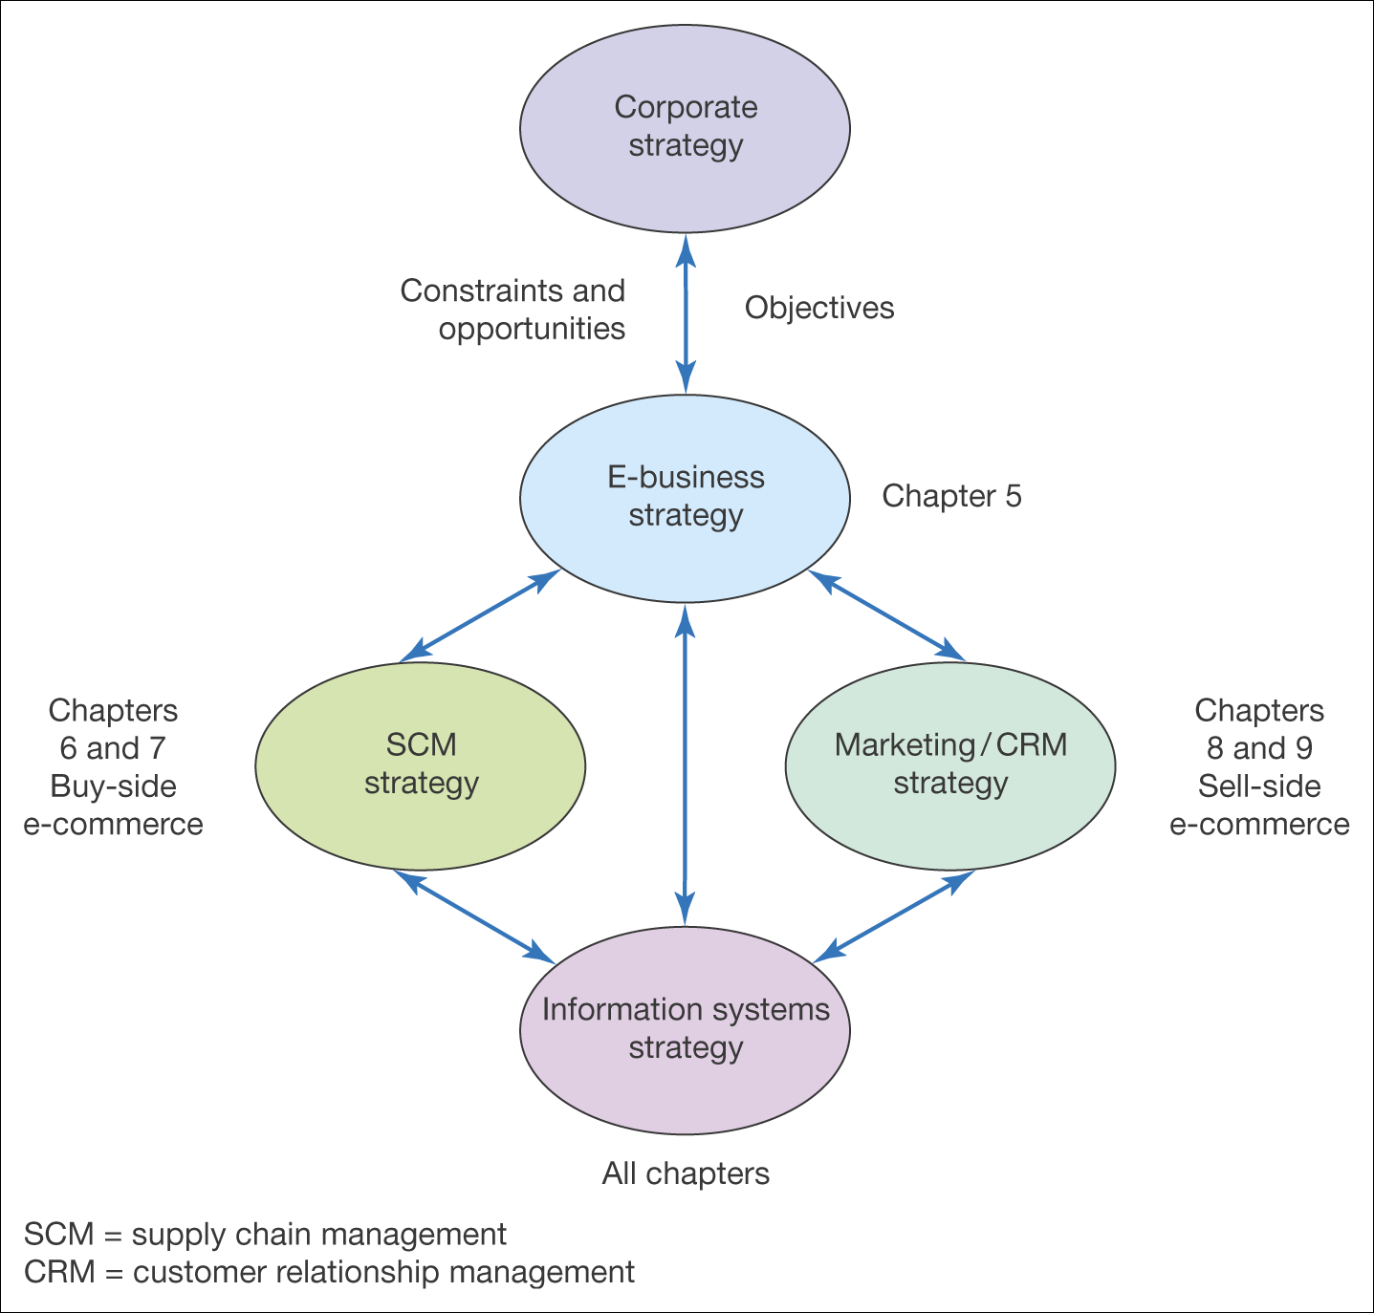
Digital Businesses are distinguished by the extent to which the e-business strategy feeds into the corporate strategy
Relationship between digital business strategy and other strategies (with mapping on to Chaffey’s text)

Slide 12
What happens where there is no digital business strategy?
Missed opportunities for additional sales on the sell-side and more efficient purchasing on the buy-side
Fall-behind competitors in delivering online services – a classic example is Morrisons Supermarket which came very late to online sales (2014) compared to rivals such as Tesco (2000)
Poor customer experience from poorly integrated channels

Slide 13
The Biggest Impact of Digital Business Strategies…
….has been on the design of new channel strategies for organisations, often prioritising e-channels
e-Channel strategies define the specific goals and approaches for using electronic channels
These can be ‘buy side’, ‘sell side’ or internal infrastructure

Slide 14
Buy-side channel strategy or e-supply chain management strategy
Buy-side channel strategy is about maximising operational efficiencies while improving customer service quality
The buy-side e-commerce strategy defines how to:
Automate internal processes
Link internal resource management systems with external purchasing systems
Prioritise suppliers/partners collaborating using this channel
Prioritise applications for SCM – create a roadmap
Involves selection of appropriate strategic partners.
Operational efficiency KPIs should drive the strategy

Slide 15
Sell-side channel strategy or e-marketing/CRM strategy
The sell-side channel strategy defines how to:
Hit channel leads and sales targets
Acquisition, Conversion, Retention, Service, Profitability
Communicate benefits of using this channel
Prioritise products available through channel
Prioritise audiences targeted through channel
Select partners for this channel
Objectives for online contribution percentage should drive this strategy – what percentage of sales did Morrisons plan to take in Year 1?
BUT, need to manage channel integration - how did Morrisons manage customer returns? Online and Offline?

Slide 16
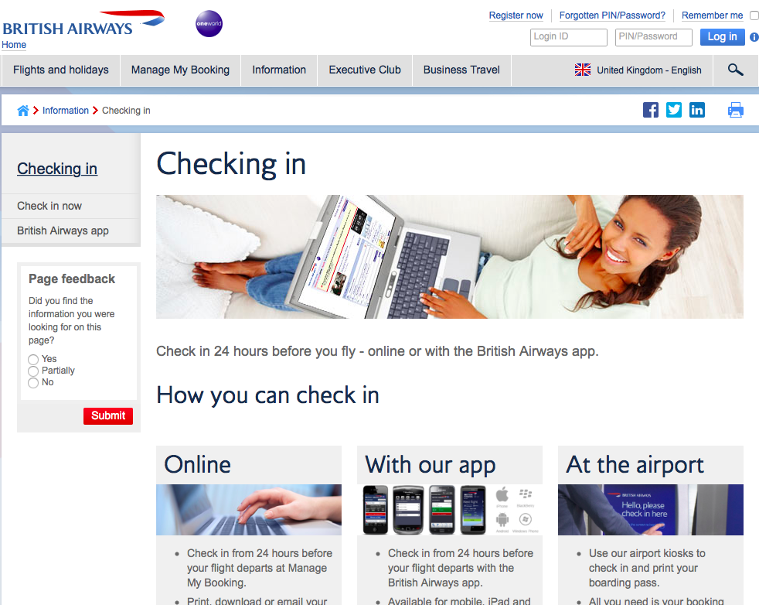
Airlines have heavily invested in channel strategies following increased competition from new entrants – and now have distinct OVPs – case study in Chaffey
British Airways Online Value Proposition (OVP)

Slide 17
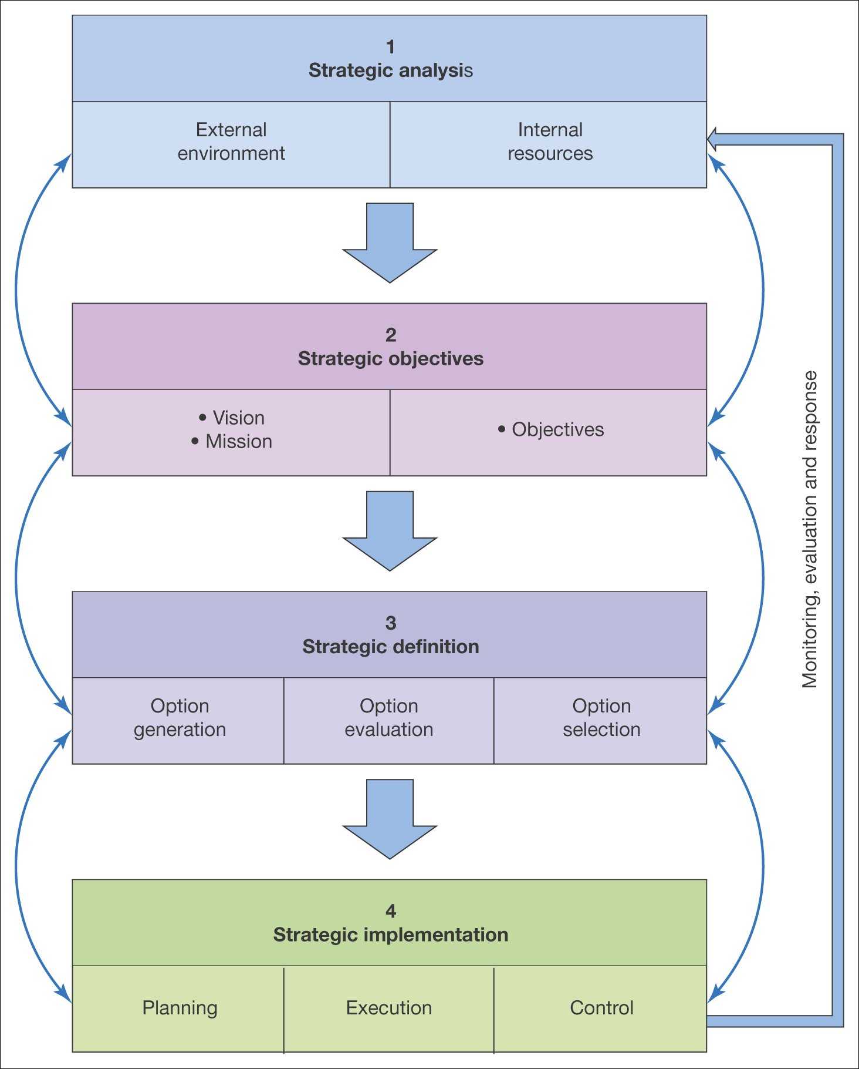
Process for generating and implementing strategy is called a strategy process model
There are many such models – some general, some focused on digital business
Figure 5.4 A generic strategy process model

Slide 18
Important Distinction
Prescriptive strategy approach – strategic analysis is used to develop a strategy which is then implemented
Emergent strategy approach – strategic analysis, strategic development and strategy implementation are inter-related
And in reality….?

Slide 19
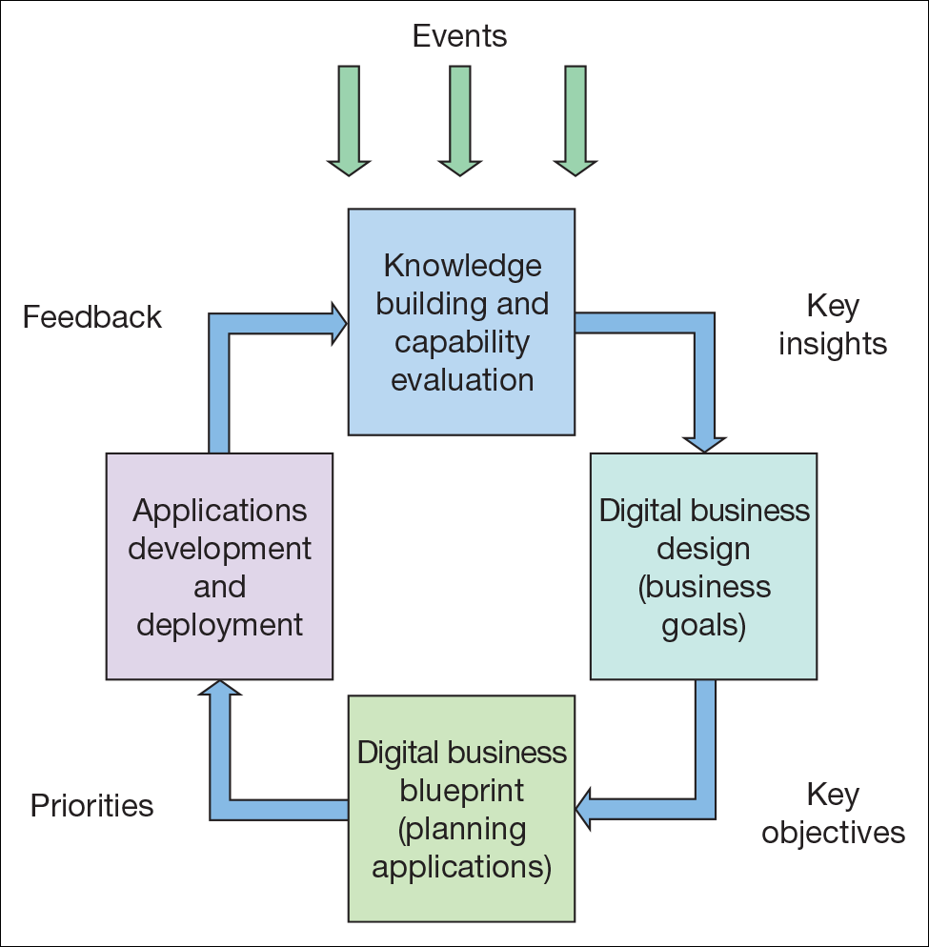
Emergent digital business
strategy model
Kalakota and Robinson (2000) recommend a dynamic emergent strategy approach where ‘events’ lead to knowledge, leading to design and deployment
However - would Apple have come up with the iPhone using this approach?

Slide 20
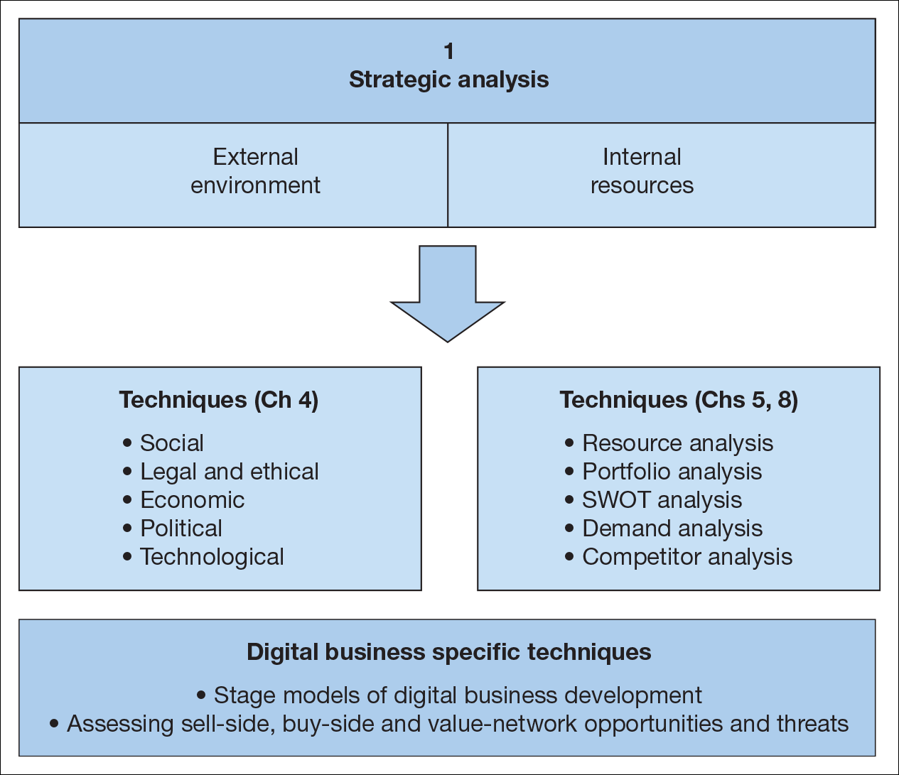
Alternatively, the Prescriptive strategy approach (4 Stages)
1. Strategic Analysis
Prescriptive models start with strategic analysis or situation analysis
Review of internal resources, processes
Analysis of micro and macro environments
Perhaps some benchmarking (stage models)
Figure 5.6 Elements of strategic situation analysis for the digital business

Slide 21
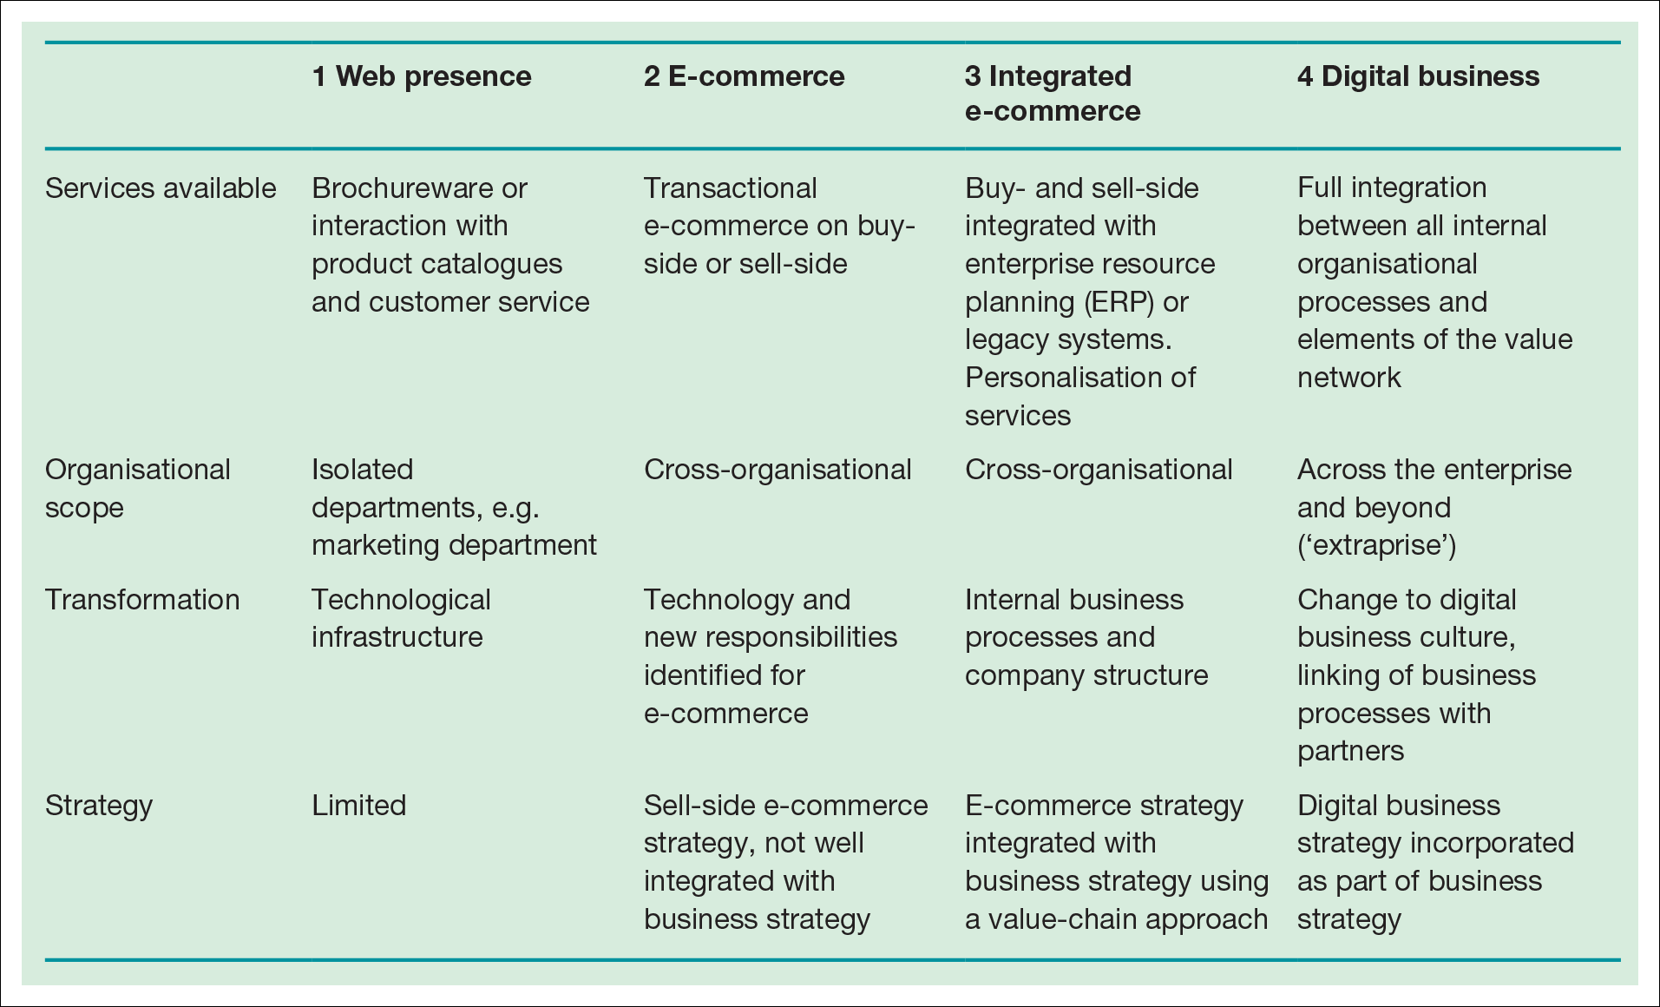
…..and might draw upon a stage model
Table 5.3 A stage model for digital business development
Where should we be at?

Slide 22
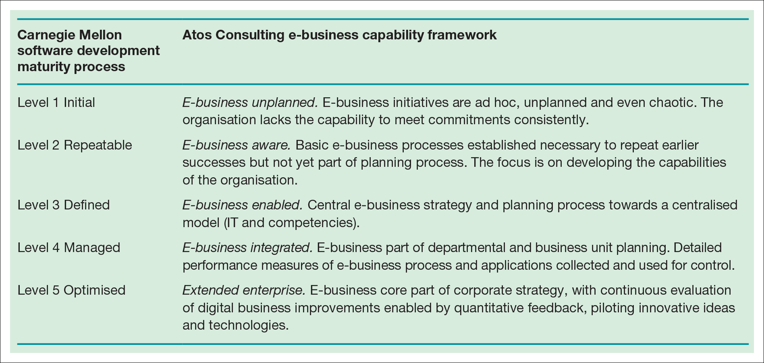
Or involve a Capability Maturity model
Capability maturity model (how good are our software development processes) of the adoption of digital business

Slide 23
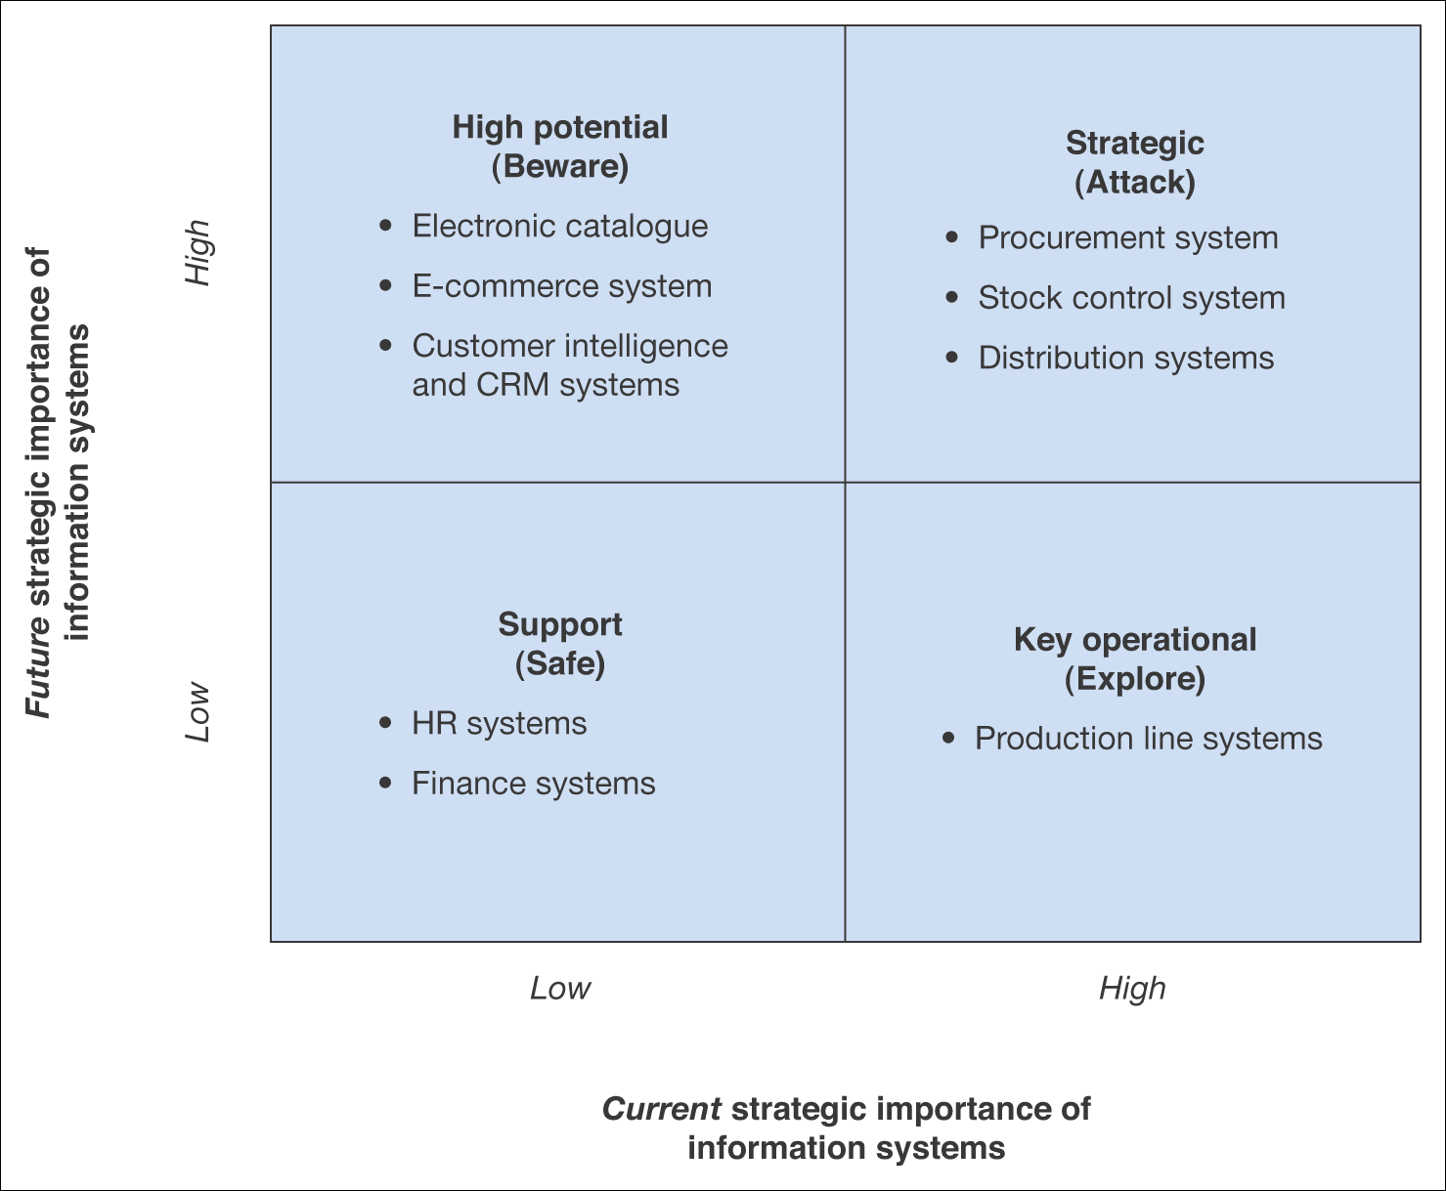
We might look at our existing infrastructure
The ‘applications portfolio’ is the installed technical infrastructure of the business – is it holding you back or a platform for growth?
Figure 5.7 Summary applications of a portfolio analysis for an example B2B company
Assessing the Applications Portfolio

Slide 24
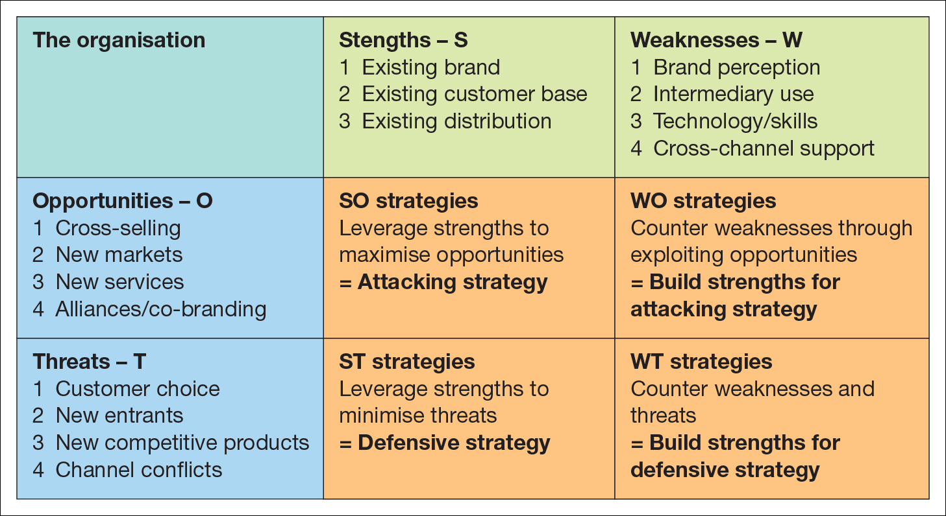
SWOT is a useful strategic tool – if you use it well

Slide 25
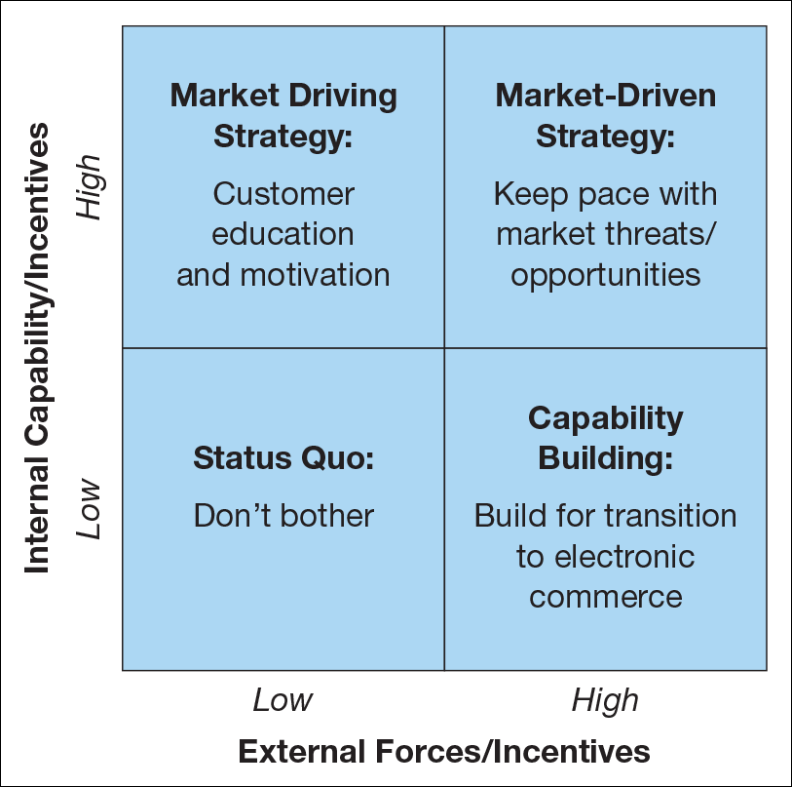
Consultants LOVE 2x2 Matrices
Could you use this to ‘position’ the adoption of online selling by Tesco (2000) and Morrisons (2014)?
Matrix for evaluation of external capability against internal capabilityt.

Slide 26
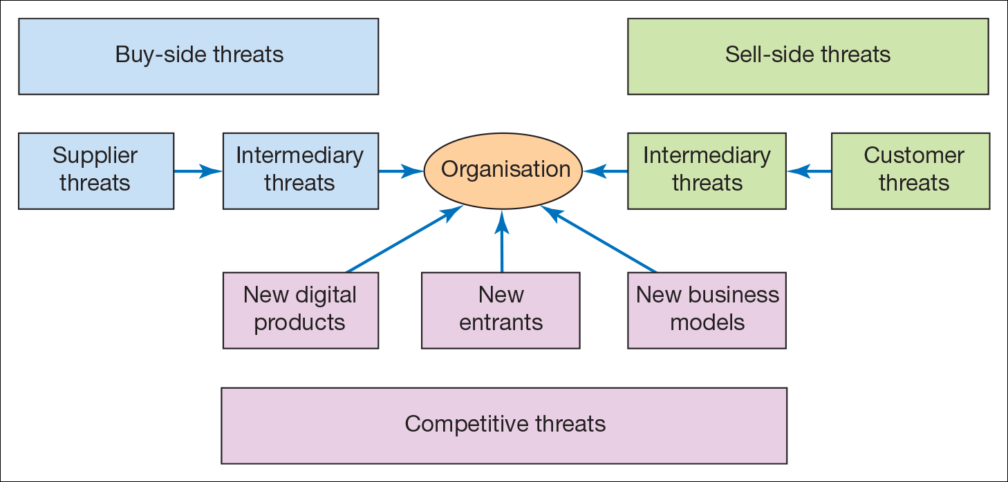
Strategy Formation must engage with the Competitive Environment
For many traditional companies, digital business environments bring new Competitive Threats

Slide 27
Michael Porter on the Internet
‘The key question is not whether to deploy Internet technology – companies have no choice if they want to stay competitive – but how to deploy it.’

Slide 28
Michael Porter
Michael Porter, the Bishop William Lawrence University Professor at The Institute for Strategy and Competitiveness, Harvard Business School
Seminal 1979 paper – the Five Forces https://www.youtube.com/watch?v=mYF2_FBCvXw
2001 article written in aftermath of dotcom crash
Cut through a lot of the hype – argued that Internet business was fundamentally business, not a complete ‘game changer’, the old rules still apply

Slide 29
Michael Porter – the Rules
Profits are a function of
Industry structure
Sustainable competitive advantage
There are ‘five forces’ shaping the competitive environment of every business
Intensity of industry rivalry
Threat of new entrants
Threat of substitutes
Bargaining power of suppliers
Bargaining power of buyers

Slide 30
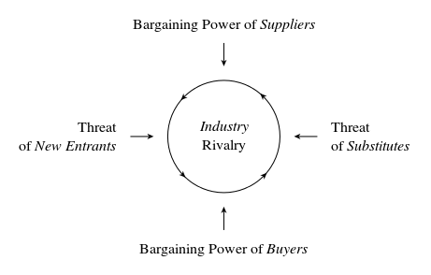
Five Forces

Slide 31
How to use Porter’s model
Answer five questions from the point of view of a single company, and you will obtain a detailed and in-depth analysis of the competitive basis of the industry it operates in

Slide 32
Calculating the Degree of Power
Power | + | -
Power of Competitive Rivalry
Supplier Power
Substitute Power
Buyers Power
Power of New Entrants

Slide 33
Calculating the Degree of Power
The outcome depends on the number of points entered in each of box – positive and negative.
If the competitive rivalry has many entries in the ‘+’ box, the power of competitors are low, etc.
The ‘-’ box contains threats for the company.

Slide 34
What is the Rivalry among existing Competitors?
Competitors
How many direct or indirect competitors are there?
What are the size of my competitors?
How diverse are my competitors?
Industry
What is the industry growth rate?
How high are the stakes? Winner takes all or stable market shares?
Impact of Gov. Regulation
Is market heavily regulated?

Slide 35
What is the Bargaining Power of Suppliers?
Substitution
What are the switching costs of suppliers and firms in the industry?
Are substitute inputs available?
Players
How high is the concentration of suppliers?
Integration
How does supplier integration affect your competitiveness?

Slide 36
What is the threat of Substitute products?
What is the relative price performance of substitutes?
Are my products comparatively priced?
Are the prices of substitutes stable? (increase or decrease)
How high are the switching costs?
What costs are incurred in customers adopting substitutes?
What is the buyer propensity to substitute?
What are the buyers preferences on the product category?
What is distinctive about my products? (quality, prices)

Slide 37
What is the Bargaining Power of Buyers?
Buyer‘s type
Difference between buyer concentration vs. firm concentration?
What is the buyer volume?
Is the buyer capable of backward integration?
Information
How much information does the buyer have?
Are they attracted by substitutes?
How much does product differences effect the buyer?
Brand awareness
How does the buyer judge the brand identity?
How high is the impact of quality/performance?

Slide 38
What are New Entrants threats?
Production costs
Are there any economies of scale?
What are the capital requirements?
Brand
How different is the product?
How strong is the brand identity?
Distribution
Is it easy to access distribution channels?
How does government regulation affect new entrants?

Slide 39
Porter – general trends caused by the Internet
Buyer bargaining power is increased
Reduces barriers to entry – reduced need for a sales force or access to channels
Creates new substitutes
Open system (no proprietary advantage) increases intensity of rivalry
Expands geographic market – but brings more competitors
Reduces variable costs* – leading to greater price competition
* http://www.dummies.com/how-to/content/business-expense-analysis-variable-vs-fixed-expens.html

Slide 40
Porter’s Generic Competitive Strategies
There are essentially two ways to compete in a market and two competitive strategies that can be adopted
Cost Leadership
Differentiation
It’s not difficult to work out which strategy Apple is following
Five Forces analysis helps set the Strategic Objectives

Slide 41
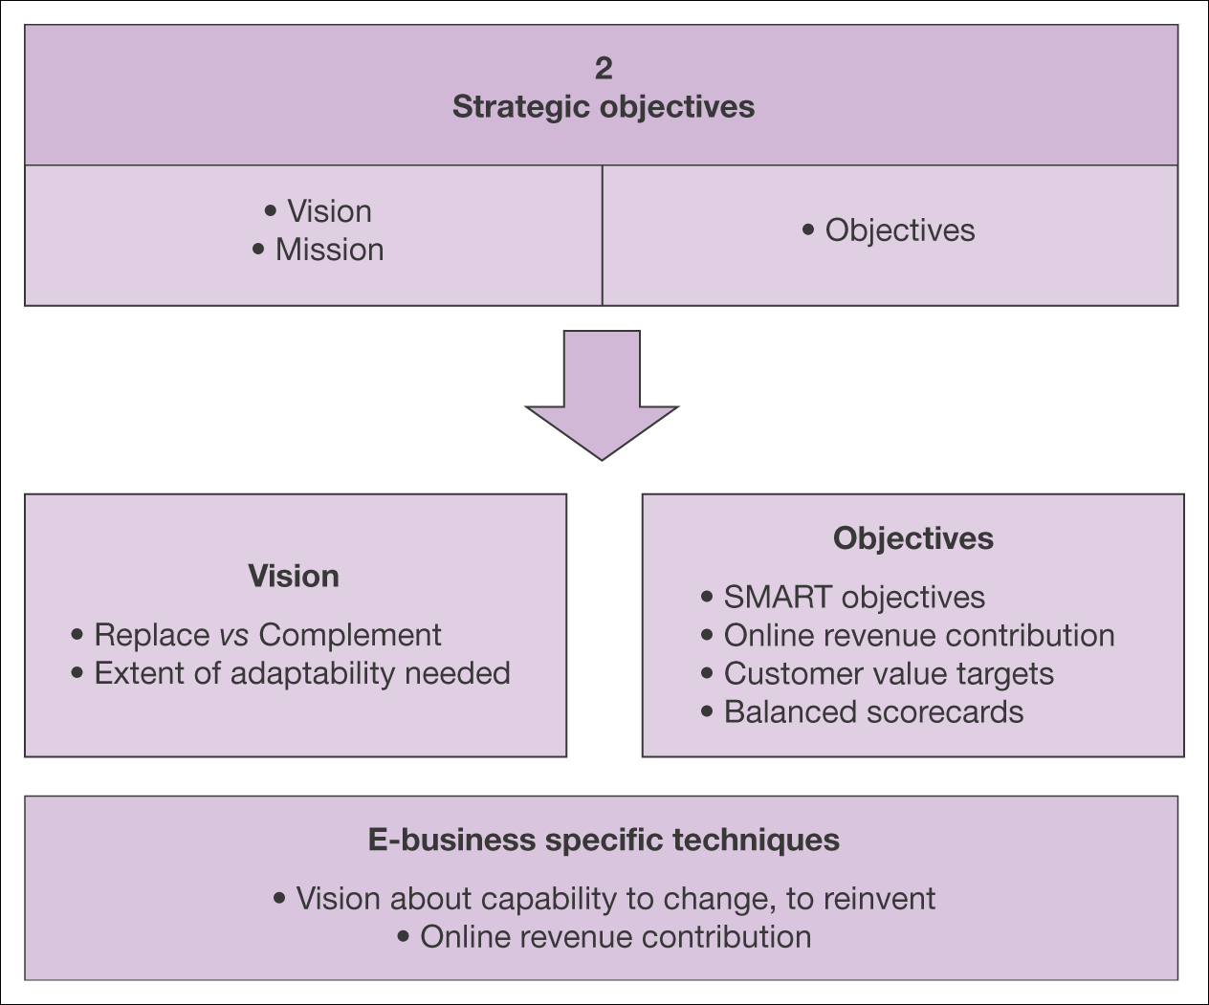
Prescriptive strategy approach: 2. Setting Strategic Objectives
Elements of strategic objective setting for the digital business

Slide 42
Strategic Objectives
These usually emerge during strategic analysis -
A mental image of the possible and desirable state of the organisation
Captured in vision and mission statements
These should define the scope and aims of digital channels
‘Top level’ mission statements might then influence operational mission statements
Amazon mission statement 2013 (most current)
“We seek to be Earth’s most customer-centric company for four primary customer sets: consumers, sellers, enterprises, and content creators.”

Slide 43
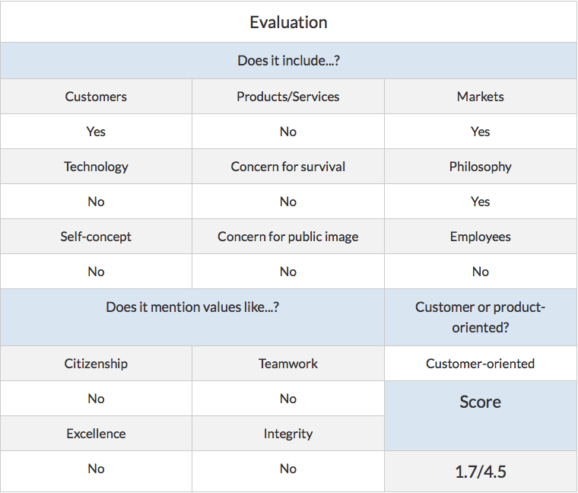
Scoring a mission statement
There have been attempts to ‘score’ mission statements
http://www.strategicmanagementinsight.com/mission-statements/amazon-mission-statement.html
Amazon - “We seek to be Earth’s most customer-centric company for four primary customer sets: consumers, sellers, enterprises, and content creators.”

Slide 44
Scenario-Based Analysis
This is a good way to assess different visions prior to objective setting
Key aspect of vision is
Whether the internet will complement or else replace alternative channels (for multi-channel)
How to build presence in digital channels (pureplay)

Slide 45
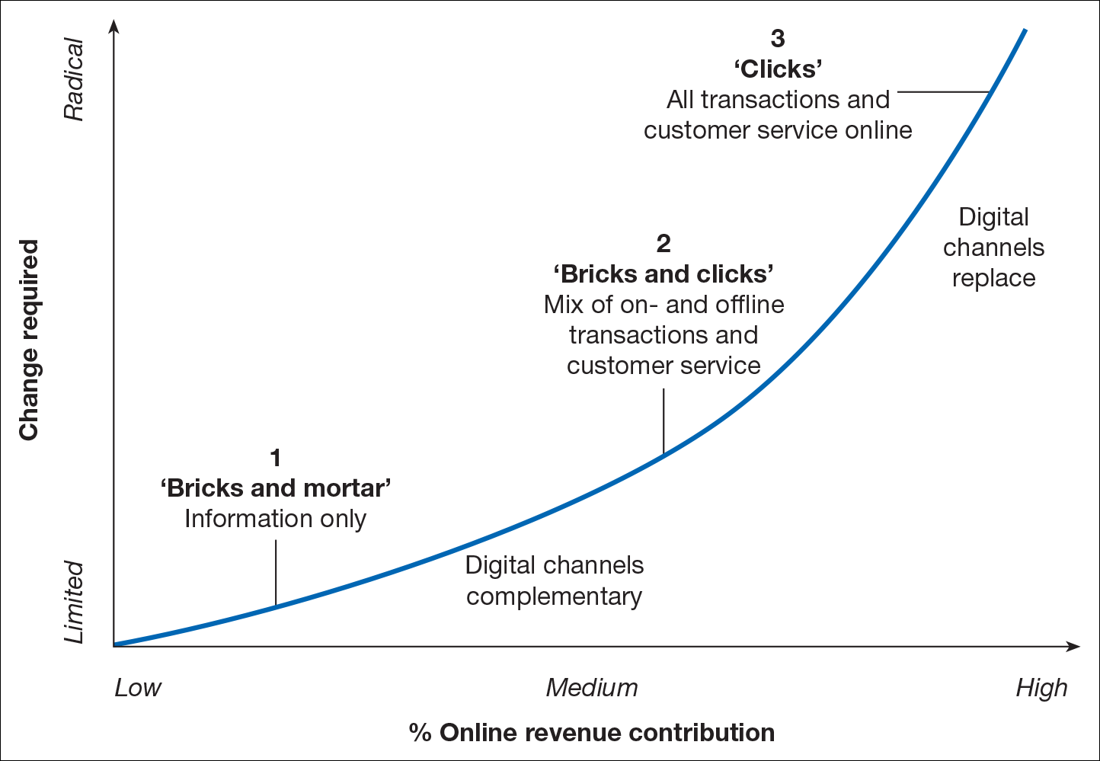
Strategic objectives for a company in relation to the importance of the Internet as a channel

Slide 46
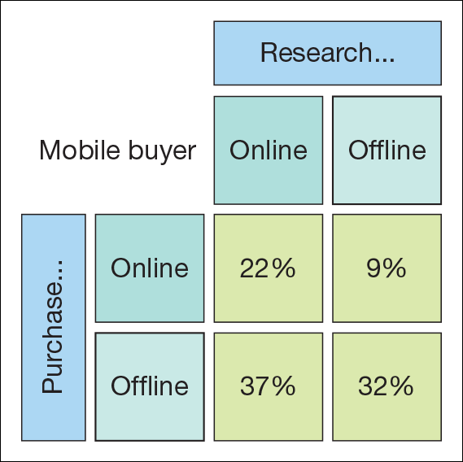
Recurring theme of the module:
Very good information on customer behaviour is needed to fully understand offline and online interactions

Slide 47
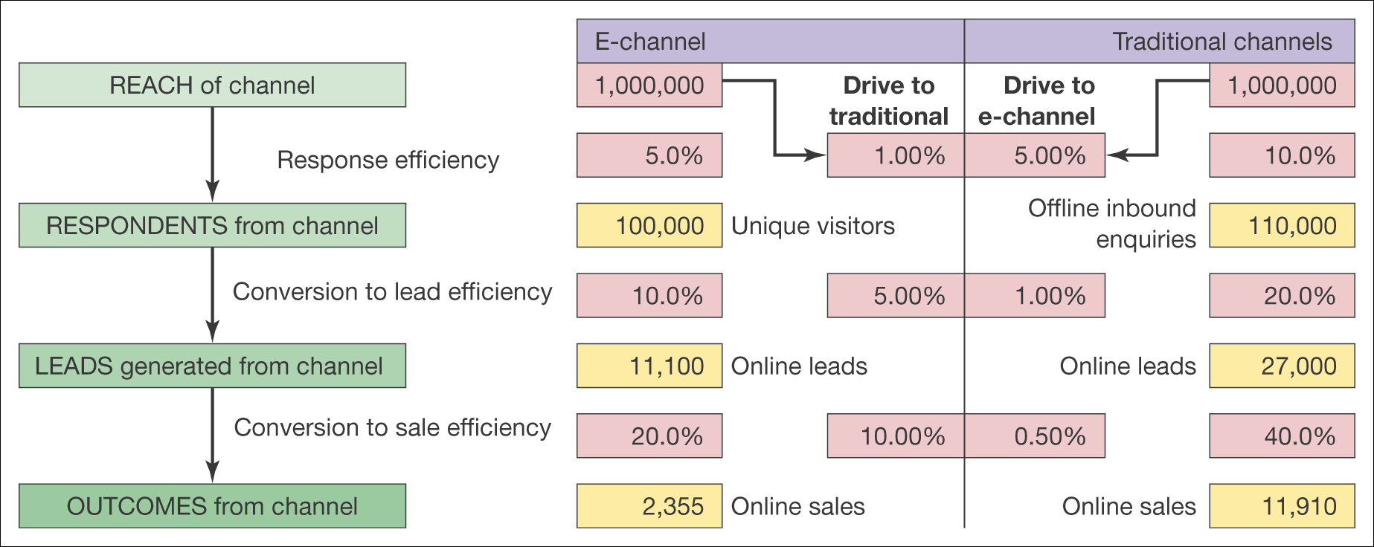
An example of conversion modeling: a retailer
Many non-digital economy businesses have sought to drive customer services online (banks, utilities) which means investing in the digital service channel

Slide 48
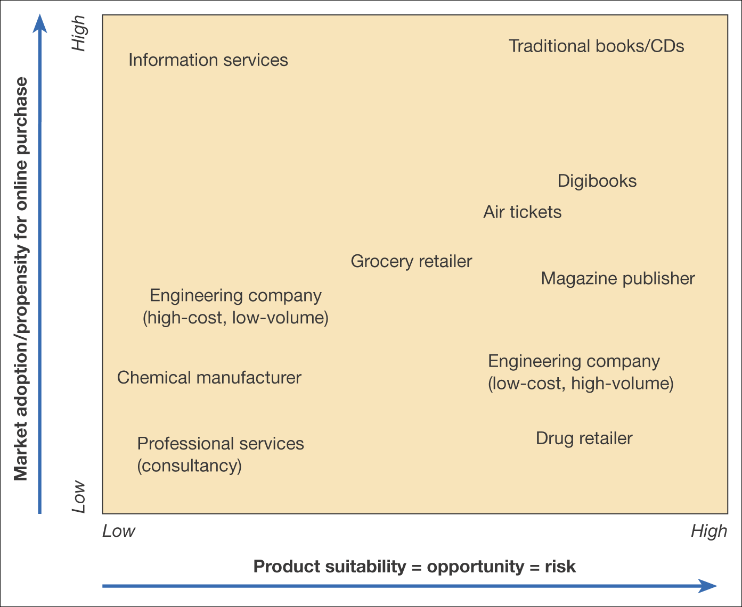
There are limits to this!
Not all products will successfully migrate online
Product suitability
Market adoption propensity
Grid of product suitability against market adoption for transactional e-commerce (online purchase)

Slide 49
Beyond channel management…
Strategic Objectives might be aimed at:
Adding value – better products and services through better information
Reducing costs – by leveraging new technologies. Restaurants in London are latest example
Managing risks – better dashboards for decision makers
Creating a new reality – innovative products and services Grindr and Tinder.

Slide 50
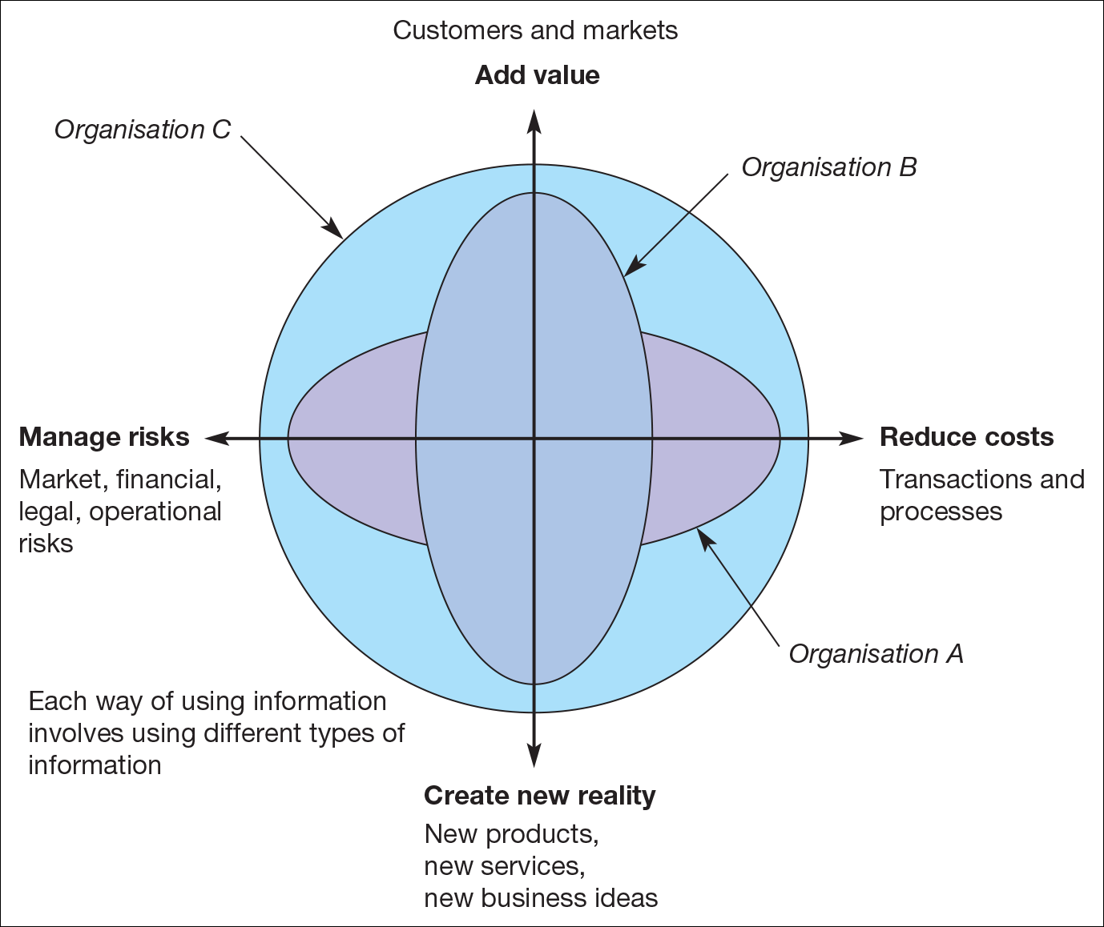
An organisation’s use of information on each axis can be assessed from 1 (low use of information) to 10 (high use of information).

Slide 51
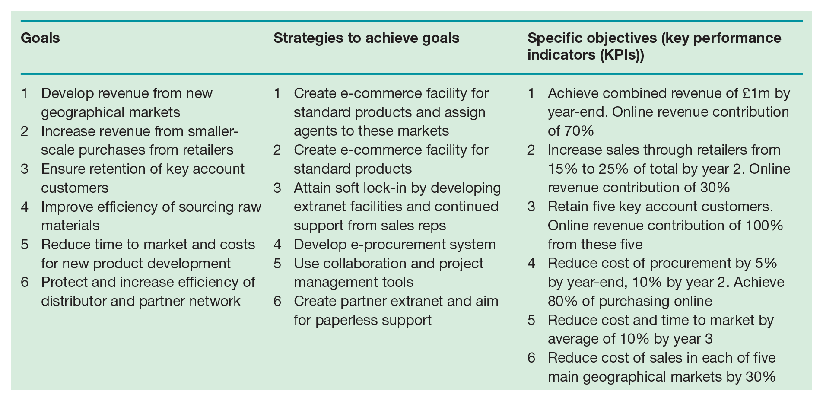
Objectives must be Measurable )
Goals, Strategies, Objectives, KPIs)

Slide 52
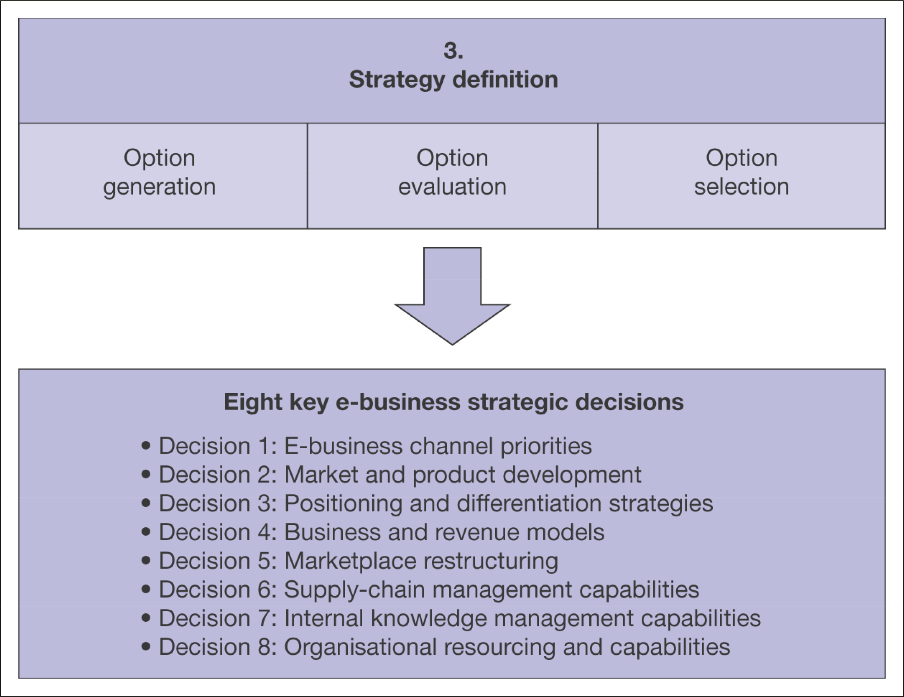
Prescriptive strategy approach: 3. Strategy Definition
Elements of strategy definition for the digital business

Slide 53
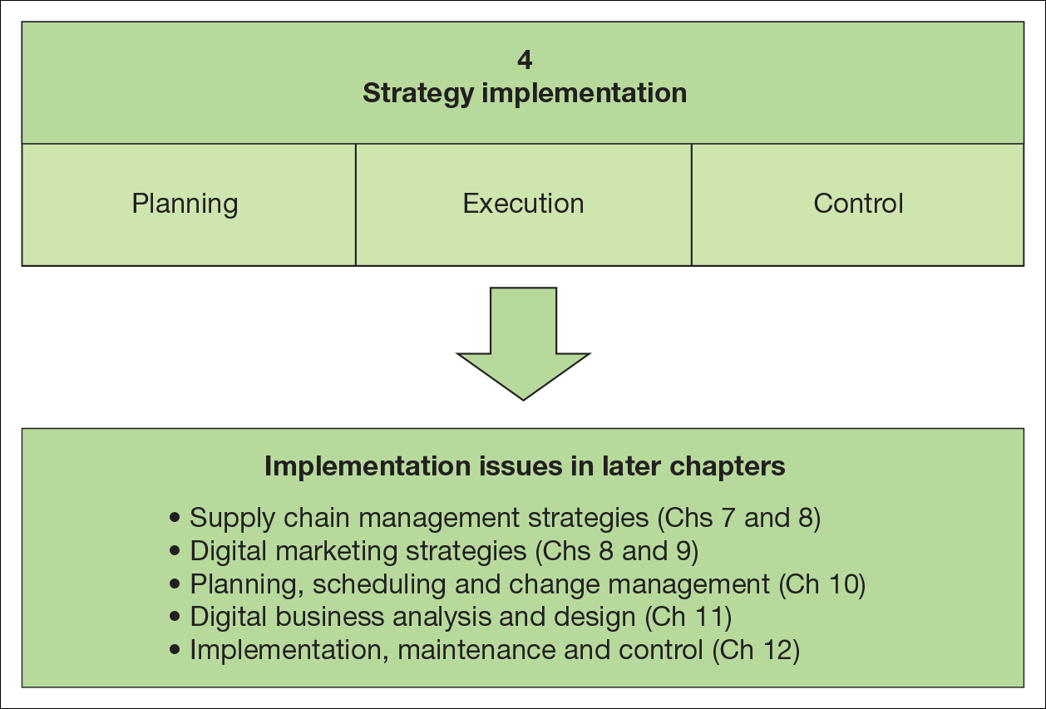
Prescriptive strategy approach: 4. Strategy Implementation

Slide 54
Strategy for a Digital Start-Up is different
The strategy process map outlined by Chaffey is top-heavy and suited to large corporates deploying multi-channel strategies, looking to achieve better growth from the Internet
Strategy roadmaps for start-ups need to be ‘light touch’, are often ‘emergent” and are heavily associated with the vision of founders.
Gareth Williams talks about start-up ‘acceleration’ https://www.youtube.com/watch?v=wvCeXuDfSsg

Slide 55
Assessing the ‘web-economy’ business
Hyper growth, web economy businesses
myfuneral.com Skyscanner.com | Google
usedferraris.com
How universal is your product?
a business with a website…but not web economy
How frequently can your website be used?

Slide 56
Week 6 (timetable week 24) (next week) Tutorial
Revisit the slides and read the Forbes eBay analysis on Moodle. Then:
Choose a company that you are familiar with which trades via a website
Undertake a five forces analysis for its digital competitive environment
Come to the tutorial ready to discuss your work
Got an idea for a ‘web economy’ business based on universality and frequency? Write it down and bring it along.
(a slightly more detailed version of these instructions is available on Moodle)

