Slide 1
Digital Business Environments
Week 3 (timetable week 21) Lecture 3
Level 2 of a 4-level analytical stack:
Channel Structures and Level 3:
Value Analysis

Slide 2
Directed Reading
Chaffey 6th Edition Chapter 2
Gottschalk (2006) Information Systems in Value Configurations Industrial Management & Data Systems vol. 106, no. 7, pp. 1060-1070
McQuivey, James (Blogpost, 2015) Building Direct Digital Relationships In A Sea Of Rising Intermediaries http://blogs.forrester.com/james_mcquivey/15-09-17-building_direct_digital_relationships_in_a_sea_of_rising_intermediaries
Thakran, K and Verma, R (2013) The Emergence of Hybrid Online Distribution Channels in Travel, Tourism and Hospitality Cornell Hospitality Quarterly 54(3) 240–247 (on Moodle)

Slide 3
Industry News!
What’s happened in Digital Business since the last lecture?

Slide 4
Lecture Outcomes
Identify marketplace channel structures, disintermediation and reintermediation (we’ll return to this topic in a few weeks)
Understand approaches to classifying business models
Understand the place of Value Analysis as an approach to understanding the value-adding activities of a business

Slide 5
Why?
Marketplace Channel Structures is the second level of the four-level analytical stack
Value Analysis is the third level of the four-level analytical stack
n.b. we are still largely focusing on Micro Environment Analysis at this point

Slide 6
Channel Structures

Slide 7
Management Issues
What are the implications of changes in marketplace structures for how businesses engage with customers and other partners?
Which business models and revenue models should be considered in order to exploit the digital environment – taking into account physical operations?
How can we best analyse how we are adding value to customers?

Slide 8
Marketplace Channel Structures
This is a higher level of analysis than the Online Marketplace Map – the Channel Structures approach takes a ‘whole industry’ view
The way that a manufacturer or service provider delivers products and services to their customers is referred to as the ‘marketplace channel structure’
Intermediaries exist in many markets for a number of different reasons
We need to be clear about when intermediaries add value to the product or service as it is experienced by the customer, and also about when they do not add value
In markets that existed offline before online equivalents emerged, the Internet has often been a source of Disintermediation

Slide 9
The Vocabulary
Intermediaries
Disintermediation
Reintermediation

Slide 10
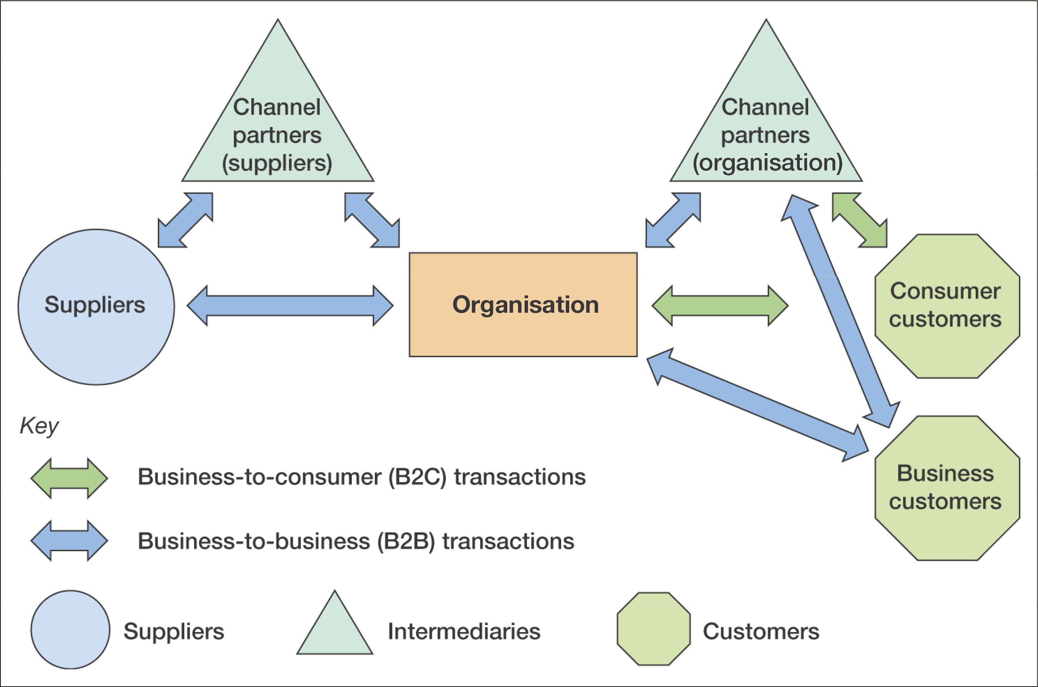
B2B and B2C interactions between an organisation, suppliers and customers

Slide 11
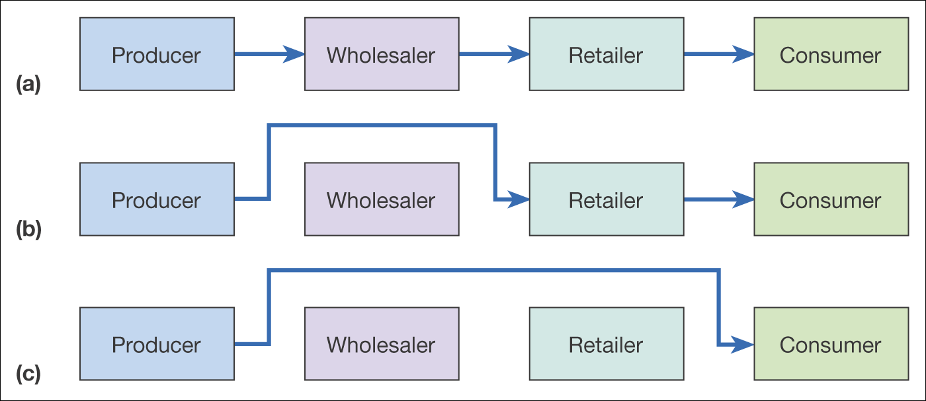
Figure 2.7 Disintermediation of a consumer distribution channel showing (a) the original situation, (b) disintermediation omitting the wholesaler, and
(c) disintermediation omitting both wholesaler and retailer
Disintermediation(c)

Slide 12
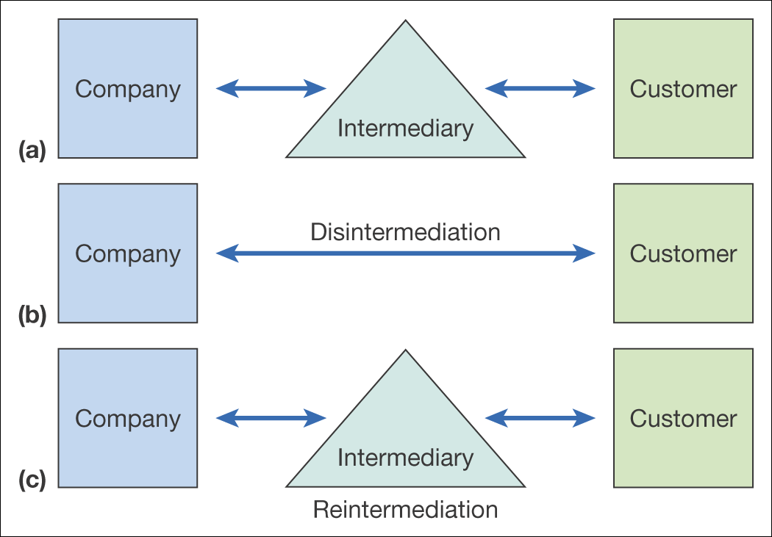
Disintermediation and Reintermediationtermediation (c)

Slide 13
Multichannel Marketplace Models
It is important to recognise that multi-channel models now dominate in many markets
Online Purchasers might use a combination of channels as they follow their customer journeys
The Internet is not used in isolation – online purchasers consume other media, print, TV, direct mail, billboards
The ‘Channel Chain’ approach is used to help us understand this behaviour
The Channel Chain shows alternative customer journeys for customers with different channel preferences and is used to assess channel performance

Slide 14
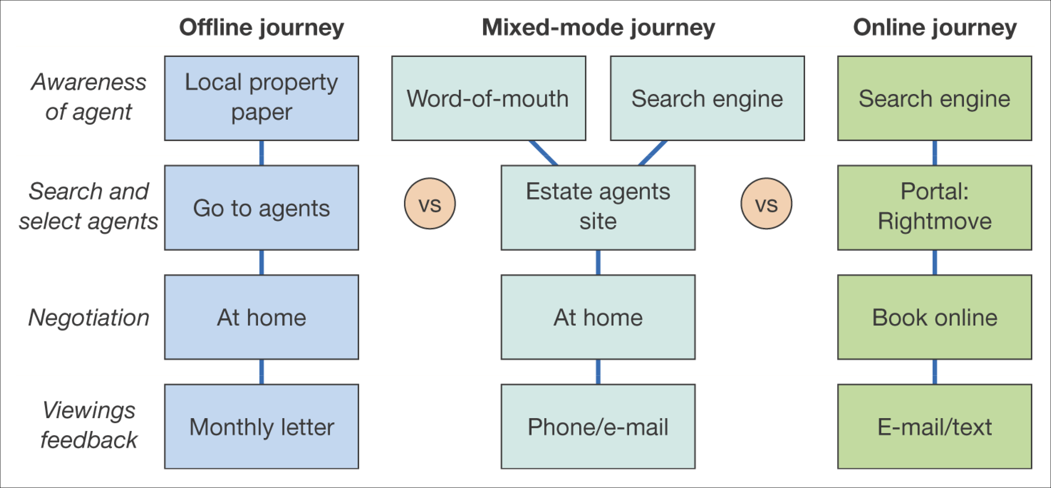
Figure 2.9 Example channel chain map for consumers selecting an estate agent to sell their property
Channel Chain Maps for Selecting an Estate Agent(c)

Slide 15
Business Models

Slide 16
Business Models for Digital Business
Defining a clear business model is very important for new online start-ups
But it is equally important for offline businesses as they develop important online channels
Many sectors have found that their offline model does not translate online and that the online environment has undermined their offline model – e.g. the case of recorded music

Slide 17
Business Model
Timmers (1999) defines a ‘business model’ as:
An architecture for product, service and information flows, including a description of the various business actors and their roles; and a description of the potential benefits for the various business actors; and a description of the sources of revenue.

Slide 18
Business Model Classifications
Business model classifications have tended to take specific perspectives, classifying a business across a range of dimensions
The Marketplace Position perspective, is the company a:
  Manufacturer, reseller, intermediary, supply chain provider
The Revenue Model perspective, does the company make money through:
  Direct sales, subscriptions, commission based sales, advertising
The Commercial Model perspective, sales are achieved by:
  Fixed price sales, brokered sales, product bundling, auction, razor-blade model

Slide 19
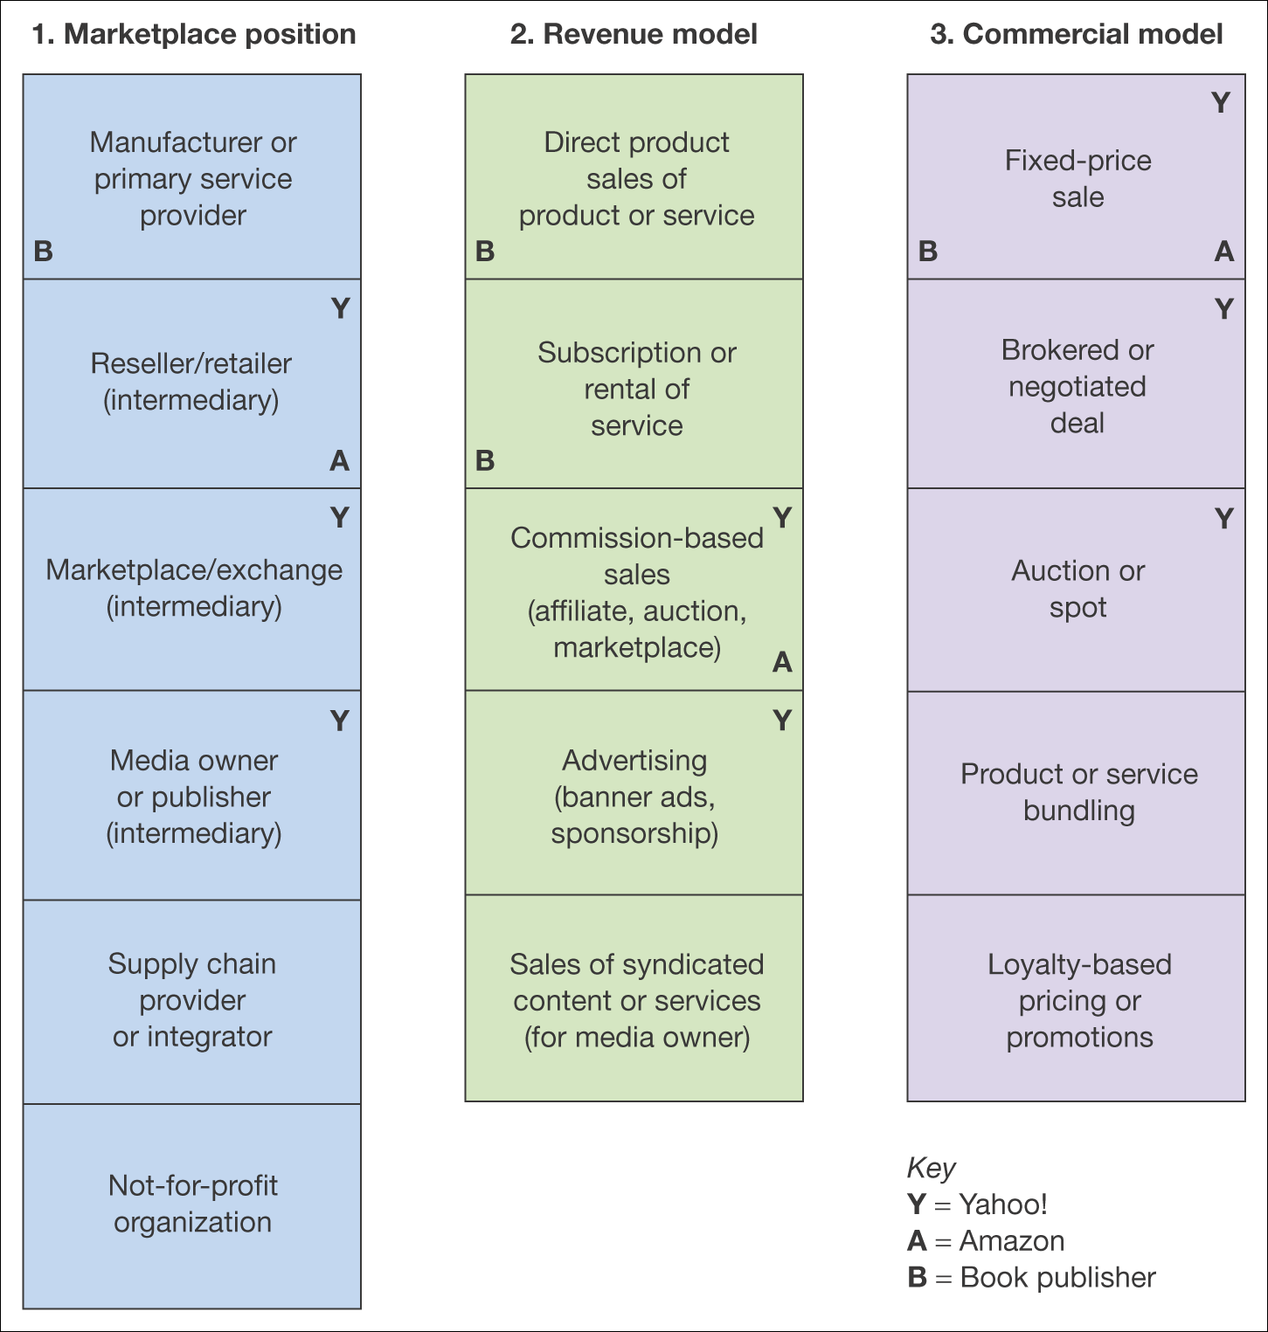
Classification, shown Visually, plotting 3 Companies

Slide 20
Classification is difficult – e.g. some businesses have more than one Revenue Model in operation
Online newspaper:
Subscription access to content
Pay-per-View access to content
CPM (cost per thousand views) display advertising
CPC advertising on site
Sponsorship of sections, content or widgets
Affiliate revenue
Subscriber data - e-mail marketing

Slide 21
The Business Model Canvas
One of the most widely used tools used nowadays is quite recent (2008) - the Business Model Canvas by Alex Osterwalder
  https://www.youtube.com/watch?v=QoAOzMTLP5s
A sophisticated tool to help companies define their business -accommodates offline and online together
If you have a spare 43 minutes OR are setting up a new business then listen to Alex outlining the Canvas
  https://www.youtube.com/watch?v=RzkdJiax6Tw

Slide 22
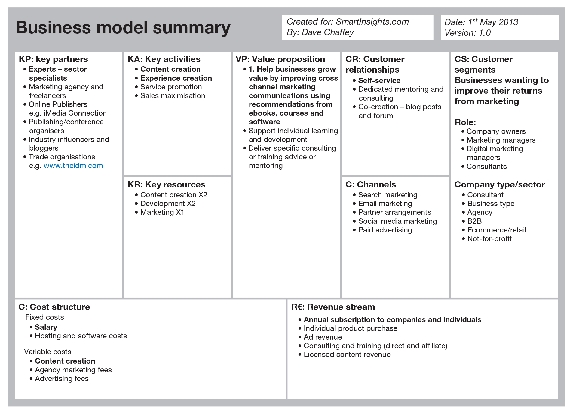
The ‘Business Model Canvas’ for Chaffey’s own ‘Smart Insights’ websiteSource: Smart Insights. With permission.

Slide 23
Value Analysis

Slide 24
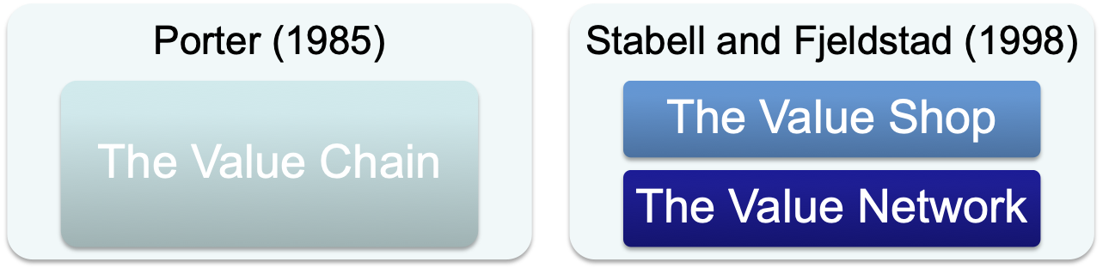
Value Configurations
Describes how value is created in a company for its customers
Shows how the most important business processes function to create value for customers
Represents the way a particular organisation conducts business

Slide 25
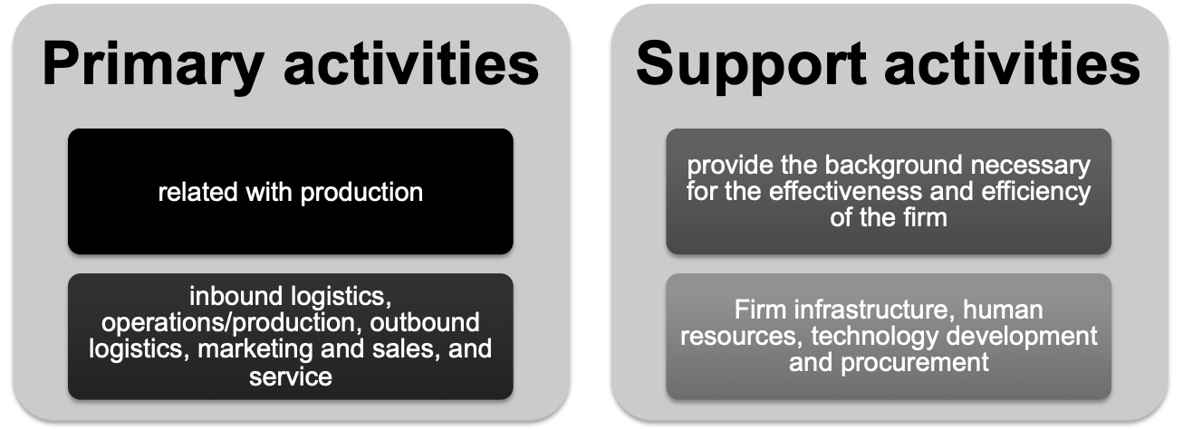
Value Chain
Michael Porter Competitive Advantage: Creating and Sustaining Superior Performance (Porter, 1985).
Value is created through the efficient production of goods and services based on a variety of resources

Slide 26
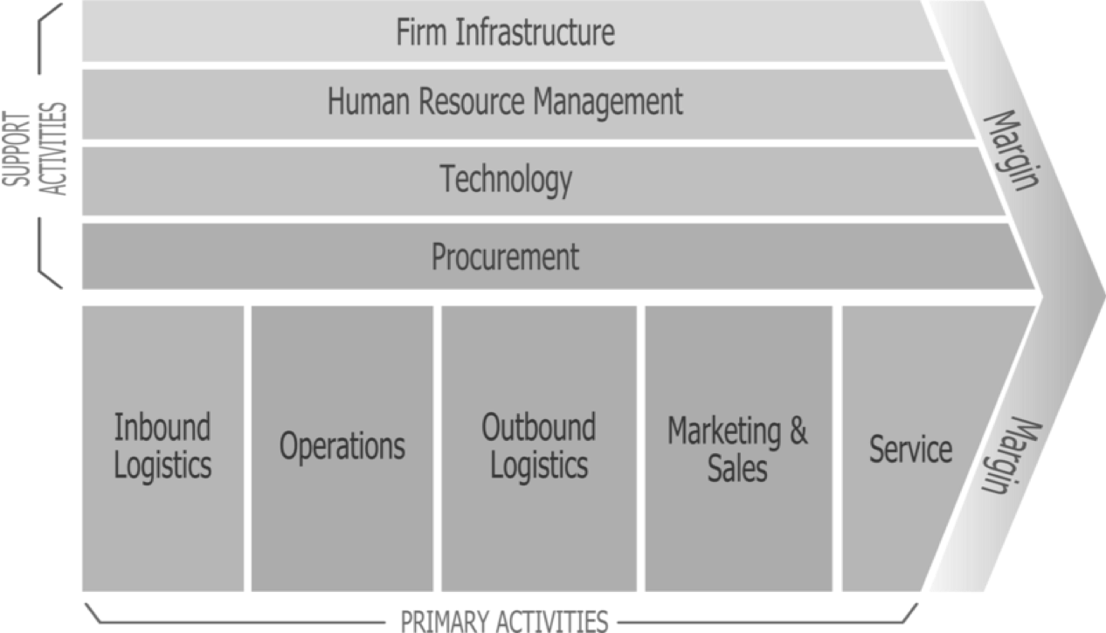
Value Chain
(Wikipedia)

Slide 27
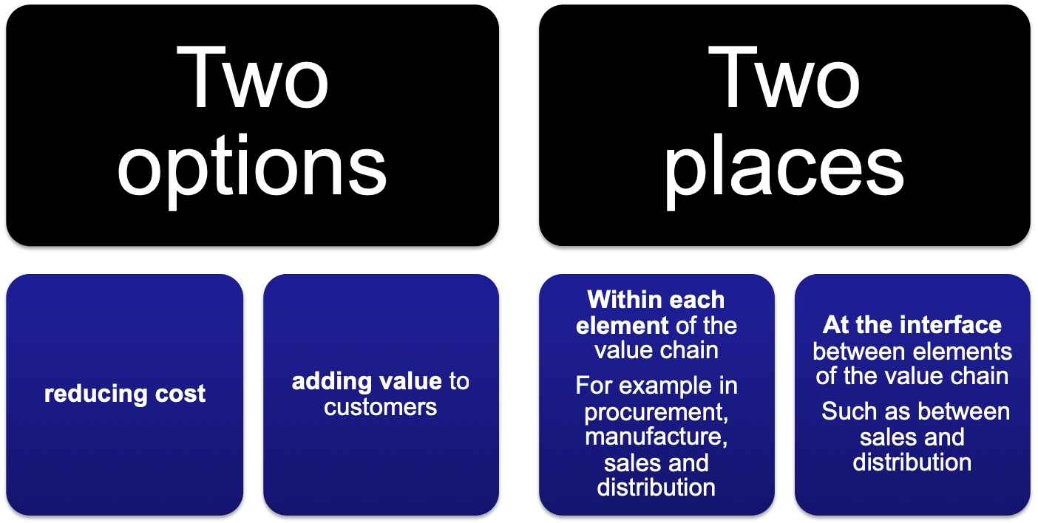
Value can be added:

Slide 28
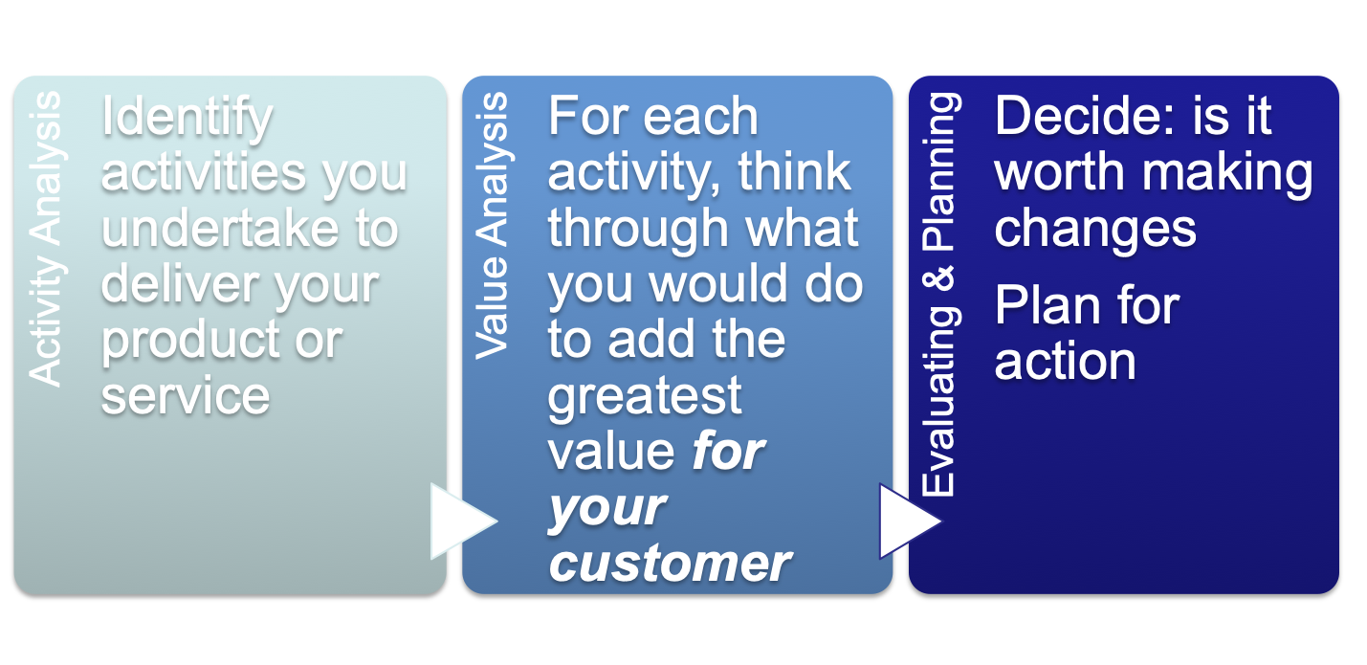
How Value Chain Analysis works

Slide 29
Where does Amazon add most value?
Where does John Lewis add most value?
Where does IKEA add most value?
(Wikipedia)

Slide 30
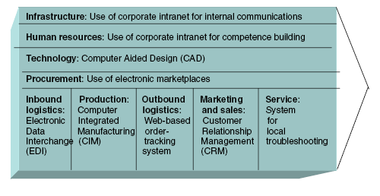
Information Systems in the Value Chain
L i n e a r
From Gottschalk (2006: 5)

Slide 31
Weaknesses of the Value Chain
It is most applicable to manufacturing organisations
Emphasises the Primary Activities
Emphasises ‘push’ over ‘pull’
It neglects wider ‘value networks’
It doesn’t emphasise the importance of firm infrastructure

Slide 32
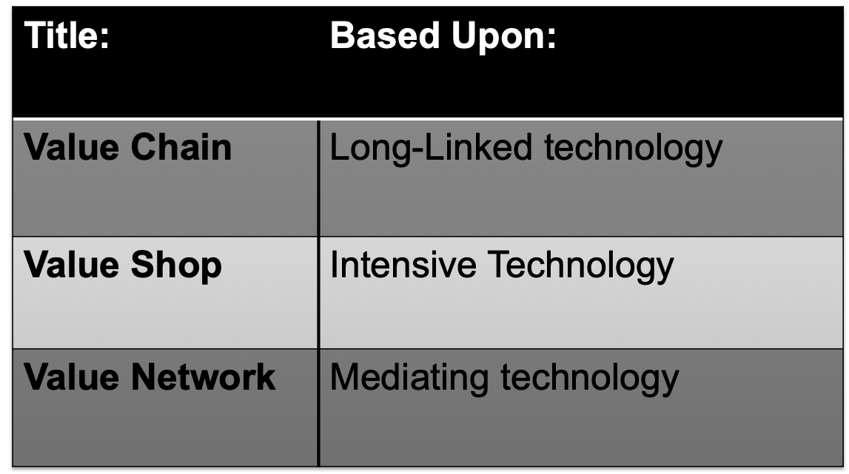
Additional Value Configurations
(Stabell and Fjelstad, 1998, citing Thompson, 1967)

Slide 33
The ‘Value Shop’: Technology used to help solve problems
“at any moment an emergency admission may require some combination of dietary, x-ray, laboratory and housekeeping services, together with various medical specialities, pharmaceuticals, occupational therapies, social work services, spiritual or religious services. Which of these, and when, can be determined only from evidence from the patient.”

Slide 34
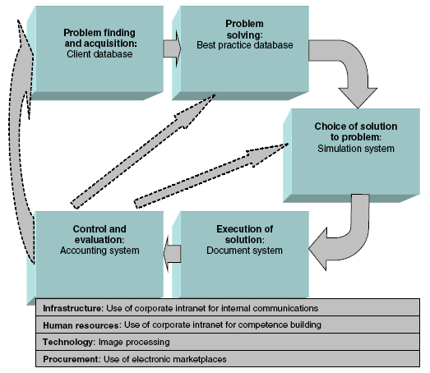
Information Systems in the Value Shop
Example:
Crocker|Smith

Slide 35
Value Network: Mediating technology
Parallel rather than sequential activities
Typical activities
  Development of customer network
    Through marketing and recruiting of new customers
      to enable increased value for both existing customers and new customers
  Continuous development of new services
    and improvement in existing services
  Development of infrastructure
    so that customer services can be provided more efficiently and effectively

Slide 36
Value Network: Mediating technology
Examples
Telecommunications companies (Skype)
Payment providers (PayPal)
Media companies (Virgin)
Banks
Insurance companies, brokers etc
Uber

Slide 37
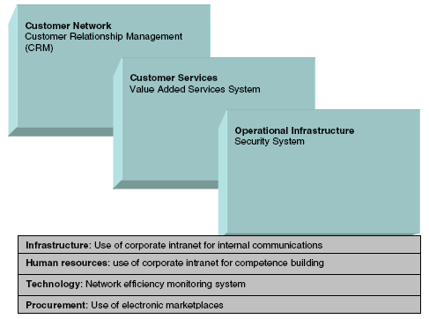
Information Systems in the Value Network

Slide 38
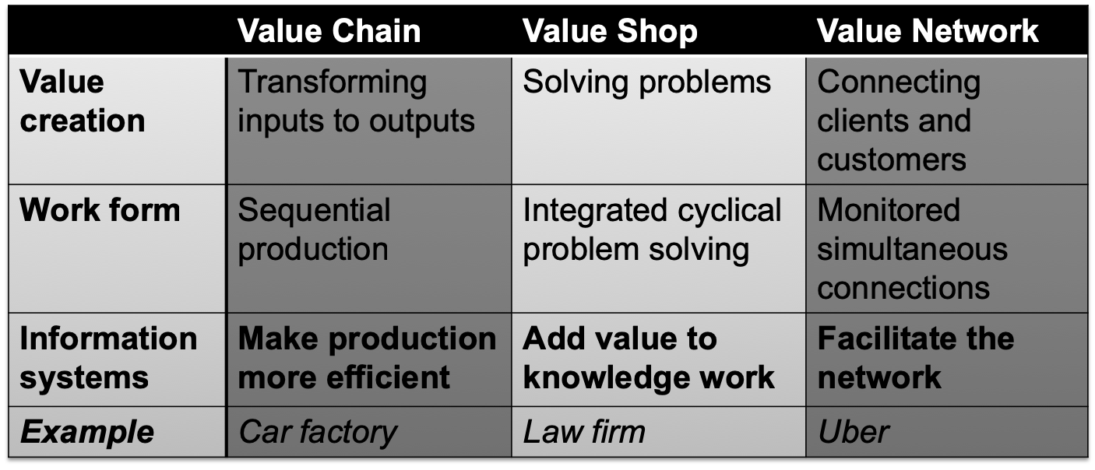
Characteristics of Value Configurations

Slide 39
Week 3 (this week’s) Tutorial
Q1. Before attending the tutorial, investigate and construct an Online Marketplace Map (OMM) for either Deliveroo, Skyscanner or Marks and Spencer’s online business
  Define main customer segment(s) being targeted
  Write up a (very) short Persona to represent this segment.
  What is their search behaviour, what intermediaries might be relevant to their customer journeys?
  Identify relevant partner sites for the business that would be used by the Persona
  Find competitors to the company - benchmark their OVPs
Q2. Search for relevant 3rd party online tools that might be useful to investigate a company’s OMM

Slide 40
Week 4 (next week’s) Tutorial
Before the tutorial:
Sensecheck – write a couple of paragraphs that explain the distinction between Online Marketplace Analysis and Marketplace Channel Structures for someone who’s never heard of either
Choosing one appropriate value configuration (of the three covered today), carry out a value analysis of AirBnB
In the tutorial, we will also do a SWOT analysis of AirBnB, so you may wish to recap on Week 2’s slides

