Slide 1
Machine learning in online marketing: analysis and identification of optimisation opportunities
Project presentation by Oliver Schulz

Slide 2
Agenda
Idea and goal of the project
The data
Visualisation of the results with Tableau
Machine Learning
Sales Forecast App (Streamlit)
Conclusion - problems and learnings

Slide 3
Idea and Aim of the project
The challenge : interpret campaign results correctly and draw the right conclusions.
Aim: Optimisation of the results of future advertising campaigns through better data interpretation.
How: Machine learning can help to better understand the data from the results and make better predictions.

Slide 4
The data
Source: Kaggle Dataset „Online Advertising Performance Data“ => https://www.kaggle.com/datasets/naniruddhan/online-advertising-digital-marketing-data
Description: This freely available dataset provides insights into the online advertising performance of a company referred to as "Company X", which has run 3 campaigns, with different ad formats and placements.
Period under review : 1st April 2020 until 30th June 2020.

Slide 5
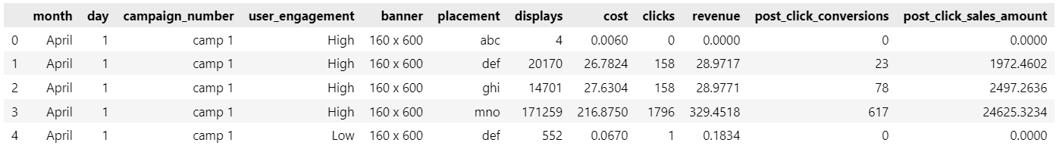
The data - Exploration
Understanding the data - insight into the data set:
Identification/selection of the relevant features and the target
Hypothese: Company X can influence these features :
„banner“ => The choice of advertising formats
„placement“ => The choice of advertising placements
„revenue“ => The amount of advertising expenditure / campaign budget
Target that we want to optimize : „post_click_sales_amount“ => Sales generated

Slide 6
The data - Preprocessing and Visualisation
Data Preprocessing with Python
Remove missing values
Renaming columns
Dummy coding of categorical variables („banner“ und „placement“)
Data Preprocessing in Tableau
Calculate additional Key Metrics via "Calculated field"
=> CPM, CPC, CTR, CR und ROAS
Visualisation of the results in Tableau via Dashboards in Data-Story
Key Metrics total and per Campaign
Correlations

Slide 7
Machine Learning
Model selection
Target available => Supervised
Target is numeric => Linear Regression
Evaluation of different models
„Normal“ Linear Regression
vs regulated: Ridge + Lasso
Decision Tree + Random Forest not taken into account because of not beeing interpretable in sufficient way.

Slide 8
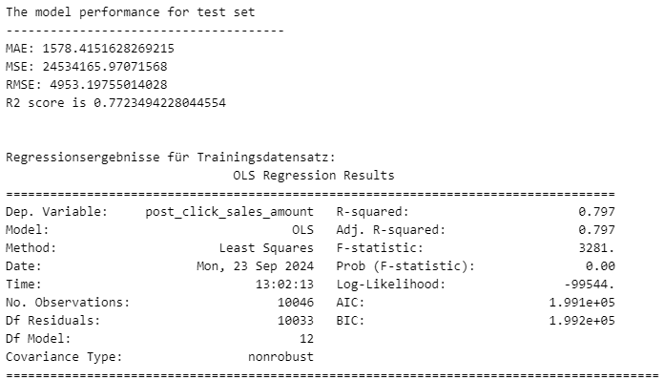
Machine Learning - Evaluation
Linear Regression
R²: In the test data set, 77% of the variance is explained.
p-Wert: Is with 0.00 clearly below 0.05.
=> null hypothesis is refuted => the model is significant.

Slide 9
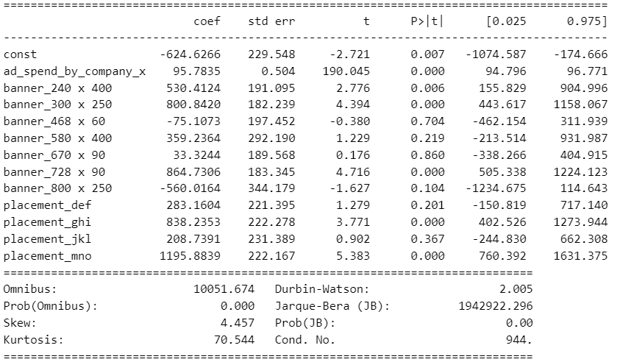
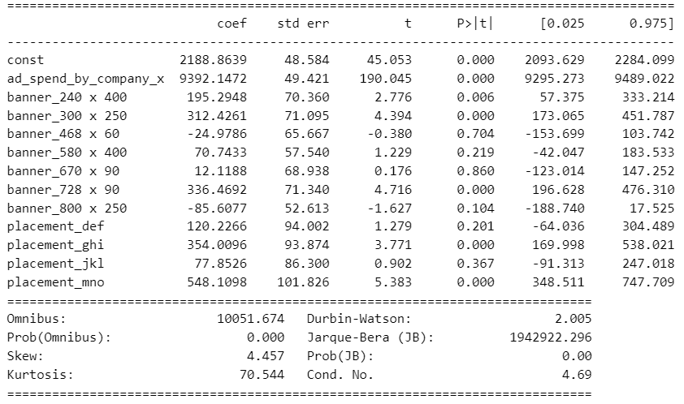
Machine Learning - Evaluation
Ridge / Lasso Regression with standardised data and an alpha = 0.1
Quality metrics of normal vs. regularised regression unchanged.
BUT: The variance of the coefficients could be significantly reduced. The regularised model is therefore easier to generalise.
Normal Linear Regression
Ridge / Lasso (identical result, even with other alphas)

Slide 10
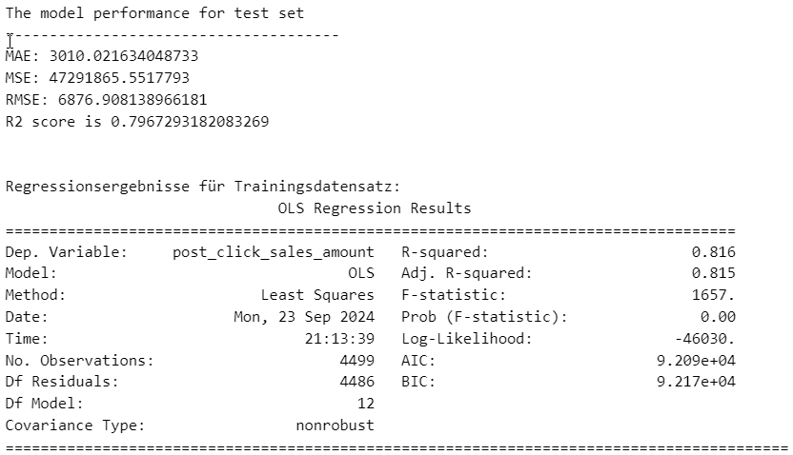
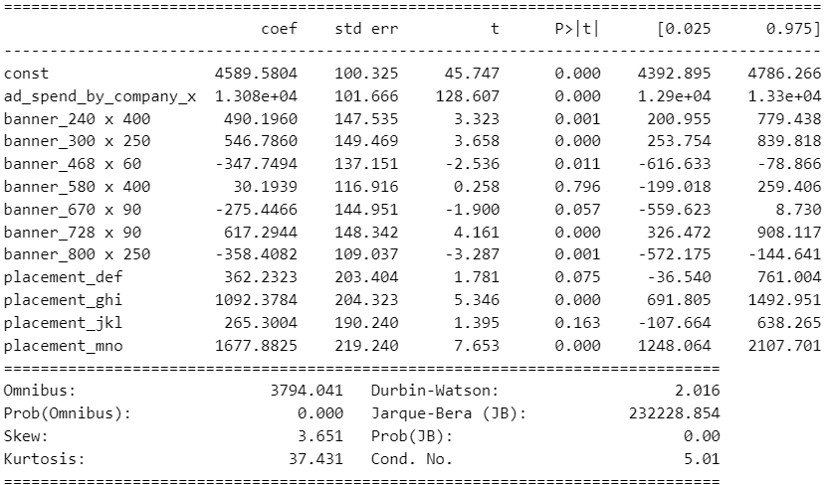
Machine Learning - Evaluation: Ridge Regression per Campaign
Campaign 1
If we restrict ourselves to the data from Campaign 1, we get a better R².
The coefficients tend to be more significant.
Regression
Koeffizienten

Slide 11
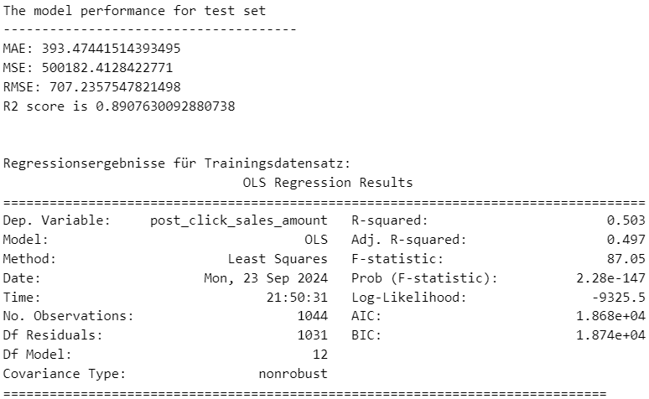
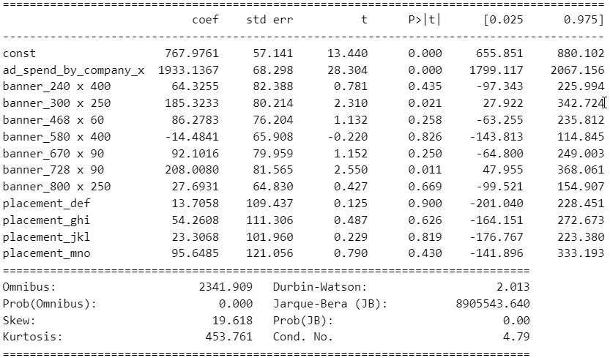
Machine Learning - Evaluation: Ridge Regression per Campaign
Campaign 2
The R² is significantly better for the data from Campaign 2, but only for the test data set. #Overfitting?
The coefficients tend to be less significant compared to Campaign 1.
Regression
Coefficients

Slide 12

Machine Learning - Evaluation: Ridge Regression per Campaign
Campaign 3
The explained variance (R²) is very low => low adjustment.
Despite its low explanatory power, the model is statistically significant overall.
=> Nevertheless, the model has very limited predictive power.

Slide 13
Sales-Forecast-App (Streamlit)
Aims of the app
Generation of learnings.
Optimisation of future campaigns.
Funktionsumfang
Changing parameters (budget, choice of advertising formats and placements).
Sales forecast in real time.
Overview of the regression results for the purpose of recommending action.
The programming is based on two Python files
„main.py“ => Controls the Streamlit app.
„forecast.py“ => Functions for generating data, regression results and sales prediction.

Slide 14
Conclusion – Problems and weaknesses
Fictitious data? => Sales Amount values extremely high.
Initial hypothesis : Possibly Company X cannot choose banners/placements at all => Pure "click purchasing"?
General lack of knowledge about :
Type of campaigns,
Design of the advertising material/creatives,
Products/services offered and
Publisher / Ad Platforms.
Partially low quality/significance of the regression due to the given data structure - especially for campaign 3.
Possibly Non-linear model (Random Forest) with better adaptation/explanatory quality.

Slide 15
Conclusion – Learnings
Datenexploration is
Time consuming
and fundamental.
Process: Data analysis and machine learning are a process in which you sometimes get lost and have to go back to the beginning and think again.

Slide 16
Conclusion – what could be next?
Functional expansion of the app :
Adding new campaign results.
Input of offered delivery quantities.
Output of budget allocation for the maximum achievable turnover.
Change of perspective : Analysing the results from the perspective of the advertising company.
Which factors determine their margin.
How can it optimise its remuneration in future.

Slide 17
Thank you!
Oliver Schulz
oliverschulz@mail.de
www.linkedin.com/in/oliver-schulz-44830237/

