Slide 1
CREDORA FINANCE CREDIT RISK ANALYTICS PLATFORM
Internship Project Presentation
Presented By : Olive Ruth
B.Tech – Computer Science and Engineering (Artificial Intelligence)
Dr. M.G.R. Educational and Research Institute
Internship Organization: InternMo
Academic Year: 2026

Slide 2
Introduction
Credit risk assessment is an important process in banks and financial institutions.
Manual loan evaluation can be time-consuming and may lead to inconsistent decisions.
Machine learning helps improve the speed and accuracy of loan approval decisions.
The Credora Finance Credit Risk Analytics Platform analyzes customer, credit history, and loan application data to support better credit risk assessment.
An interactive Streamlit dashboard provides visual insights for decision-making.

Slide 3
Problem Statement
Banks receive thousands of loan applications every day.
Manual loan evaluation is slow and can lead to inconsistent decisions.
Traditional methods may not identify high-risk applicants accurately.
Financial institutions need an intelligent system to analyze customer data efficiently.
This project uses machine learning to improve credit risk assessment and support better loan approval decisions.

Slide 4
Objectives
Develop a machine learning–based credit risk analytics platform.
Analyze customer, credit history, and loan application data.
Predict loan approval using the Random Forest algorithm.
Classify customers into different risk categories.
Build an interactive Streamlit dashboard for data visualization.
Support faster and more informed loan approval decisions.

Slide 5
Technology Stack
Technology | Purpose
Python | Core Programming Language
Pandas | Data Loading & Preprocessing
Scikit-learn | Machine Learning
Random Forest | Loan Approval Prediction
Matplotlib | Data Visualization
Streamlit | Interactive Dashboard
Joblib | Save Trained Model
VS Code | Development Environment

Slide 6
Dataset Description
Customers Dataset
Credit History Dataset
Loan Applications Dataset
Merged Dataset
Customers Dataset
Customer ID
Name
Age
Gender
Employment Type
Annual Income
City & State
Credit History Dataset
Credit Score
Credit Utilization Ratio
Open Accounts
Late Payments
Bankruptcies
Outstanding Debt
Loan Applications Dataset
Loan Type
Requested Amount
Interest Rate
Loan Term
Approval Status
Loan Default
All datasets are merged using the Customer ID field before preprocessing and model training

Slide 7
System Architecture
Customers Dataset
Credit History Dataset
Loan Applications Dataset
Data Preprocessing (Cleaning, Merging, Encoding)
Random Forest Classifier
Credit Risk Prediction
Streamlit Dashboard

Slide 8
Methodology
Data Collection
Data Preprocessing
Feature Selection
Model Training
Model Evaluation
Dashboard Development
Customer data was cleaned and merged.
A Random Forest model was trained.
The model was evaluated using Accuracy, Confusion Matrix, and ROC-AUC.
Results were displayed using a Streamlit dashboard.

Slide 9
Machine Learning Model
Algorithm Used: Random Forest Classifier
Why Random Forest?
High prediction accuracy
Handles large datasets efficiently
Works with numerical and categorical data
Reduces overfitting by combining multiple decision trees
Provides feature importance for prediction
Model Performance
Accuracy: Approximately 89–91%
ROC-AUC Score: Approximately 0.68
Evaluated using:
Accuracy Score
Confusion Matrix
Classification Report
ROC-AUC Score

Slide 10
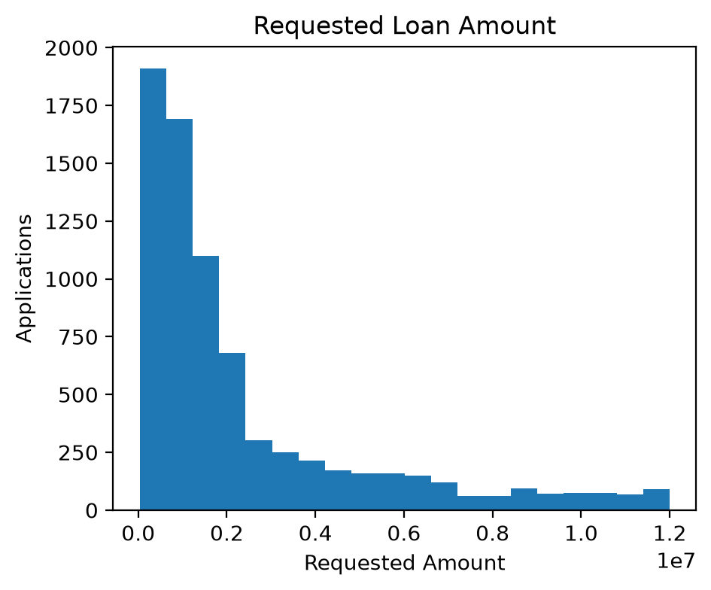
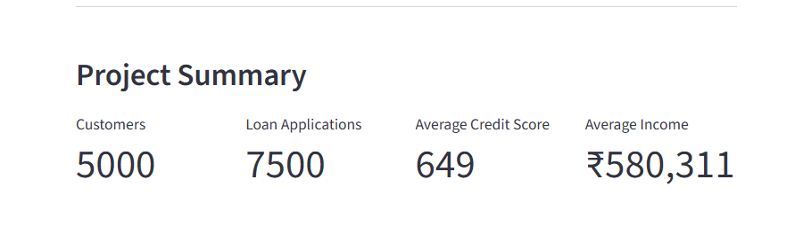
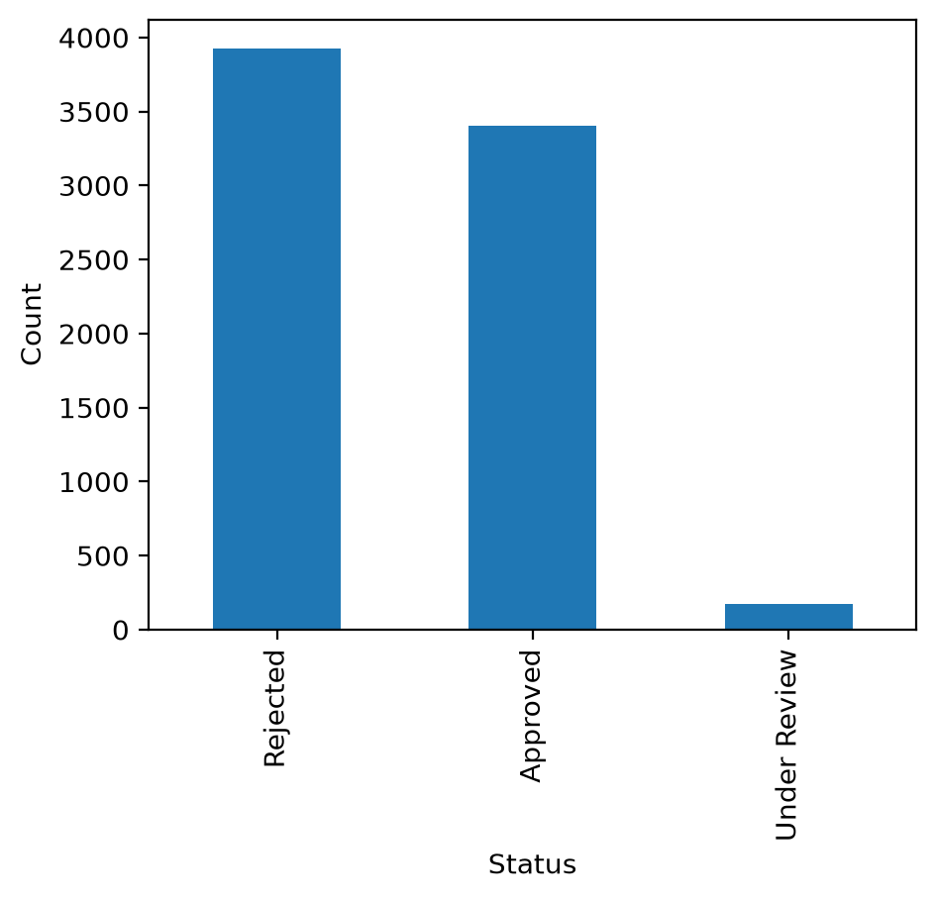
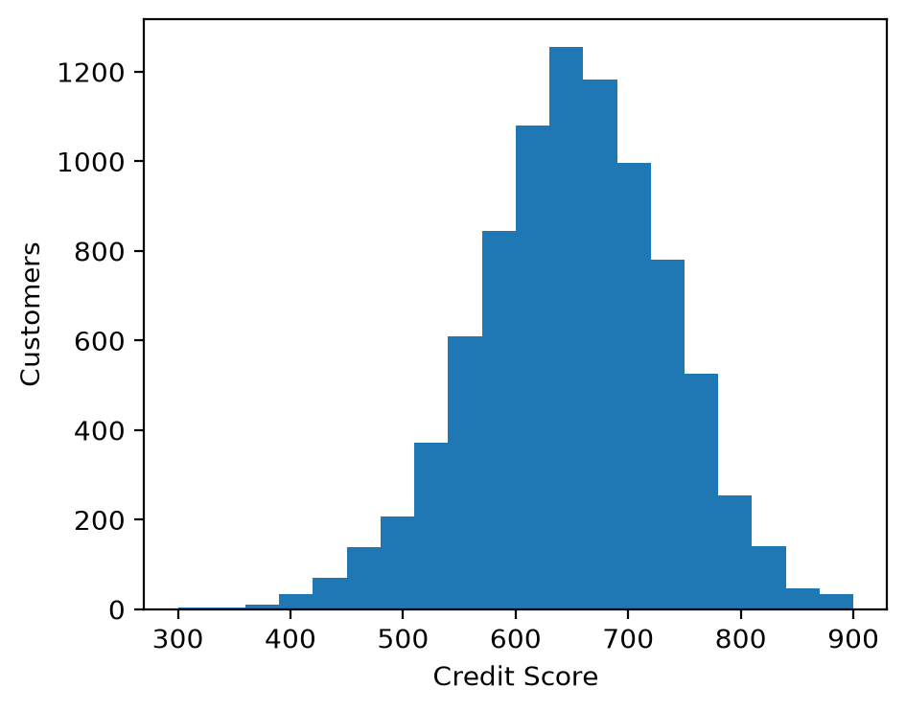
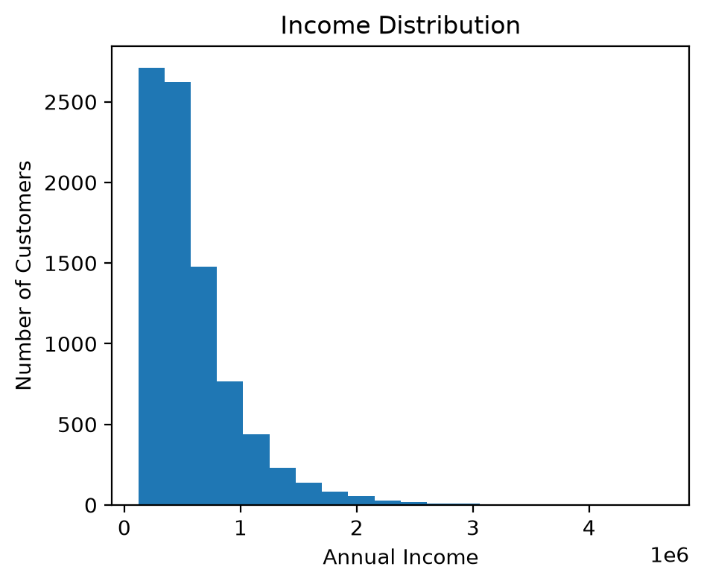
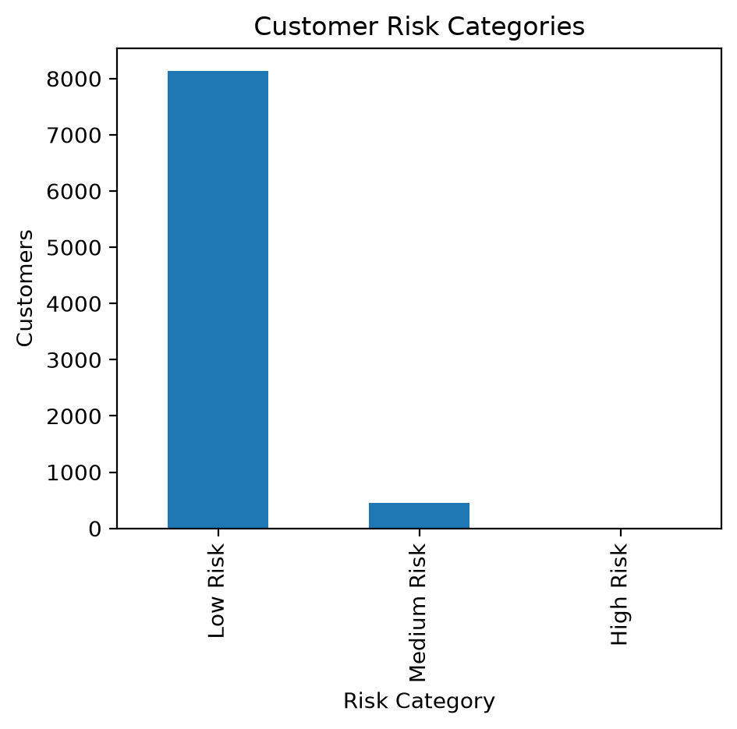
Dashboard Overview
The Streamlit dashboard provides an
interactive interface for analyzing
customer data, loan applications
and credit risk.

Slide 11
Results
Project Outcomes:
Successfully merged customer, credit history, and loan application datasets.
Cleaned and preprocessed the data for machine learning.
Trained a Random Forest Classifier for loan approval prediction.
Achieved approximately 89–91% model accuracy.
Generated customer Risk Scores and categorized customers into Low Risk, Medium Risk, and High Risk.
Developed an interactive Streamlit Dashboard for visualization and analysis.
Metric | Value
Model | Random Forest Classifier
Accuracy | 89–91%
ROC-AUC Score | 0.68
Risk Categories | Low, Medium, High

Slide 12
Conclusion
Developed a machine learning–based credit risk analytics platform.
Improved loan approval analysis using customer and financial data.
Built an interactive Streamlit dashboard for visual analytics.
Demonstrated the practical application of AI and machine learning in the finance domain.
Thank You

