Slide 1
SWEN772-Software Quality Engineering
Week 1-2: Quality Systems Frameworks

Slide 2
What is a Quality System Framework?
A quality system framework is a coherent set of objectives, policies, and practices for managing quality in an organization
As a framework, it provides the essential elements of a quality system
The elements are expected to be tailored and expanded for a given organization and situation
The framework emphasizes what needs to be done and why, without prescribing how

Slide 3
What is a Quality System Framework?
A Quality System is a set of formal and informal practices and processes that focus on ...
... to achieve organizational outcomes.
Customer needs
Leadership vision
Employee involvement
Continual improvement
Informed decision making based on real-time data
Mutually beneficial relationships with external business partners
An organization uses quality systems to control and improve the effectiveness of the processes used to deliver a quality product or service.
[Adapted from US Food and Drug Administration Staff Manual Guide 2020 http://www.fda.gov/smg/vol3/2000/SMG_2020.pdf]

Slide 4
Using a Quality System Framework
Use a quality system framework as guidance
A quality system framework can help an organization to ...
Review their current quality activities
Identify quality system elements that may already exist
Identify additional elements needed to implement a quality system
Use a quality system framework for external assessment and validation
Objective criteria for assessing quality processes
Often required to be “in business”
Cannot bid on a contract if you are not certified
Use as a marketing tool—Certified Seal of Approval

Slide 5
Some Major Quality Frameworks (1 of 3)
ISO 9000 Family of Standards
A general international standard for organizational quality systems
Specializations for specific types of products and services (including software)
Oriented towards assessment and certification
Malcolm Baldrige National Quality Award
Developed by the US Department of Commerce to encourage and recognize excellence
Created in 1987 in response to foreign competition eroding US productivity growth by having better product and process quality

Slide 6
Some Major Quality Frameworks (2 of 3)
Software Engineering Institute Capability Maturity Models (SEI CMM)
Created in response to US Department of Defense needs to improve software development capabilities for large, complex defense and other government systems
Originally a software-specific model for assessing the maturity of software development practices
Oriented towards both internal self-assessment and improvement and external certification assessment
CMM-Integrated includes software engineering, systems engineering, outsourcing (acquisition), services, etc.

Slide 7
Some Major Quality Frameworks (3 of 3)
Total Quality Management (TQM)
A philosophy and practices for improving quality
Build an organization-wide quality culture, focusing on providing customers with the products and services that satisfy their needs
Do it right the first time; eliminate defects and waste

Slide 8
All the Frameworks Define Principles That Embrace a Philosophy and Practice of Quality

Slide 9
Some Key Principles from W. E. Deming
Continuously improve product, service, and process
Result: continuously decreasing cost
Don’t depend on detecting defects; Prevent them
Don’t focus on initial cost, instead minimize total cost in a long-term relationship of loyalty and trust
Drive out fear, so that everyone may work effectively for the company
Break down barriers between departments, roles, and disciplines
Eliminate defect and productivity targets – management by numbers
Substitute leadership
Enable pride of workmanship
[Paraphrased and adapted from Deming, W. E. (1986) Out of the Crisis]

Slide 10
Some TQM Principles
Quality can and must be managed
Customer focus; Everyone has a customer and is a supplier
Processes, not people are the problem
Every employee is responsible for quality
Problems must be prevented, not just fixed
Quality must be measured
Quality improvements must be continuous
The quality standard is defect free
Goals are based on requirements, not negotiated
Life cycle costs, not front end costs
Management must be involved and lead
Plan and organize for quality improvement

Slide 11
Quality vs. Quality Frameworks
A major point to note is that all these are about Quality Systems and not directly about the actual quality of the product
The difference between excellence in quality control for an assembly line car and producing a handmade Rolls-Royce (work of art) is significantly different!
The principle is that an organization with a culture of focusing on quality and on continuous improvement will consistently produce good product output and achieve customer delight
Remember also “continually optimize achievement of multiple objectives”
The systems help find the optimal balance

Slide 12
Quality System Frameworks Identify Areas of Importance

Slide 13
Key Process Areas from SEI CMMI
Category
Process Area
Project
Management
Project Planning
Project Monitoring and Control
Supplier Agreement Management
Integrated Project Management
Integrated Supplier Management
Integrated Teaming
Risk Management Quantitative Project Management
Support
Configuration Management
Process and Product Quality Assurance
Measurement and Analysis Causal Analysis and Resolution
Decision Analysis and Resolution
Organizational Environment for Integration
The SEI CMMI details the expectations of a software engineering process definition in each of these key areas
Engineering
Requirements Management
Requirements Development
Technical Solution
Product Integration
Verification
Validation
Process
Management
Organizational Process Focus
Organizational Process Definition
Organizational Training
Organizational Process Performance
Organizational Innovation and Deployment

Slide 14
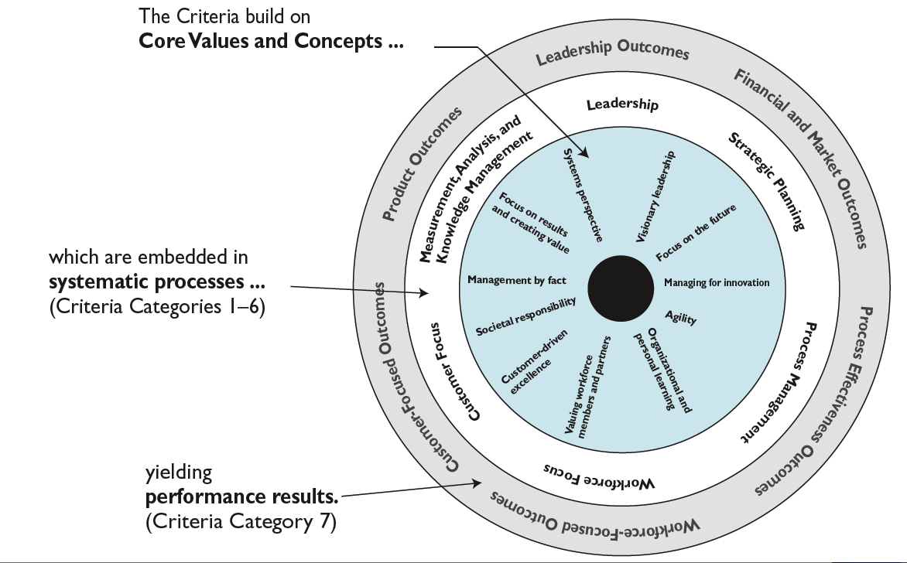
Core Values & Concepts of the Baldrige Criteria for Performance Excellence
http://www.quality.nist.gov/PDF_files/2009_2010_Business_Nonprofit_Criteria.pdf

Slide 15
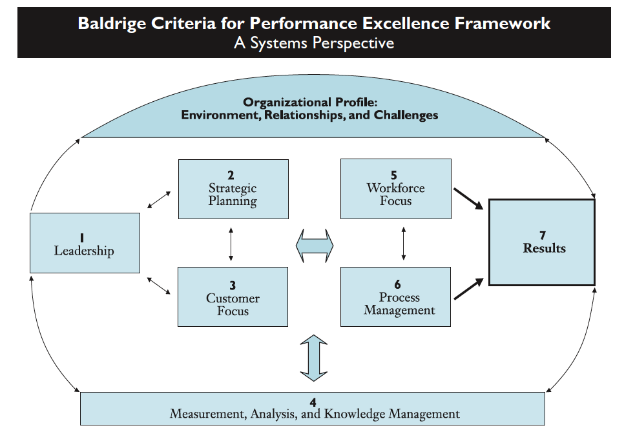
Categories for the Baldrige Criteria
http://www.quality.nist.gov/PDF_files/2009_2010_Business_Nonprofit_Criteria.pdf

Slide 16
ISO 9000
A standard for certifying that organizations follow procedures for ensuring quality
Heavy focus on processes and evidence of compliance (documentation)
Some focus on statistical techniques and processes for improvement
ISO 9000 focuses on procedures for ensuring quality:
“assure minimum standards of operation”
“existence of quality systems and commitment to them”
Complementary to other quality management frameworks – limited value in itself

Slide 17
Value of the Frameworks
“Optimize across all project and organizational objectives” is too open-ended
Frameworks provide models of what needs to be addressed
Primary value from these frameworks includes:
Defining the specific set of areas to address
Defining specific criteria for determining whether the areas are being addressed well
Providing basic structures to ensure continuing focus
Defining appropriate processes and metrics
Mechanisms for continuous improvement, so that processes keep improving and evolving as needs change
Assessment mechanisms, to check that all this is happening

Slide 18
Which Framework to Use?
Different frameworks address different needs
Also, there are many other frameworks, and many additions/variations to each
Organizations design their own quality management approaches (or it just evolves without design!), possibly using one or more frameworks as a starting point
Frameworks only supply goals, and suggest some ways to achieve goals
Each organization needs to adapt the framework(s) to their needs, and decide how to achieve their specific goals
If used well, any of the frameworks are helpful
If used poorly, none of them will help (In fact, they will hurt!)

Slide 19
Why This “Big Picture” Now?
Understanding the big picture helps, before we start to focus on specific quality metrics and practices
Understanding the philosophy and limitations helps you to get a more balanced picture of the quality area
General knowledge
As a software engineer, people will expect you to know about these models
As a software quality engineer or software process engineer, these models provide a wealth of wisdom
Quality and Software process improvement pay for themselves (see next slide)

Slide 20
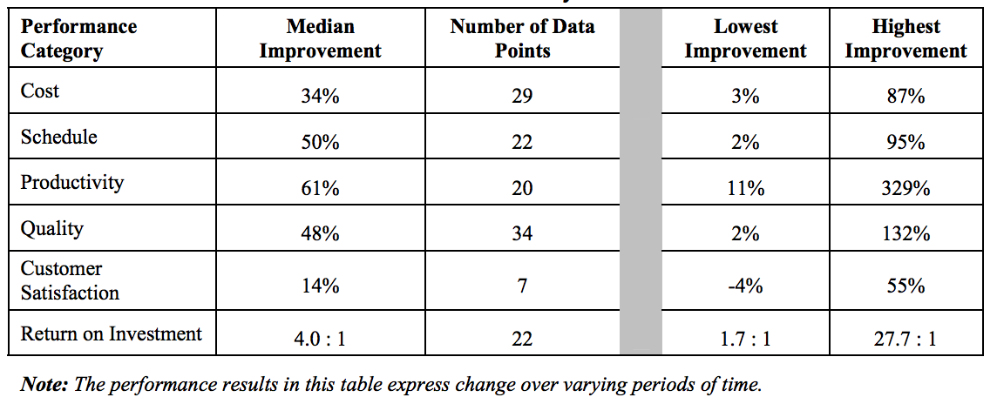
Results from CMMI Improvements in 2005

Slide 21
Frameworks as Knowledge Bases
The quality system frameworks are a knowledge base to guide your quality system:
What areas do we need to address if we want projects to be successful?
How do we keep everyone aware of good ways to accomplish tasks?
What are common sources of problems?
What structures can we put in place to reduce the chance that problems will occur?
What structures do we need to ensure that the organization will keep trying to improve its processes and practices?
How do we ensure that good processes lead to good results?
How we can we figure out when things aren’t working and how to fix them?
An organization’s quality management system is its own knowledge base of the best answers to these questions!

Slide 22
Capability and Compliance Assessments
Assessments are massive exercises
Value: Feedback on what’s working, opportunities for improvement
Cross-fertilization of ideas
Problems
Easy to “create evidence for the assessment”
Passing means at best that systems are in place, not that results are superior
Assessments easily become exercises in PR (public relations)
Over-focus on “avoiding mistakes” can take energy away from excellence
It would be a mistake to read too much into the results
Being assessed at high maturity levels or receiving a quality award does NOT guarantee that the organization will be more successful or produce better products
It just means that they have structures in place to keep trying to do better

Slide 23
Some Thoughts About Quality Frameworks
Culture is always the best approach
Systems have their place and value
“Less is more”
Small organizations may not need very much formal quality management
Know the theory. As problems are perceived, incrementally put in only what is obviously useful
When designing a quality system, think carefully about what the needs of the organization are and what is appropriate
Processes tend to grow with time, so quality people should spend as much energy “deleting” unnecessary process as adding process

Slide 24
Conclusion
There are many quality systems frameworks, appropriate to different needs
The quality system frameworks provide a good starting point for creating quality systems for your organization
Understand the underlying quality system philosophy and supporting activities and incorporate them throughout the organization
Most organizations use a combination of quality systems
Assemble a quality system from the principles and practices that are most appropriate to your situation

Slide 25
Discussions
“Systems don’t produce quality, people do.”
Do you agree with this? Why?
What are the advantages & disadvantages of a quality system that is heavily procedures and documentation-oriented?
The culture approach to quality is not really about “compliance” at all. It is about building an environment where focusing on project and organizational objectives is part of what it means to “get work done” and to “deliver”.
Is such an approach good?
Is it workable?
What are the barriers?

