Slide 1
SWEN 772-Software Quality Engineering W2-1 Measurement and Metrics Fundamentals

Slide 2
Lecture Objectives
Provide some basic concepts of metrics
Quality attribute ←→ metrics and measurements
Reliability, validity, error
Correlation and causation
Discuss process variation and process effectiveness
Introduce a method for identifying metrics for quality goals
Goal-Question-Metric approach

Slide 3
Context: Define Measures and Metrics that are Indicators of Quality
Quality attribute
Definition: Identify measurements for quality assessment and improvement
Execution: Measure, analyze, and improve quality
Operational definition, metrics
Data analysis and interpretation
Measurements
Data collection

Slide 4
Software Quality Metrics
IEEE-STD-1061-1998(R2004) Standard for Software Quality Metrics Methodology

Slide 5
A Metric Provides Insight on Quality
A measure is a way to ascertain or appraise value by comparing it to a norm [2]
A metric is a quantitative measure of the degree to which a system, component, or process possesses a given attribute [1]
Software quality metric: A function whose inputs are software data and whose output is a single numerical value that can be interpreted as the degree to which software possesses a given attribute that affects its quality [2], e.g., Line of Code (LoC).
An indicator is a metric or combination of metrics that provide insight into a process, a project, or the product itself
[1] IEEE-STD-610.12-1990 Glossary of Software Engineering Terminology
[2] IEEE-STD-1061-1998 Standard for Software Quality Metrics Methodology

Slide 6
Measurements vs. Metrics
A measurement just provides information
Example: “Number of defects found during inspection: 12”
A metric is often derived from one or more measurements or metrics, and provides an assessment (an indicator) of some property of interest:
It must facilitate comparisons
It must be meaningful across contexts, that is, it has some degree of context independence
Example: “Rate of finding defects during the inspection = 8 / hour”
Example: “Defect density of the software inspected = 0.2 defects/KLOC”
Example: “Inspection effort per defect found = 0.83 hours”

Slide 7
Operational Definition
Concept
Concept is what we want to measure, for example, “cycletime”
We need a definition for this: “elapsed time to do the task”
The operational definition spells out the procedural details of how exactly the measurement is done
“Cycletime is the calendar time between the date when the project initiation document is approved to the date of full market release of the product”
Definition
Operational Definition
Measurements

Slide 8
Operational Definition Example
One operational definition of “development cycletime” is:
The cycletime clock starts when effort is first put into project requirements activities (still somewhat vague)
The cycletime clock ends on the date of release
If development is suspended due to activities beyond a local organization’s control, the cycletime clock will be stopped, and restarted again when development resumes
This is decided by the project manager
Separate “development cycletime” from “project cycletime” which has no clock stoppage and beginning at first customer contact
The operational definition addresses various issues related to gathering the data, so that data gathering is more consistent

Slide 9
Measurement Scales
Nominal scale: categorization
Different categories, not better or worse
Example: Type of risk: business, technical, requirements, etc.
Ordinal scale: Categories with ordering
Example: CMM maturity levels, defect severity
Sometimes averages quoted, but only marginally meaningful
Interval scale: Numeric, but “relative” scale
Example: GPAs. Differences more meaningful than ratios
Ratio scale: Numeric scale with “absolute” zero
Ratios are meaningful and can be compared
Increasing information content and analysis tools

Slide 10
Using Basic Measures
Ratios are useful to compare magnitudes
Proportions (fractions, decimals, percentages) are useful when discussing parts of a whole
Such as a pie chart
When number of cases is small, percentages are often less meaningful – Actual numbers may carry more information
Because percentages can shift so dramatically with single instances (high impact of randomness)
When using rates, better if denominator is relevant to opportunity of occurrence of event
Requirements changes per month, or per project, or per page of requirements more meaningful than per staff member

Slide 11
Reliability & Validity
Reliability is whether measurements are consistent when performed repeatedly
Example: Will process maturity assessments produce the “same” outcomes when performed by different people?
Example: If we measure repeatedly the reliability of a product, will we get consistent numbers?
Validity is the extent to which the measurement actually measures what we intend to measure
Construct validity: Match between operational definition and the objective
Content validity: Does it cover all aspects? (Do we need more measurements?)
Predictive validity: How well does the measurement serve to predict whether the objective will be met?

Slide 12
Reliability vs. Validity
Rigorous operational definitions of how the measurement will be collected can improve reliability, but worsen validity
Example: “When does the cycletime clock start?”
If we allow too much flexibility in data gathering, the results may be more valid, but less reliable
Too much dependency on who is gathering the data
Good measurement systems design often needs a balance between reliability & validity
A common error is to focus on what can be gathered reliably (“observable & measurable”), and lose out on validity
“We can’t measure this, so I will ignore it”, followed by “The numbers say this, hence it must be true”
Example: SAT scores for college admissions decisions
Measure what is necessary, not what is easy

Slide 13
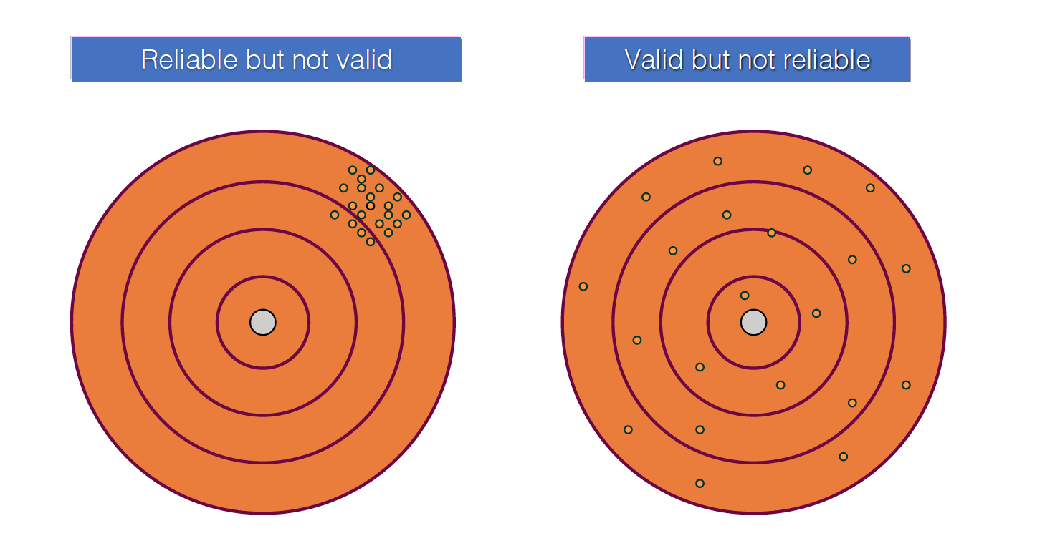
Reliability vs. Validity

Slide 14
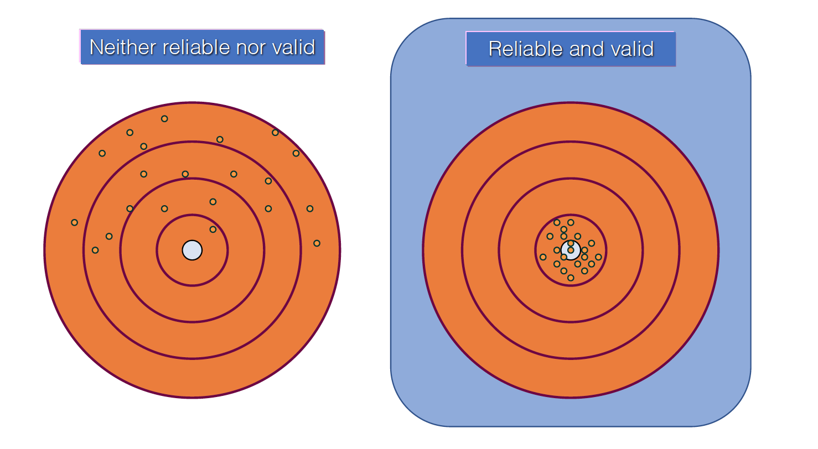
Reliability vs. Validity

Slide 15
Systematic & Random Error
Gaps in reliability lead to random error
Variation between “true value” and “measured value”
Gaps in validity may lead to systematic error
“Biases” that lead to consistent underestimation or overestimation
Example: Cycletime clock stops on release date rather than when customer completes acceptance testing
From a mathematical perspective (True Score Theory):
We want to minimize the sum of the two error terms, for single measurements to be meaningful
Trend information is better if random error is less
When we use averages of multiple measurements (such as organizational data), systematic error is more worrisome
Broader measurement scope → Broader impact of error

Slide 16
Assessing Reliability
Can relatively easily check if measurements are highly subject to random variation:
Split sample into halves and see if results match
Re-test and see if results match
We can figure out how reliable our results are, and factor that into metrics interpretation
Can also be used numerically to get better statistical pictures of the data
Example: the reliability measure can be used to correct for attenuation in correlation coefficients

Slide 17
Correlation
Checking for relationships between two variables:
Example: Does defect density increase with product size?
Plot one against the other and see if there is a pattern
Statistical techniques to compute correlation coefficients:
Most of the time, we only look for linear relationships
Text explains the possibility of non-linear relationships, and shows how the curves and data might look
Common major error: Assuming correlation implies causality (A changes as B changes, hence A causes B)
Example: Defect density increases as product size increases → Writing more code increases the chance of coding errors!

Slide 18
Criteria for Causality
Observation indicates correlation
Cause precedes effect in time or logical dependence
The cause is not spurious
Not so easy to figure out!
Maybe common cause for both
Example: Code size and defects are a result of problem complexity
Maybe there is an intermediate variable
Size → number of dependencies → defect rate
Why is this important? Because it affects quality management approach
For example, we may focus on dependency reduction
Maybe both are indicators of something else:
Example: developer competence (less competent: more size, defects)

Slide 19
Measuring Process Effectiveness
A major concern in process theory (particularly in manufacturing) is “reducing process variation”
If you are doing the same thing, then do it the same way
Monitor the output to make sure that the process is “in control”
It is about “improving process effectiveness” so that the process consistently delivers non-defective results
Process effectiveness is measured as “sigma level”

Slide 20
The Normal Curve
Area within –3σ/+3σ: contains about 99.7%
σ: Standard deviation is the square root of variance
Sigma level is the area under the curve between the limits
Percentage of situations that are “within tolerable limits”

Slide 21
Six Sigma
Given “tolerance limits” (the definition of what is defective), if we want +/- 6σ to fit within the limits, the curve must become very narrow:
We must “reduce process variation” so that the outcomes are highly consistent
Area within +/- 6σ is 99.9999998%
~2 defects per billion
This assumes a normal curve. But actual curve is often a “shifted” curve, for which it is a bit different
The Motorola (and generally accepted) definition is 3.4 defects per million operations

Slide 22
Why So Stringent?
Because manufacturing involves thousands of process steps, and output quality is dependent on getting every single one of them right:
Need very high reliability at each step to get reasonable probability of end-to-end correctness
At 6 sigma, product defect rate is ~10% with ~1200 process steps
Concept came originally from chip manufacturing
Software has sort of the same characteristics:
To function correctly, each line has to be correct
A common translation is 3.4 defects per million lines of code

Slide 23
Six Sigma Focus
Six sigma is NOT actually about “achieving the numbers,” but about:
A systematic quality management approach
Studying processes and identifying opportunities for defect elimination
Defect prevention approaches
Measuring output quality and improving it constantly

Slide 24
Comments on Process Variation
Note that “reducing” process variation is a “factory view” of engineering development
Need to be careful about applying it to engineering processes
Each software product may vary, but be consistent in the engineering processes
Most applicable for activities performed repeatedly, such as, writing code, running tests, creating releases, etc.
Less applicable for activities that are different every time, such as, innovation, learning a domain, architecting a system
Many “creative” activities do have a repetitive component
Partly amenable to “systematic defect elimination” such as in design
Simple criterion: Are there defects that can be eliminated by systematic process improvement?
Reducing variation eliminates some kinds of defects
Defect elimination is a two-outcome model—ignores excellence

Slide 25
Conclusions
Measurement starts with an operational definition of some quality attribute of interest
We need to put some effort into choosing appropriate measures and scales, and understanding their limitations
Measurements have both systematic and random error
Measurements must have both reliability and validity
Often, hard to achieve both
A common error is confusing correlation with causation
A major concern in process design is reducing process variation:
Six sigma is actually more about eliminating and identifying defects, and identifying opportunities for process improvement
Defects are NOT the sole concern in process design!
There are other quality attributes than defects and failures
Process optimization is oriented primarily towards repetitive activities

Slide 26
Discussion
Scale | Type of Scale
Hair_color = {auburn, black, blond, brown, grey, red, white} | ?
Second Lieutenant, First Lieutenant, Captain, Major, Lieutenant Colonel, Colonel, Brigadier General, Major General, Lieutenant General, General, General of the Army | ?
Temperature in C˚or F˚ | ?
Monthly Payment | ?
Temperature in Kelvin | ?

Slide 27
Discussion - Answers
Scale | Type of Scale
Hair_color = {auburn, black, blond, brown, grey, red, white} | Nominal
Second Lieutenant, First Lieutenant, Captain, Major, Lieutenant Colonel, Colonel, Brigadier General, Major General, Lieutenant General, General, General of the Army | Ordinal
Temperature in C˚or F˚ | Interval
Monthly Payment | Ratio
Temperature in Kelvin | Ratio

