Slide 1
SWEN 772-Software Quality Engineering W2-2 Measurement and Metrics Fundamentals 2 - GQM

Slide 2
Goal, Question, and Metrics
Origins from real world problems at NASA Goddard Space Fighter Project in 1970s: How to decide what you need to measure in order to achieve your goals?
GQM defines a measurement model on three levels:
Conceptual level (Goal) A goal is defined for an object, for a variety of reasons, with respect to various models of quality, from various points of view and relative to a particular environment.
Operational level (Question) A set of questions is used to define models of the object of study and then focuses on that object to characterize the assessment or achievement of a specific goal.
Quantitative level (Metric) A set of metrics, based on the models, is associated with every question in order to answer it in a measurable way.

Slide 3
Goals identify what we want to accomplish; questions, when answered, tell us whether we are meeting the goals or help us understand how to interpret them; and the metrics identify the measurements that are needed to answer the questions and quantify the goal

Slide 4
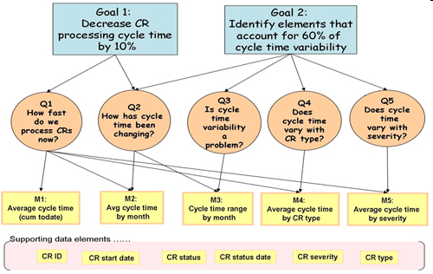
Example
(CR: Change Request)

Slide 5
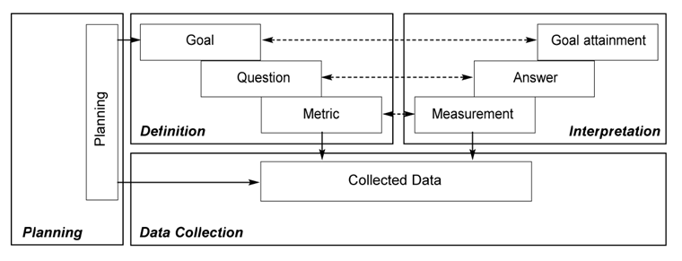
Phases of GQM Practice

Slide 6
Six Steps of GQM
Steps 1-3: Definition
Use business goals to drive identification of the right metrics
Steps 4-6: Data Collection and Interpretation
Gather the measurement data and make effective use of the measurement results to drive decision making and improvements

Slide 7
Six Steps of GQM-Steps 1-3: Definition
Use business goals to drive identification of the right metrics
Develop a set of corporate, division and project business goals and associated measurement goals for productivity and quality
Generate questions (based on models) that define those goals as completely as possible in a quantifiable way
Specify the measures needed to be collected to answer those questions and track process and product conformance to the goals

Slide 8
Six Steps of GQM-Steps 4-6: Data Collection and Interpretation
Gather the measurement data and make effective use of the measurement results to drive decision making and improvements
Develop mechanisms for data collection
Collect, validate and analyze the data in real time to provide feedback to projects for corrective action
Analyze the data in a postmortem fashion to assess conformance to the goals and to make recommendations for future improvements

Slide 9
Defining Goals—PPE Template
Purpose: Analyze some (objects: processes, products, other experience models) for the purpose of (why: characterization, evaluation, prediction, motivation, improvement)
Perspective: with respect to (what aspect: cost, correctness, defect removal, changes, reliability, user friendliness, etc.) from the point of view of (who: user, customer, manager, developer, corporation, etc.)
Environment: in the following context: (where: problem factors, people factors, resource factors, process factors, etc.)
IEEE-STD-1061-1998 Standard for Software Quality Metrics Methodology

Slide 10
Goal Example
Analyze the (system testing method) for the purpose of (evaluation) with respect to a model of (defect removal effectiveness) from the point of view of the (developer) in the following context: the standard NASA/GSFC environment, i.e., process model [e.g., Software Engineering Laboratory (SEL) version of the waterfall model], application (ground support software for satellites), machine (running on a DEC 780 under VMS), etc.
IEEE-STD-1061-1998 Standard for Software Quality Metrics Methodology

Slide 11
Key Practices of GQM (p. 1 of 3)
Get the right people involved in the GQM process
Set explicit measurement goals and state them explicitly
Don’t create false measurement goals (for example, matching metrics you already have or are easy to get)
Acquire implicit quality models from the people involved

Slide 12
Key Practices of GQM (p. 2 of 3)
Consider context
Derive appropriate metrics
Stay focused on goals when analyzing data
Let the data be interpreted by the people involved
Integrate the measurement activities with regular project activities

Slide 13
Key Practices of GQM (p. 3 of 3)
Do not use measurements for other purposes (such as to assess team member productivity)
Secure management commitment to support measurement results
Establish an infrastructure to support the measurement program
Ensure that measurement is viewed as a tool, not the end goal
Get training in GQM before going forward

Slide 14
GQM Recent Development: GQM+
GQM+: extends the goal/question/metric paradigm for measuring the success or failure of goals and strategies, adding enterprise-wide support for determining action on the basis of measurement results. An organization can thus integrate its measurement program across all levels
Provides solutions to achieve Business Alignment
May be applied in other non-software development domains (e.g., professional training)

Slide 15
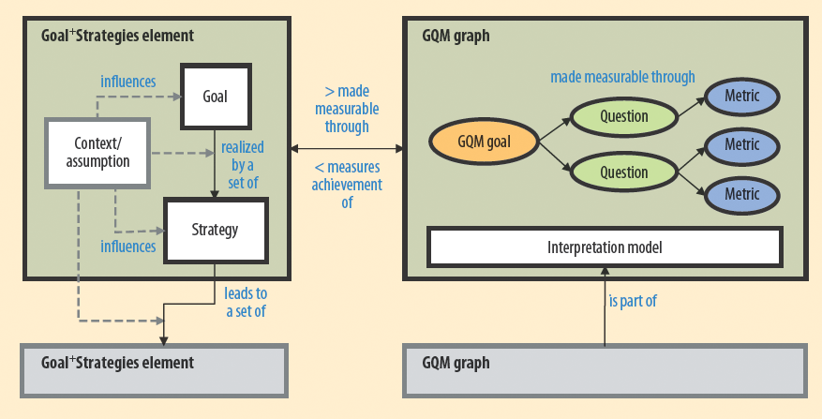
GQM+ Strategies components
The primary components are the Goal+ Strategies element and the GQM graph. The Goal+ Strategies element includes a single goal and derived strategies, as well as all context information and assumptions that explain how goals and strategies link. The GQM graph reflects a single GQM goal, the corresponding questions and metrics, and an interpretation model.

Slide 16
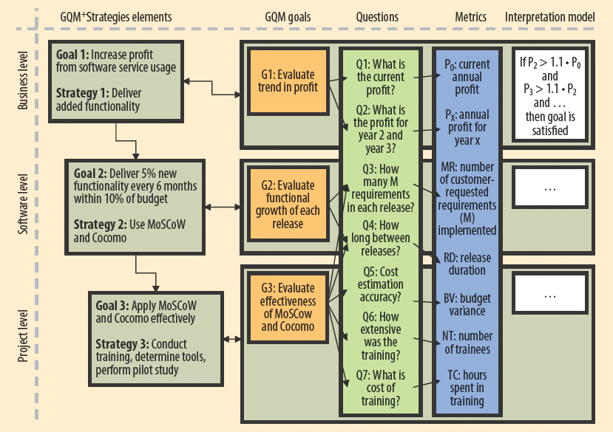
GQM+ Example
GQM+Strategies enforces the explicit documentation of the relevant context factors and assumptions that are necessary for understanding and evaluating each goal.
A Goal+ Strategies element consists of a goal and an associated strategy (bottom of each goal box). Each element, in turn, is associated with a GQM graph (green rectangle to the right of the goal) representing questions and metrics as well as an interpretation model that evaluates if the goal was achieved.

Slide 17
More about GQM+ and Its Applications
Original Paper
Basili, V. R., Lindvall, M., Regardie, M., Seaman, C., Heidrich, J., Münch, J., ... & Trendowicz, A. (2010). Linking software development and business strategy through measurement. Computer, 43(4), 57-65.
Application in Non-Software Development Domains
Sarcia, S. A. (2010, September). Is GQM+ Strategies really applicable as is to non-software development domains?. In Proceedings of the 2010 ACM-IEEE International Symposium on Empirical Software Engineering and Measurement (p. 45). ACM.

Slide 18
Discussion
Take an everyday context, such as coursework, commuting to school, research.
Identify one or more quality objectives you would like to achieve, such as "improve grades", or "publish a paper".
Use the GQM framework to design two metrics that relate to the objective.
Identify the measurements that you need to compute the metric.
What are the reliability and validity limitations of the metrics you have identified?

