Slide 1

Combining Full Bayesian Inference With Prior-fitted Networks For Time Series Forecasting
Che-Yu Wu 31977251
Supervisors:
Dr. Angus Dempster
Dr. Christoph Bergmeir
Prof. Daniel Schmidt

Slide 2
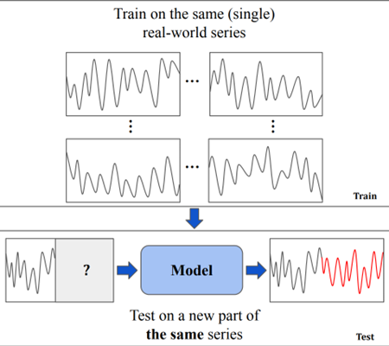
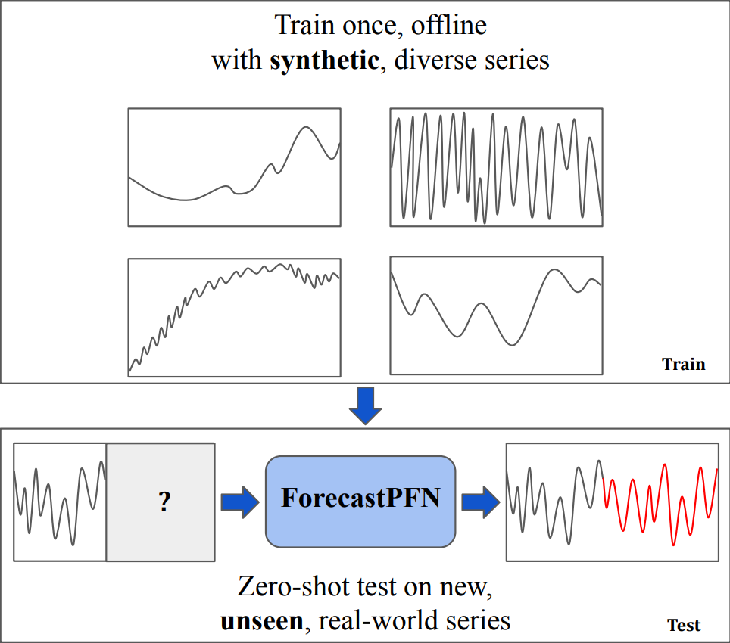
What Is Prior-fitted Network &
Why It Matters?
Traditional Setting (Dooley et al., 2023)
Traditional Machine Learning:
Trains on examples from a single dataset.
Must retrain or fine-tune for each new dataset.
Requires either fitting, validation, hyperparameter tuning per task.
Prior-Fitted Networks (PFNs):
Train on entire synthetic datasets from a prior distribution.
Can design different priors based on different context.
At inference: Takes the training data as context only without further training.
Makes predictions via in-context learning (like LLMs with prompts).
Why This Matters:
True zero-shot forecasting on unseen series.
Instant deployment across domains.
Eliminates per-series model fitting costs.
Our Research Question: Does Bayesian Time Series Model provide a better prior for PFNs in context of Time Series Forecasting?
PFN Setting (Dooley et al., 2023)
Notes:
Let me first explain what Prior-Fitted Networks are and why they're interesting for forecasting.
In traditional machine learning, we train models on individual examples from a single dataset. Every time you encounter a new forecasting problem, you need to retrain the model, do hyperparameter tuning, and validation. This is time-consuming and computationally expensive.
Prior-Fitted Networks flip this paradigm. Instead of training on individual examples, PFNs train on entire synthetic datasets sampled from a prior distribution. You can design different priors based on different contexts.
At inference time, the PFN takes your historical data as context - similar to how large language models work with prompts - and makes predictions through in-context learning. No retraining needed, no parameter updates.
Why does this matter? Because it enables true zero-shot forecasting. Once trained, you can instantly deploy the model across any new domain without per-series fitting costs. This is particularly valuable when you have limited data or need to forecast across thousands of series.
Our research question is: Does a Bayesian Time Series Model provide a better prior for PFNs in the context of time series forecasting?"

Slide 3
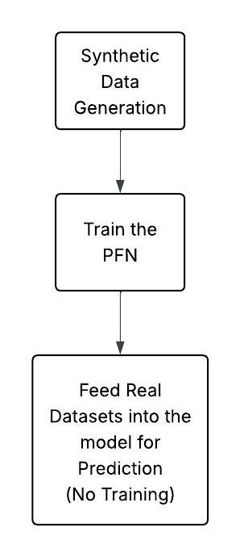
Experimental Process
Modified The Local Global Trend Model (LGT) to Generate Synthetic Data
LGT is a Bayesian forecasting model that can capture complex trend and seasonality patterns.
We changed it to a data generator from forecaster by making the starting point and trend component random.
Fit 1428 M3 monthly series to the data and generate 100 per series (Total: 142800).
Feed The Synthetic Datasets to Train the model ForecastPFN Provided
ForecastPFN is the first PFN that provided framework for time series forecasting.
It claims to achieve state-of-the-art performance.
Finally, We Generate Zero-shot Predictions From Our Trained Model.
However, there are some issues that we encountered when running the model.
Notes:
Let me walk you through our experimental process, which has three main stages.
First, we modified the Local and Global Trend model - LGT - to generate synthetic data. LGT is a Bayesian forecasting model that captures complex trend and seasonality patterns. We transformed it from a forecaster into a data generator by making the starting points and trend components random.
Here's what we did: We fit LGT to all 1,428 M3 monthly competition series. From each fitted model, we extracted the posterior parameter distributions and generated 100 synthetic series per original series. This gave us 142,800 diverse synthetic time series for training.
Second, we fed these synthetic datasets to train ForecastPFN. ForecastPFN is the first framework that applied Prior-Fitted Networks to time series forecasting, and it claims to achieve state-of-the-art performance.
Finally, we generated zero-shot predictions from our trained model on multiple benchmark datasets.
However - and this is crucial - we encountered serious issues when running the model, which became a major part of our findings

Slide 4
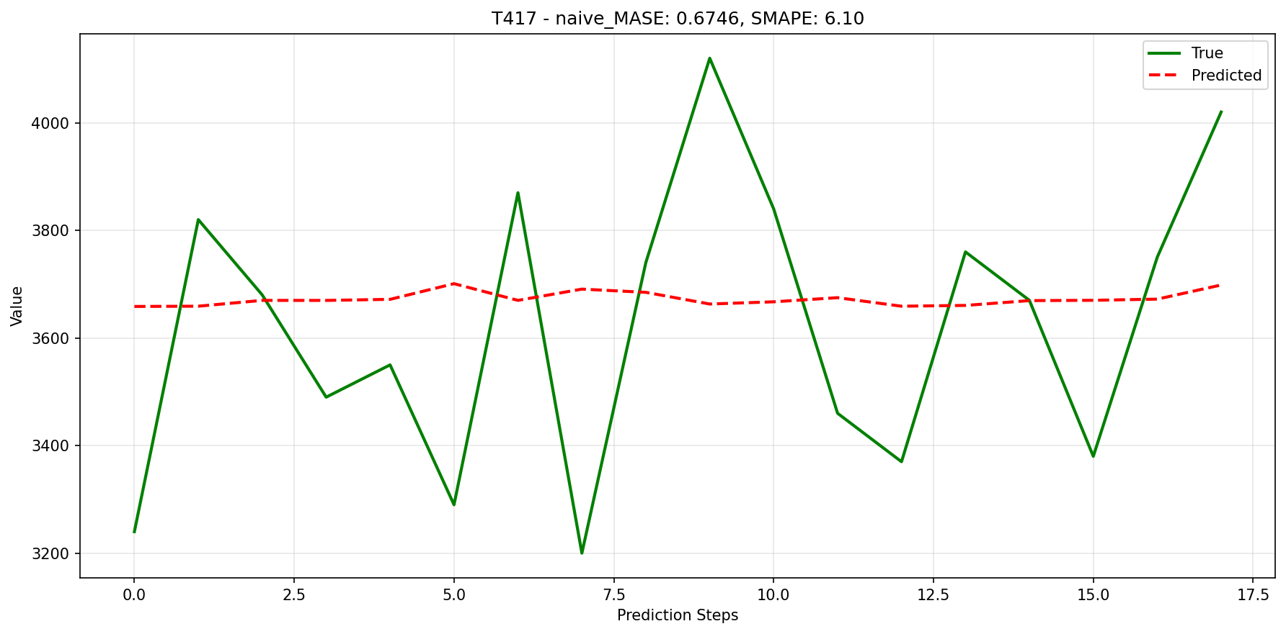
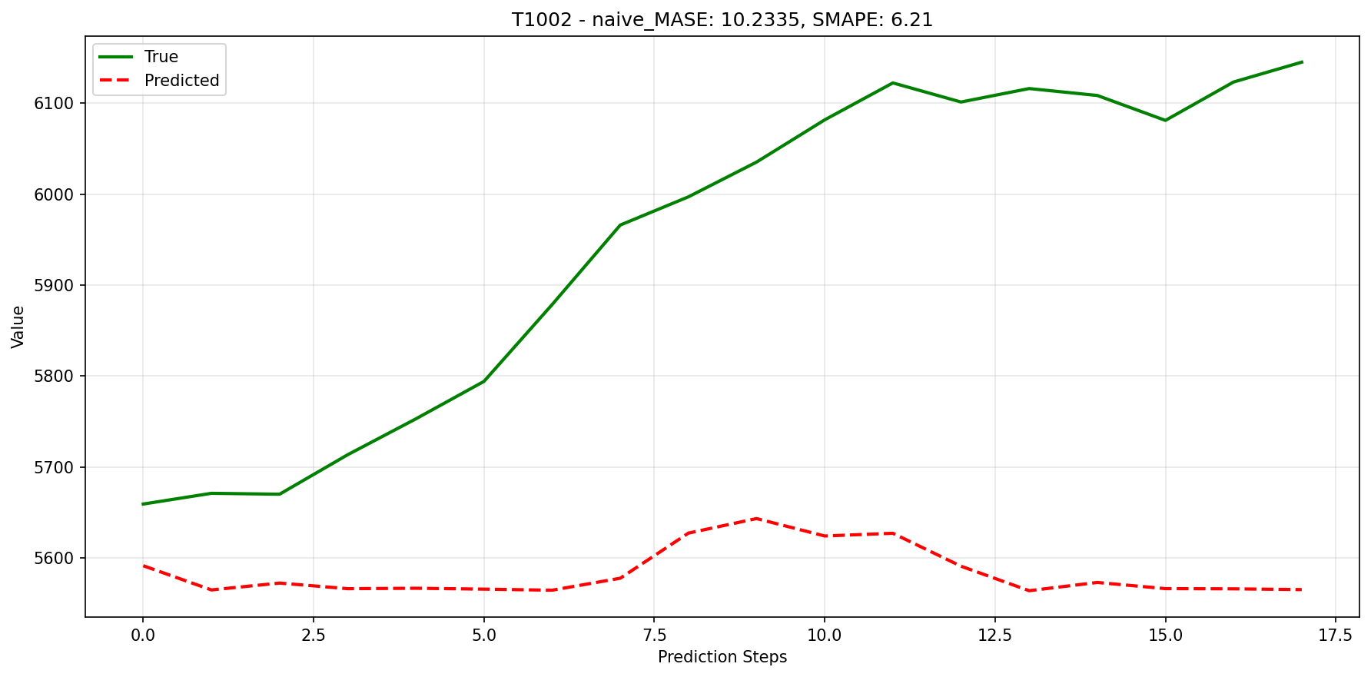
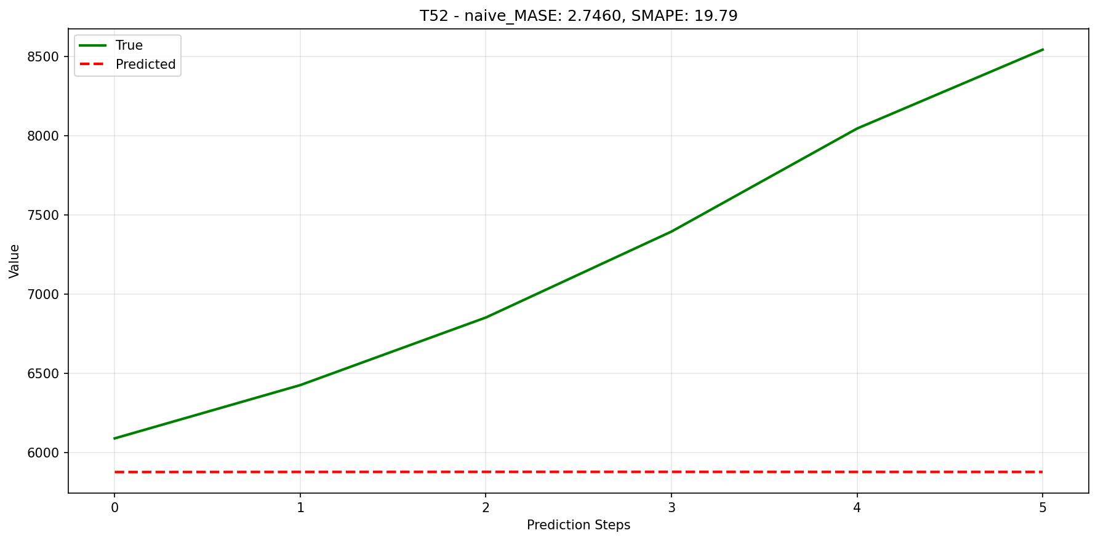
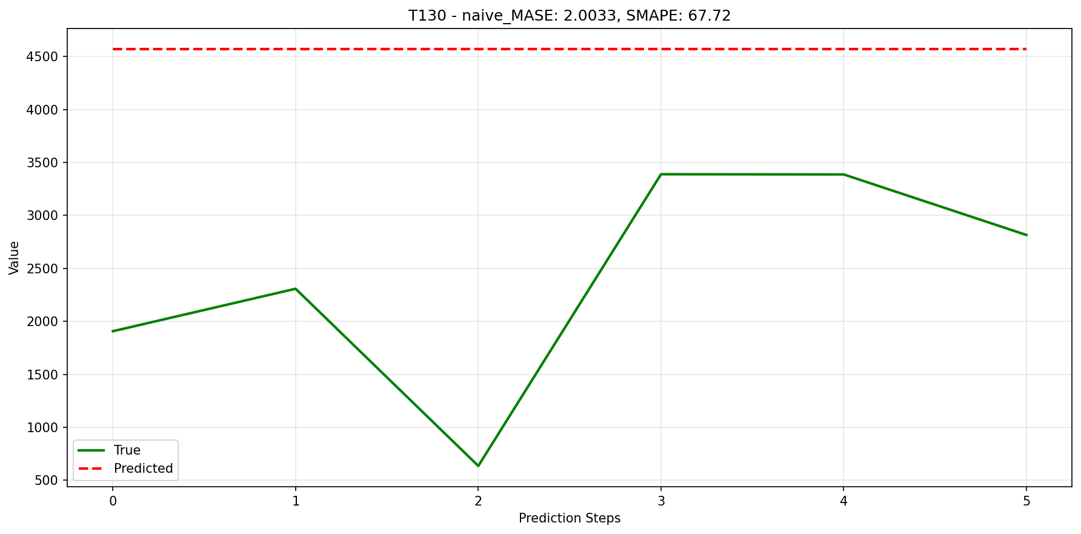
Critical Discovery: ForecastPFN Implementation Issues
M3 monthly predictions has some pattern changes
Problems Found:
Scaling instability leading to training divergence and gradient explosion
Evaluation on normalised data (violates forecasting standards)
Testing on single random series (not representative).
Persistent "flat" predictions.
Our Corrections:
Proper scaling (max-scaling)
Evaluation on original-scale data
Testing on complete datasets
Proper scale-independent metrics (MASE, sMAPE)
Implications:
Original ForecastPFN results likely invalid, which is a shame as it is a paper that is presentedin NeurIPS 2023.
Our work establishes rigorous evaluation framework
M3 yearly predictions has a serious flatness problem
Notes:
This slide represents one of our most important contributions. When implementing ForecastPFN, we discovered multiple critical problems with the original approach.
First, there was scaling instability that led to training divergence and gradient explosion. The original 'robust scaler' implementation caused the training to fail.
Second, evaluation was performed on normalised data. This is a serious violation of forecasting standards because it hides true performance. A model might look good on normalized data but fail on actual scales that matter for decision-making.
Third, the original implementation tested on only a single randomly selected series per dataset rather than comprehensive evaluation across all series. This makes results completely unrepresentative.
And fourth, we observed persistent flat predictions - the model produces forecasts that are excessively smooth and fail to capture the variability in actual series.
We corrected what we could. We implemented proper max-scaling, evaluated on original-scale data, tested on complete datasets, and used proper scale-independent metrics like MASE and sMAPE.
The implications are significant. The original ForecastPFN results are likely invalid, and more broadly, this raises questions about rigor in PFN forecasting research.
You can see the problem clearly in these plots. On the left, M3 monthly predictions show some pattern changes, but on the right, M3 yearly predictions exhibit severe flatness - the forecasts are nearly horizontal lines while the actual data is highly volatile.

Slide 5
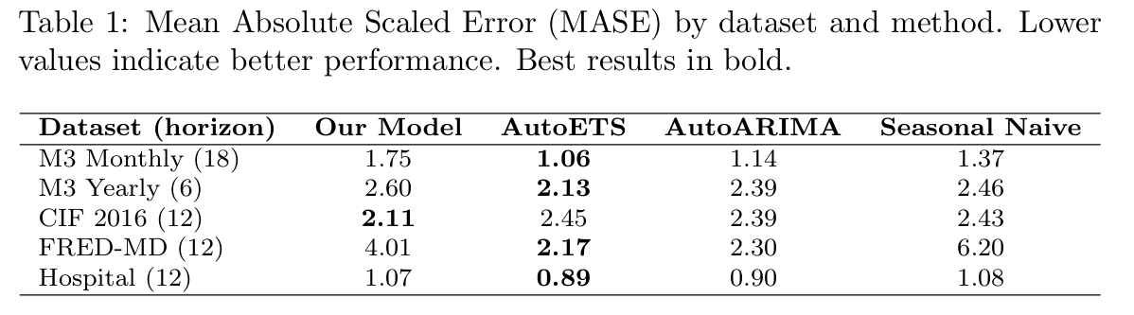
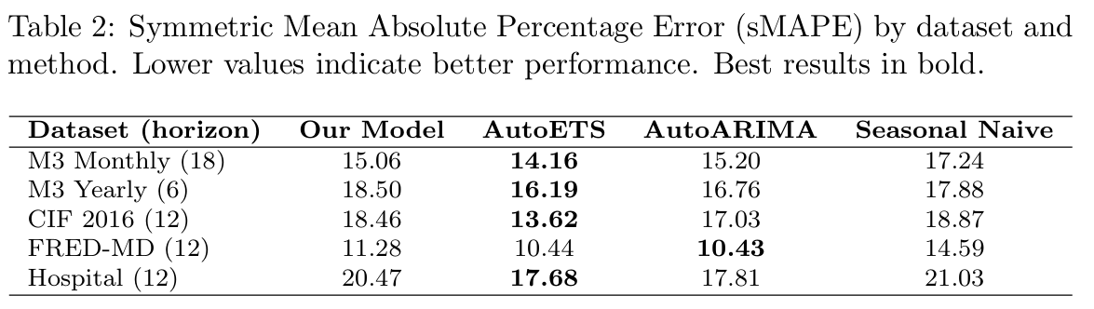
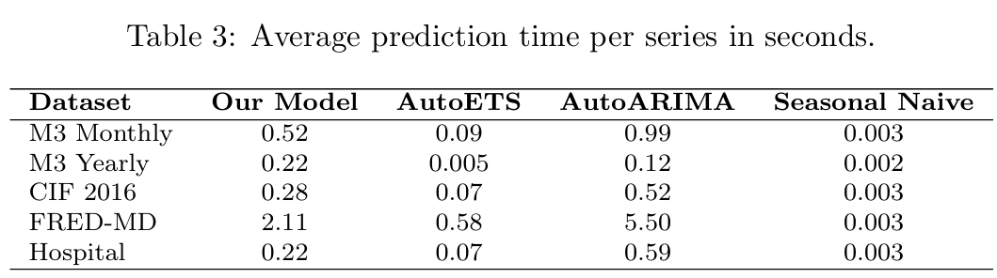
Results: Mixed Performance
M3 Monthly:
Comes Second in sMAPE, but last in MASE.
The model captures some patterns.
M3 Yearly:
Comes last in both metrics.
Flatness issue definitely plays a big role.
CIF 2016
Comes First in MASE.
Shows some capability in prediction accuracy.
Other datasets:
Better than Seasonal Naïve on sMAPE.
Performs poorly on MASE.
Prediction Speed:
Predicted within seconds, proving zero-shot is true.
Notes:
Our results show mixed performance, which is actually quite informative given the architectural issues we just discussed.
On M3 Monthly - the data source we used to condition our LGT simulations - we came second in sMAPE but last in MASE. The model captures some patterns, but doesn't consistently outperform traditional methods even on this in-domain data.
On M3 Yearly, we came last in both metrics. The flatness issue we showed earlier definitely plays a major role here.
But here's where it gets interesting: On CIF 2016, we came first in MASE. This is a completely different dataset from M3, and our model outperformed AutoETS, AutoARIMA, and Seasonal Naive. This demonstrates that LGT-generated synthetic data CAN capture meaningful forecasting patterns and generalize to new domains when conditions align.
On other datasets like FRED-MD and Hospital, we performed better than Seasonal Naive on sMAPE, but poorly on MASE, showing inconsistent performance.
Critically, prediction speed was within seconds per series across all datasets, proving that true zero-shot inference is achieved. Once trained, the model applies instantly without any fitting.
So what we have is proof of concept - the approach works in specific cases - but architectural limitations prevent consistent performance.

Slide 6
Implications and Future Directions
LGT-generated synthetic data CAN capture meaningful forecasting patterns.
Major Confound:
Cannot definitively assess "LGT as prior" due to persistent architectural issues
Flatness problem suggests ForecastPFN limitations, not just prior inadequacy
Question Remained: Is poor performance due to LGT or the architecture?
Broader Contributions:
Validity of existing PFN forecasting literature
Establishes rigorous evaluation methodology
Demonstrates feasibility of Bayesian model → synthetic data → PFN pipeline
Real-world value: Zero-shot forecasting crucial for data-scarce domains
Future Direction:
Design architectures specifically for LGT characteristics
Incorporate diverse source datasets (beyond M3 monthly)
Explore alternative priors and ensemble approaches
Notes:
Let's interpret these results. We can confidently say that LGT-generated synthetic data CAN capture meaningful forecasting patterns. Our win on CIF 2016 proves this.
However, there's a major confound in our assessment. We cannot definitively say whether LGT is an effective prior because of the persistent architectural issues. The flatness problem suggests ForecastPFN's limitations, not necessarily inadequacy of our LGT-based prior.
The key question that remains is: Is the poor performance due to LGT failing as a prior, or due to the architecture being fundamentally limited? We can't fully separate these factors.
But our work still makes important broader contributions. First, it questions the validity of existing PFN forecasting literature - if the original implementation had these problems, what does that mean for published results?
Second, we've established a rigorous evaluation methodology that future researchers can follow.
Third, we've demonstrated the complete feasibility of this pipeline: Bayesian model to synthetic data to PFN. The concept works.
And fourth, we've shown real-world value - zero-shot forecasting is crucial for data-scarce domains like new products, emerging markets, or rare events.
For future directions, we need architectures specifically designed for LGT characteristics. We should incorporate diverse source datasets beyond just M3 monthly. We could extend to probabilistic forecasts to leverage the full Bayesian distributions. And we should explore alternative priors and ensemble approaches.

Slide 7
Conclusion
PFNs offer promising paradigm for zero-shot forecasting.
LGT can generate realistic synthetic training data.
Mixed results due to architectural confounds, not concept failure.
Established foundation for rigorous PFN forecasting research.
Notes:
To conclude, I want to emphasize four key points.
First, PFNs offer a promising paradigm for zero-shot forecasting. The in-context learning approach is fundamentally sound.
Second, LGT can generate realistic synthetic training data. We've proven that Bayesian models can condition synthetic data generation on real-world patterns.
Third, our mixed results are due to architectural confounds, not concept failure. The flatness issue and implementation problems we identified prevent us from fully assessing the approach, but the successes we achieved - particularly on CIF 2016 - demonstrate feasibility.
And fourth, we've established a foundation for rigorous PFN forecasting research. By identifying and correcting critical methodological flaws, we've cleared the path for future work.
The bottom line: We've shown the approach works in principle and identified exactly what needs to be fixed for it to work consistently. This is foundational work that future researchers can build upon with confidence in the methodology.

Slide 8
Reference List
Dooley, S., Khurana, G. S., Mohapatra, C., Naidu, S., & White, C. (2023). ForecastPFN: Synthetically-Trained Zero-Shot Forecasting. ArXiv.org. https://arxiv.org/abs/2311.01933

