Slide 1
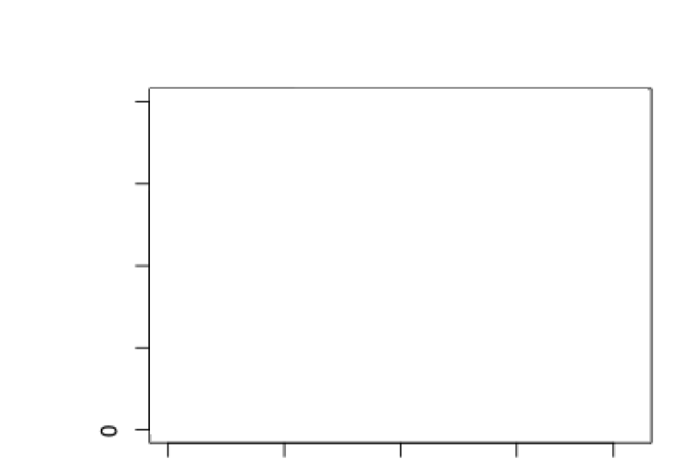
1
1
1
Identification accuracy rate
Identification accuracy rate
Identification accuracy rate
Age
Age
Age
1
1
1
Identification accuracy rate
Identification accuracy rate
Identification accuracy rate
Age
Age
Age

