Slide 1
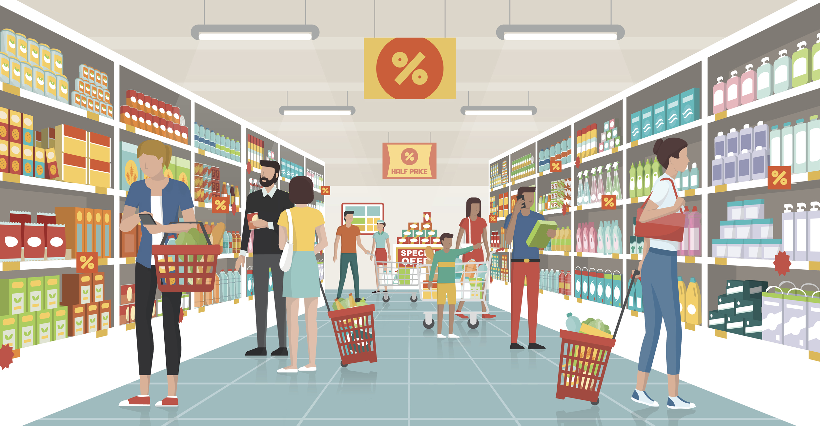

A Focus On Freschetta
Caroline Moss, Cleo Qu, Crosby Haile, Sedo Senou, Oliver Yuan

Slide 2



Our Goals
Increase Market Sales
Gain Market Share
Ensure Customer Satisfaction
Streamline Product Offerings
Notes:
Goal : increase sales, gain market share, insure customer satisfaction, streamline product offerings

Slide 3
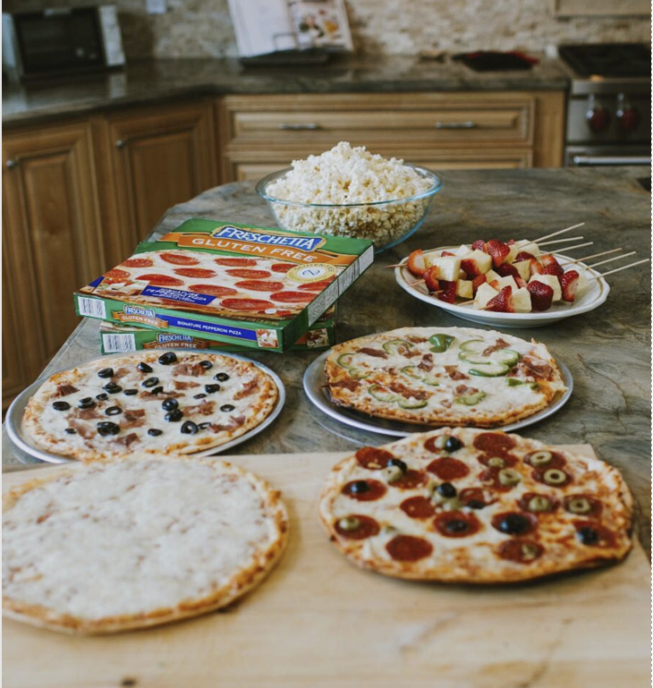
The
Freschetta
Brand
Notes:
Goal : increase sales, gain market share, insure customer satisfaction, streamline product offerings

Slide 4
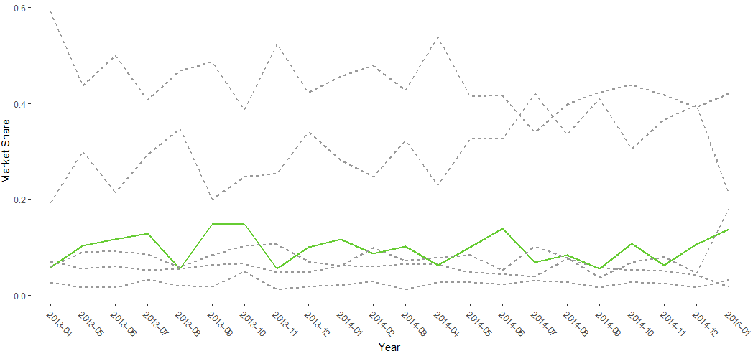
Consistent Market Share
Digiorno
Freschetta
Notes:
Goal : increase sales, gain market share, insure customer satisfaction, streamline product offerings

Slide 5
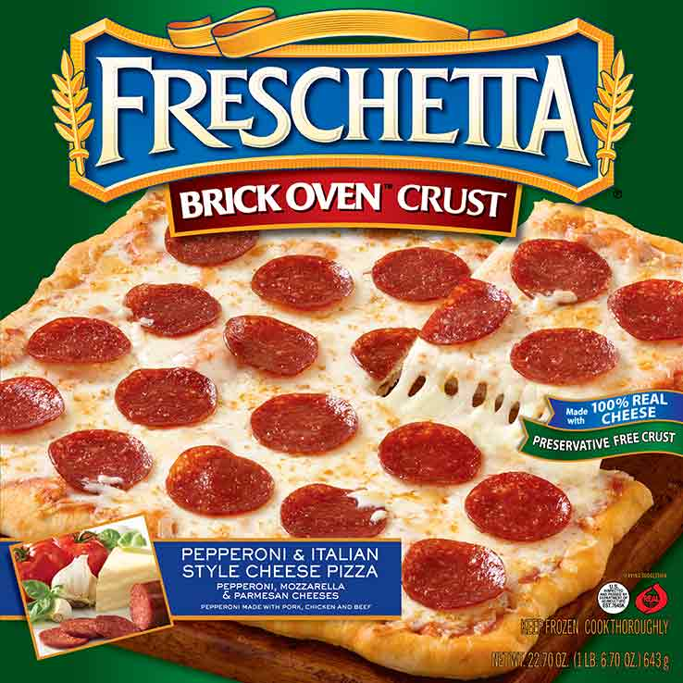
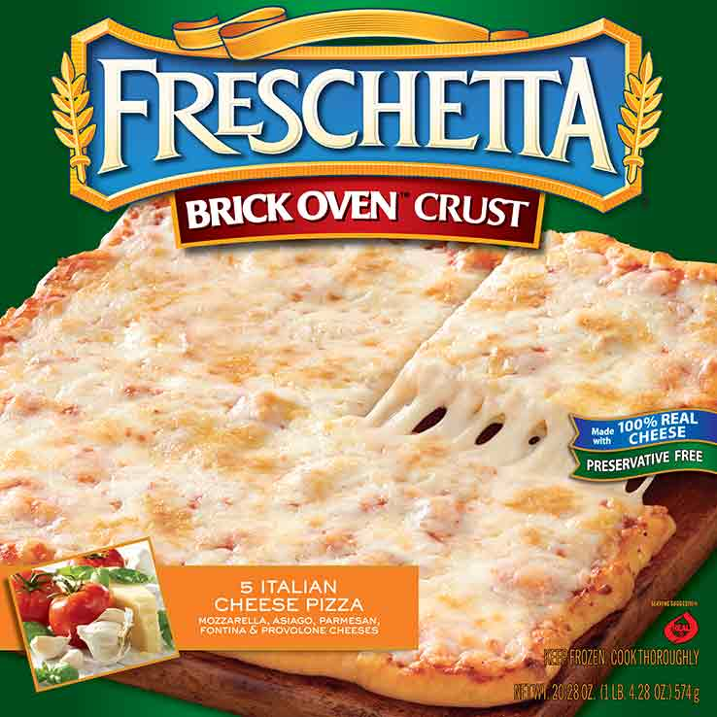
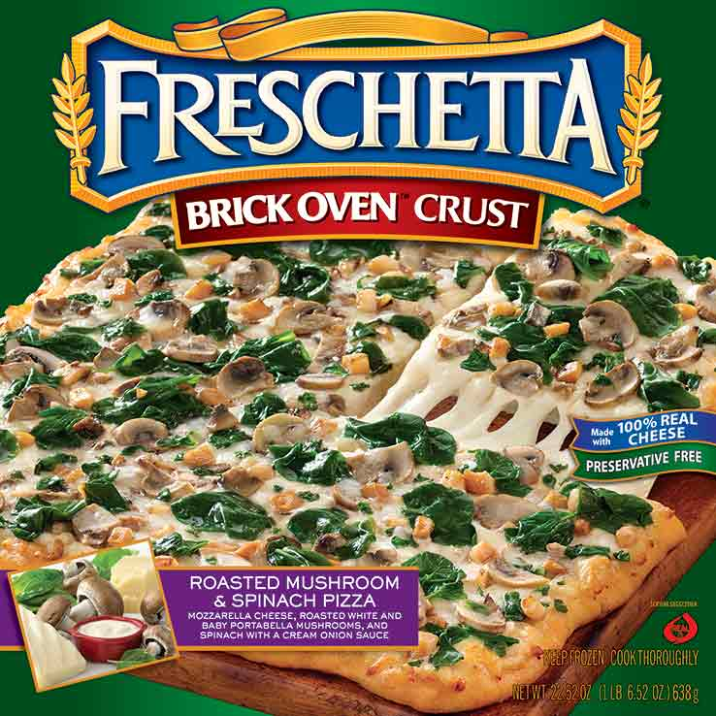
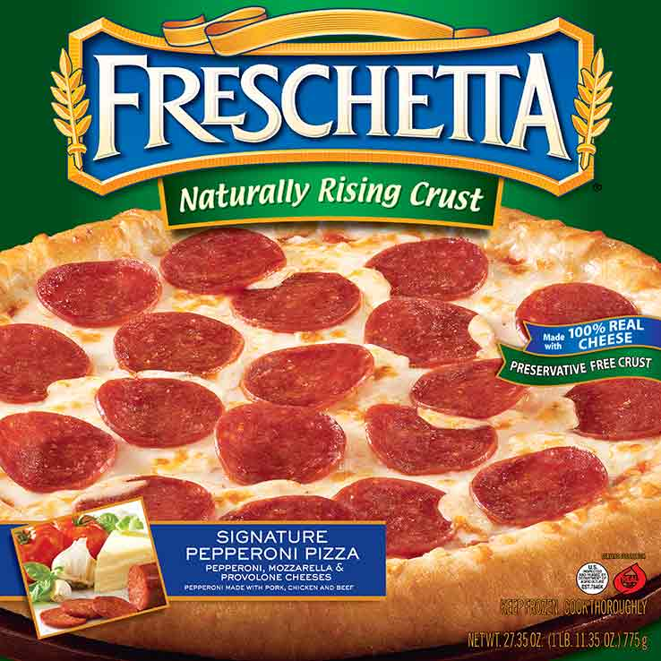
Fan Favorites
56%
Notes:
Goal : increase sales, gain market share, insure customer satisfaction, streamline product offerings

Slide 6
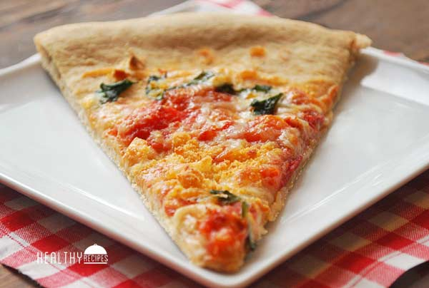
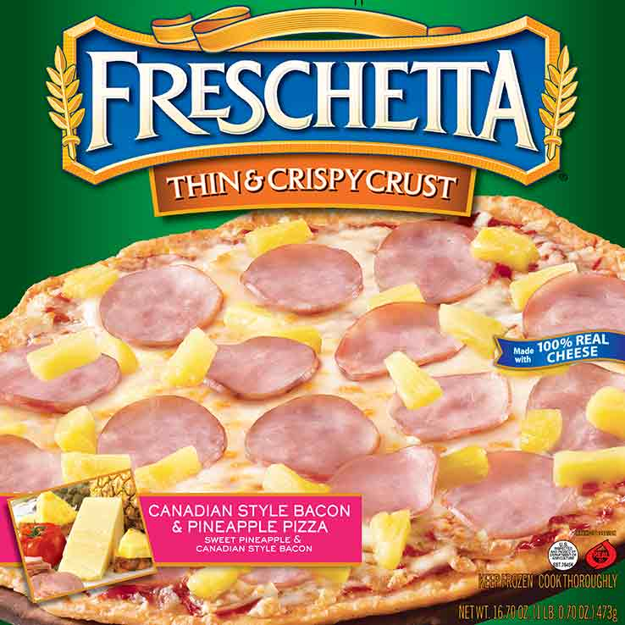
Less Desired
Notes:
Goal : increase sales, gain market share, insure customer satisfaction, streamline product offerings

Slide 7
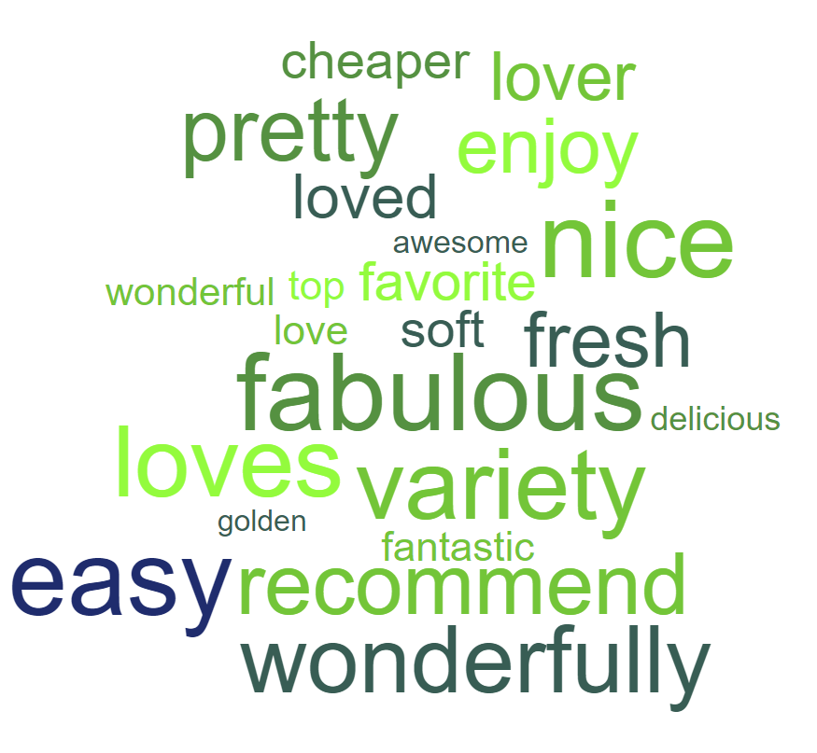

The Reviews Are In…
Notes:
Goal : increase sales, gain market share, insure customer satisfaction, streamline product offerings

Slide 8
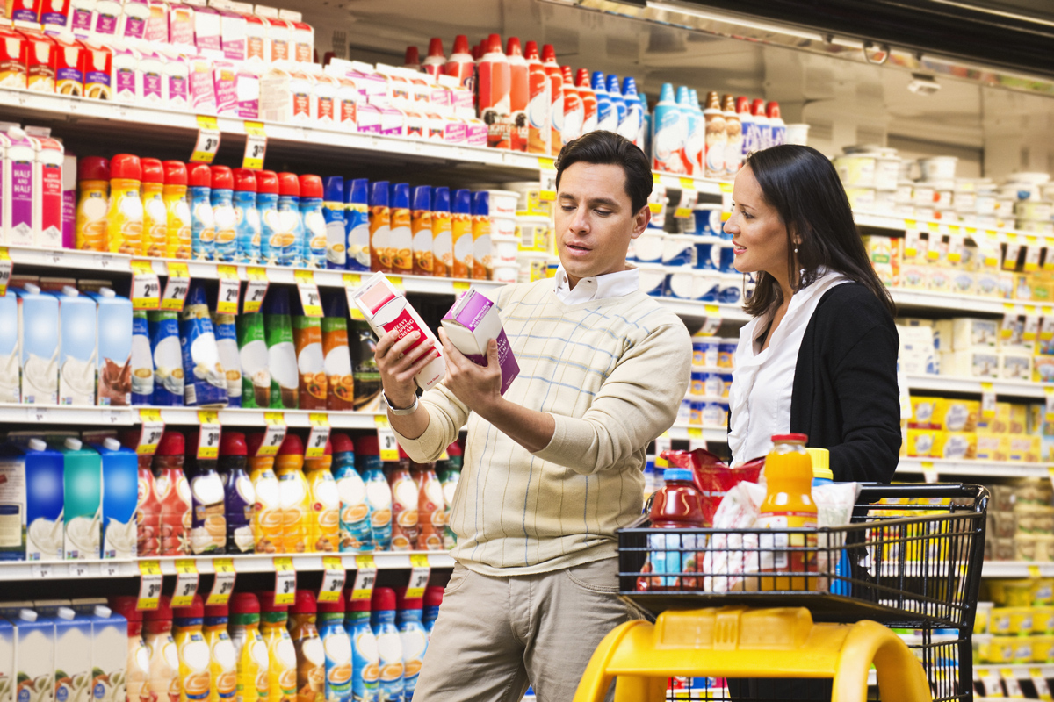
People Shopping in the Grocery Store
$80
Avg $ amount / transaction
23
Avg # of items / transaction
Price Sensitive Customers

Slide 9











What Do They Buy?
Average Consumers
Freschetta Consumers

Slide 10
What They Care About?
Favorite
Freschetta
Family
Taste
Rise Crust
Family Love
Cheese
Notes:
Goal : increase sales, gain market share, insure customer satisfaction, streamline product offerings

Slide 11
The Future of Freschetta

Slide 12
So What?
Freschetta placement near fresh foods
Link Freschetta coupons to organic goods
Offer family Freschetta pizza bundles
Re-strategize thin & crispy offerings
Notes:
Goal : increase sales, gain market share, insure customer satisfaction, streamline product offerings

Slide 13
Thanks!
Any questions?
Notes:
Goal : increase sales, gain market share, insure customer satisfaction, streamline product offerings

