Slide 1

Application-Based TCP Hijacking (ABTH)
September 29, 2009
Oliver Zheng, Jason Poon, Konstantin Beznosov
University of British Columbia
Vancouver, Canada

Slide 2
Agenda
Introduction
TCP
Attacks on TCP
Application-Based TCP Hijacking (ABTH)
Case Study: Windows Live Messenger
Demonstration of ABTH Attack

Slide 3
Transmission Control Protocol (TCP)
RFC 793
Core transport protocol for numerous applications:
SMTP, HTTP, TFTP, Bittorrent
Characteristics:
Connection-oriented
Bi-directional
Reliable

Slide 4
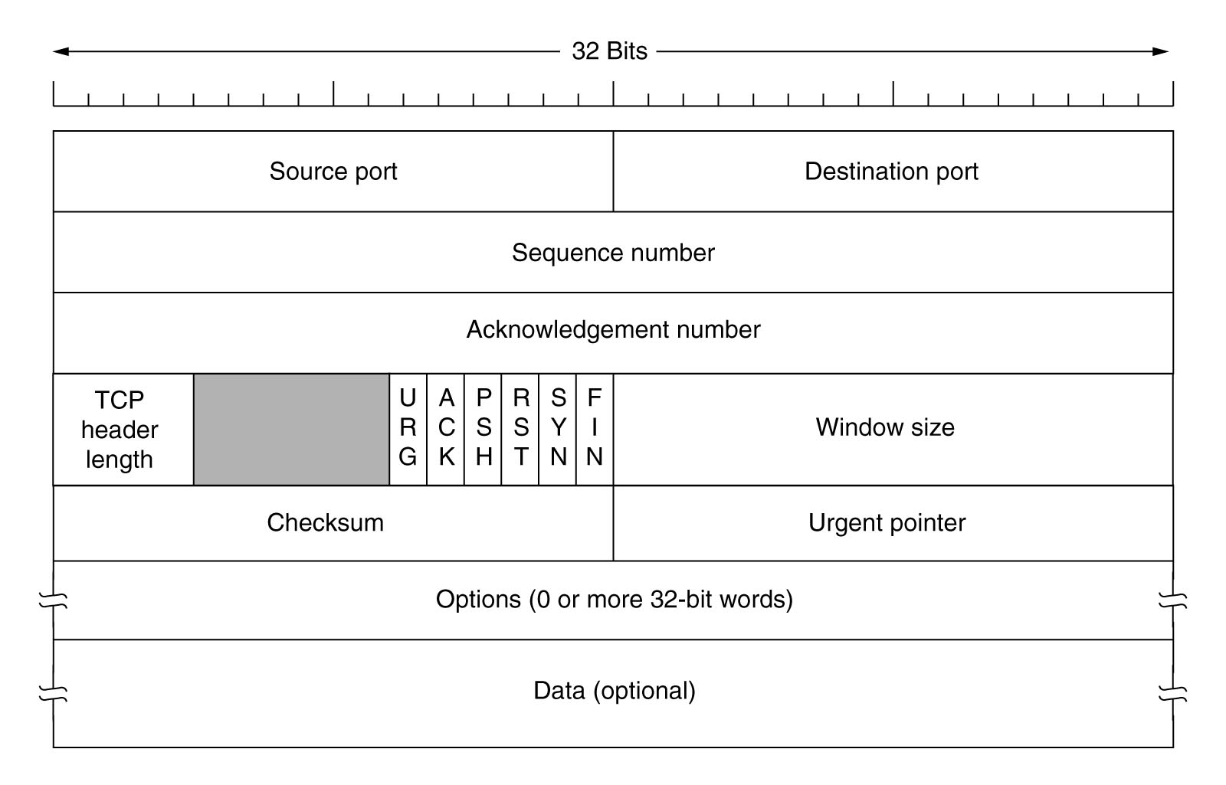
TCP Elements Critical for ABTH

Slide 5
TCP Hijacking Attack
Server
Attacker
Victim
Legitimate Packets
Spoof (30)
App Cmd (10): Seq = 0 Ack = 30
Seq = 0 Ack = 0
Seq = 10 Ack = 30
…
…

Slide 6
Limitations of TCP Hijacking
Loss of Synchronization
Each host expects different:
sequence number
acknowledgement number
Ack Storm
Each host recursively sends a TCP ack
ack contains their version of the sequence and acknowledgement numbers

Slide 7
TCP Hijacking: Timeline & Related Work

Slide 8
Application Based TCP Hijacking
Distinctions
Avoid ACK storm
Bypasses current TCP hijacking mitigation techniques
Method
Resynchronizes TCP connection following the spoofed packet
Means
Utilize application-layer commands

Slide 9
TCP Hijacking with ABTH
Bob ( Server)
Eve (Attacker)
Alice (Client)
Legitimate Packets
Spoof (30)
App Ping (10)
Response (20)
App Ping (5)
Response (10)
App Ping (10)
Equal
Response (20)
App Ping (5)
Response (10)
Legitimate Packets
Equal

Slide 10
ABTH Main Prerequisite
Application protocol provides an application level command (ping mechanism) that:
Is asynchronous
Prompts automatic response from the other host
Does not modify application state
Available to both the client and server
Size of responses must be larger than command that provoked the responses

Slide 11
Environment Fingerprinting
Behaviour of TCP when receiving packet with unexpected seq and/or ack:
Seqnum | Acknum | RFC Interpretation |  | Microsoft Windows |  | Linux
 |  | Accepted | Ack Returned | Accepted | Ack Returned | Accepted | Ack Returned
= Expected | ≤ Expected | ✔ | ✔ | ✔ | ✔ | ✔ | ✔
= Expected | > Expected | ✗ | ✔ | ✗ | ✔ | ✔ | ✔
> Expected | ≤ Expected | ✔ | ✗ | ✔ | ✗ | ✔ | ✗
> Expected | > Expected | ✗ | ✔ | ✗ | ✗ | ✗ | ✔
Seqnum | Acknum | RFC Interpretation |  | Microsoft Windows |  | Linux
 |  | Accepted | Ack Returned | Accepted | Ack Returned | Accepted | Ack Returned
= Expected | ≤ Expected | ✔ | ✔ | ✔ | ✔ | ✔ | ✔
= Expected | > Expected | ✗ | ✔ | ✗ | ✔ | ✔ | ✔
> Expected | ≤ Expected | ✔ | ✗ | ✔ | ✗ | ✔ | ✗
> Expected | > Expected | ✗ | ✔ | ✗ | ✗ | ✗ | ✔
Seqnum | Acknum | RFC Interpretation |  | Microsoft Windows |  | Linux
 |  | Accepted | Ack Returned | Accepted | Ack Returned | Accepted | Ack Returned
= Expected | ≤ Expected | ✔ | ✔ | ✔ | ✔ | ✔ | ✔
= Expected | > Expected | ✗ | ✔ | ✗ | ✔ | ✔ | ✔
> Expected | ≤ Expected | ✔ | ✗ | ✔ | ✗ | ✔ | ✗
> Expected | > Expected | ✗ | ✔ | ✗ | ✗ | ✗ | ✔

Slide 12

Windows Live Messenger
What is WLM?
Windows Live Messenger (WLM)
Instant messaging client
What is MSNP?
Microsoft Notification Protocol (MSNP)
Defines communication between WLM and .NET Messaging Service
Source: http://microsoft.com/

Slide 13

How does WLM work?
WLM Client
Control
Presence Updates
Notifications of Pending Instant Messages
Content
Instant Messages
File Transfers
Control Packets
Content Packets
.NET Messenger Service
Notification Server
Mixer
Server

Slide 14
How does WLM work?
1. Requests IM Session
Alice
6. Informs client that “Bob” has connected to the Mixer
Instant Messages
2. Address of Mixer
3. Request IM Session w/ Bob
Notification Server
Mixer
Server
4. Instructs Bob of pending IM session
Instant Messages
5. Joins the session
Bob

Slide 15

Identity Spoofing
Eve
Address of Rogue Mixer Server
RNG [ip]:[port] [email] [name]
Notification Server
Rogue Mixer
Server
Instant Messages
Opens new
TCP connection
Bob

Slide 16
Identity Spoofing
Eve (Attacker)
Bob
(Victim)
Notification Server
(1) NS Ack = Client Seq
5x = 60y
x = 12y
(2) NS Seq = Client Ack
8x = 36y + 120
8(12y) = 36y + 120
y = 2
x = 24
Legitimate Packets
RNG(120)
PNG (5)
Repeat x times
QNG (8)
CHL (28)
Repeat y times
QRY (60)
QRY (8)
Legitimate Packets

Slide 17
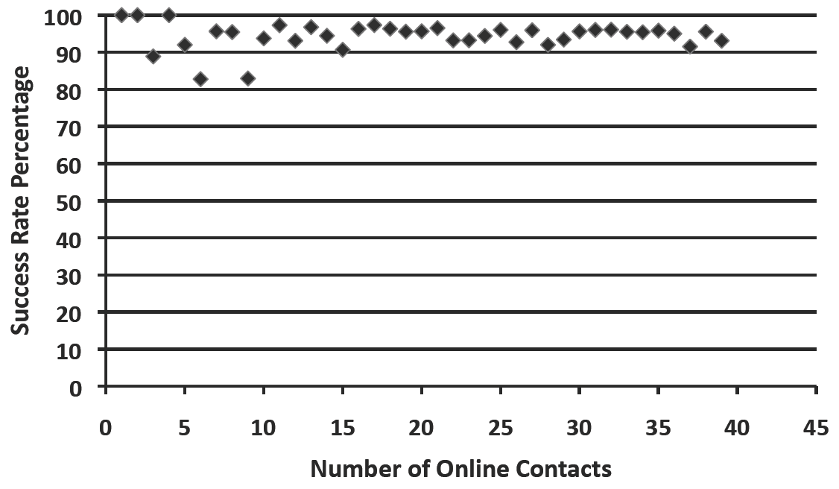
Feasibility of Attack
Best if no traffic occurs between two hosts until ABTH completes
For MSNP, ABTH completes within 2 seconds

Slide 18
Countermeasures
Encrypt application traffic (e.g., SSL/TLS)
Include sequence numbers in application messages
Ensure application protocol does not allow for asynchronous pinging mechanism to server and client

Slide 19
Summary of Contributions
Introduced Application-based TCP Hijacking
New method of attacking a TCP connection
Utilizes application-level commands to resynchronize TCP connection following TCP hijacking attack
Developed proof of concept for WLM
Discovered new differences in Windows vs. Linux TCP stack implementations
Can be utilized for remote OS fingerprinting

Slide 20
Oliver Zheng [abth@oliverzheng.com]
Jason Poon [jasazn@interchange.ubc.ca]
Konstantin (Kosta) Beznosov [beznosov@ece.ubc.ca]

