Slide 1

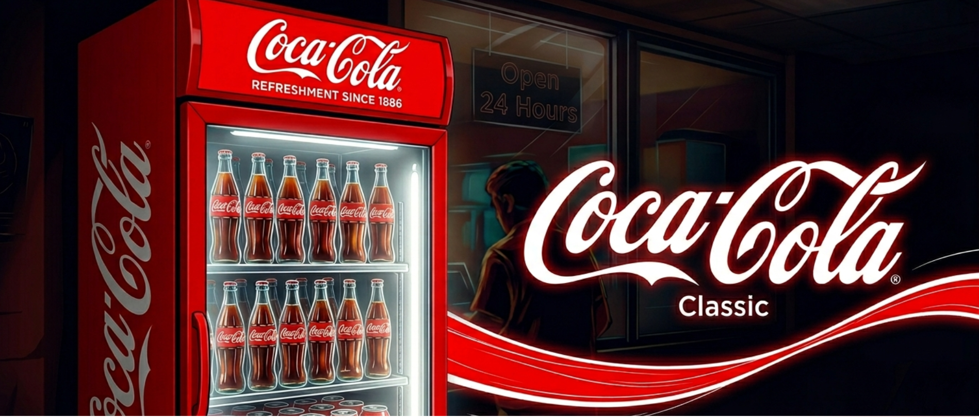
Smart Refrigeration
Monitoring System
COCA-COLA
IoT DIVISION
IoT-Based Dashboard for Real-Time Coca-Cola Refrigeration Intelligence
Powered By OLIVE TS by FFC

Slide 2
PROBLEM STATEMENT
Why traditional refrigeration management falls short
No Real-Time Visibility
Delayed Fault Detection
Field teams lack live status updates on refrigerator health and performance across locations.
Faults go undetected for hours or days without automated monitoring, increasing repair costs.
Temperature Fluctuations
Manual & Error-Prone
Manual checks miss critical temperature spikes, leading to significant product spoilage and loss.
Paper-based reporting is slow, inconsistent, and impossible to scale across hundreds of units.
Coca-Cola Smart Refrigeration · Confidential 2025

Slide 3
01
Real-Time Monitoring
OUR
Track all refrigeration units live — temperature, humidity, and power status across all cities.
OBJECTIVES
02
Centralized Dashboard
Building smarter refrigeration
for Coca-Cola's future
One smart interface visualizing all data with zone-wise filters for CBU and SBU operations.
03
Instant Fault Alerts
Automated critical and warning alerts dispatched the moment anomalies are detected.
04
Energy & Analytics
Track energy consumption per unit and generate actionable insights to cut operational costs.

Slide 4
PROPOSED SOLUTION
End-to-end IoT pipeline from sensor to insight
01
02
03
04
IoT Sensors
▶
Backend Engine
▶
Database
▶
Smart Dashboard
Temperature, humidity & voltage sensors deployed on every refrigerator unit.
Node.js backend processes, validates, and stores incoming sensor data streams.
Structured storage with historical logs enabling trend analysis and reporting.
React-powered web dashboard with live charts, alerts, and zone-based views.
Coca-Cola Smart Refrigeration · Confidential 2025

Slide 5
SYSTEM ARCHITECTURE
Continuous real-time data flow from edge to insight
SENSORS
BACKEND
DATABASE
DASHBOARD
Temp · Humidity · Voltage
Processing · Validation
Cloud · Historical Logs
React · Charts · Alerts
500+ fridge units
REST API
Cloud storage
Live charts
▶
▶
▶
6 sensor types
Real-time push
30-day history
Alert panel
1-min intervals
Data validation
Backup & sync
Zone filters
Cloud-Based · Scalable · Real-Time

Slide 6
KEY FEATURES
Six pillars powering the Smart Refrigeration Platform
Zone-Based Monitoring
Real-Time Alerts
Device Tracking
CBU & SBU units tracked independently with city-level drill-down for focused operations.
Critical and warning notifications triggered instantly via automated alert engine.
Online/offline status with live sensor sync and device-level performance visibility.
Energy Monitoring
Smart Analytics
Fault Prevention
Per-unit energy usage tracked to identify wastage and reduce operational costs.
Historical trends, performance charts, and KPI dashboards for data-driven decisions.
Predictive signals and early anomaly detection to stop failures before they escalate.
Coca-Cola Smart Refrigeration · Confidential 2025

Slide 7
DASHBOARD OVERVIEW
Unified command center for all refrigeration operations
500
462
38
3.2K
Total Fridges
Working
Faulty
Energy Today
units
operational
need attention
kWh consumed
4.2°C
Within safe range
Avg Temp
68%
Acceptable level
Avg Humidity
92.4%
Last 30 days
Uptime
Coca-Cola Smart Refrigeration · Confidential 2025

Slide 8
ZONES MODULE
Geographic segmentation for precision refrigeration management
CBU
Carbonated Business Unit
SBU
Still Business Unit
Total Fridges
280
Total Fridges
220
Working Units
265
Working Units
197
Faulty Units
15
Faulty Units
23
CITIES COVERED
CITIES COVERED
Lahore
Karachi
Islamabad
Hyderabad
Faisalabad
Quetta
Coca-Cola Smart Refrigeration · Confidential 2025

Slide 9
ALERTS SYSTEM
Automated multi-tier alerting for zero blind spots
ALERT BREAKDOWN
High Temperature
4
Power OFF
2
Compressor Failure
2
Door Open
3
Low Voltage
2
High Humidity
2
Coca-Cola Smart Refrigeration · Confidential 2025

Slide 10
DEVICE MONITORING
Live device health tracking with full sensor synchronization
Online/Offline Status
Know exactly which units are live vs disconnected in real time.
Sensor Tracking
Temp, humidity, voltage, and compressor sensors monitored per device.
Live Device Status
Health scores and diagnostic flags surfaced on the device panel.
Data Synchronization
Auto-sync every 60 seconds with conflict resolution for edge cases.
Coca-Cola Smart Refrigeration · Confidential 2025

Slide 11
TECHNOLOGIES USED
Modern stack built for scale, speed, and reliability
React.js
Tailwind CSS
IoT Sensors
FRONTEND FRAMEWORK
UI STYLING
DATA COLLECTION
Component-based UI for the live dashboard with Recharts integration.
Utility-first CSS framework delivering fast, consistent design across views.
Edge sensors capturing temperature, humidity, voltage data per fridge.
Node.js
Data Charts
Cloud Database
BACKEND API
VISUALIZATION
DATA STORAGE
REST API server handling real-time data ingestion and alert dispatch.
Recharts and Chart.js powering bar, pie, and line graphs on the dashboard.
Scalable cloud database storing sensor logs, alerts, and device records.
Coca-Cola Smart Refrigeration · Confidential 2025

Slide 12
RESULTS & BENEFITS
Measurable impact across Coca-Cola refrigeration operations
40%
25%
30%
92%
Faster Fault Detection
Reduction in Product Loss
Better Energy Management
Fleet Uptime Achieved
Automated alerts cut response time from hours to minutes.
Real-time temp monitoring prevents spoilage before it occurs.
Per-unit tracking identifies wasteful units for optimization.
Continuous monitoring keeps the majority of units operational.
Coca-Cola Smart Refrigeration · Confidential 2025

Slide 13
FUTURE ENHANCEMENTS
The roadmap ahead — building tomorrow's refrigeration intelligence
Q1 2026
Q2 2026
Q3 2026
Q4 2026
1
2
3
4
AI-Based Predictions
Mobile Application
Advanced Analytics
Map-Based Tracking
Machine learning models to predict faults 24 hrs before they occur, enabling preventive maintenance.
Cross-platform iOS/Android app giving field teams live access to all dashboard data on the go.
Deep-dive reports with custom KPIs, benchmarking, and automated executive summaries.
Geo-mapped view of all refrigerator locations with live status overlays and routing for technicians.
Coca-Cola Smart Refrigeration · Confidential 2025

Slide 14
COCA-COLA
CONCLUSION
SMART
1
Real-time visibility across 500+ Coca-Cola refrigeration units deployed nationwide.
REFRIGER-
2
Automated alert engine catching critical faults within seconds — not hours.
ATION
Monitoring System
3
Energy and performance analytics driving data-led operational decisions.
4
A scalable foundation ready for AI predictions and mobile expansion in 2026.
Thank You

