Slide 1
Flight Delay Prediction Project
Using Machine Learning to Predict Flight Delays Based on Weather and Flight Data
OLIVE FLORE YATIO NJIKE
2024-09-29

Slide 2
INTRODUCTION
Objective
Predict flight delays using a combination of flight and weather data.
Techniques
Machine learning models including SVM, KNN, and Logistic Regression.
Using a stacking method for improved accuracy

Slide 3
DATASET OVERVIEW
Flight Data
Collected from the OpenSky API.
Features: Departure and arrival airports, aircraft identifiers, timestamps.
Weather Data
Collected from the Visual Crossing API
Features: Temperature, humidity, and weather conditions like rain, snow, etc.

Slide 4
FEATURES USED
Flight-Related Features
Aircraft ICAO24 identifier.
Departure and arrival airports.
Flight duration (calculated from timestamps).
Weather-Related Features
Maximum and minimum temperatures at departure and arrival.
Humidity levels.
Weather conditions at both departure and arrival.

Slide 5
PREPROCESSING AND FEATURE ENGINEERING
Handling Missing Data: Imputation using mean values.
Encoding Categorical Data: Label encoding for weather conditions and other categorical columns.
Normalization: Applied StandardScaler for better performance with models like SVM and KNN.

Slide 6
MODEL SELCTION
ENSEMBLE LEARNING APPROACH
SVM: Accuracy of 98.88%.
KNN: Accuracy of 99.00%.
SVM OPTIMIZE: Achieved an accuracy of 99.93%.
LOGISTIC REGRESSION : Accuracy of 99.93%.
STACKING MODEL: Combined these models using a stacking ensemble for an overall accuracy of 99.94%

Slide 7
FINAL STACKING MODEL
WHY STACKING
It combines the strengths of each model to handle different aspects of the data.
Even though the individual models performed well, stacking model has the highest score.

Slide 8
MODEL EVALUATION
Metrics
Accuracy scores for each model.
Classification reports.
Key Observations
STACKING MODEL achieving the highest accuracy.

Slide 9
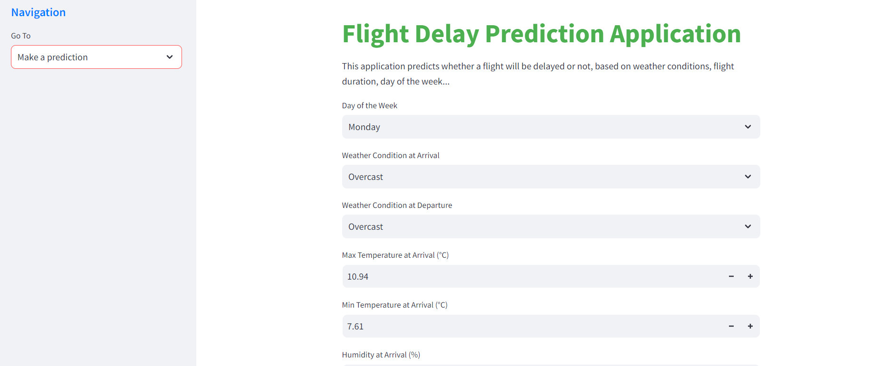
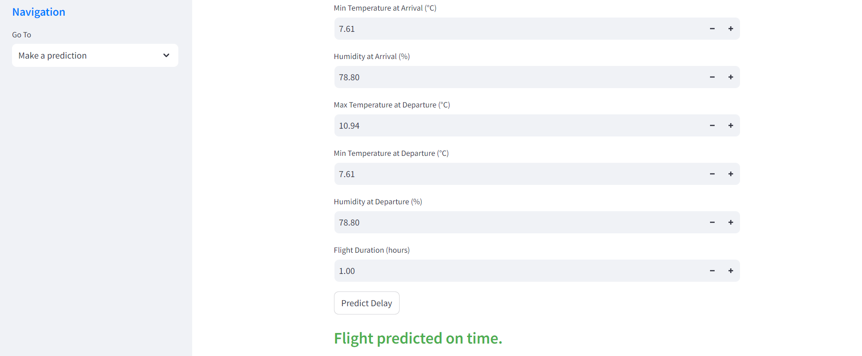
MY APPLICATION

Slide 10
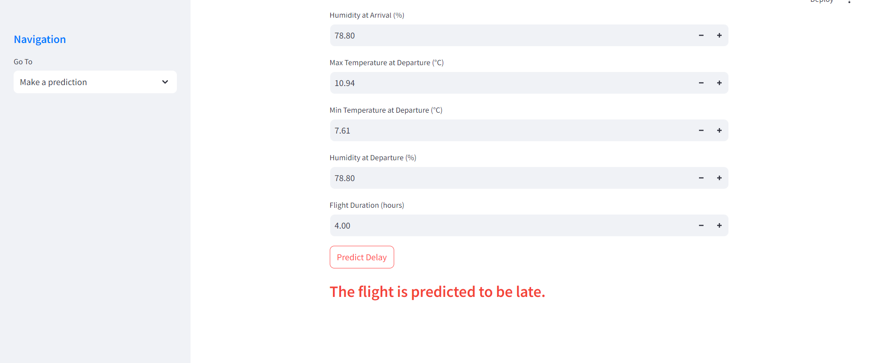
MY APPLICATION

Slide 11
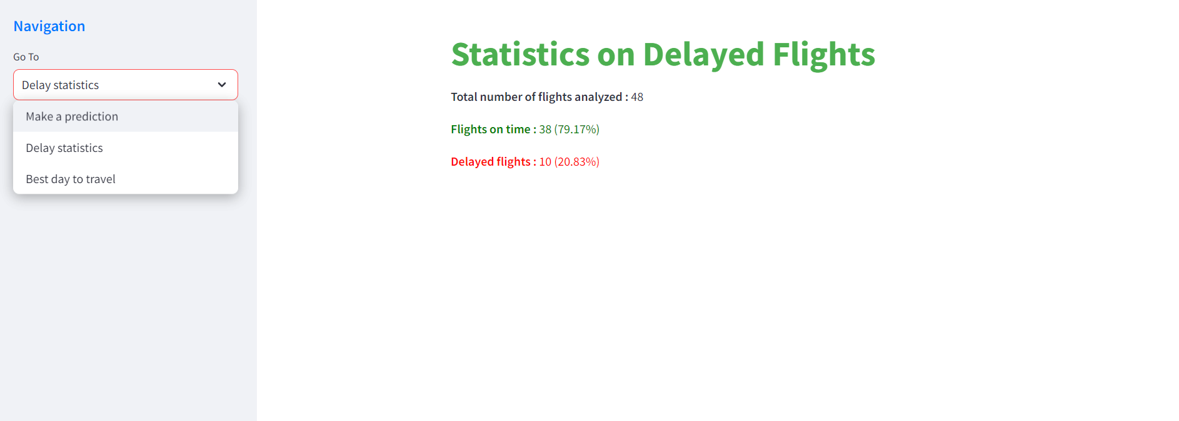
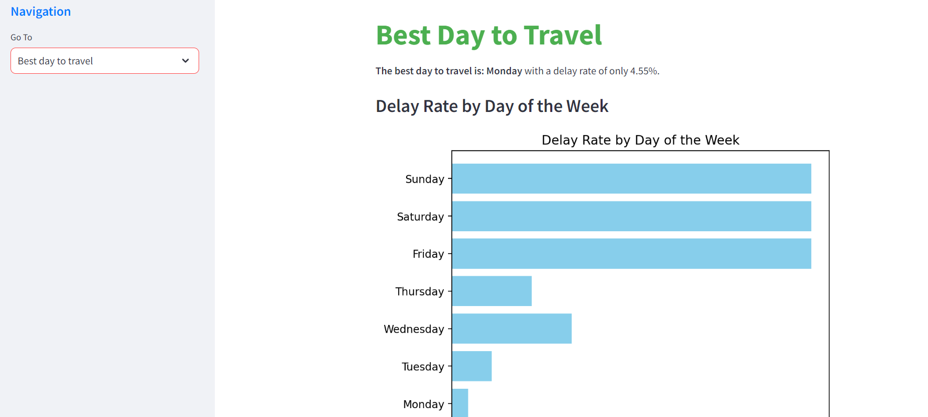
MY APPLICATION

Slide 12
CONCLUSION
Summary
The project successfully predicted flight delays using weather and flight data. Machine learning models performed exceptionally well, with high accuracy levels.
Future work
Could explore more advanced ensemble techniques like Boosting and Bagging, add additional weather features, or include live data predictions.

Slide 13
THANK YOU FOR YOUR KIND ATTENTION

