Slide 1
Cellphone Pricing Prediction
Client - Craigslist
Team Unstructured
Cheng-Yu Chen
Ting-Yun Cheng
Yu-Lin Tai
Pin-Jui Lin
Yi- Chen Chiou
December 07 2021

Slide 2
Agenda
Data Analysis
Process Overview
Data Collection
Data Preprocessing
Validation
Business Problem
Business Analysis
Conclusion Remarks
01
03
02
04

Slide 3
1.
Business Problem

Slide 4
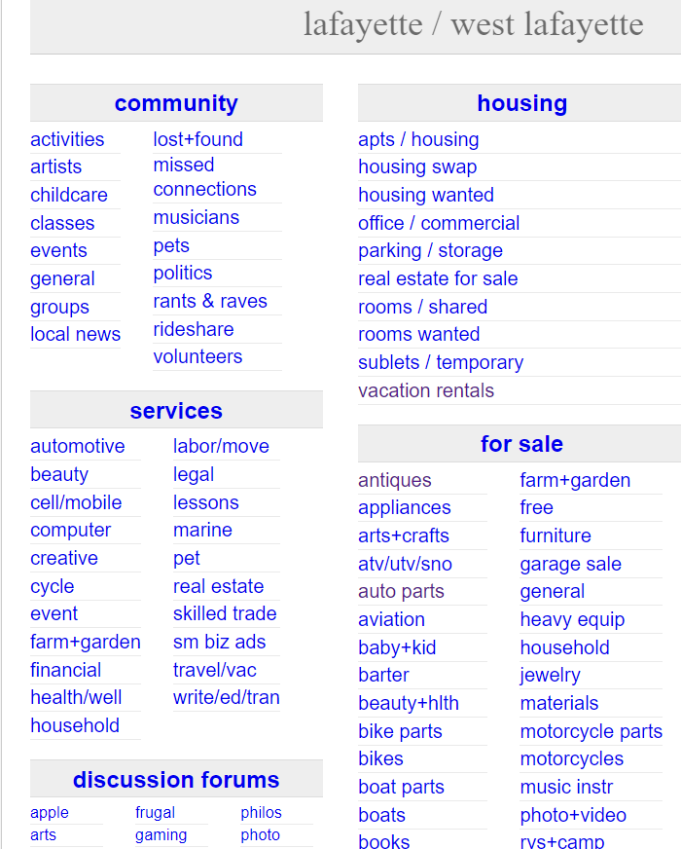
Business Background
Craigslist :
An American classified advertisements website that allows users to hold conversations or sell their items. Craigslist provide many different sections that allow people to search for jobs, housing, and etc.
People can sell or purchase items on Craigslist, and hiring managers can find candidates here.

Slide 5
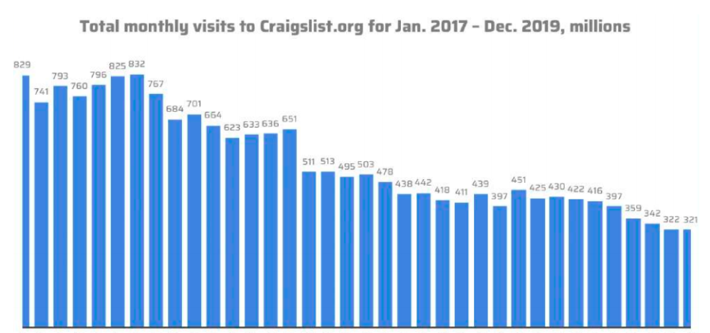
Business Problem
Craigslist was the king of classifieds, but the shine is off its crown.
The decline stems from several factors, such as increasing competition and the Covid-19 pandemic. However, the decline started serveral years ago.

Slide 6
Business Problem (continued)
External factors:
Increasing Competitions: more and more companies enter this field, such as Facebook and AirBnB.
Covid-19 Pandemic: As the pandemic ravaged the world, people were locked at home and the golbal economy shrinked
Internal factors:
Unfriendly User experience: As people can pose whatever they want, the contents are usually unstructured, making people spend more time finding the information or product they want.
Notes:
XProduct Quality: Many products sold on Craigslist are second-handed, so their quality are not as stable as new ones. Customers would spend more time comparing several similar products.

Slide 7
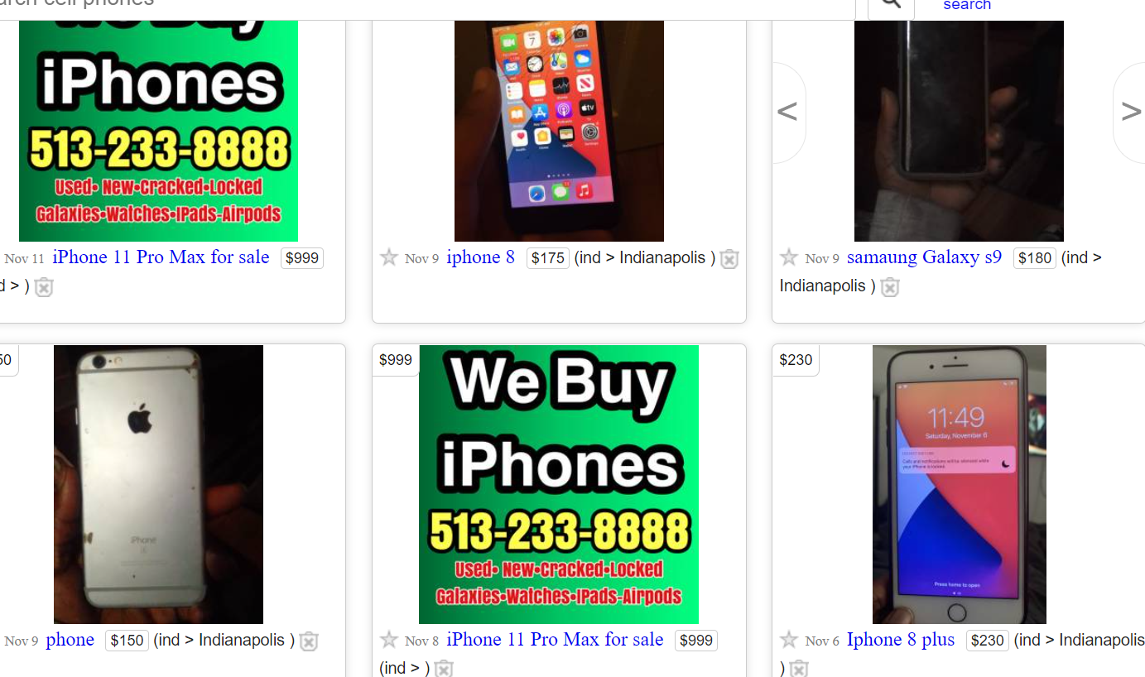
Business Problem (continued)

Slide 8
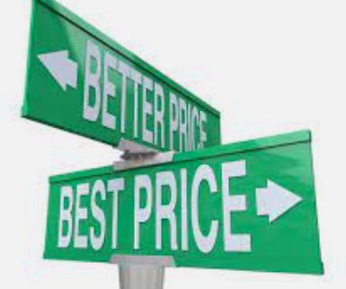
Problem Improvement
An advanced tool that can predict the price of a new product. When customers are considering purchasing a product, a suggested price will be shown, which is based the titles and descriptions of similar products. Customers can use this price to improve their decision-making process.
This feature will also make sellers more careful when writing the description of a product, refining user experience and increasing customer engagement

Slide 9
3.
Data Analysis

Slide 10
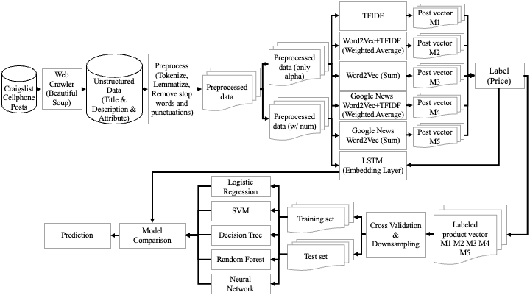
Data Analysis- Process Overview

Slide 11
Data Analysis-Data Collection

Slide 12
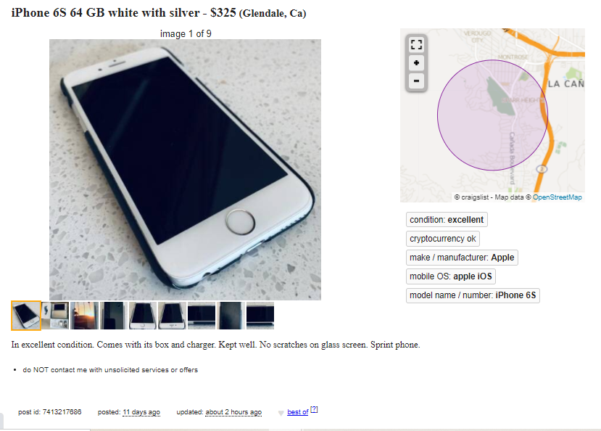
Data Analysis-Data Collection
Title
Price
Attributes
Description
Post ID
Notes:
使用套件
避免被block的方式

Slide 13

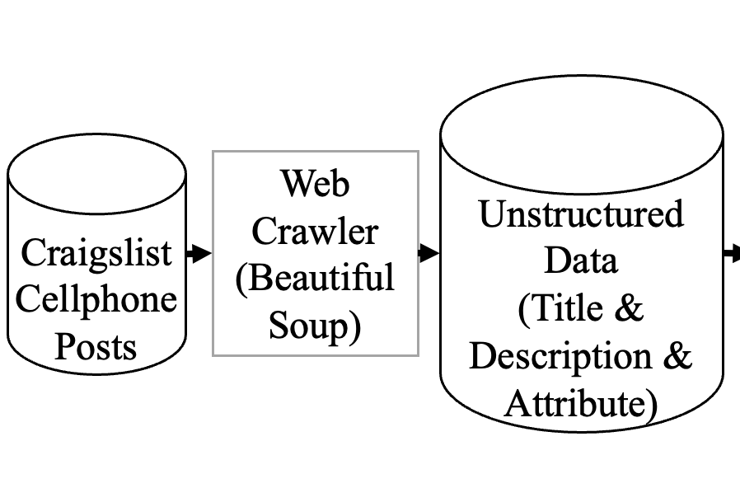


Data Analysis-Data Collection
increase sleeping time
time.sleep(20,25)
add a list of user agents
Mozilla/5.0 (X11; CrOS x86_64 8172.45.0) AppleWebKit/537.36 (KHTML, like Gecko) Chrome/51.0.2704.64 Safari/537.36
Notes:
使用套件
避免被block的方式

Slide 14
Data Analysis-Data Preprocessing

Slide 15
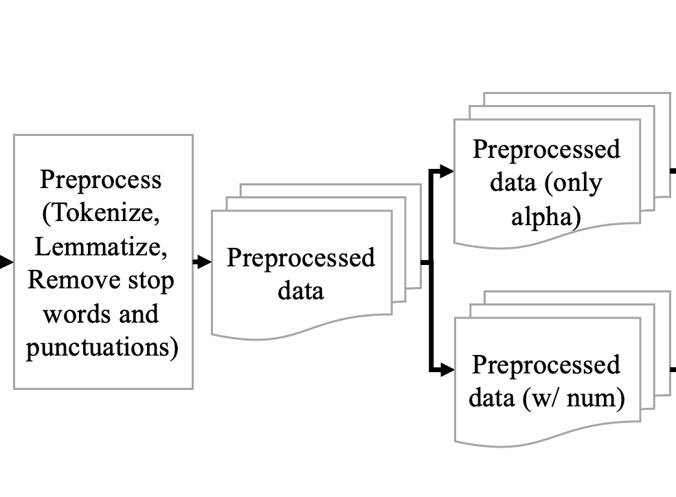
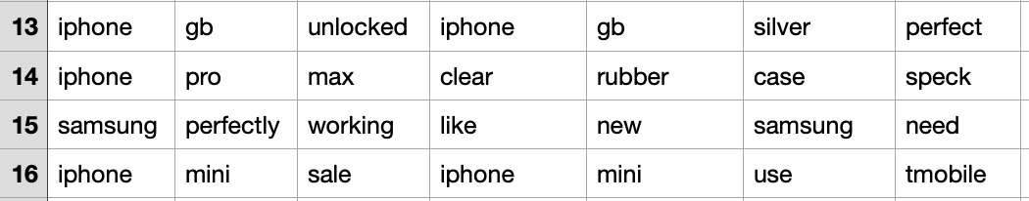
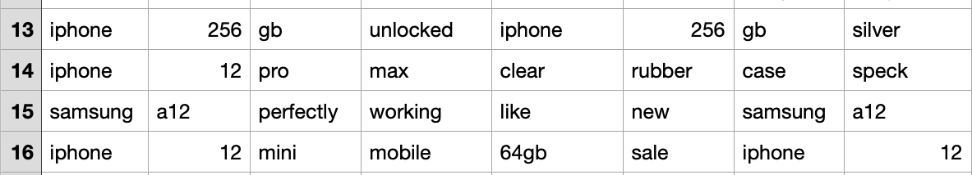
Data Analysis-Data Preprocessing
…
.
…
.
.

Slide 16
Data Analysis-Text Representations

Slide 17
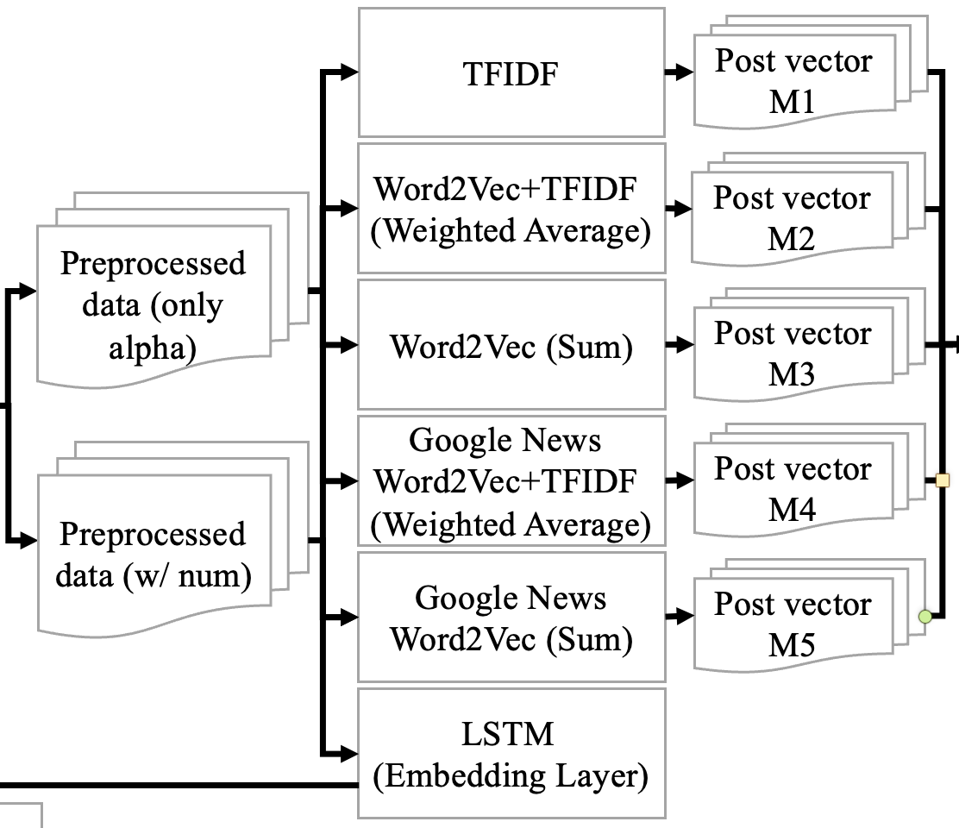
Data Analysis-Text Representations
1
TFIDF
2
Selftrained Word2Vec Weight Avg
Use TFIDF as weight to do weight average on Craigslists data selftrained Word2Vec vector
3
Selftrained Word2Vec Sum
Add selftrained Word2Vec vector up in a post

Slide 18
Data Analysis-Text Representations
4
Pretrained Google News Word2Vec Weight Avg
Use TFIDF as weight to do weight average on pretrained Word2Vec vector in a post
5
Pretrained Google News Word2Vec Sum
Add pretrained Word2Vec vector up in a post
6
LSTM
LSTM including embedding layer

Slide 19
Data Analysis-Text Labeling

Slide 20
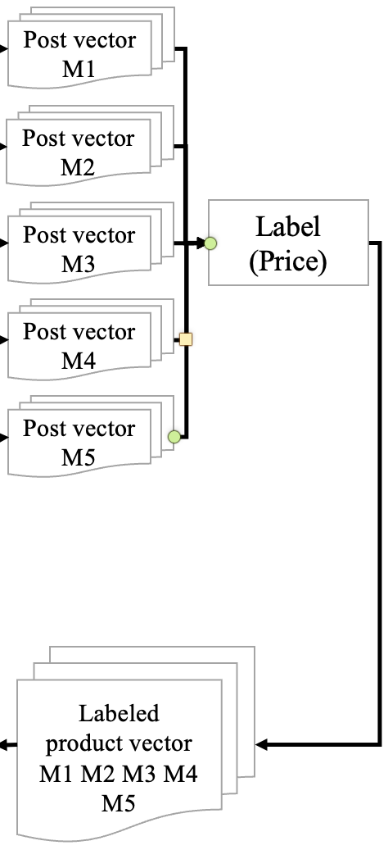
Data Analysis-Text Labeling
Price (target variable) is labled in intervals:
0-50->”0”
51-100->”1”
101-150->”2”
…

Slide 21
Data Analysis-Cross Validation

Slide 22
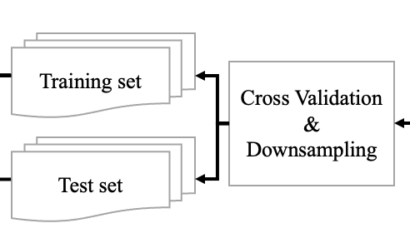
Data Analysis-Cross Validation
Random Split
We use train_test_split() function to random split our training and testing data to 90% and 10%
Down Sampling
To avoid highly right skewed problem in our label

Slide 23
Data Analysis-Classification Model

Slide 24
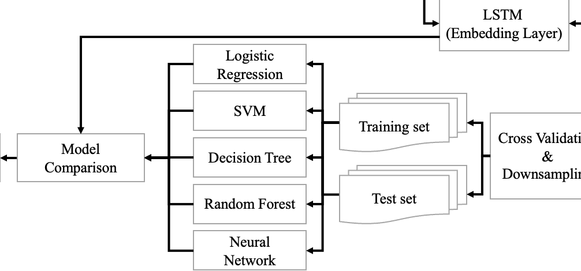
Data Analysis-Classification Model
6 Models
Logistic Regression, SVM, Decision Tree, Random Forest, Neural Network, LSTM.

Slide 25

Data Analysis-Validation
Model Comparison: Accuracy
Low : High
 |  | Logistic Regression | Decision Tree | Random Forest | SVM | Neural Network
w/ num | TFIDF | 37.62% | 37.62% | 20.79% | 44.55% | 14.85%
 | Weighted Avg | 43.56% | 36.63% | 26.73% | 43.56% | 35.64%
 | sum | 42.57% | 37.62% | 27.72% | 47.52% | 14.85%
 | pretrained_sum | 38.61% | 33.66% | 30.69% | 31.68% | 14.85%
 | pretrained_weighted_avg | 33.66% | 33.66% | 20.79% | 38.61% | 14.85%
only alpha | TFIDF | 35.64% | 35.64% | 25.74% | 43.56% | 32.67%
 | Weighted Avg | 36.63% | 32.67% | 25.74% | 36.63% | 25.74%
 | sum | 36.63% | 34.65% | 26.73% | 29.70% | 21.78%
 | pretrained_sum | 36.63% | 30.69% | 28.71% | 39.60% | 26.73%
 | Pretrained_Weighted Avg | 34.65% | 31.68% | 26.73% | 36.63% | 14.85%
“sum” represents that we sum up every vector value ( no other calculation)
Notes:
the sum of self-train word2vec vector has better performance in SVM model.
So we will use this combination as our prediction model

Slide 26
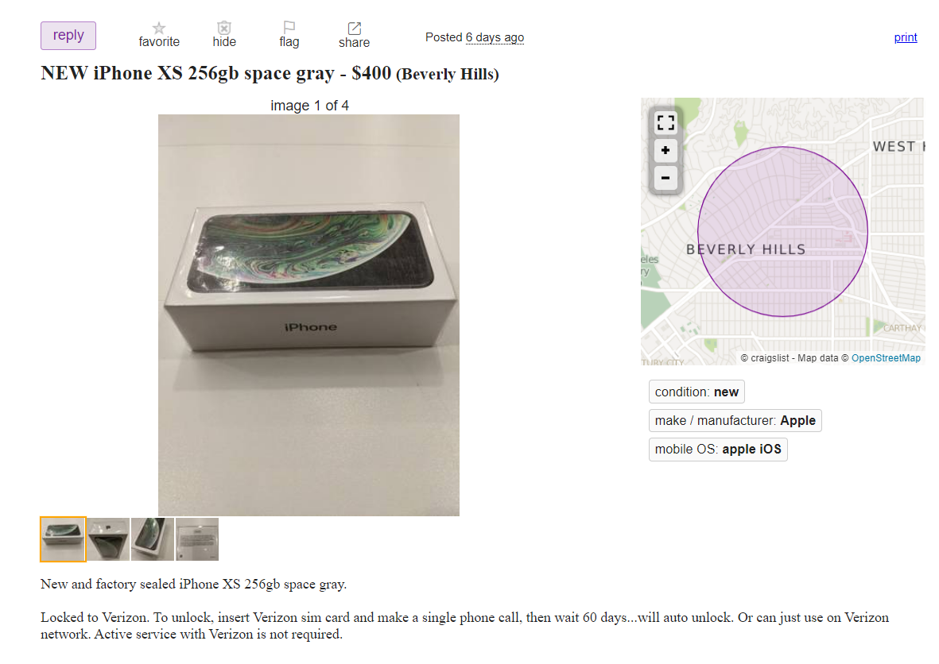

Prediction Demo
Suggested Price: $300-$350

Slide 27
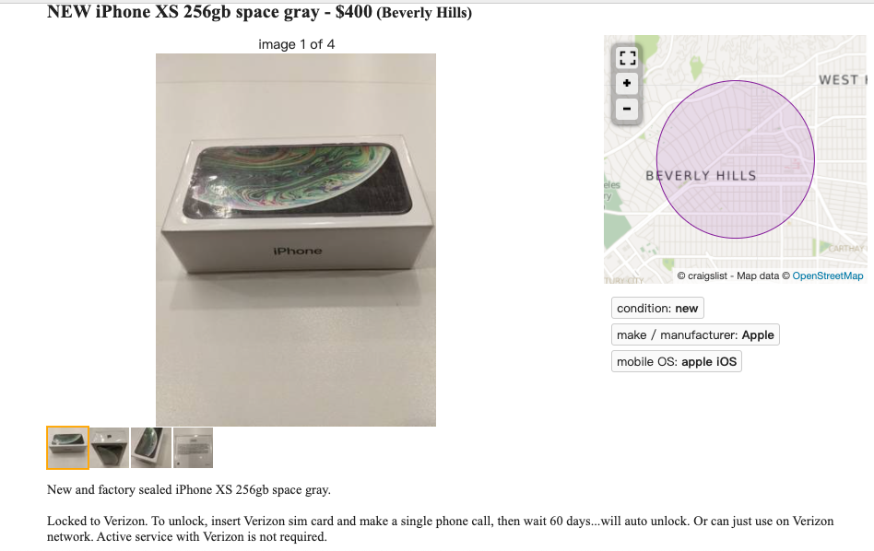

Prediction Demo
Model Result
Label 6
Price intervel: $300-$350
Initial Post ($400) OverPriced
Notes:
use this
get label 6
mean interval

Slide 28
4.
Conclusion Remarks

Slide 29
Further Improvements
Work more on preprocessing
Model Tuning
More data collected

Slide 30
Findings
Cellphone model number highly relates to price (e.g iPhone 10, iPhone 6)
Google news pre-trained words has low relationship to our data

Slide 31
Conclusion
Accuracy is 3 times higher compared to random selection.
Outperformed TFIDF model.

Slide 32
Our Achivement
Sellers would pay more attention on pricing and the description
Customers could make price comparison

Slide 33
Thanks!

Slide 34
Q & A

