Slide 1
人工智慧期末專案 使用基因演算法運行Google小恐龍遊戲
CBE105004孫浩倫 CBE105044孫芷榆

Slide 2
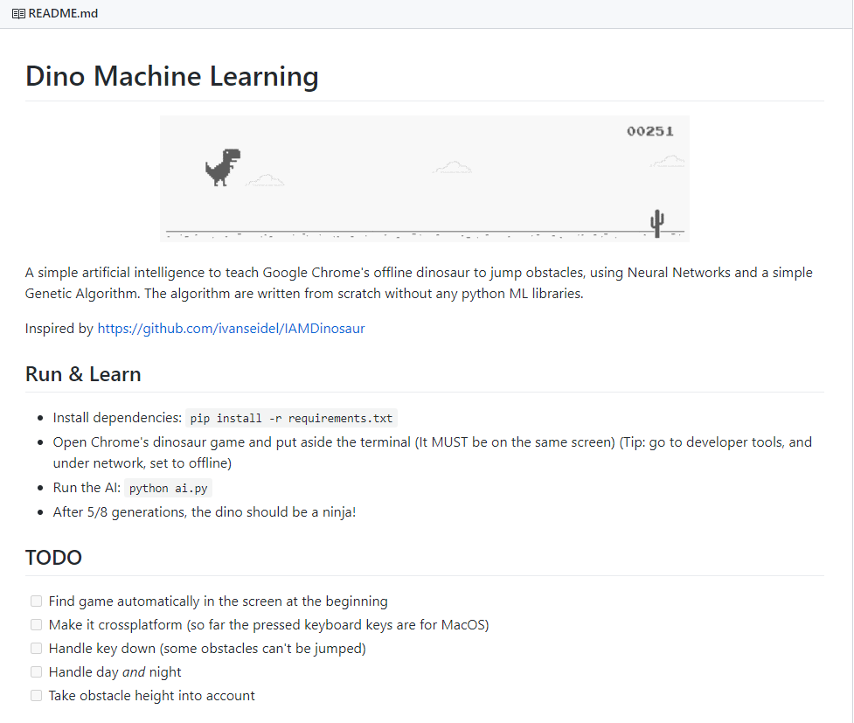
參考來源
https://github.com/utay/dino-ml

Slide 3
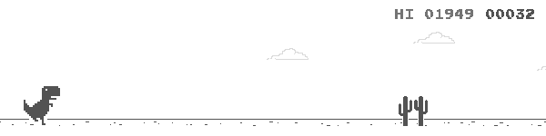
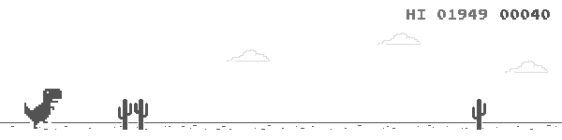
恐龍資訊
lastObs['distance']
獲取障礙物相關資訊函式: __get_obstacle_data
尋找障礙物函式:
find_next_obstacle
Time1
Time2
dist
speed = (lastObs['distance'] - dist) / (time - lastObs['time'])

Slide 4
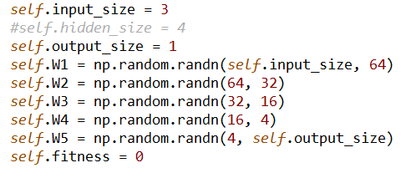
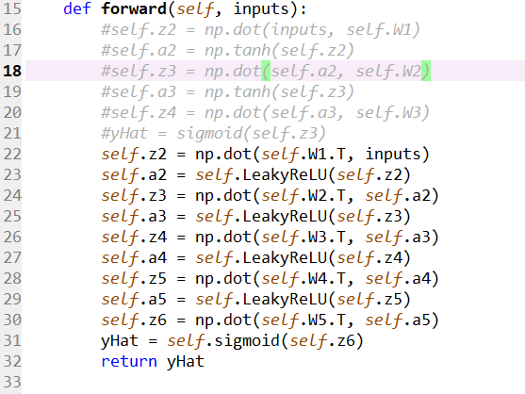
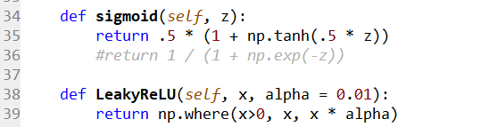
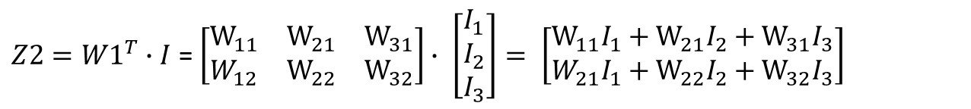
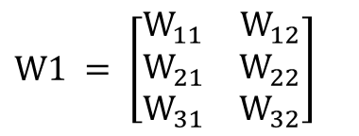
網路設計
$$W1 = \left[\begin{matrix}W_{11} & W_{12} \\ W_{21} & W_{22} \\ W_{31} & W_{32}\end{matrix}\right]$$
$Z2={W1}^{T}∙I$ = $\left[\begin{matrix}W_{11} & W_{21} & W_{31} \\ W_{12} & W_{22} & W_{32}\end{matrix}\right]∙ \left[\begin{aligned}\begin{matrix}I_{1} \\ I_{2}\end{matrix} \\ I_{3}\end{aligned}\right]= \left[\begin{matrix}W_{11}I_{1}+W_{21}I_{2}+W_{31}I_{3} \\ W_{21}I_{1}+W_{22}I_{2}+W_{32}I_{3}\end{matrix}\right]$
https://stackoverflow.com/questions/26218617/runtimewarning-overflow-encountered-in-exp-in-computing-the-logistic-function

Slide 5
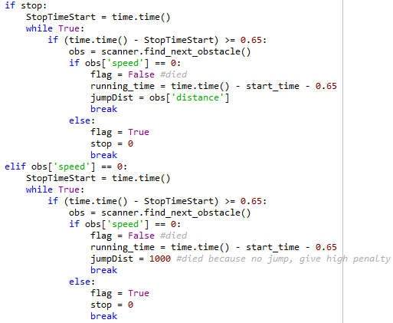
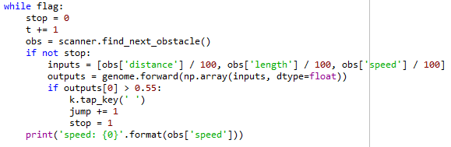
恐龍運行
因為跳而結束
因為不跳而結束
高penalty逞罰不跳而死

Slide 6
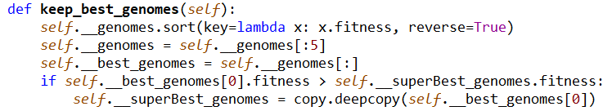
基因演算法
$$genome.fitness = 1.5 ∗ scanner.get_fitness() + 15 ∗ running_time − (jumpDist / 100)$$
恐龍看到多少障礙物
恐龍跑多少時間
恐龍死掉前與障礙物之距離

Slide 7
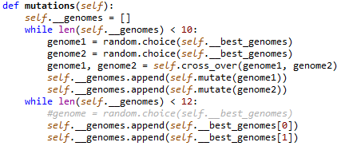
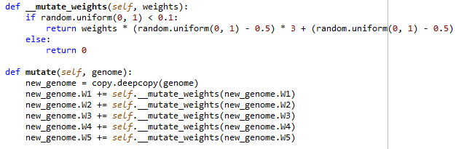
基因演算法
刻意保留最好的基因

Slide 8
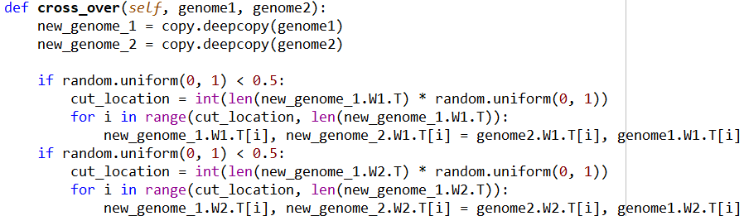
基因演算法
隨機亂數決定是否要重組基因
決定要從哪裡切開
兩段基因做重組

Slide 9
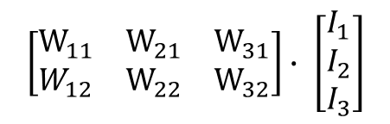
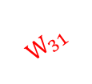




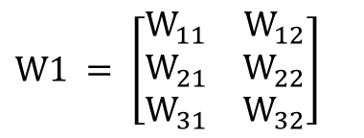
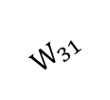


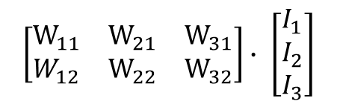




基因演算法
取轉置
不取轉置
$$W1 = \left[\begin{matrix}W_{11} & W_{12} \\ W_{21} & W_{22} \\ W_{31} & W_{32}\end{matrix}\right]$$
dist
1
dist
1
$$W_{11}$$
$$W_{11}$$
$$W_{12}$$
1
$$W_{12}$$
1
$$W_{21}$$
$$W_{21}$$
length
2
$$W_{22}$$
length
2
$$W_{22}$$
$$W_{31}$$
2
$$W_{31}$$
2
speed
3
$$W_{32}$$
3
speed
$$W_{32}$$
$$\left[\begin{matrix}W_{11} & W_{21} & W_{31} \\ W_{12} & W_{22} & W_{32}\end{matrix}\right]∙ \left[\begin{aligned}\begin{matrix}I_{1} \\ I_{2}\end{matrix} \\ I_{3}\end{aligned}\right]$$
$$\left[\begin{matrix}W_{11} & W_{21} & W_{31} \\ W_{12} & W_{22} & W_{32}\end{matrix}\right]∙ \left[\begin{aligned}\begin{matrix}I_{1} \\ I_{2}\end{matrix} \\ I_{3}\end{aligned}\right]$$
每個input Neuron之某個weights都會被重組
只有某個input neuron之weights會被重組

Slide 10
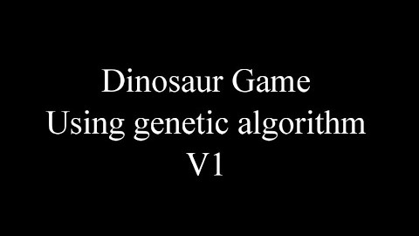
DEMO
https://www.youtube.com/watch?v=P7UFeENc9r8&lc=Ugxg_LJHe5lAzjtzai54AaABAg

