Slide 1


Transfer Learning on Edge Connecting Probability Estimation Under Graphon Model
Yuyao Wang¹, Yu-Hung Cheng²,
Debarghya Mukherjee^{1*}, Huimin Cheng^{2*}
¹Department of Mathematics and Statistics, Boston University
²Department of Biostatistics, Boston University
* Co-corresponding authors.
NeurIPS 2025

Slide 2
Outline
Introduction
  - Background
  - Motivation
Method
Experiments
Conclusion

Slide 3
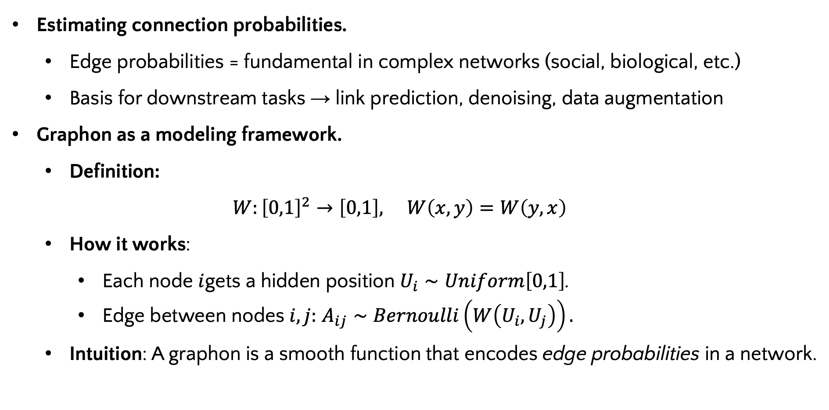
Background
Estimating connection probabilities.
  Edge probabilities = fundamental in complex networks (social, biological, etc.)
  Basis for downstream tasks → link prediction, denoising, data augmentation
Graphon as a modeling framework.
  Definition:
  $$W:{\left[0,1\right]}^{2}→\left[0,1\right], W\left(x,y\right)=W\left(y,x\right)$$
  How it works:
    Each node $i$gets a hidden position $U_{i}∼Uniform\left[0,1\right]$.
    Edge between nodes $i,j:$ $A_{ij}∼Bernoulli\left(W\left(U_{i},U_{j}\right)\right).$
  Intuition: A graphon is a smooth function that encodes edge probabilities in a network.

Slide 4
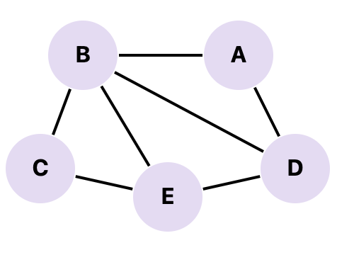
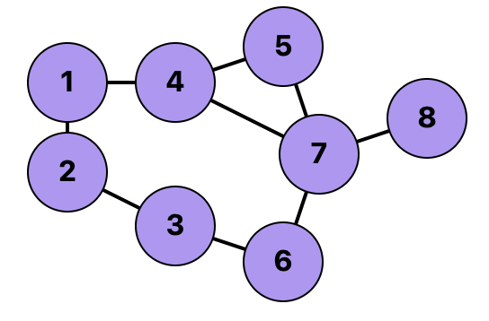
Motivation:
Small Network
Challenge:
Accurate graphon estimation typically requires large graphs, but many real datasets are small, leading to poor accuracy.
Motivation:
In practice, related domains often provide larger graphs, making transfer learning appealing.
Large Network

Slide 5
Motivation:
Problem in Transfer Learning
  Prior methods: assume target ⊂ source, node correspondences known → unrealistic
  Challenge 1: Alignment — structural patterns may misalign without correspondences
  Challenge 2: Unsupervised — no labels/signals to guide transfer in graphon estimation
Our Goal
  Framework for graphon transfer without node correspondences
  Reliable alignment + negative transfer avoidance when source ≠ target

Slide 6
Outline
Introduction
Method
  - Overview
  - Initial Graphon Estimation
  - Transferring (Alignment via Optimal Transport)
  - Adaptive Debiasing Mechanism
Experiments
Conclusion

Slide 7
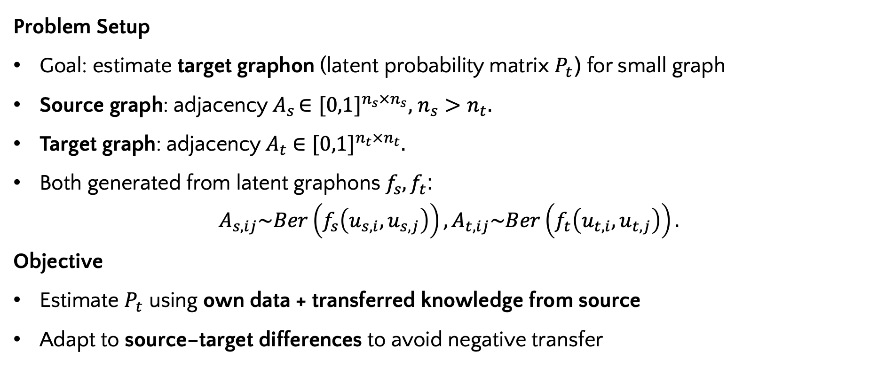
Problem Setup
Problem Setup
Goal: estimate target graphon (latent probability matrix $P_{t}$) for small graph
Source graph: adjacency${ A}_{s }∈{[0,1]}^{n_{s}×n_{s}},$ $n_{s}>n_{t}.$
Target graph: adjacency${ A}_{t} ∈{[0,1]}^{n_{t}×n_{t}}.$
Both generated from latent graphons $f_{s},f_{t}$:
$$A_{s,ij}\sim Ber\left(f_{s}\left(u_{s,i},u_{s,j}\right)\right), A_{t,ij}\sim Ber\left(f_{t}\left(u_{t,i},u_{t,j}\right)\right).$$
Objective
Estimate $P_{t}$ using own data + transferred knowledge from source
Adapt to source–target differences to avoid negative transfer

Slide 8

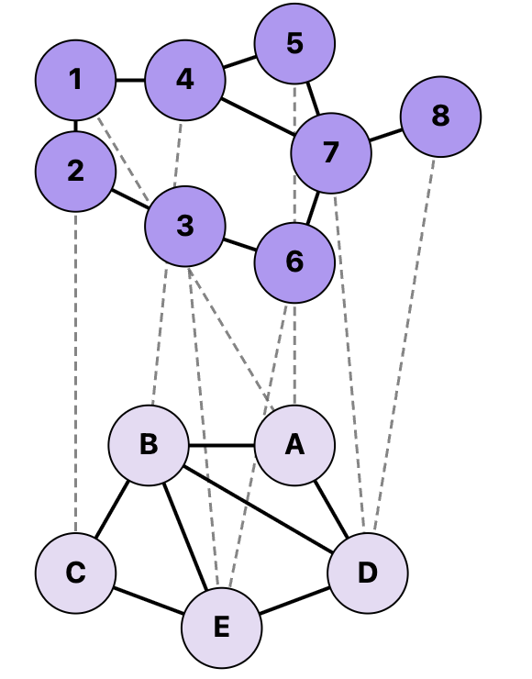
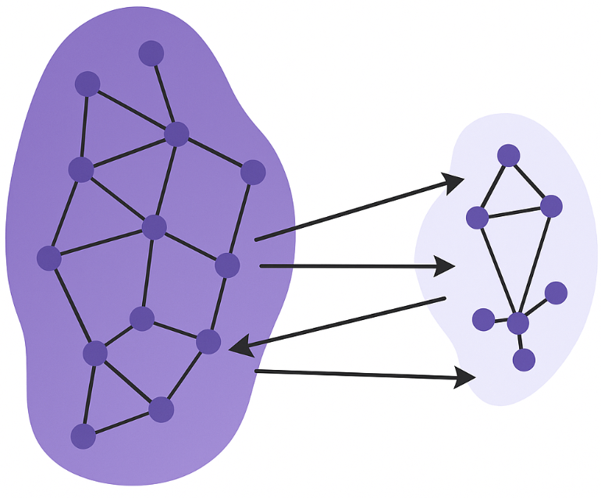


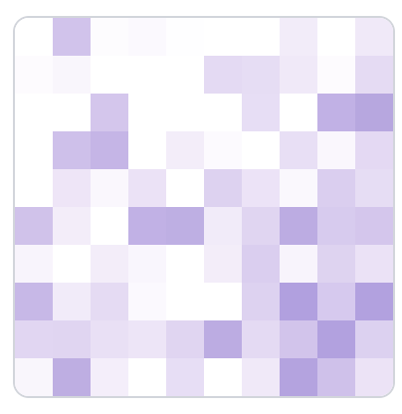

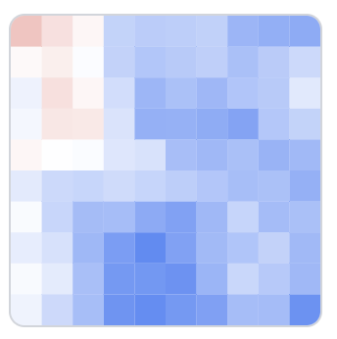
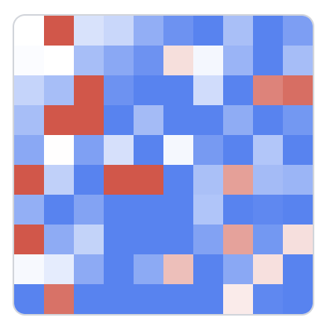








Method-Overview: GTrans
Original Networks
Initial Estimate
Optimal Transport
Alignment $π$
Transferring
Smoothing
Source Network
$${\hat{P}}_{t}^{trans}$$
$${\hat{P}}_{t}^{trans2}$$
d<$δ$
Output
Target Network
d>$δ$
Debiasing step
Debiased estimate
Smoothed Residual
Residual $R_{t}$
Output
$${\hat{P}}^{res}$$
GTrans framework (3 steps):
  Initial estimation → Neighborhood smoothing on source & target
  Transferring → Align structural patterns using optimal transport,
  Adaptive Debiasing → Correct target-specific deviations, prevent negative transfer

Slide 9
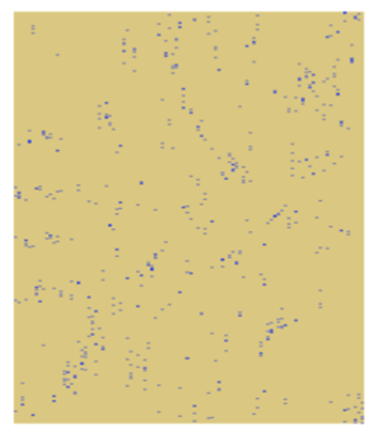
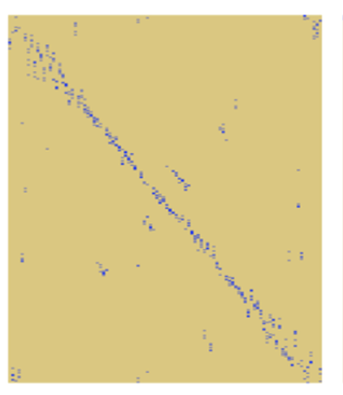
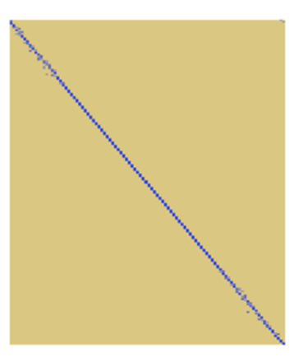
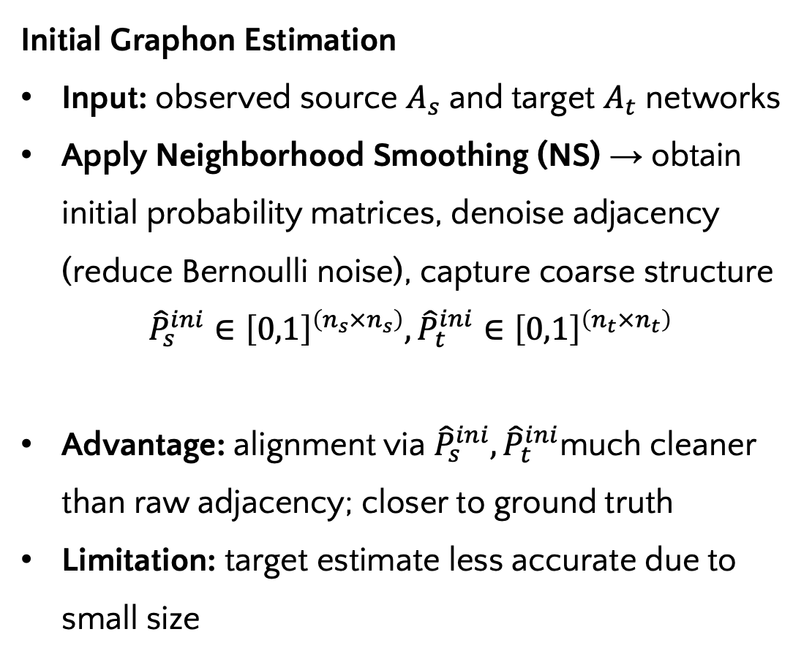
Method: Initial Estimation
Initial Graphon Estimation
Input: observed source $A_{s}$ and target $A_{t}$ networks
Apply Neighborhood Smoothing (NS) → obtain initial probability matrices, denoise adjacency (reduce Bernoulli noise), capture coarse structure
$${\hat{P}}_{s}^{ini}∈{\left[0,1\right]}^{\left(n_{s}×n_{s}\right)},{\hat{P}}_{t}^{ini}∈{\left[0,1\right]}^{\left(n_{t}×n_{t}\right)}$$
Advantage: alignment via ${\hat{P}}_{s}^{ini},{\hat{P}}_{t}^{ini}$much cleaner than raw adjacency; closer to ground truth
Limitation: target estimate less accurate due to small size
Original Networks
Initial Estimate
Source Network
Target Network
(b) Initialestimate-
based alignment
(c) Oracle
alignment
(a) Adjacency-
based alignment

Slide 10

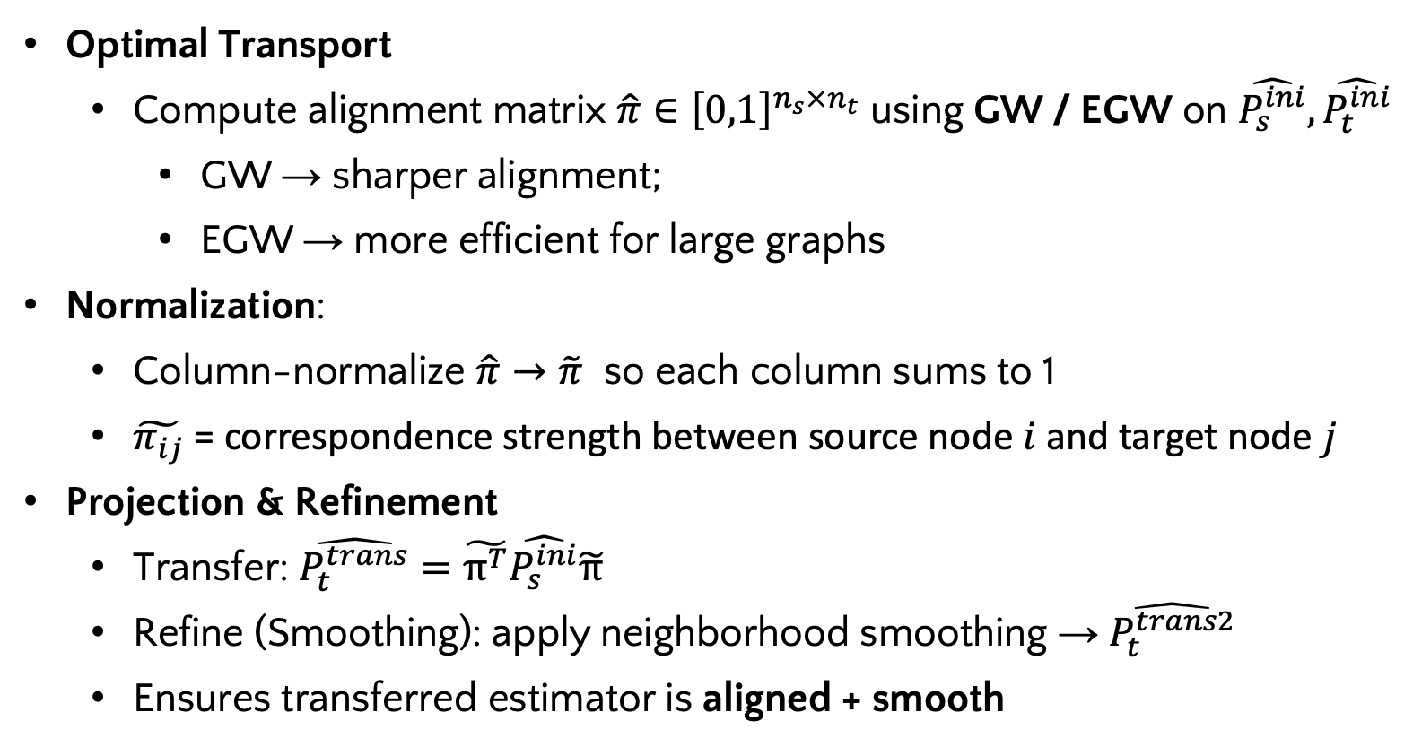

Method: Transferring
Transferring Step: Align source and target graphs, transfer structure into target latent space
Optimal Transport
  Compute alignment matrix $\hat{π}∈{\left[0,1\right]}^{n_{s}×n_{t}}$using GW / EGW on $\hat{P_{s}^{ini}},\hat{P_{t}^{ini}}$
    GW → sharper alignment;
    EGW → more efficient for large graphs
Normalization:
  Column-normalize $\hat{π}→\tilde{π}$ so each column sums to 1
  $\tilde{π_{ij}}$ = correspondence strength between source node $i$ and target node $j$
Projection & Refinement
  Transfer: $\hat{P_{t}^{trans}}=\tilde{π^{T}}\hat{P_{s}^{ini}}\tilde{π}$
  Refine (Smoothing): apply neighborhood smoothing → $\hat{P_{t}^{trans2}}$
  Ensures transferred estimator is aligned + smooth
Optimal Transport
Transferring
$${\hat{P}}_{t}^{trans}$$
Smoothing
$${\hat{P}}_{t}^{trans2}$$

Slide 11


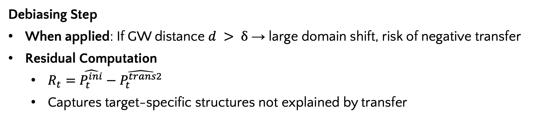


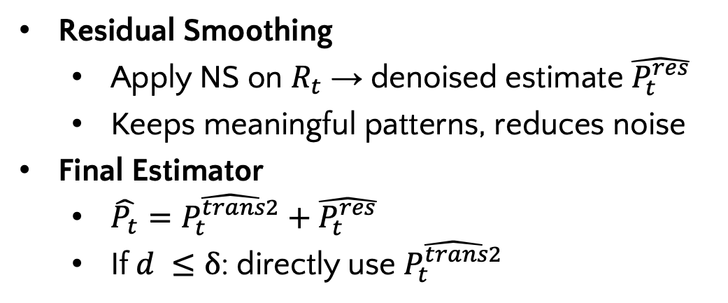

Method: Adaptive Debiasing
Debiasing Step
When applied: If GW distance $d > δ$ → large domain shift, risk of negative transfer
Residual Computation
  $R_{t}=\hat{P_{t}^{ini}}−\hat{P_{t}^{trans2}}$
  Captures target-specific structures not explained by transfer
Smoothing
$${\hat{P}}_{t}^{trans2}$$
d<$δ$
Output
Residual Smoothing
  Apply NS on $R_{t}$ → denoised estimate $\hat{P_{t}^{res}}$
  Keeps meaningful patterns, reduces noise
Final Estimator
  $\hat{P_{t}}=\hat{P_{t}^{trans2}}+\hat{P_{t}^{res}}$
  If $d ≤δ$: directly use $\hat{P_{t}^{trans2}}$
d>$δ$
Debiasing step
Debiased estimate
Smoothed Residual
Residual $R_{t}$
Output
$${\hat{P}}^{res}$$
Benefit: Adaptive correction to preserve transfer gains while avoiding negative transfer

Slide 12
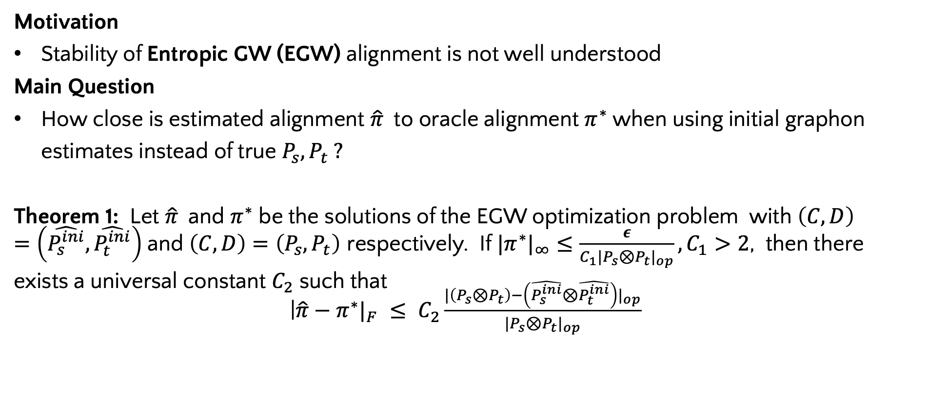
Theoretical Properties
Motivation
Stability of Entropic GW (EGW) alignment is not well understood
Main Question
How close is estimated alignment $\hat{π}$to oracle alignment $π^{∗}$when using initial graphon estimates instead of true $P_{s},P_{t} ?$
Theorem 1: Let $\hat{π}$and $π^{∗}$ be the solutions of the EGW optimization problem with $\left(C,D\right)=\left(\hat{P_{s}^{ini}},\hat{P_{t}^{ini}}\right)$and $\left(C,D\right)=\left(P_{s},P_{t}\right)$ respectively. If $|π^{∗}|_{∞}≤\frac{ε}{C_{1}|P_{s}⊗P_{t}|_{op}},C_{1}>2$, then there exists a universal constant $C_{2}$ such that
|$\hat{π}−π^{∗}|_{F} ≤ C_{2}\frac{|\left(P_{s}⊗P_{t}\right)−\left(\hat{P_{s}^{ini}}⊗\hat{P_{t}^{ini}}\right)|_{op}}{|P_{s}⊗P_{t}|_{op}}$

Slide 13
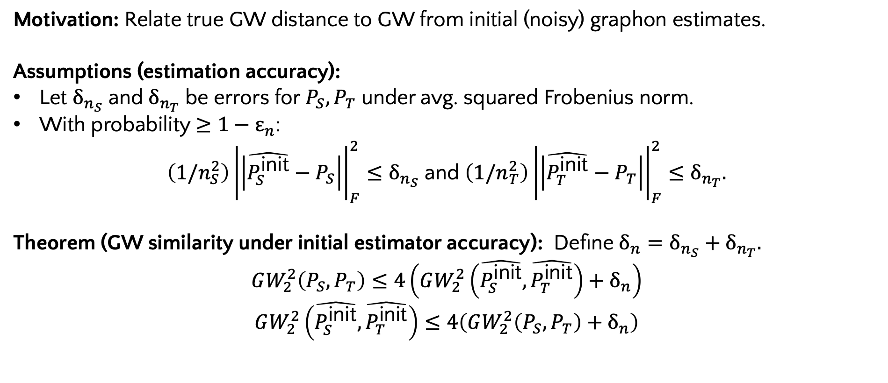
Theoretical Properties
Motivation: Relate true GW distance to GW from initial (noisy) graphon estimates.
Assumptions (estimation accuracy):
Let $δ_{n_{S}}$ and $δ_{n_{T}}$ be errors for $P_{S},P_{T}$ under avg. squared Frobenius norm.
With probability $≥1−ε_{n}$:
$\left(1/n_{S}^{2}\right){\left|\left|\hat{P_{S}^{\text{init}}}−P_{S}\right|\right|}_{F}^{2}≤δ_{n_{S}}$ and $\left(1/n_{T}^{2}\right){\left|\left|\hat{P_{T}^{\text{init}}}−P_{T}\right|\right|}_{F}^{2}≤δ_{n_{T}}.$
Theorem (GW similarity under initial estimator accuracy): Define $δ_{n}=δ_{n_{S}}+δ_{n_{T}}.$
$$GW_{2}^{2}\left(P_{S},P_{T}\right)≤4\left(GW_{2}^{2}\left(\hat{P_{S}^{\text{init}}},\hat{P_{T}^{\text{init}}}\right)+δ_{n}\right)$$
$$GW_{2}^{2}\left(\hat{P_{S}^{\text{init}}},\hat{P_{T}^{\text{init}}}\right)≤4\left(GW_{2}^{2}\left(P_{S},P_{T}\right)+δ_{n}\right)$$

Slide 14
Outline
Introduction
Method
Experiments
  - Simulation Experiments
  - Link Prediction
  - Graph Classification (via Data Augmentation)
Conclusion

Slide 15
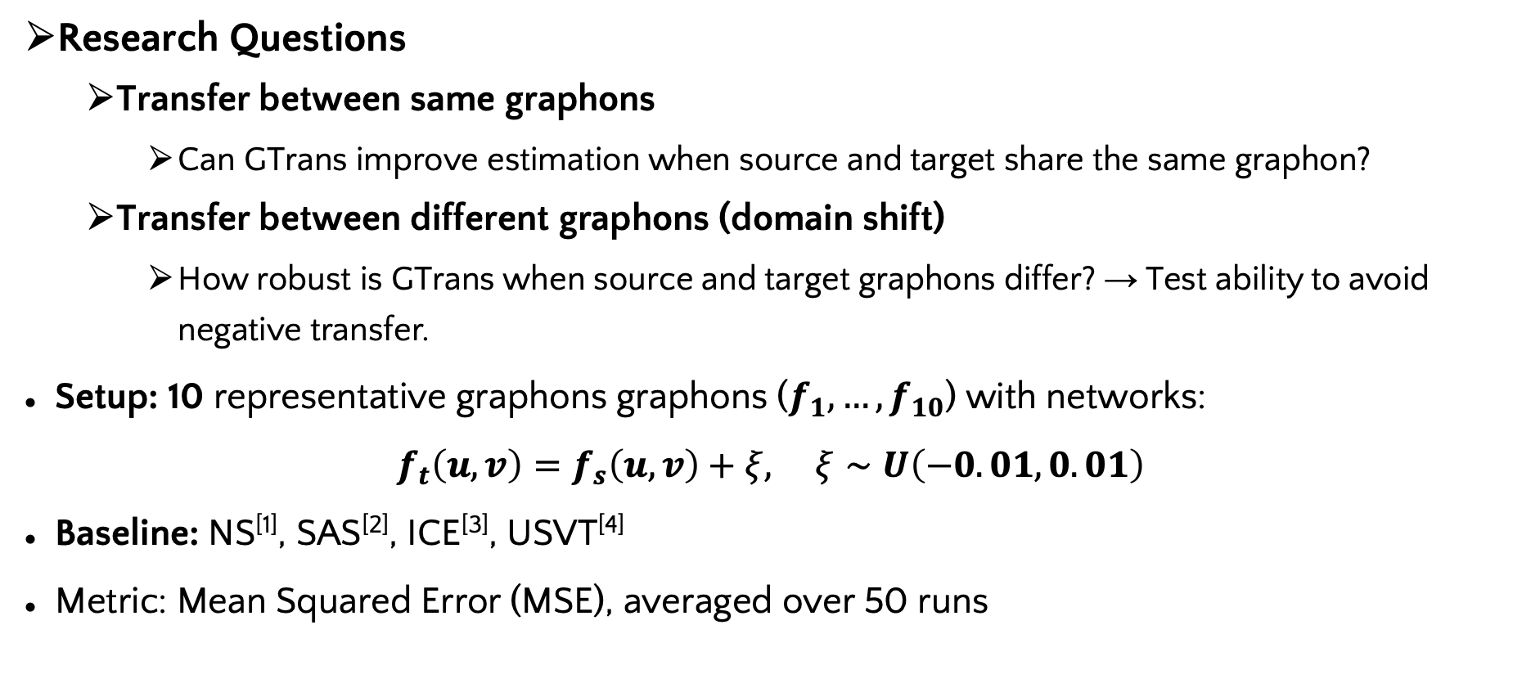
Simulation Experiments Setup
Research Questions
  Transfer between same graphons
    Can GTrans improve estimation when source and target share the same graphon?
  Transfer between different graphons (domain shift)
    How robust is GTrans when source and target graphons differ? → Test ability to avoid negative transfer.
Setup: 10 representative graphons graphons ($f_{1},…,f_{10}$) with networks:
$f_{t}\left(u,v\right)=f_{s}\left(u,v\right)+ξ, ξ∼U\left(−0.01,0.01\right)$
Baseline: NS^{[1]}, SAS^{[2]}, ICE^{[3]}, USVT^{[4]}
Metric: Mean Squared Error (MSE), averaged over 50 runs
[1] Yuan Zhang, Elizaveta Levina, and Ji Zhu. Estimating network edge probabilities by neighbourhood smoothing. Biometrika, 104(4):771–783, 2017.591
[2] Stanley Chan and Edoardo Airoldi. A consistent histogram estimator for exchangeable graph models. In Eric P. Xing and Tony Jebara, editors, Proceedings of the 31st International Conference on Machine Learning, volume 32 of Proceedings of Machine Learning Research,448 pages 208–216, 22–24 Jun 2014. PMLR.449
[3]. Yichen Qin, Linhan Yu, and Yang Li. Iterative Connecting Probability Estimation for Networks. In Advances in NeurIPS, volume 34, pages 1155–1166, 2021
[4] Sourav Chatterjee. Matrix estimation by Universal Singular Value Thresholding. The Annals of Statistics, 43(1), 2015

Slide 16
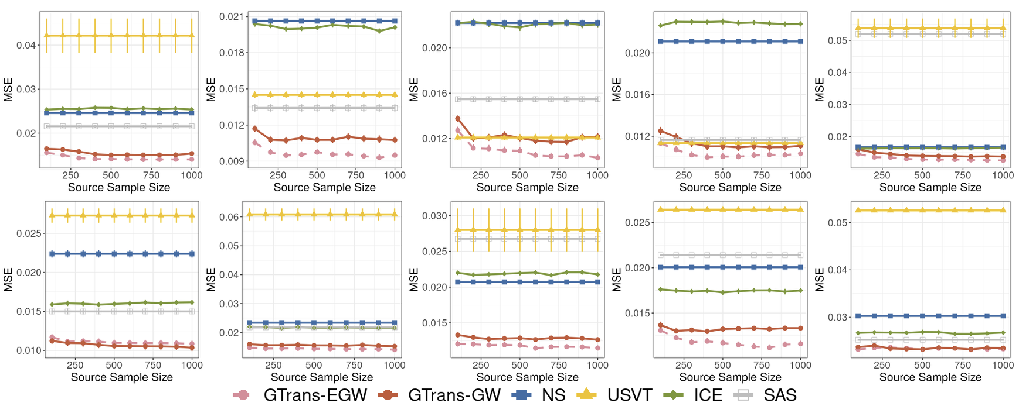

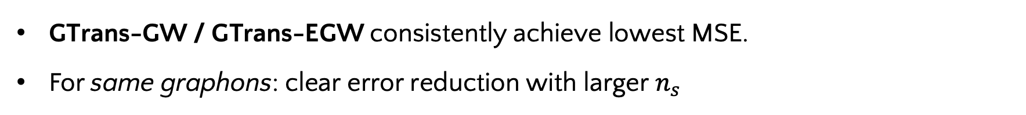
Results within Identical Graphons :
MSE Comparison under Transfer within Identical Graphons $\text{n}\text{ₛ = \{100,}…1000\},\text{n}\text{ₜ = 50})$
GTrans-GW / GTrans-EGW consistently achieve lowest MSE.
For same graphons: clear error reduction with larger $n_{s}$

Slide 17
Results between different graphons:
MSE comparison for Transfer between different graphons (nₛ = 500, nₜ = 50)
Similarity | Scenario | GTrans-GW | GTrans-EGW | NS | USVT | ICE | SAS
Similar | 7 → 6 | 0.9 ± 0.2 | 1.0 ± 0.3 | 2.1 ± 0.3 | 3.0 ± 0.9 | 1.7 ± 0.3 | 1.6 ± 0.4
 | 6 → 7 | 1.8 ± 0.3 | 1.8 ± 0.3 | 2.3 ± 0.3 | 5.9 ± 2.7 | 2.2 ± 0.3 | 2.4 ± 0.6
 | 8 → 7 | 1.3 ± 0.3 | 1.4 ± 0.3 | 2.3 ± 0.3 | 5.9 ± 2.7 | 2.2 ± 0.3 | 2.4 ± 0.6
 | 3 → 1 | 1.6 ± 0.5 | 1.7 ± 0.2 | 2.5 ± 0.3 | 5.1 ± 4.6 | 2.7 ± 0.3 | 2.1 ± 0.3
Different | 10 → 5 | 1.6 ± 0.2 | 1.5 ± 0.2 | 1.7 ± 0.1 | 3.5 ± 1.5 | 1.7 ± 0.2 | 5.5 ± 1.0
 | 5 → 10 | 2.6 ± 0.3 | 2.5 ± 0.3 | 3.1 ± 0.6 | 5.3 ± 0.6 | 2.8 ± 0.3 | 2.6 ± 0.3
GTrans-GW / GTrans-EGW consistently achieve lowest MSE.
For different graphons: adaptive debiasing prevents negative transfer.

Slide 18
Link Prediction Experiments Setup
Task: Predict missing/future edges; evaluate by AUC
Datasets:
  5 social networks: dolphins, karate, football, firm, wiki-vote
  Nodes range: 33 (firm) → 2,375 (wiki-vote)
  Wiki-vote chosen as source, others as targets
Baseline: NS^{[1]}, SAS^{[2]}, ICE^{[3]}, USVT^{[4]}
Evaluation Metrics: Each experiment repeated 50 times, report averaged AUC
[1] Yuan Zhang, Elizaveta Levina, and Ji Zhu. Estimating network edge probabilities by neighbourhood smoothing. Biometrika, 104(4):771–783, 2017.591
[2] Stanley Chan and Edoardo Airoldi. A consistent histogram estimator for exchangeable graph models. In Eric P. Xing and Tony Jebara, editors, Proceedings of the 31st International Conference on Machine Learning, volume 32 of Proceedings of Machine Learning Research,448 pages 208–216, 22–24 Jun 2014. PMLR.449
[3]. Yichen Qin, Linhan Yu, and Yang Li. Iterative Connecting Probability Estimation for Networks. In Advances in NeurIPS, volume 34, pages 1155–1166, 2021
[4] Sourav Chatterjee. Matrix estimation by Universal Singular Value Thresholding. The Annals of Statistics, 43(1), 2015

Slide 19
Link Prediction Experiments Results
Link prediction AUC (%): Real Networks, with source wiki-vote ($n_{s}$= 889):
Dataset | GTrans-GW | GTrans-EGW | NS | USVT | SAS | ICE
Dolphins (nₜ = 62) | 75.96 ± 8.53 | 76.26 ± 8.54 | 70.60 ± 9.01 | 72.36 ± 10.16 | 50.66 ± 6.35 | 75.36 ± 8.40
Firm (nₜ = 33) | 71.31 ± 12.18 | 71.26 ± 12.06 | 66.32 ± 12.27 | 65.56 ± 12.25 | 54.90 ± 7.59 | 64.26 ± 12.20
Football (nₜ = 115) | 86.64 ± 3.66 | 86.74 ± 3.72 | 86.75 ± 3.49 | 85.32 ± 3.56 | 44.56 ± 7.38 | 82.46 ± 4.59
Karate (nₜ = 34) | 82.47 ± 10.36 | 82.53 ± 10.46 | 76.74 ± 12.01 | 71.86 ± 15.20 | 63.88 ± 11.15 | 80.43 ± 11.22
GTrans consistently outperforms baselines (NS, SAS, USVT, ICE)

Slide 20
Graph Classification Experiments Setup
Motivation： Graph classification often suffers from small graphs; Graphon-based augmentation (G-Mixup) relies on accurate probability estimation → conventional estimators fail on small graphs.
Datasets
  Targets: IMDB-Binary, IMDB-Multi, PROTEINS-Full (all small graphs)
  Sources: COLLAB (74 nodes), Reddit-Binary (429 nodes), D&D (284 nodes)
Baselines:
  Non-Transfer baselines: NS^{[1]}, SAS^{[2]}, ICE^{[3]}, USVT^{[4]}, GWB ^{[5]}, IGNR ^{[6]}, SIGL ^{[7]}, Graphlet Kernel ^{[8]}
Evaluation Metrics: average test accuracy over 10 runs with standard GCN classifier.
[1] Yuan Zhang, Elizaveta Levina, and Ji Zhu. Estimating network edge probabilities by neighbourhood smoothing. Biometrika, 104(4):771–783, 2017.591
[2] Stanley Chan and Edoardo Airoldi. A consistent histogram estimator for exchangeable graph models. In Eric P. Xing and Tony Jebara, editors, Proceedings of the 31st International Conference on Machine Learning, volume 32 of Proceedings of Machine Learning Research,448 pages 208–216, 22–24 Jun 2014. PMLR.449
[3]. Yichen Qin, Linhan Yu, and Yang Li. Iterative Connecting Probability Estimation for Networks. In Advances in NeurIPS, volume 34, pages 1155–1166, 2021
[4] Sourav Chatterjee. Matrix estimation by Universal Singular Value Thresholding. The Annals of Statistics, 43(1), 2015
[5] Hongteng Xu, Dixin Luo, Lawrence Carin, and Hongyuan Zha. Learning graphons via structured gromov-wasserstein barycenters. In Proceedings of the AAAI Conference on Artificial Intelligence, volume 35, pages 10505–10513, 2021.
[6] Xinyue Xia, Gal Mishne, and Yusu Wang. Implicit graphon neural representation. In International Conference on Artificial Intelligence and Statistics, pages 10619–10634. PMLR, 2023
[7] Ali Azizpour, Nicolas Zilberstein, and Santiago Segarra. Scalable implicit graphon learning. arXiv preprint arXiv:2410.17464, 2024.
[8] Nino Shervashidze, SVN Vishwanathan, Tobias Petri, Kurt Mehlhorn, and Karsten Borgwardt. Efficient graphlet kernels for large graph comparison. In Artificial intelligence and statistics, pages 488–495. PMLR, 2009

Slide 21
Graph Classification Results
Graph classification accuracy (%) compared against baselines
Source | Target | GTrans-GW | GTrans-EGW | NS | USVT | SAS | ICE | GWB | IGNR | SIGL | Graphlet
Reddit-B | IMDB-B | 76.30 | 76.80 | 72.90 | 73.85 | 74.25 | 74.30 | 75.30 | 74.35 | 73.50 | 61.10
COLLAB | IMDB-B | 76.25 | 77.50 | 72.90 | 73.85 | 74.25 | 74.30 | 75.30 | 74.35 | 73.50 | 61.10
Reddit-B | IMDB-M | 49.10 | 51.27 | 43.80 | 48.00 | 44.10 | 43.90 | 47.70 | 47.50 | 49.13 | 39.37
COLLAB | IMDB-M | 50.47 | 50.23 | 43.80 | 48.00 | 44.10 | 43.90 | 47.70 | 47.50 | 49.13 | 39.37
D&D | PROTEINS | 69.33 | 68.52 | 63.18 | 65.11 | 65.25 | 65.38 | 63.45 | 65.87 | 67.13 | 70.11
GTrans-GW and GTrans-EGW, consistently achieves the best or comparable performance in most cases.

Slide 22
Outline
Introduction
Method
Experiments
Conclusion

Slide 23
Conclusion
Understanding Gap
  Graphon estimation is unreliable on small, sparse networks.
  Existing transfer methods assume known node correspondences, which is unrealistic.
  Gap: transfer information without correspondences, while avoiding negative transfer.
GTRANS Framework
  Proposed GTRANS, with three core steps
  First framework enabling robust, correspondence-free graphon transfer.
Theory: consistency guarantees for alignment via smoothed estimators.
Experiments
  Synthetic: outperforms baselines, robust to domain shifts.
  Real networks: Outperforms baselines in link prediction and graph classification.

