Slide 1
Cyclistic – 2020 Quarter 1 by Olivia brubaker

Slide 2
Agenda
The following presentation will include cover the following:
Overview of Cyclistic’s data for the 2020 first quarter
The business goal
Graphics to explain trends
Offer recommendations

Slide 3
The Data
The data provided for the project covers riders journey in time and location for every ride in the 2020 first quarter. The aspects of the data include:
Unique trip identifier
Bicycle type: Electric or Classic
Trip Starting Location
Trip End Location
Date
Member Classification
Notes:
In the repository, the data is divided by quarter, and includes the following categories: * Unique trip identifier* Bicycle type: Electric or Classic* Trip Starting Location: Includes name of the cross streets, latitude and longitude* Trip End Location: Includes name of cross streets, latitude, and longitude* The trip's date and when the trip began and ended* Member Classification: If the member is an annual subscriber, the data assigns "member". To the other classification, it is labeled "casual", and that represents consumers who have rented a bicycle for their one-time, daily, or monthly passes.

Slide 4
The Goal
Classify behavior of the casual riders to help inform a marketing campaign to help convert casual riders into annual members as Cyclistic.

Slide 5
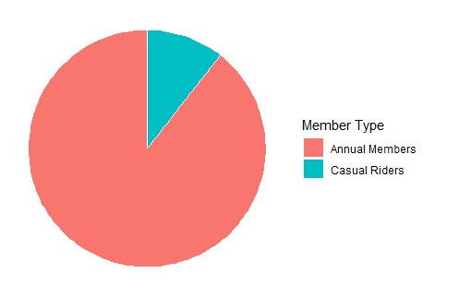
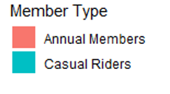
10.57%
89.43%
Notes:
Out of the 423,120 riders in the first quarter of 2020…
Now, let’s look at how this looks on a typically weekly timeline.

Slide 6
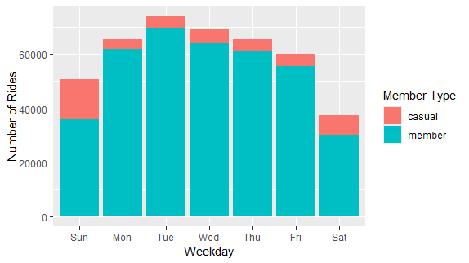
Rides by Day by member Type
Notes:
Tuesday is the most popular day for riding, but since our focus is to target casual riders, if we focus just the casual data…

Slide 7
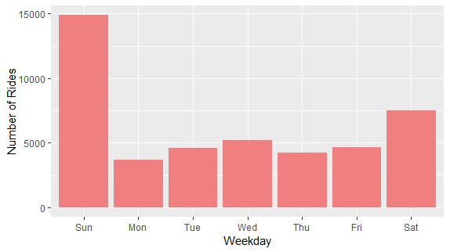
Rides by Day - Casual
Notes:
Sunday exceeds the second most popular day by 50%. So we may focus our in-person marketing attempts on Sundays. But where?

Slide 8
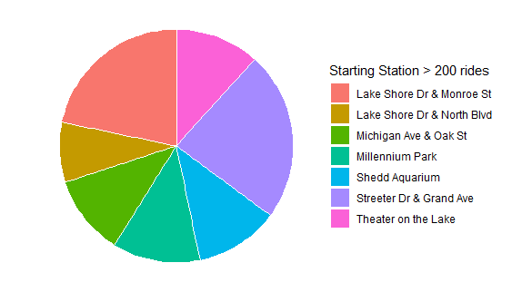
Rides by Day – Casual/Sunday
Notes:
Each of these stations have over 200 casual riders starting their rides at these stations on Sunday. And for ending stations…

Slide 9
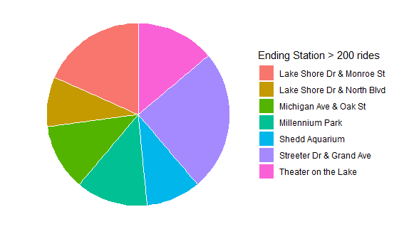
Rides by Day – Casual/Sunday
Notes:
Each of these stations have over 200 casual riders ending their rides at these stations on Sunday.

Slide 10
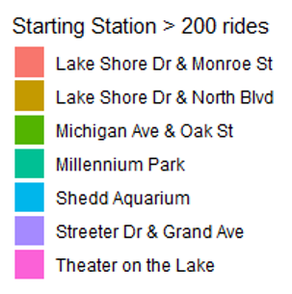
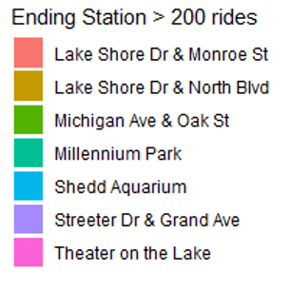
Rides by Day – Casual/Sunday
Notes:
Notice: These are the same most popular stations as the starts! That lead me to consider how many of our data points were round-trips!

Slide 11
Round trips - Total
All Riders | 3.9%
Round trips – By Member Type
Member Type | Percentage
Casual | 14.9%
Annual | 2.6%
Notes:
Round trips are much more common in a casual rider.
The other aspect to observe is the trip duration. How long are casual riders and annual members riding?

Slide 12
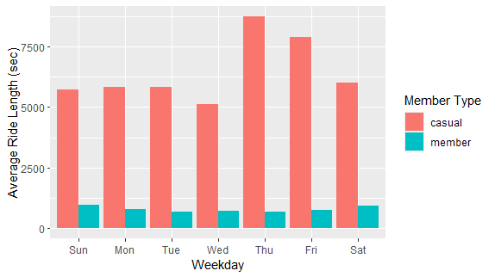
AVG. Trip Duration (Sec)
Notes:
By this graphic, we see that casual members are consistently taking much longer trips (on average). This is a possible incentive point to approach in advertising.

Slide 13
RECOMMENDATIONS
Focus advertising/surveys at the most common start and end station types for casual riders
Create an incentive for the annual program targeted around riders who take longer trips.

Slide 14
Acknowledgements - license
The datasets have a different name because Cyclistic is a fictional company. For the purposes of this case study, the datasets are appropriate and will enable you to answer the business questions. The data has been made available by Motivate International Inc. under this license.

