Slide 1

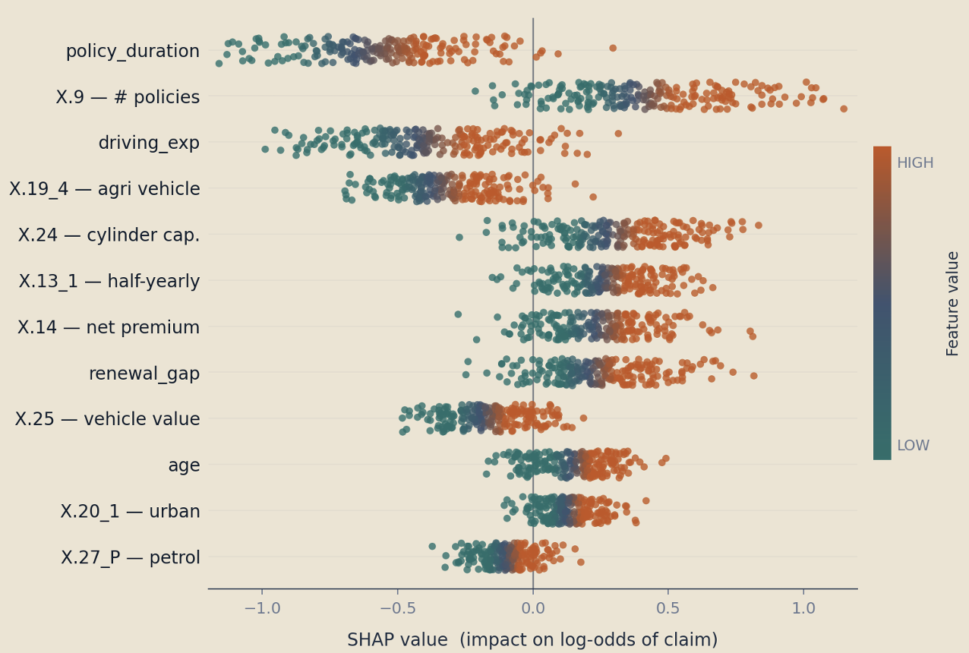
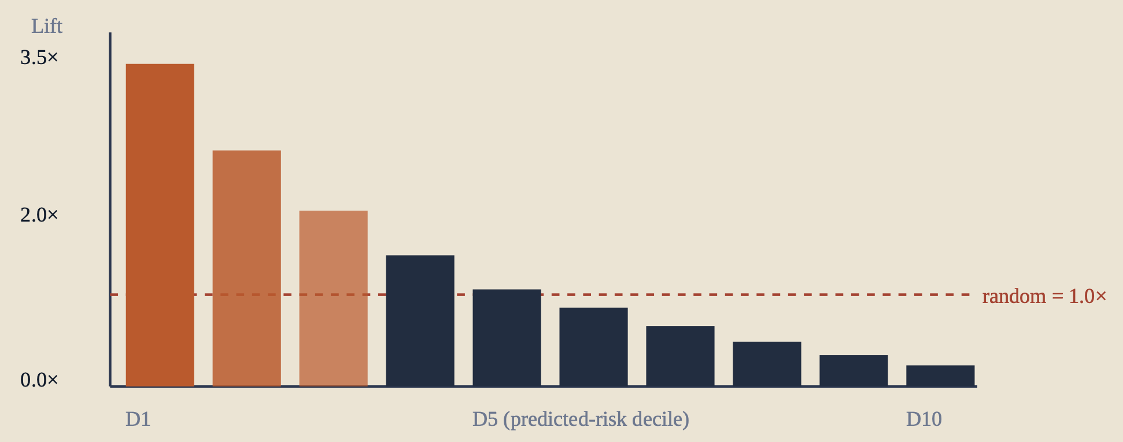
Group 7
USC MARSHALL · DSO 530
DSO 530 · GROUP PROJECT 2026 · CASE COMPETITION
Pricing Risk in a Zero-Inflated World
Naivedhya Shah · Xinze Chi · Junshu Xin
Shravya Addanki · Olivia Cai · Huanxuan Tang
A Tweedie-aware ML pipeline for predicting auto-insurance claim frequency, loss cost, and historically-adjusted loss cost, engineered for fairer premiums.
TRAINING SET
OUT-OF-SAMPLE TEST
CLASS IMBALANCE · CS
ZERO-INFLATION · LC
MODELING FEATURES USED
39,928
policy-year transactions
13,310
held-out policies
11.2%
positives → ranker not classifier
88.8%
zeros → Tweedie territory
25
after removing X.15–X.18
The pricing dilemma
Models we tried
Model leaderboard
01 / PROBLEM
02 / APPROACHES
03 / PERFORMANCE
Insurers must price each policy at its expected loss, too high and good drivers leave; too low and the book bleeds.
MODEL
STRENGTH
WEAKNESS
TASK 2 · CLAIM STATUS (CS)
ROC-AUC ↑
Tweedie GLM
Native zero-inflation
Linear; misses interaction
Stack ensemble
0.7886
Three targets, one story: LC, HALC, CS
Zero-inflation: most policyholders never claim
Heavy right tail: $4–35K (LC), $3–78K (HALC)
Leakage trap: X.15–X.18 excluded
Logistic Reg.
Calibrated; interpretable
AUC ≈ 0.72 ceiling
LightGBM
0.7880
XGBoost tuned
0.7840
Random Forest
Non-linear; little tuning
Weaker than booster
Random Forest
0.7691
XGBoost (Tw.) ★
Best LC/HALC MSE
Needs calibration
Logit (balanced)
0.7239
LightGBM ★
Top CS ranker
Sensitive leaf-size
Logit + SMOTE
0.7190
Stacking Ensemble
Combines linear + tree
Marginal gain; black box
TASK 1 · LOSS COST (LC)
CV-MSE ↓
TWEEDIE DECOMPOSITION · p ∈ (1, 2)
SMOTE Oversamp.
Balances classes
Hurt AUC empirically
XGBoost (Tweedie) tuned
257,072
E[Loss] = Pr(Claim) × E[Loss | Claim]
XGBoost baseline
259,418
Tweedie GLM (p=1.1)
260,385
Final models
Lift, not accuracy
For stakeholders
04 / WINNERS
05 / WHY IT MATTERS
06 / IMPACT & LIMITS
CS · CLASSIFICATION
TOP DRIVERS · SHAP SUMMARY
AUC 0.79 still mislabels singletons, but the model is highly effective at risk segmentation → claims concentrated in the top deciles, which impacts pricing.
Stacked Ensemble logit + RF + LGBM + XGB
▸ FOR ACTUARY & UNDERWRITER
Calibrated CS feeds Tweedie split: E[Loss] = Pr(Claim) × E[Loss|Claim]
Two interpretable factors, one premium
Decile ranking enables tiered review on top 10–20%
0.789
0.344
0.191
5×CV
ROC-AUC
PR-AUC
Brier
Strat
LC / HALC · REGRESSION
▸ LIMITS & CAVEATS
XGBoost with Tweedie loss
Auto-only data is not transferable to life insurance (different tails, longer horizons). Drift monitoring still required.
~1.07M
257K
HALC CV-MSE
Top decile ≈ 3× the average claim rate, a meaningful pricing signal
Cost-sensitive threshold (FN = 10× FP) shifts boundary, surfacing recall
Bootstrap 95 % CI AUC: [0.7737, 0.8033] → no over-claiming
▸ NEXT STEPS
LC CV-MSE
Tenure dominates risk while Exposure & payment behavior raise risk
Tweedie loss in NN head; fairness audit; per-segment re-calibration; SHAP reason codes for adverse-action notices.
Boosted trees + isotonic calibration delivered both
ranking quality and probability honesty

