Slide 1
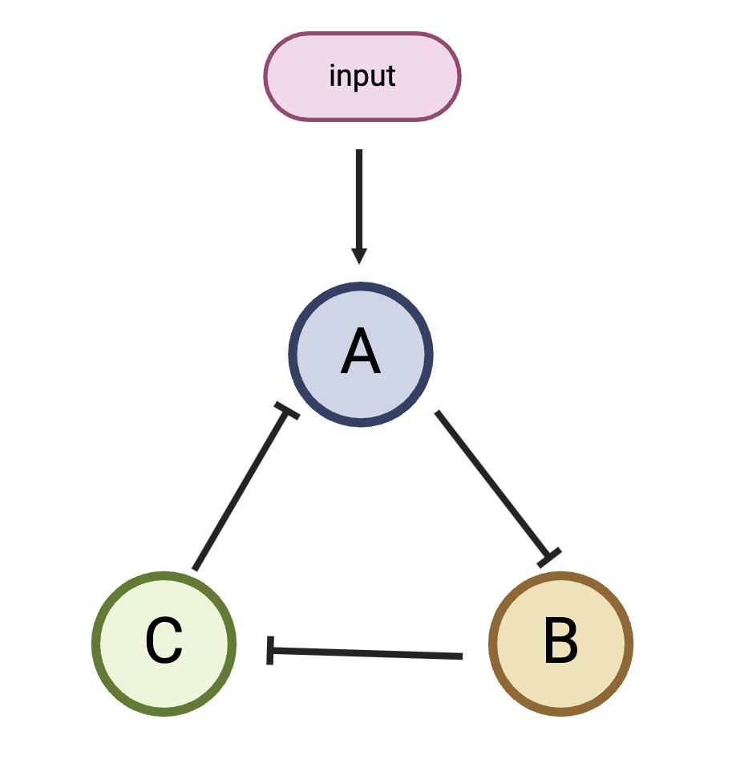
Notes:
Figure 1

Slide 2
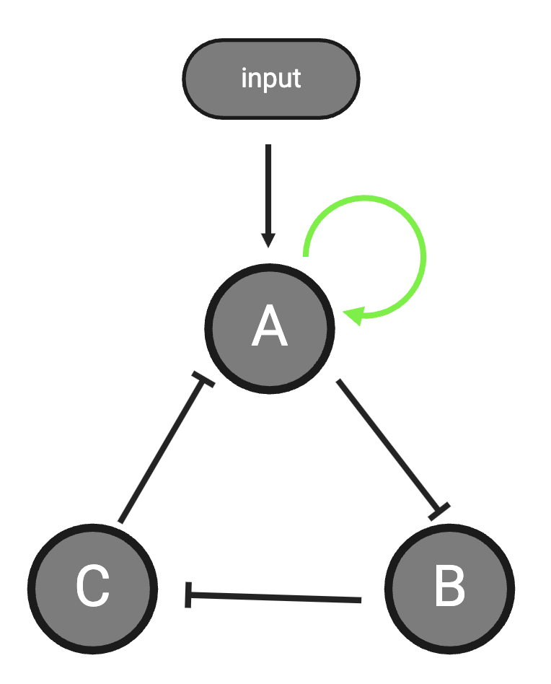
Notes:
Figure 2

Slide 3
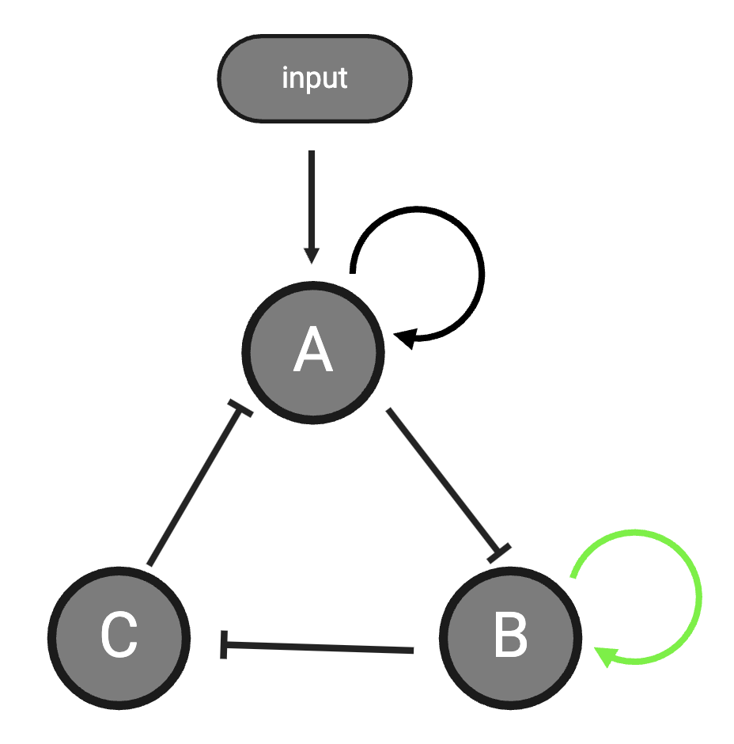
Notes:
Figure 3

Slide 4
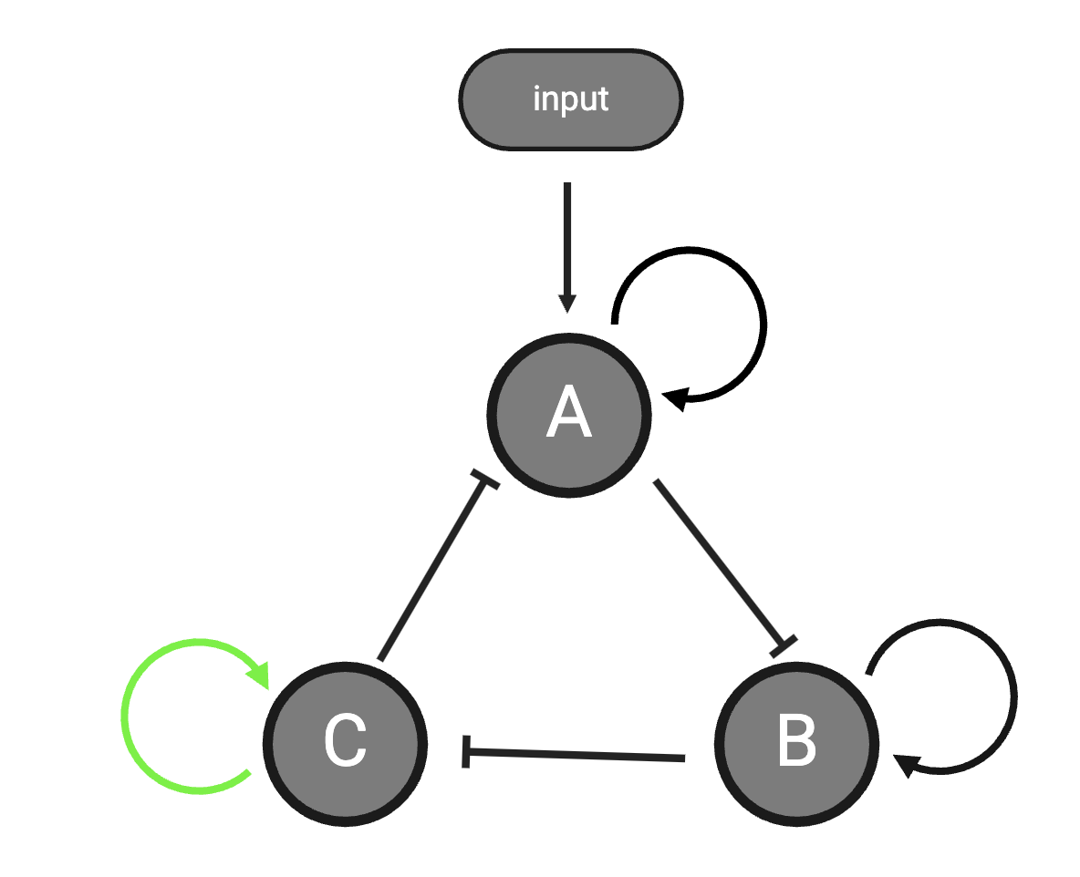
Notes:
Figure 4

Slide 5
A.
B.
Notes:
Figure 5

Slide 6
Notes:
Figure 6

Slide 7
Notes:
Figure 7

Slide 8
A.
B.
Notes:
Figure 8

Slide 9
Notes:
Figure 9

Slide 10
A.
B.
Notes:
Figure 10

Slide 12
A.
B.

