Slide 1
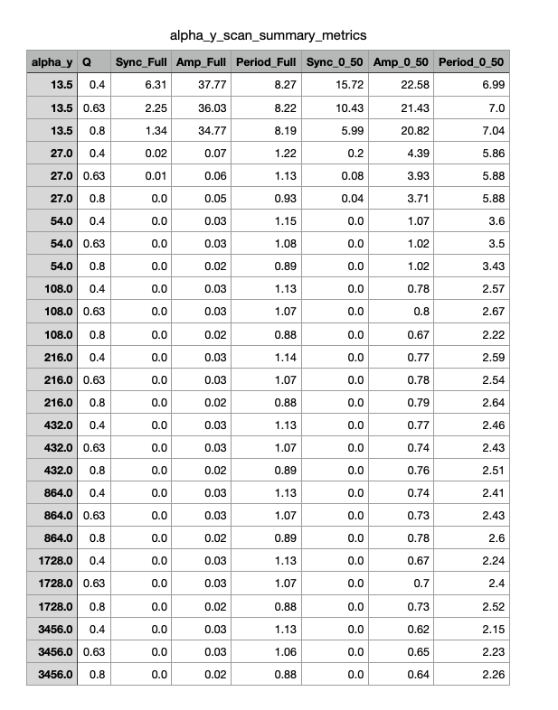
Summary Table From Alpha_Y Parameter Scan

Slide 2
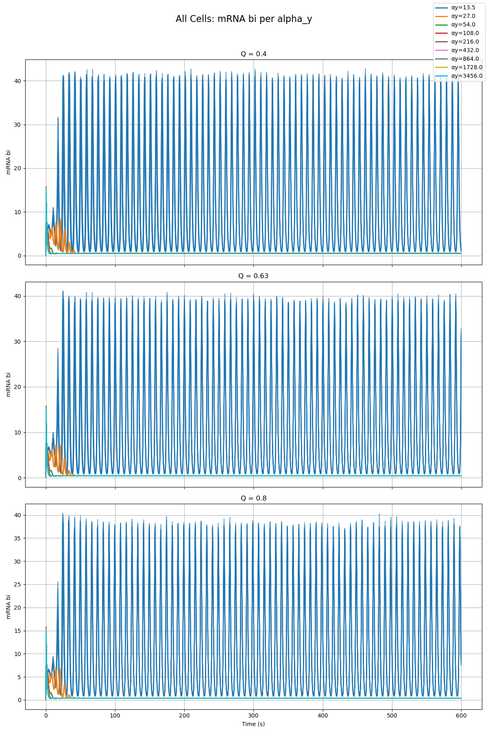
Combined Plot of All Cells and All Qs From Alpha_Y Parameter Scan

Slide 3
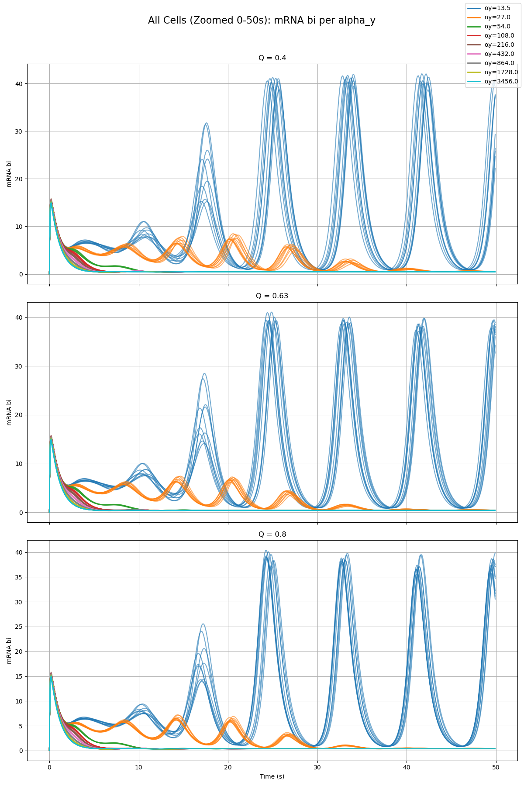
Combined Plot of All Cells and All Qs From Alpha_Y Parameter Scan

Slide 4
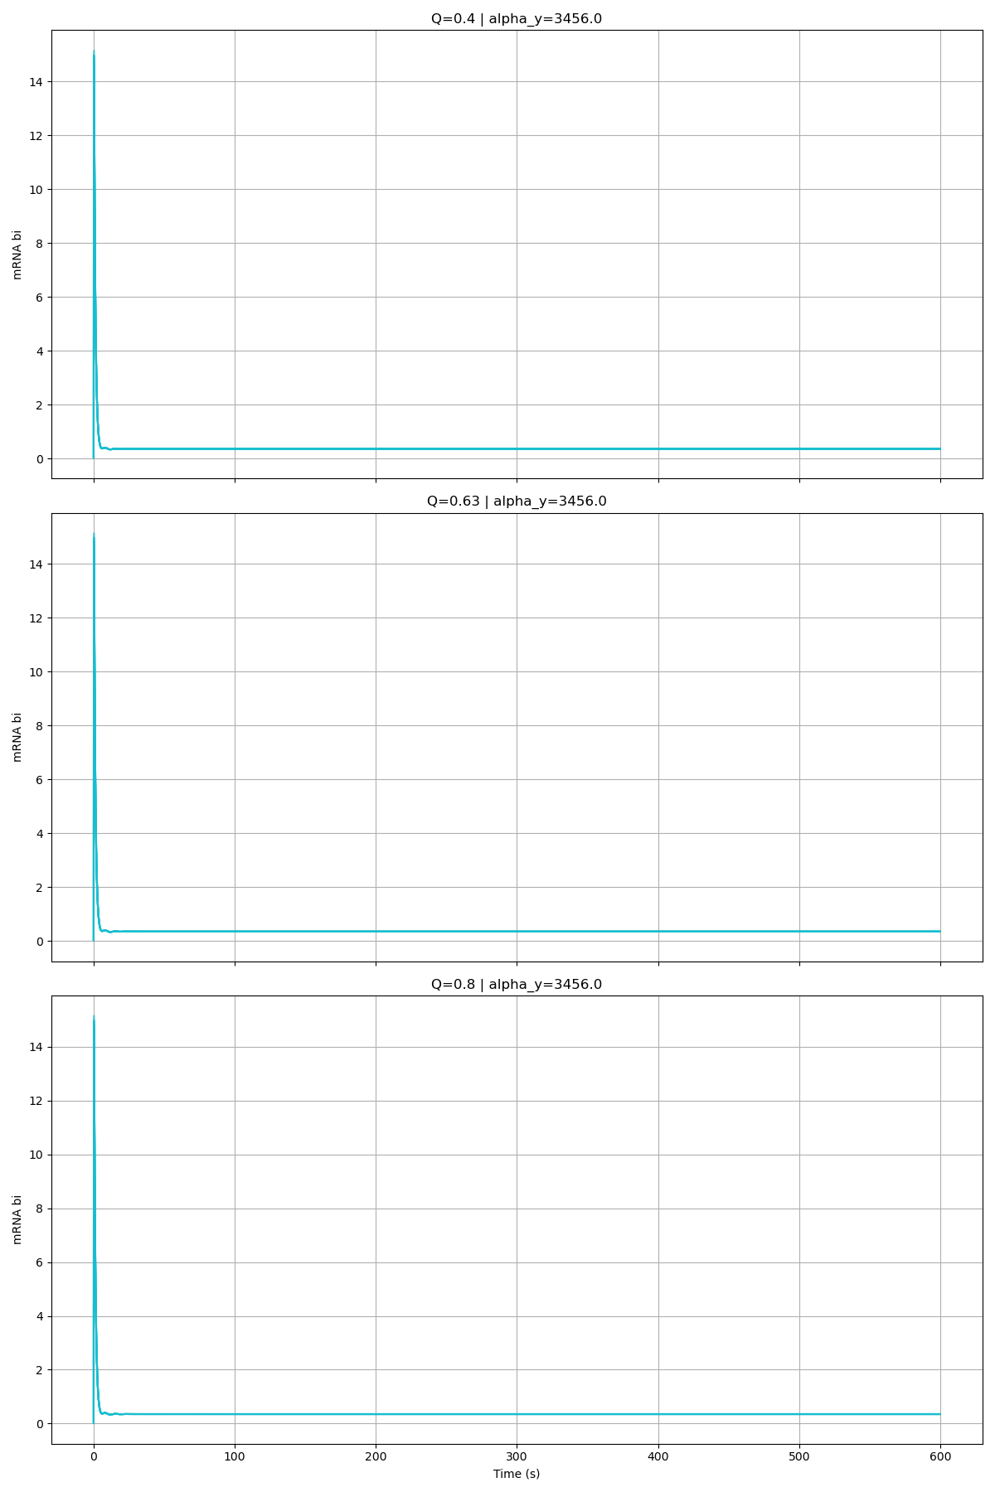
Alpha_Y = 3456

Slide 5
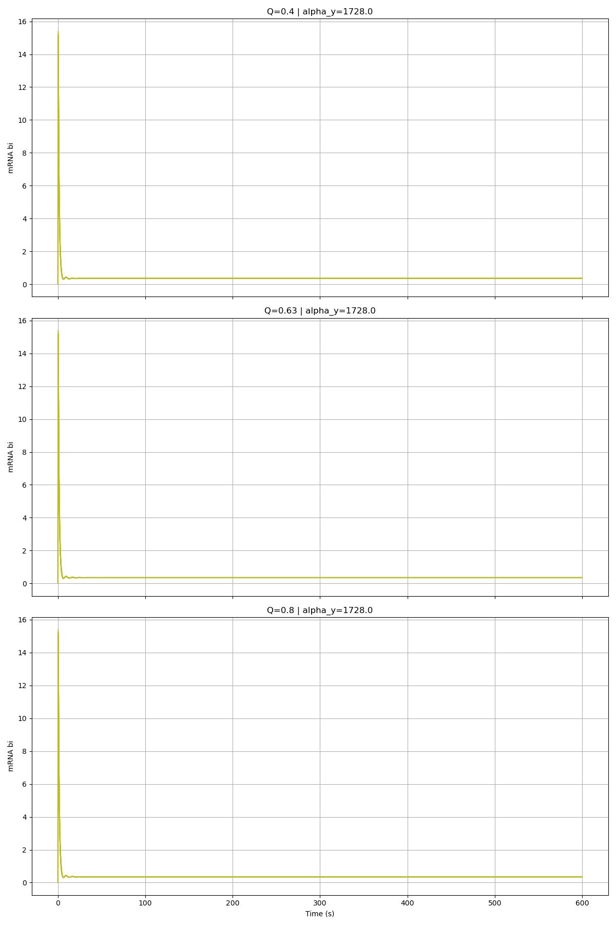
Alpha_Y = 1728

Slide 6
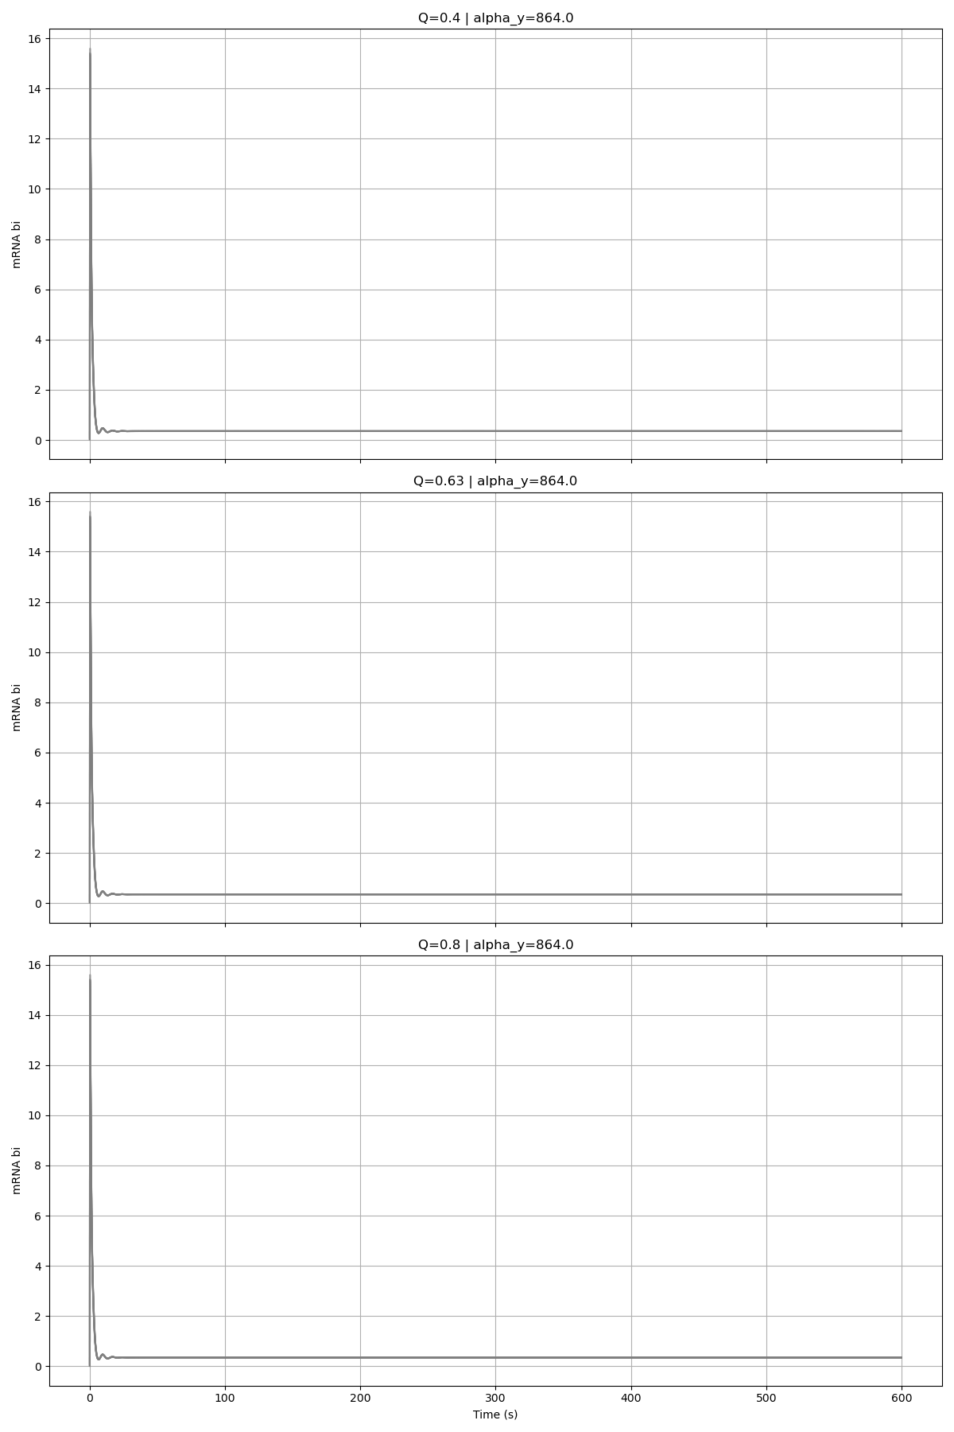
Alpha_Y = 864

Slide 7
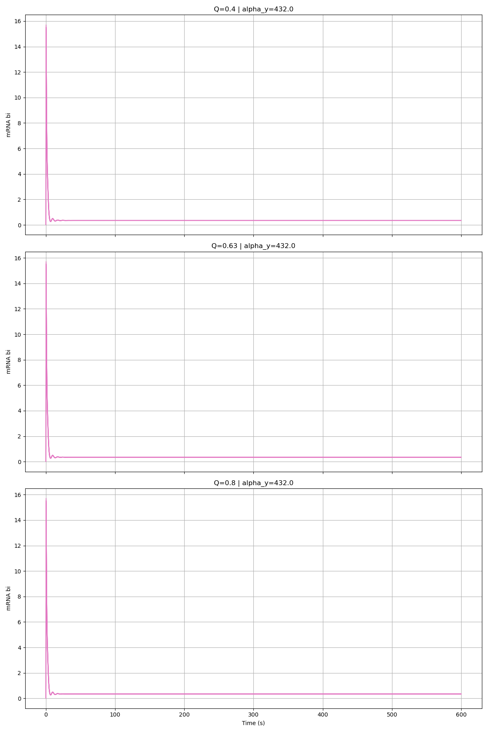
Alpha_Y = 432

Slide 8
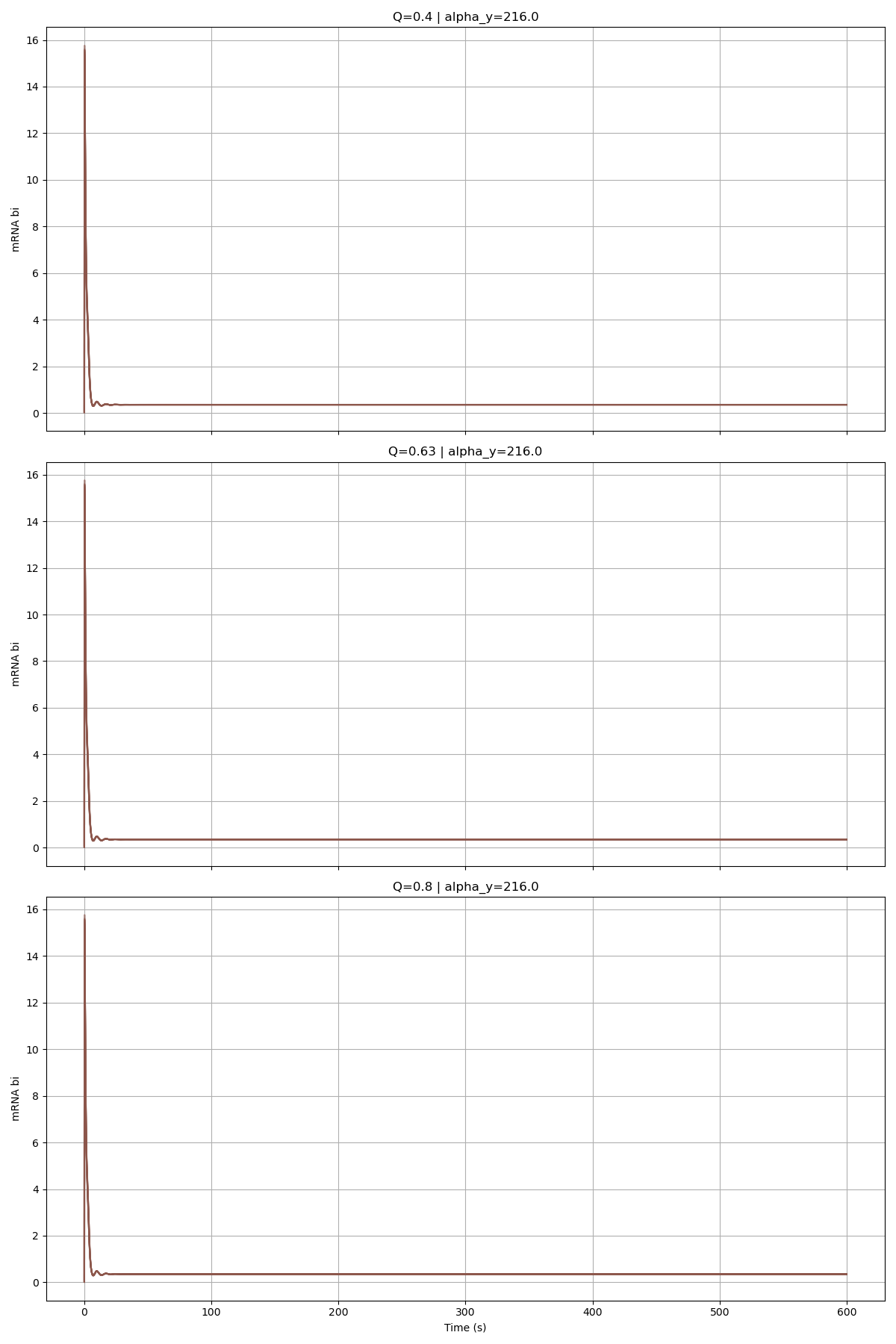
Alpha_Y = 216

Slide 9
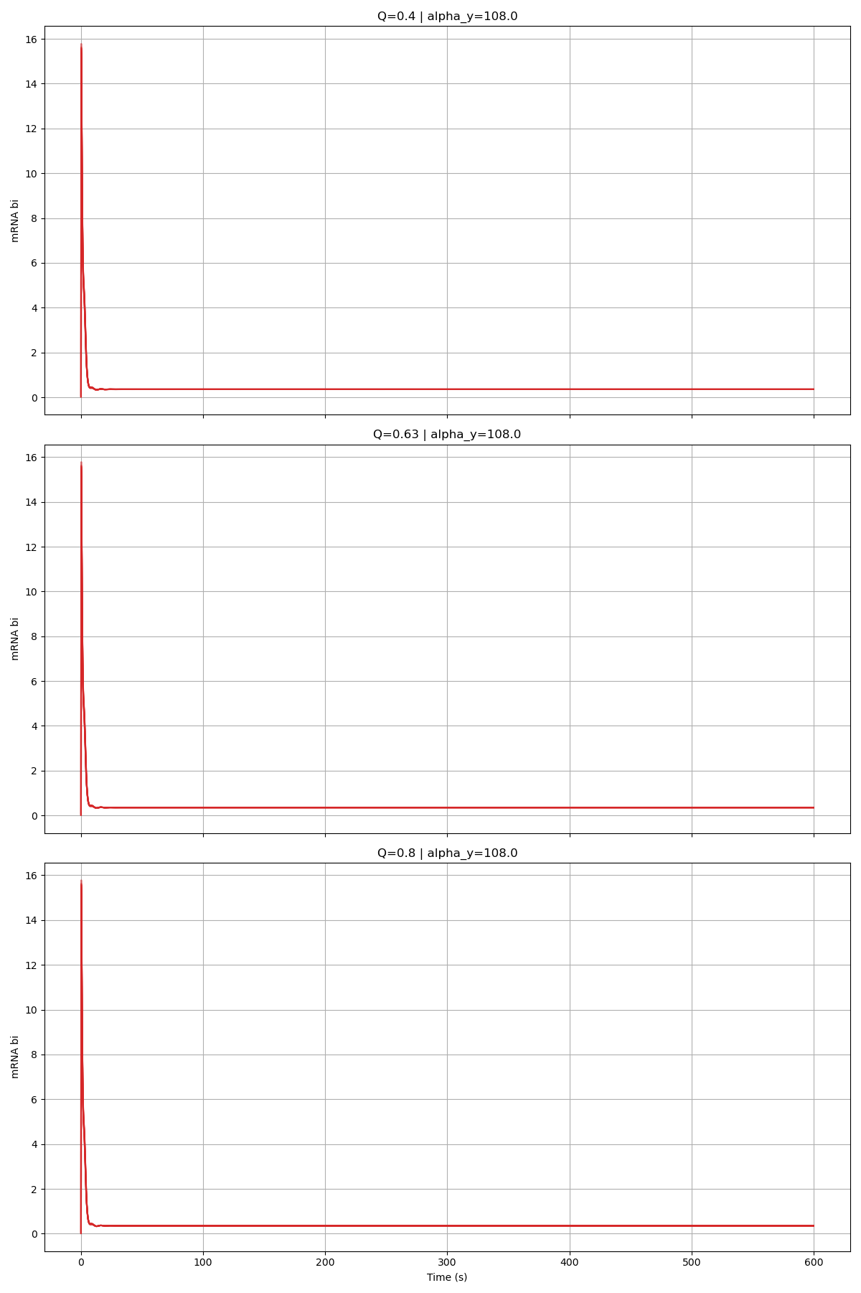
Alpha_Y = 108

Slide 10
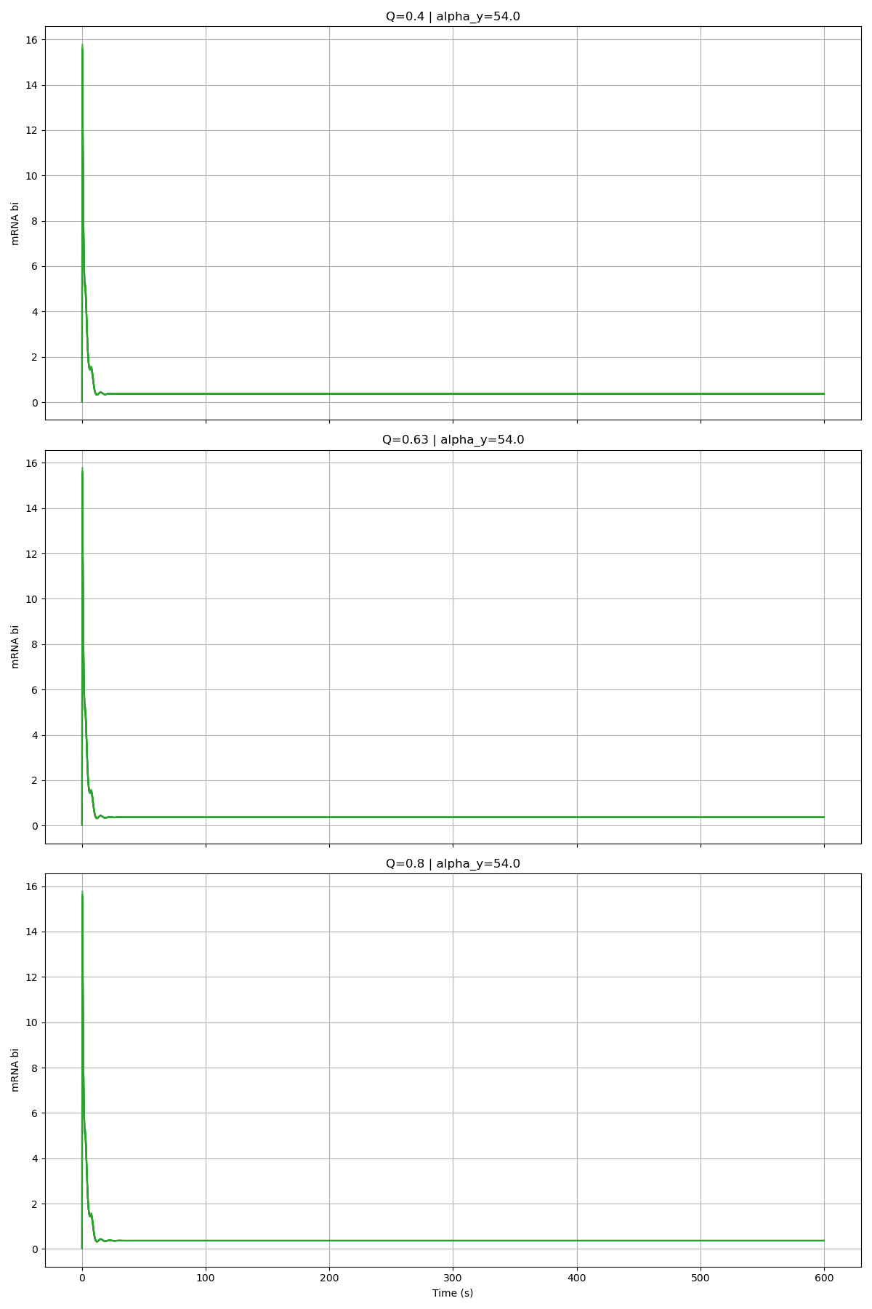
Alpha_Y = 54

Slide 11
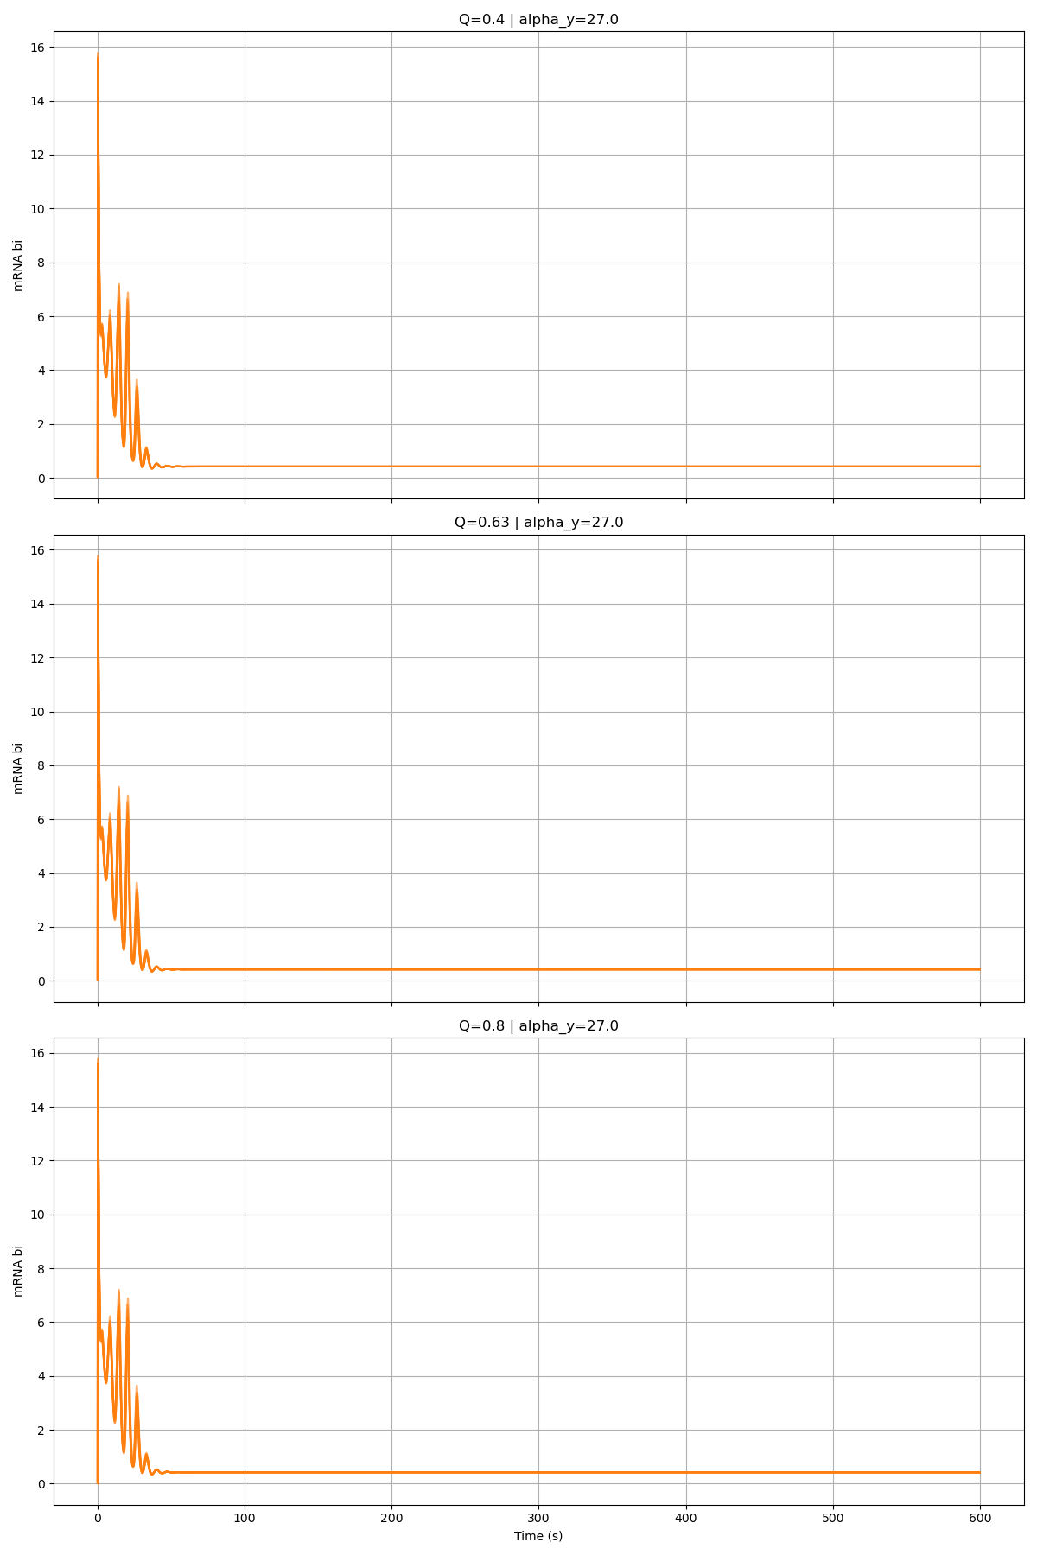
Alpha_Y = 27

Slide 12
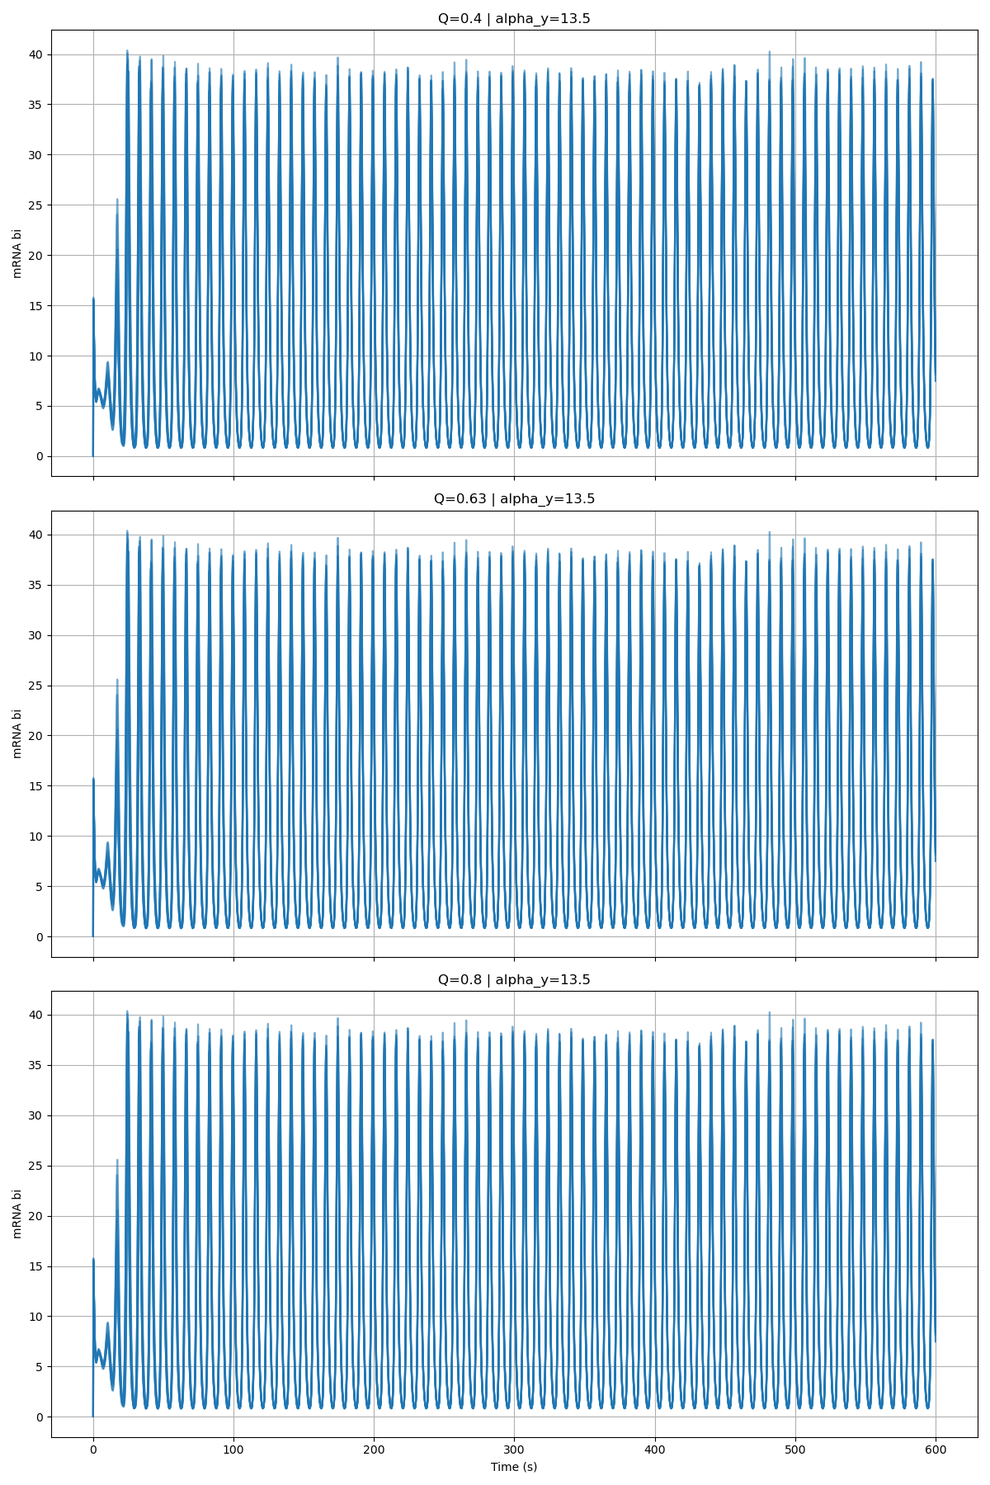
Alpha_Y = 13.5

