Slide 1
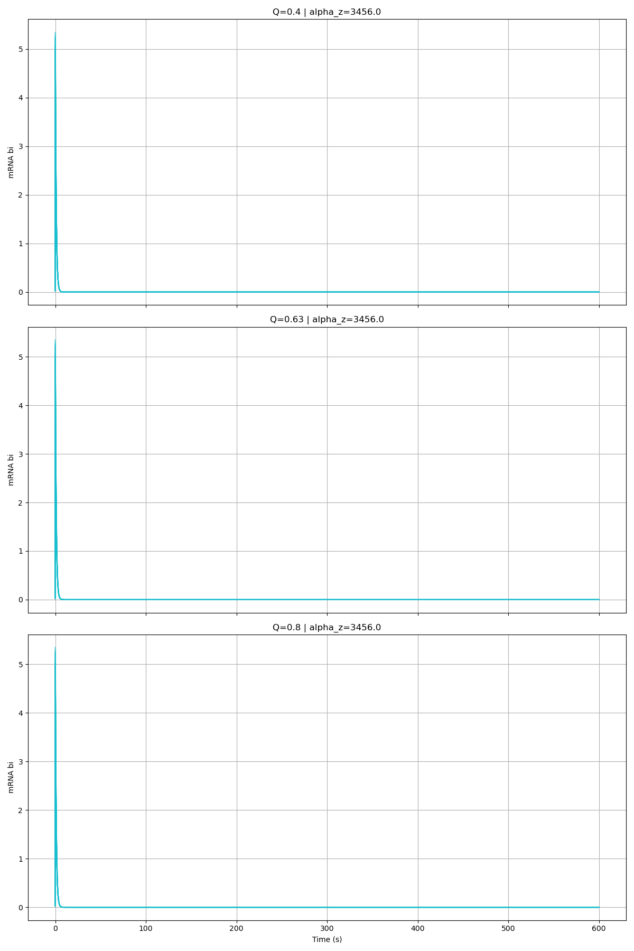
Alpha_Z = 3456

Slide 2
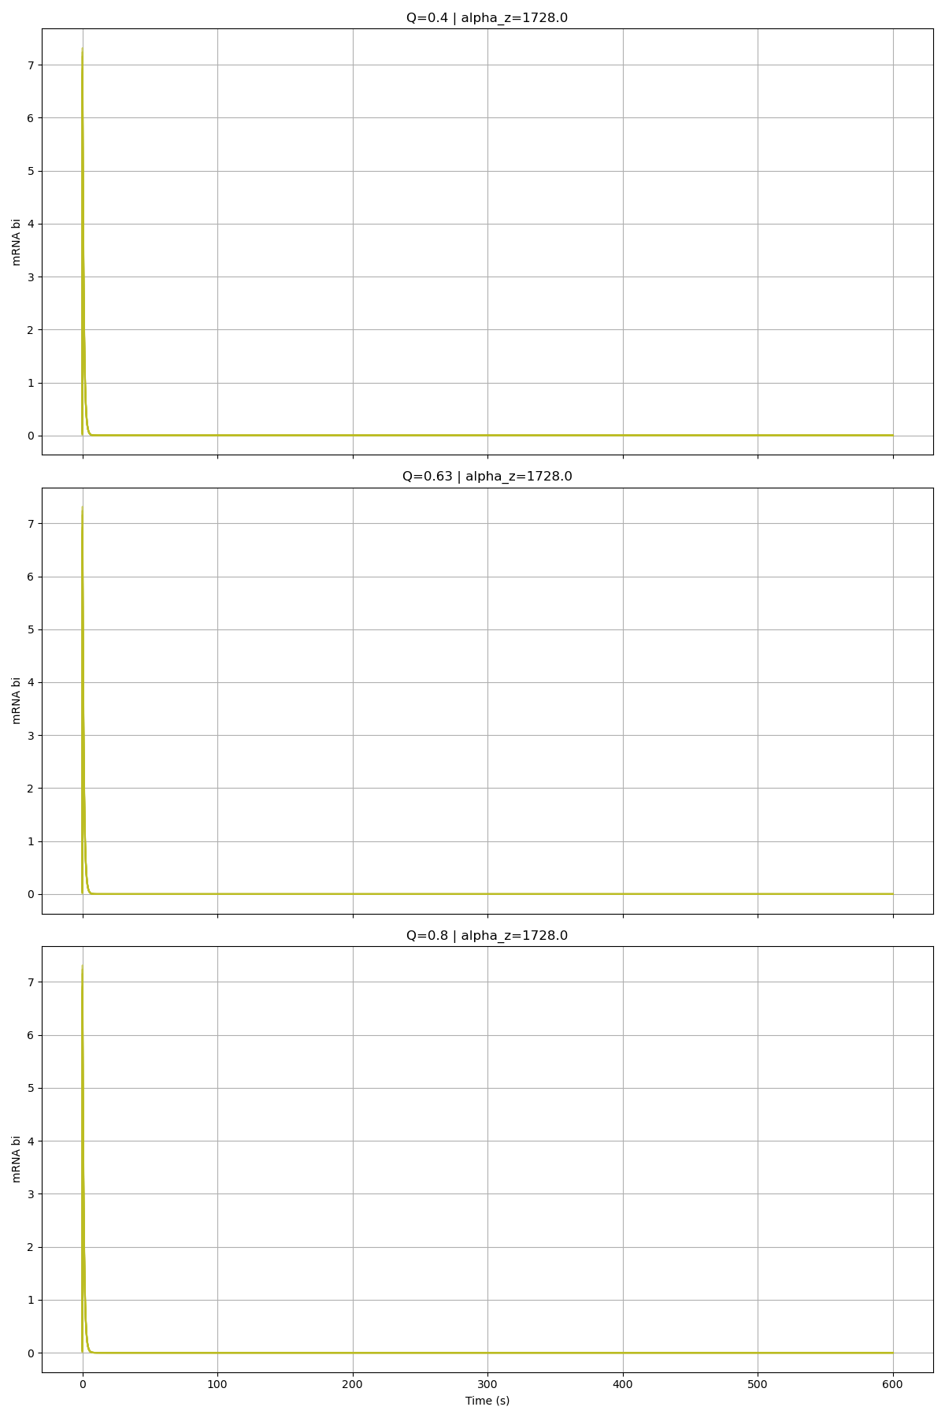
Alpha_Z = 1728

Slide 3
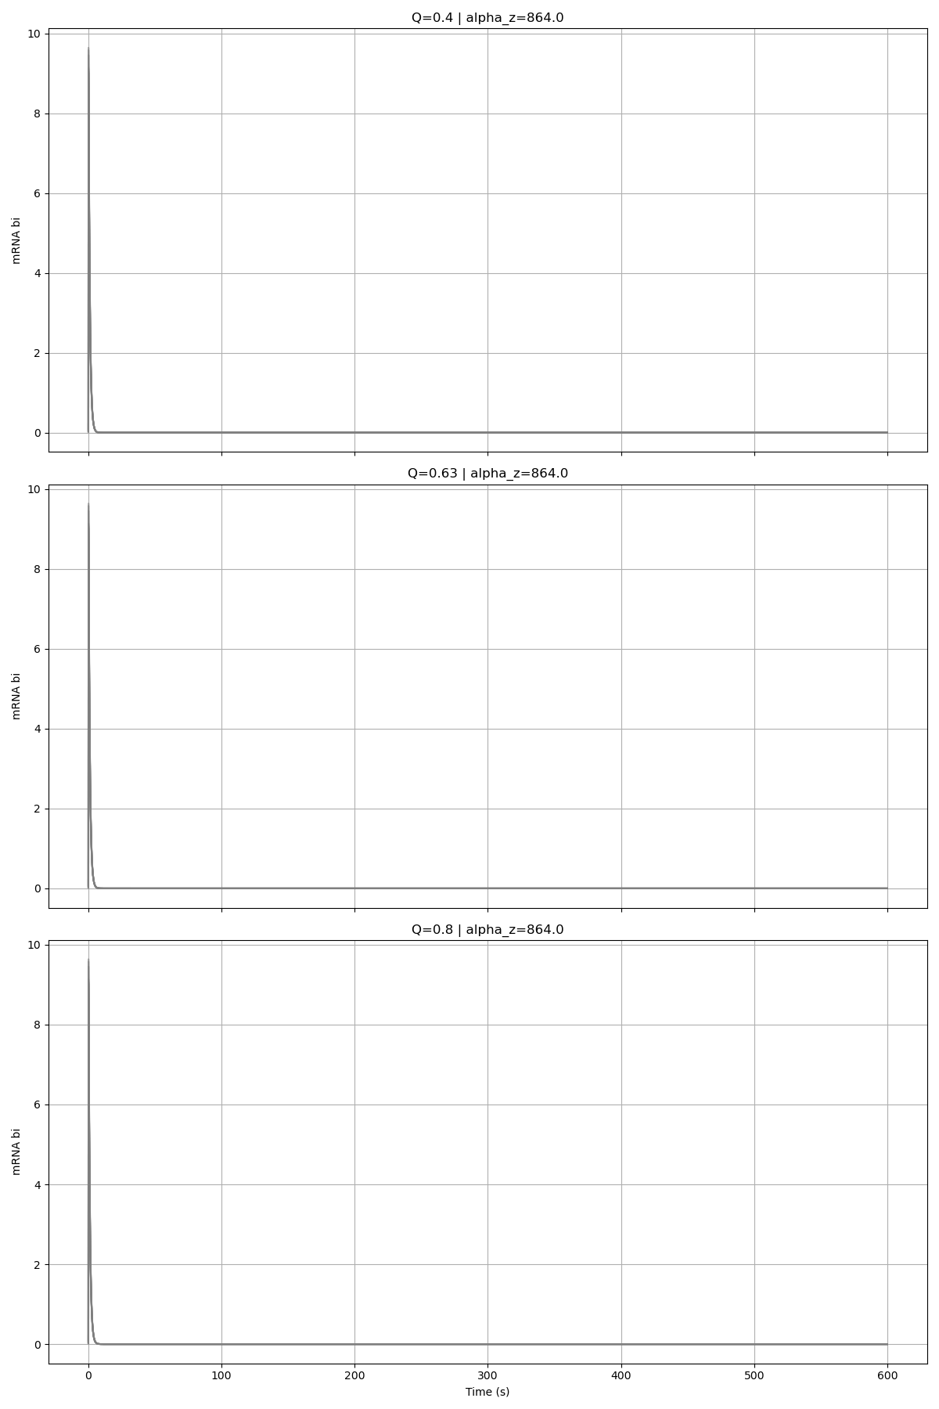
Alpha_Z = 864

Slide 4
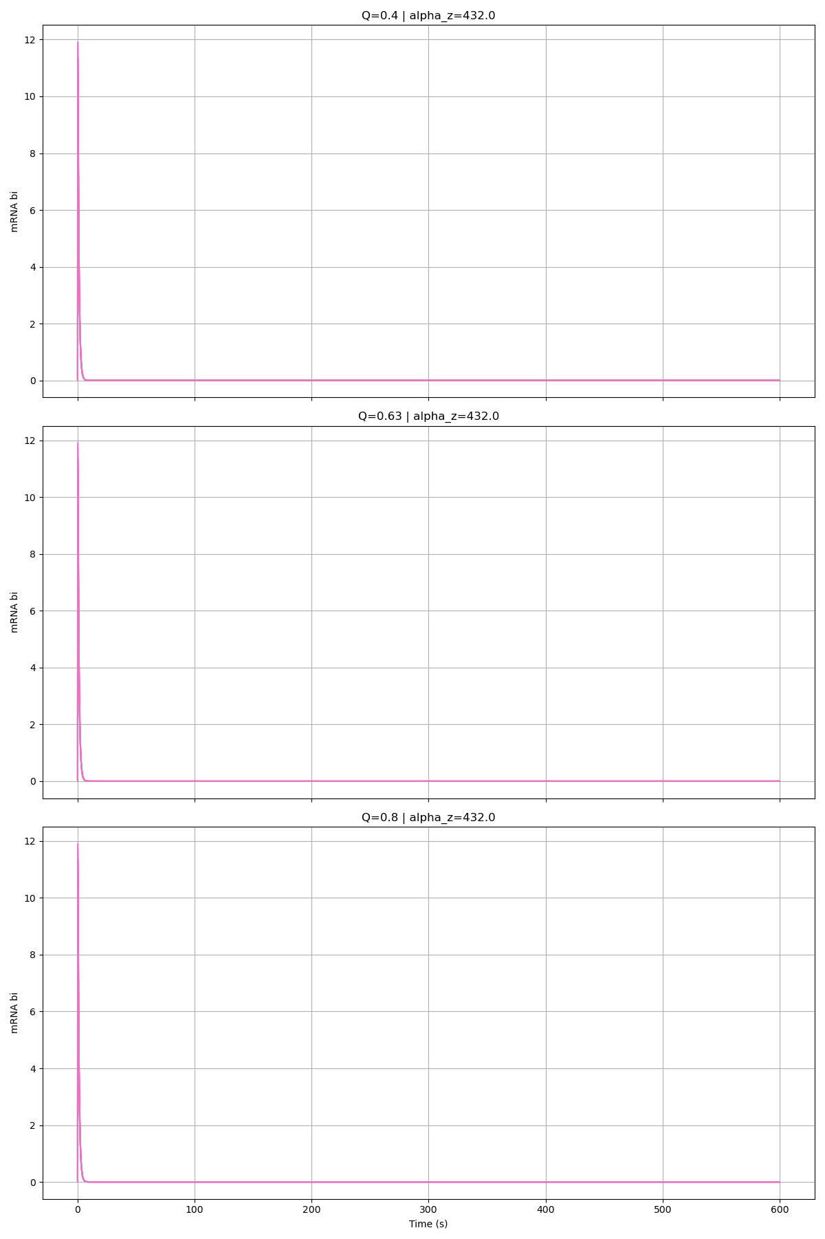
Alpha_Z = 432

Slide 5
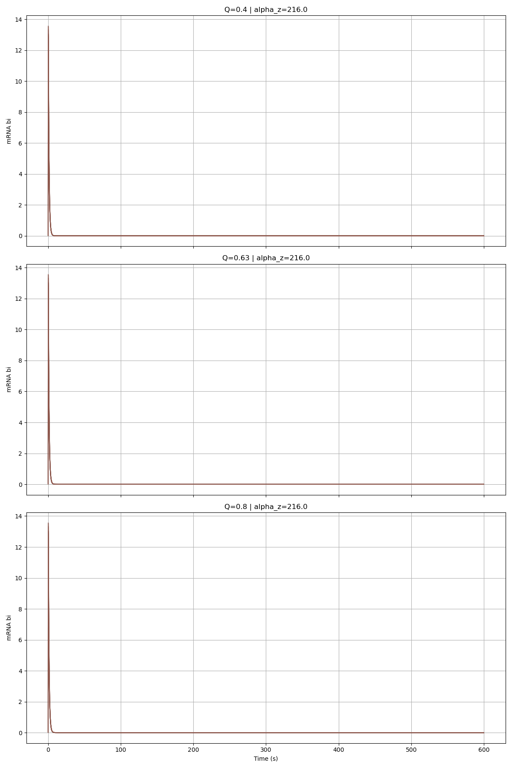
Alpha_Z = 216

Slide 6
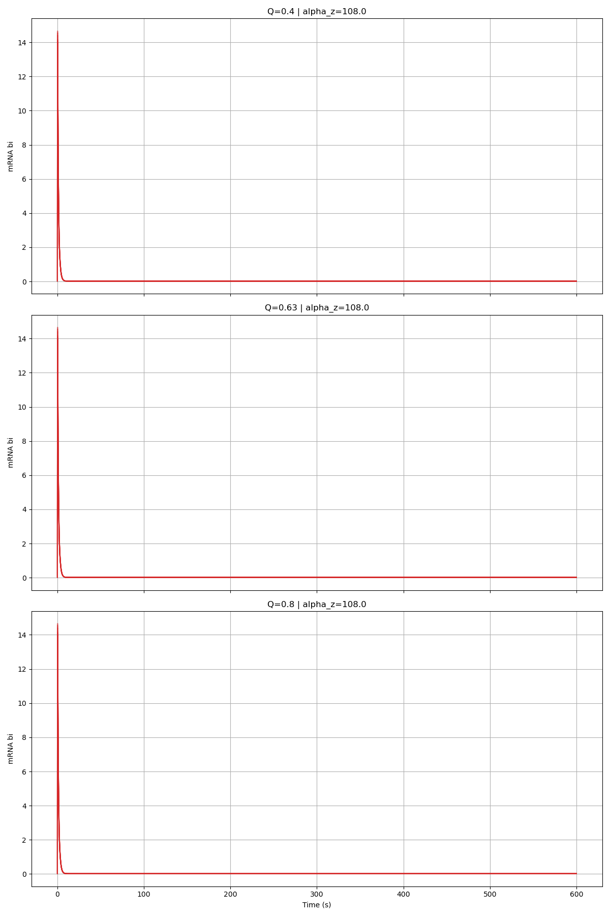
Alpha_Z = 108

Slide 7
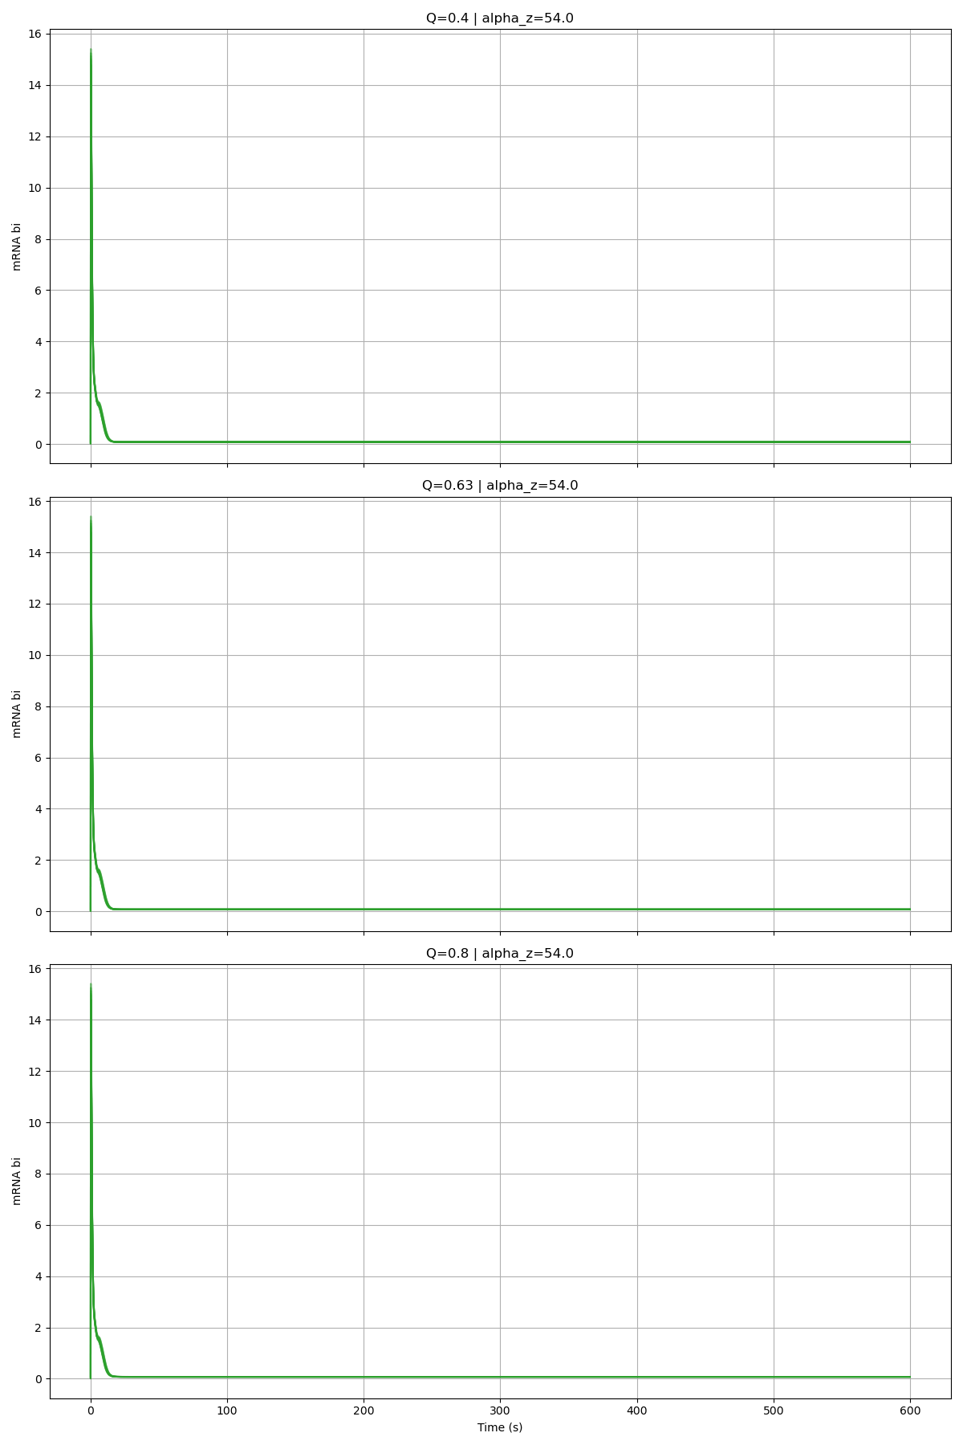
Alpha_Z = 54

Slide 8
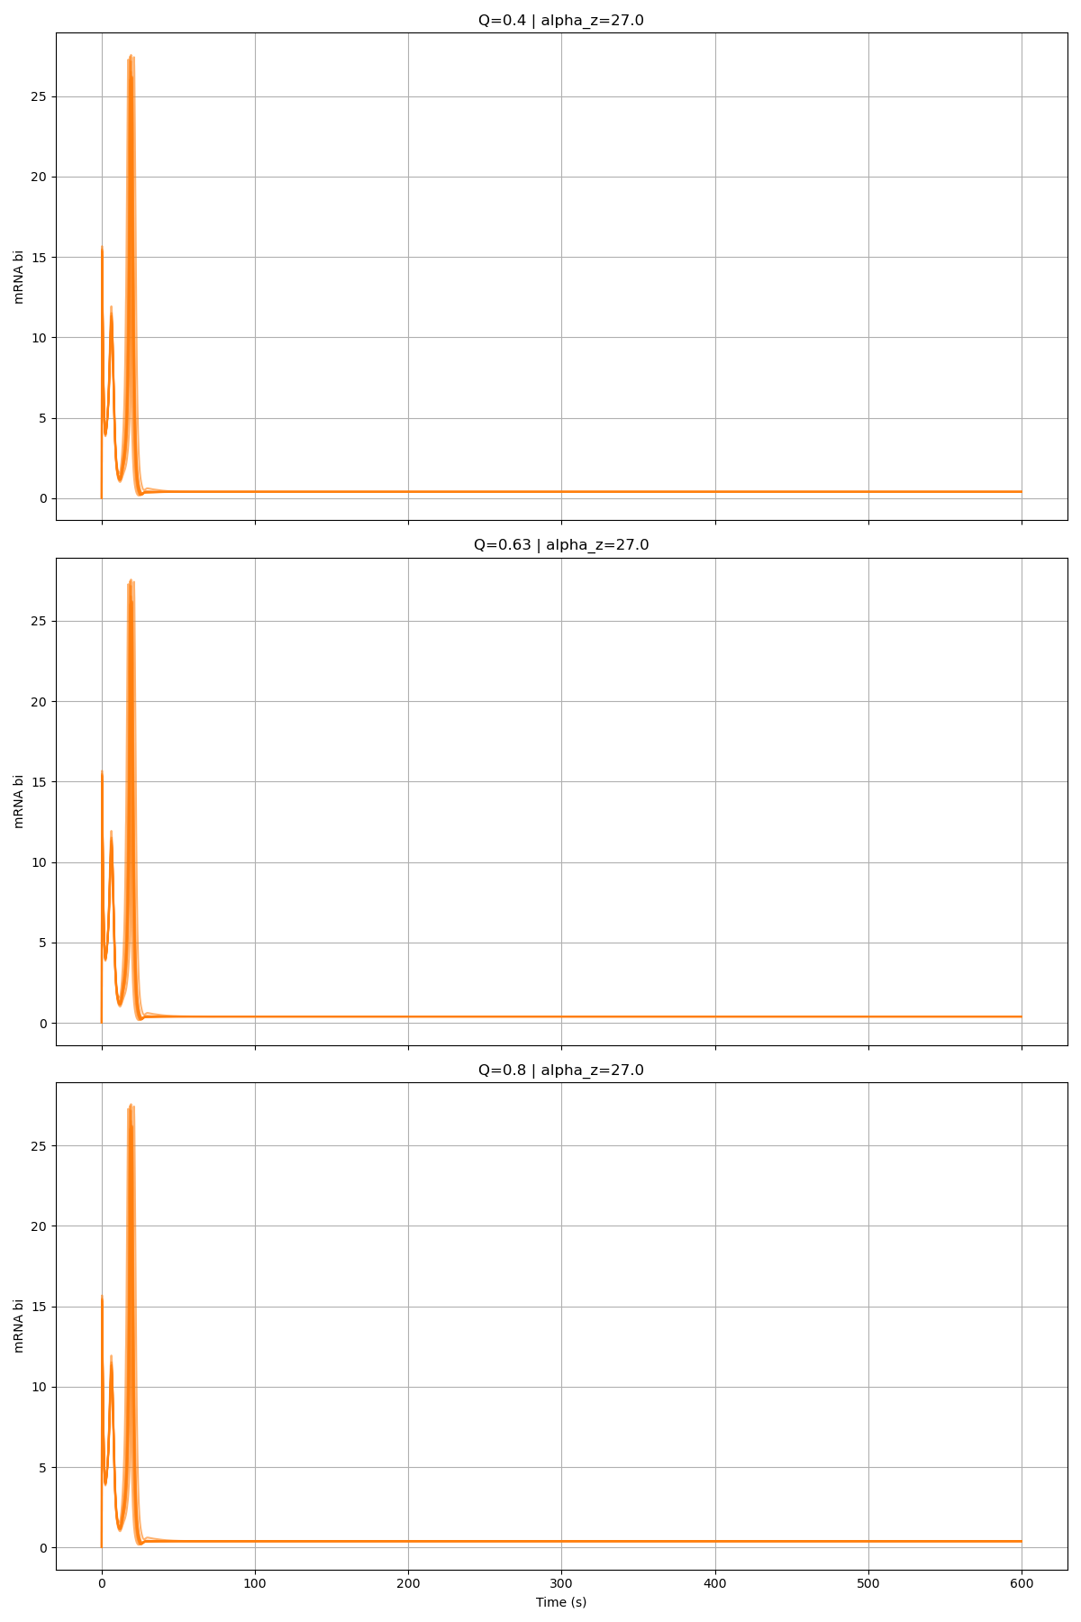
Alpha_Z = 27

Slide 9
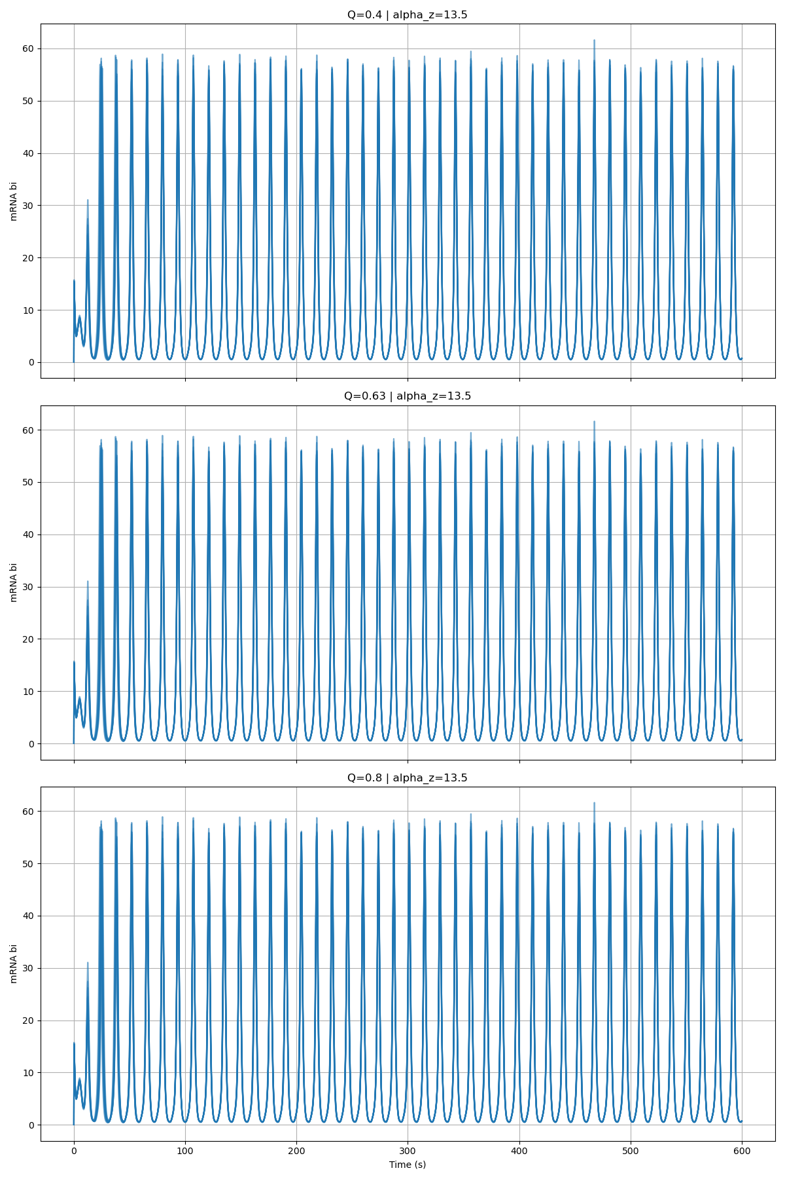
Alpha_Z = 13.5

