Slide 1
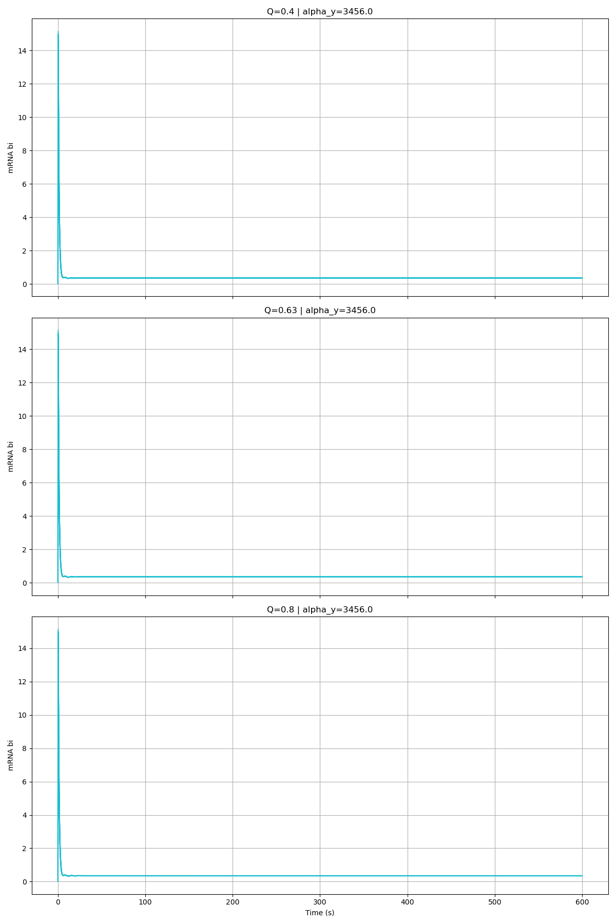
Alpha_Y = 3456

Slide 2
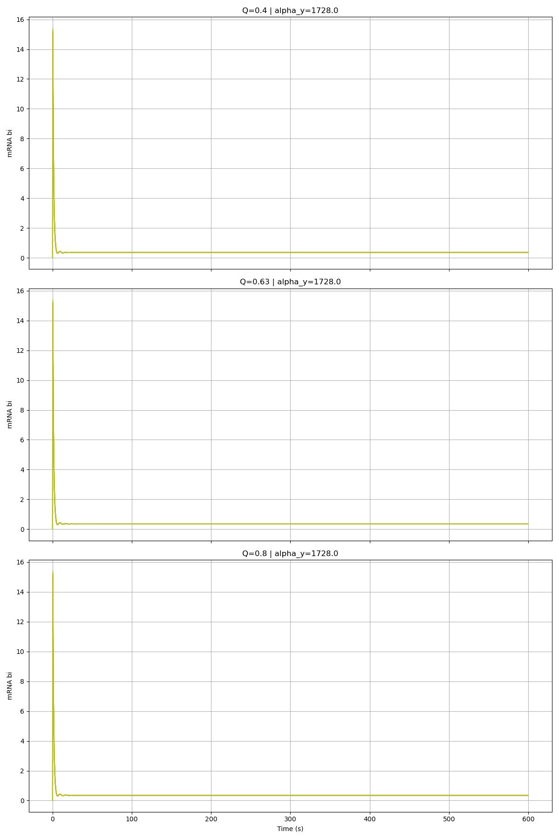
Alpha_Y = 1728

Slide 3
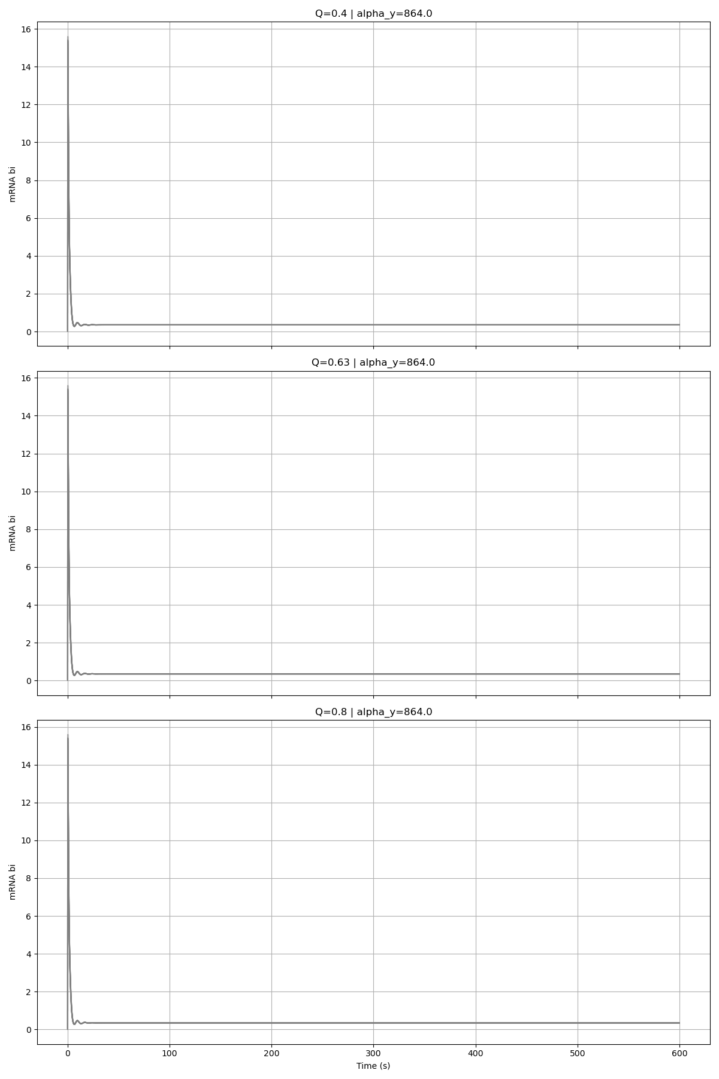
Alpha_Y = 864

Slide 4
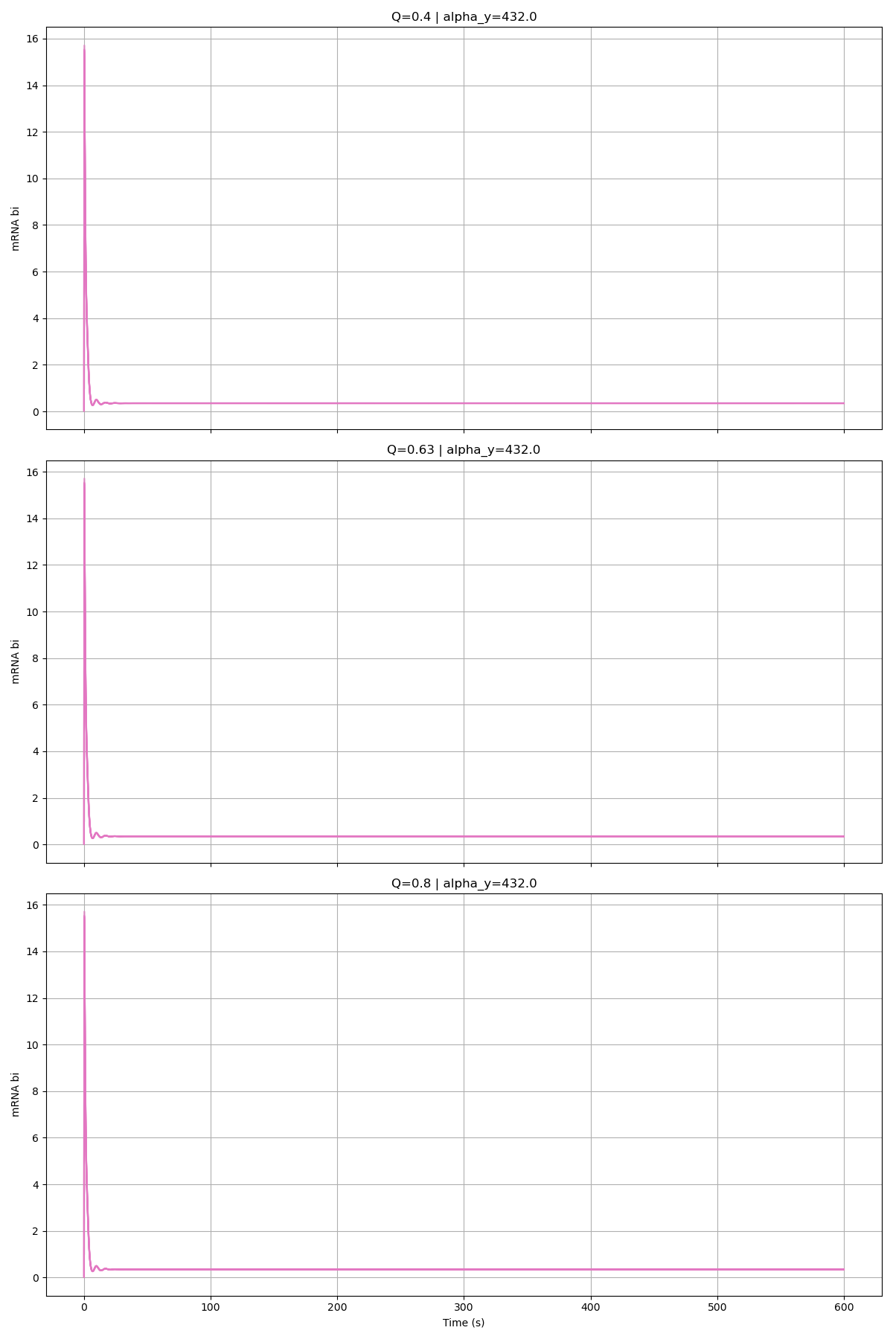
Alpha_Y = 432

Slide 5
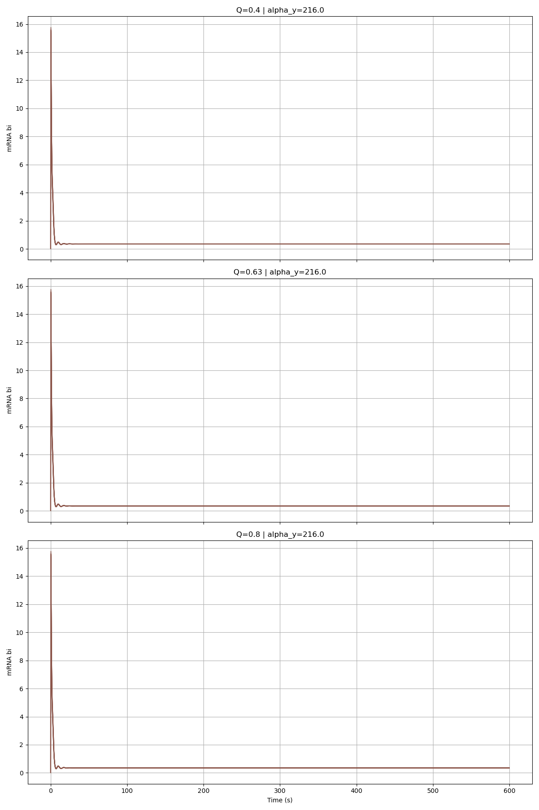
Alpha_Y = 216

Slide 6
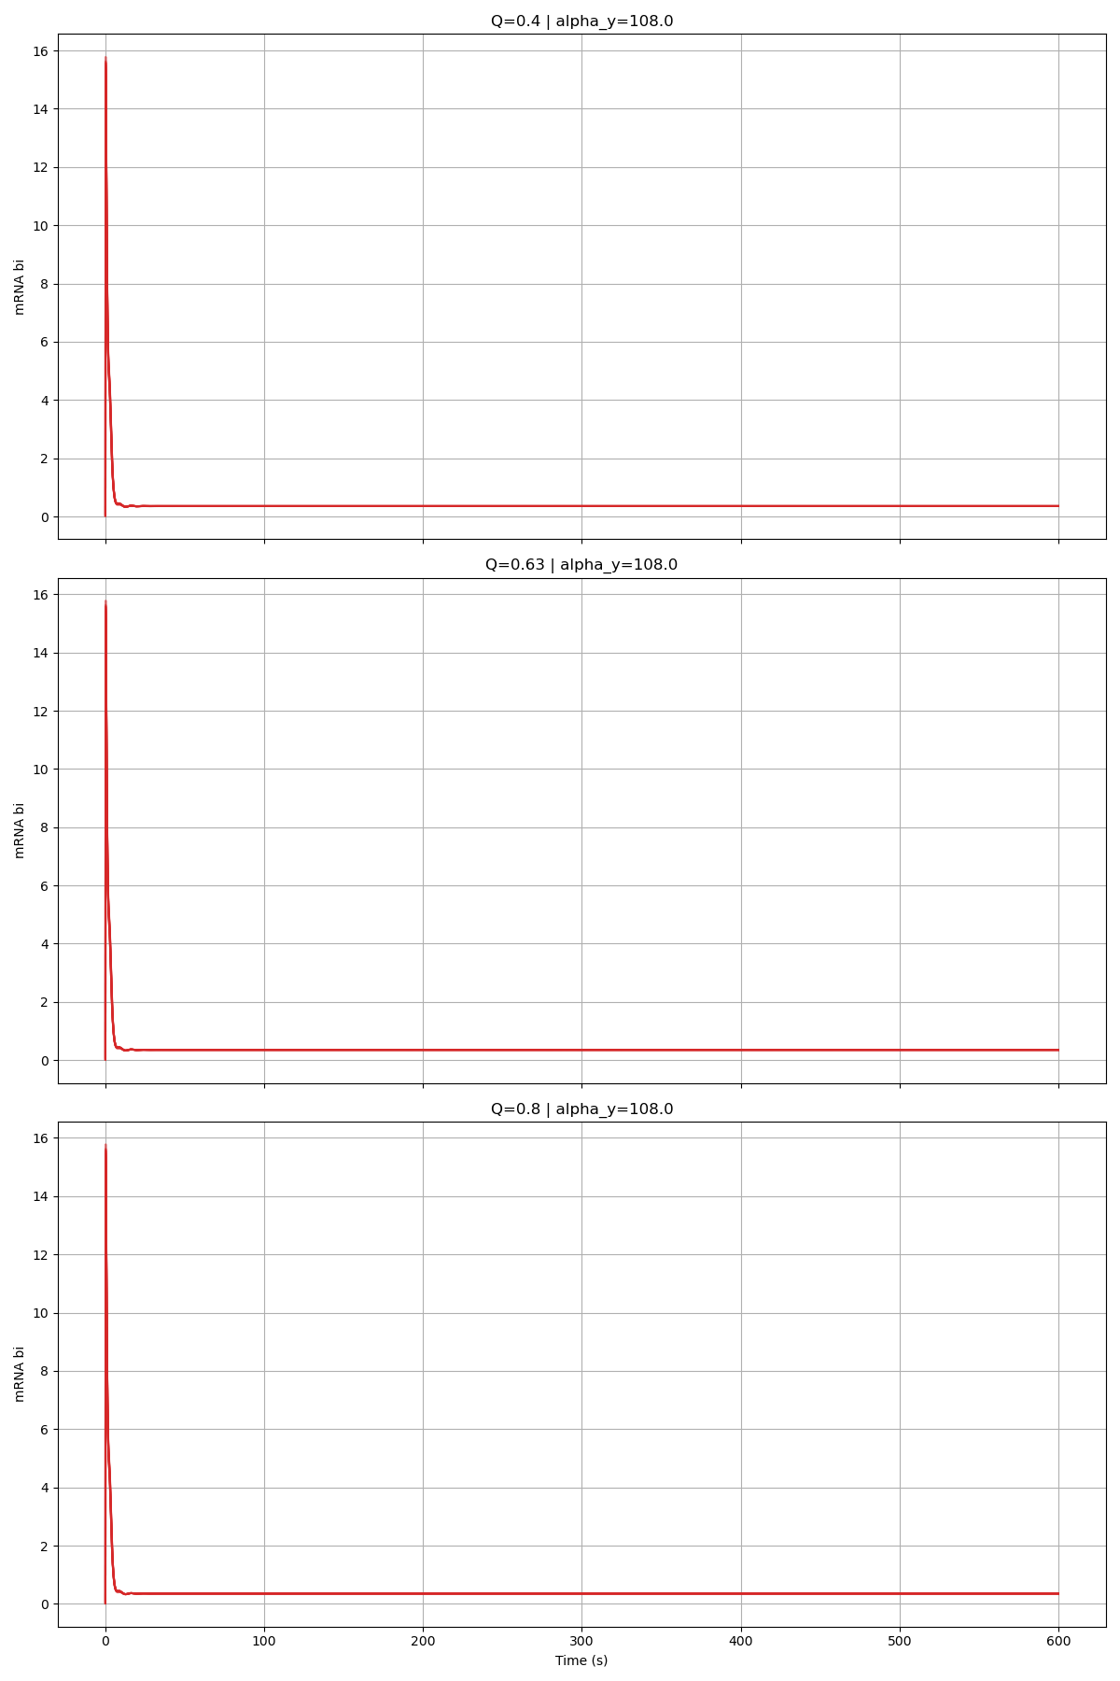
Alpha_Y = 108

Slide 7
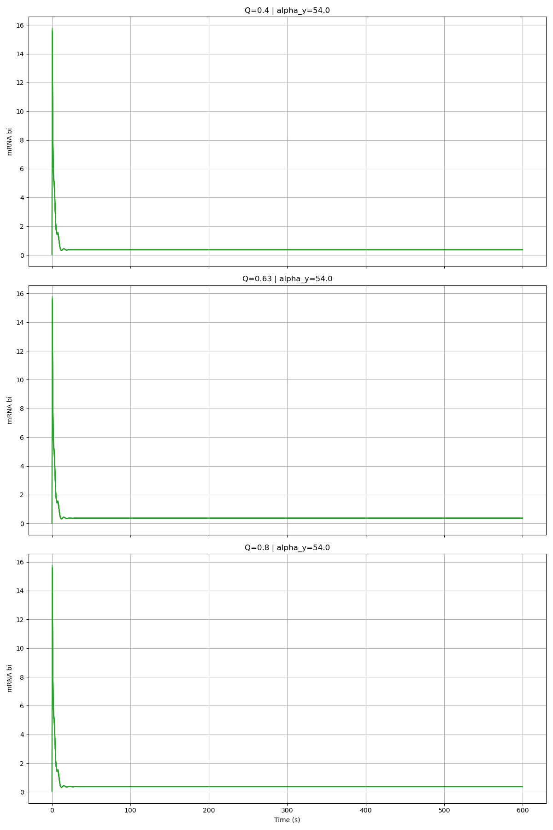
Alpha_Y = 54

Slide 8
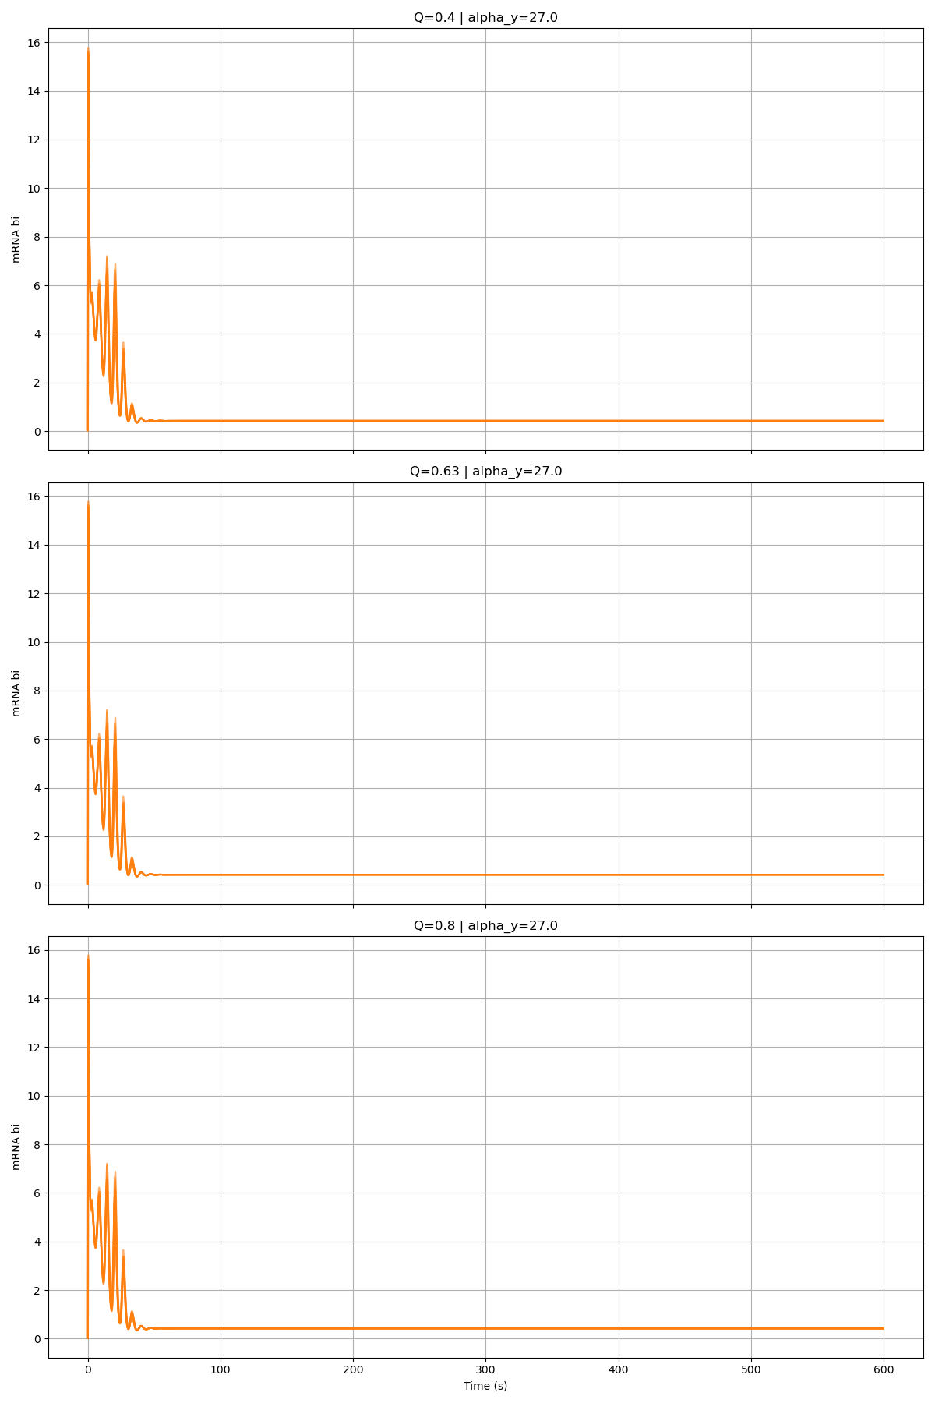
Alpha_Y = 27

Slide 9
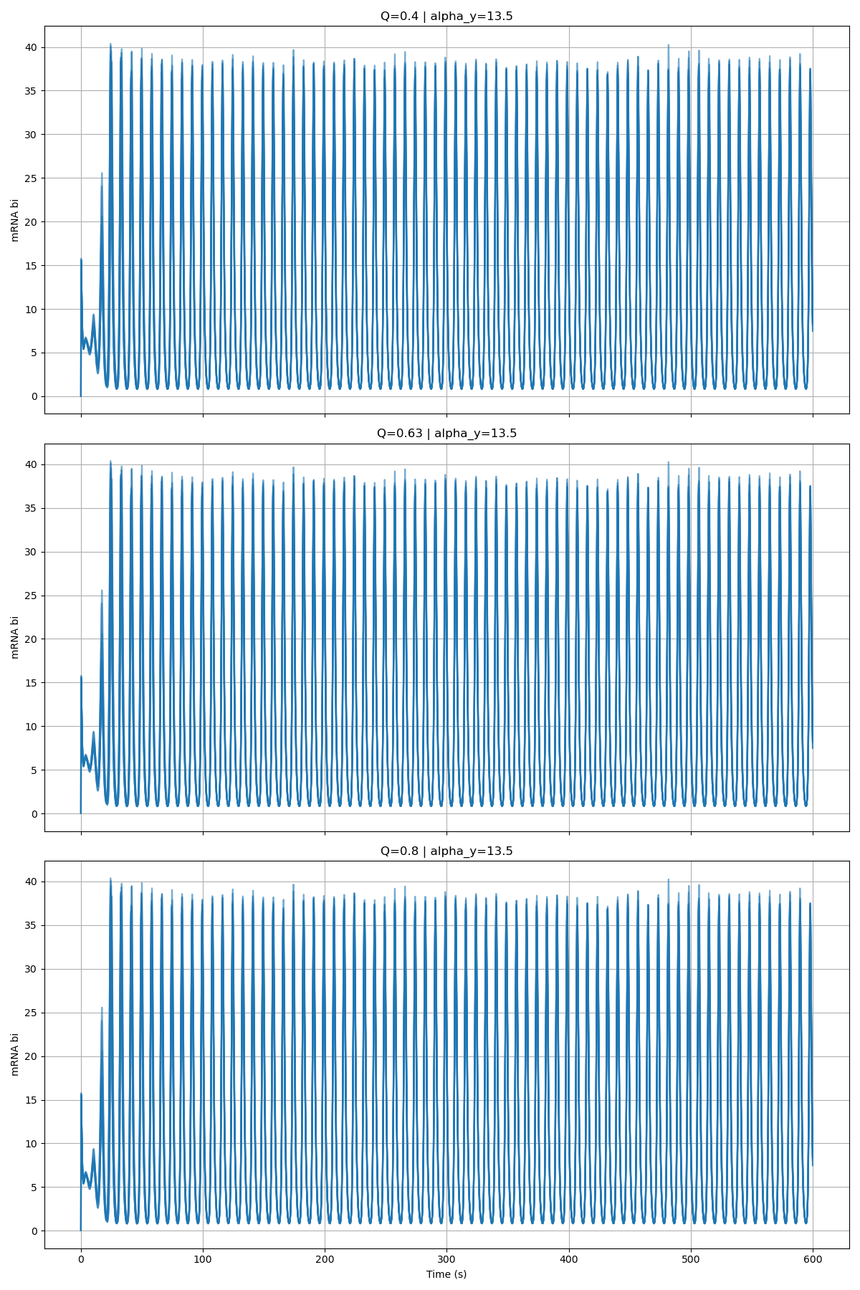
Alpha_Y = 13.5

