Slide 1
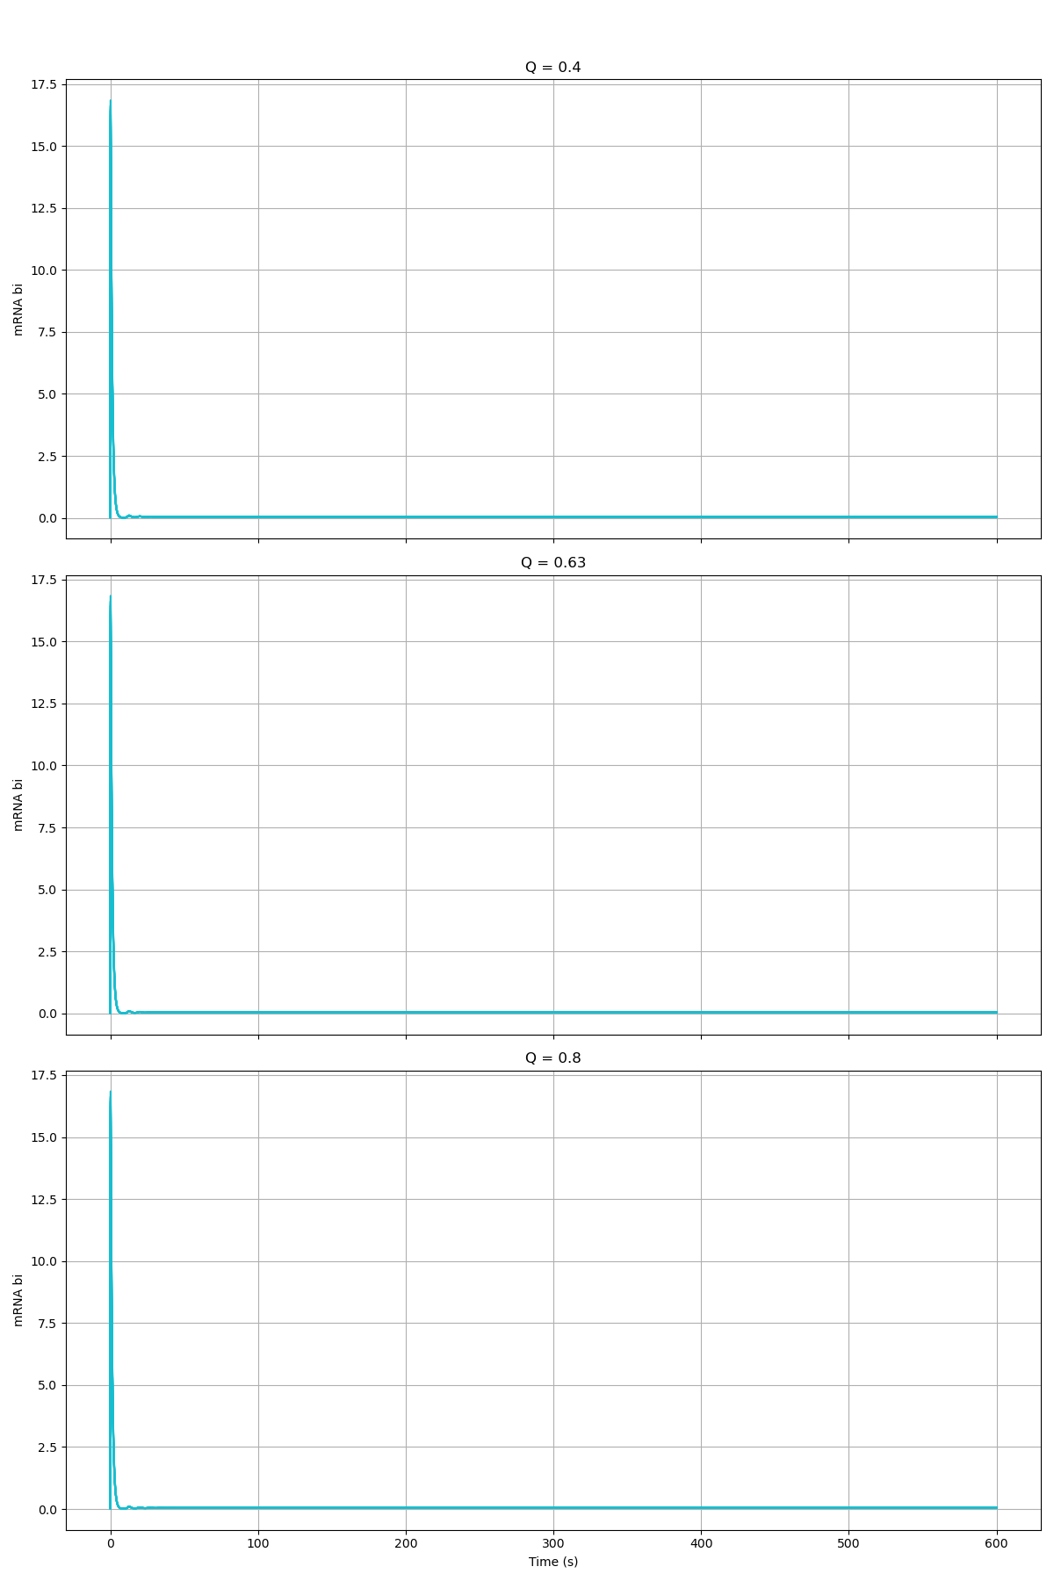
Alpha_W = 3456

Slide 2
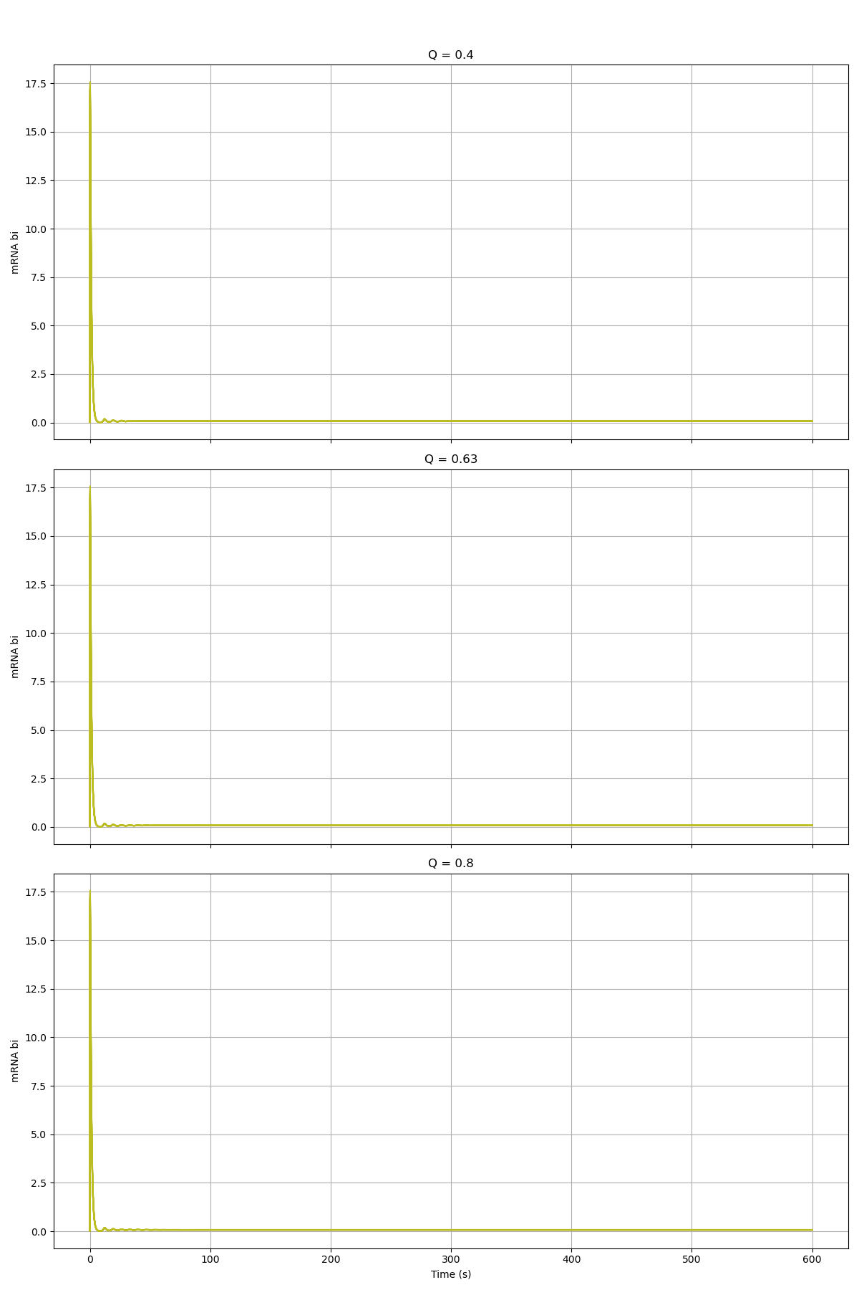
Alpha_W = 1728

Slide 3
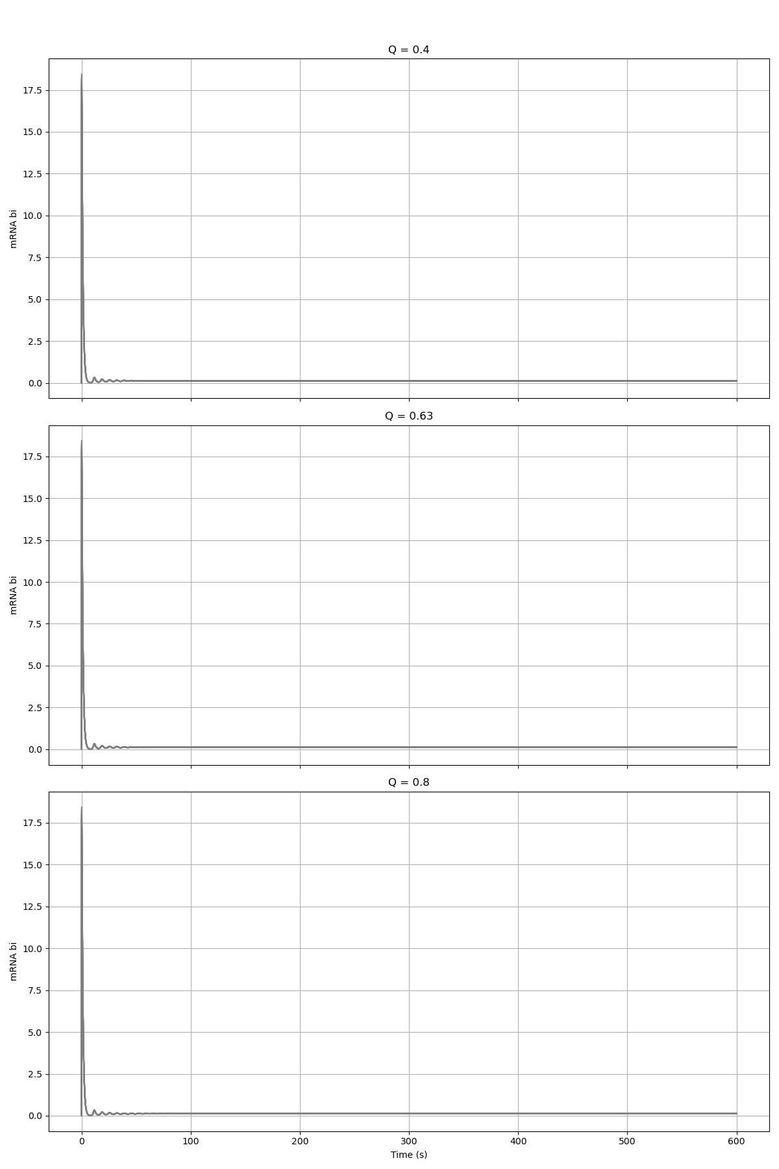
Alpha_W = 864

Slide 4
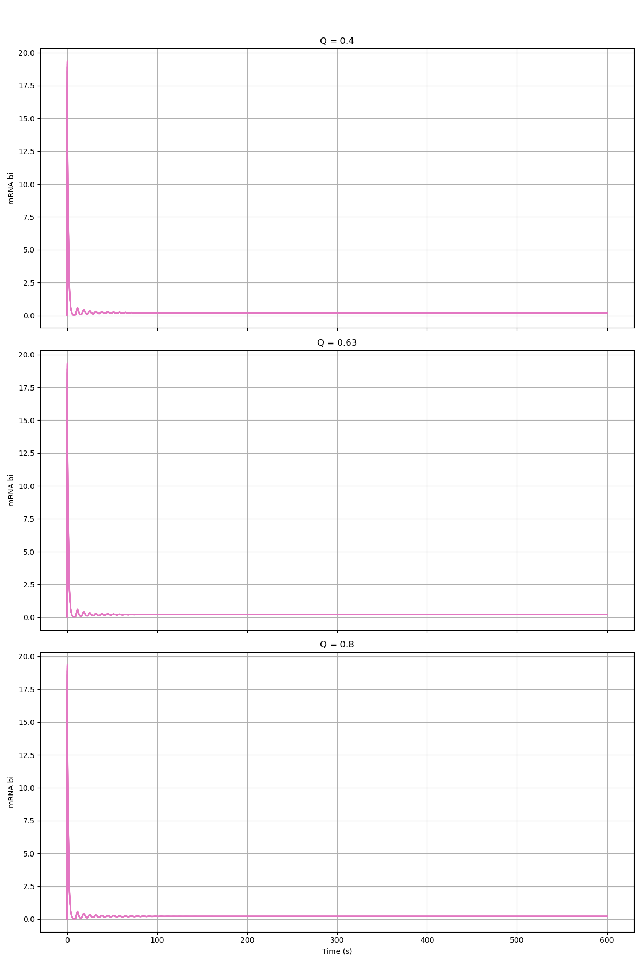
Alpha_W = 432

Slide 5
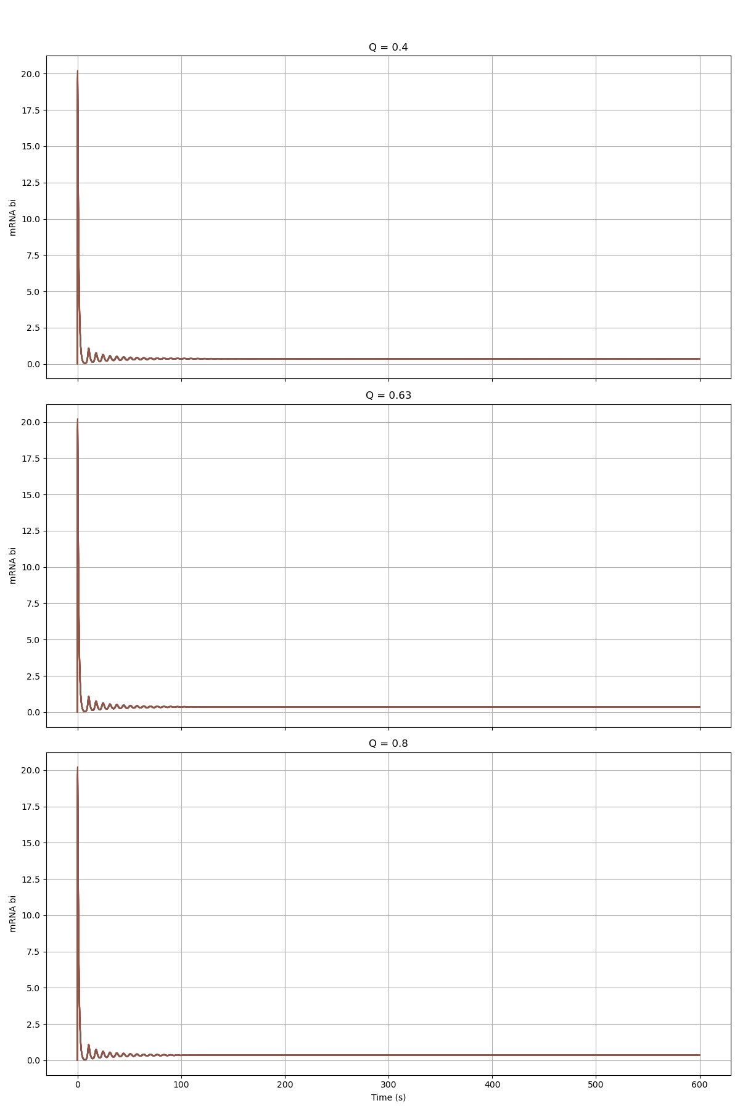
Alpha_W = 216

Slide 6
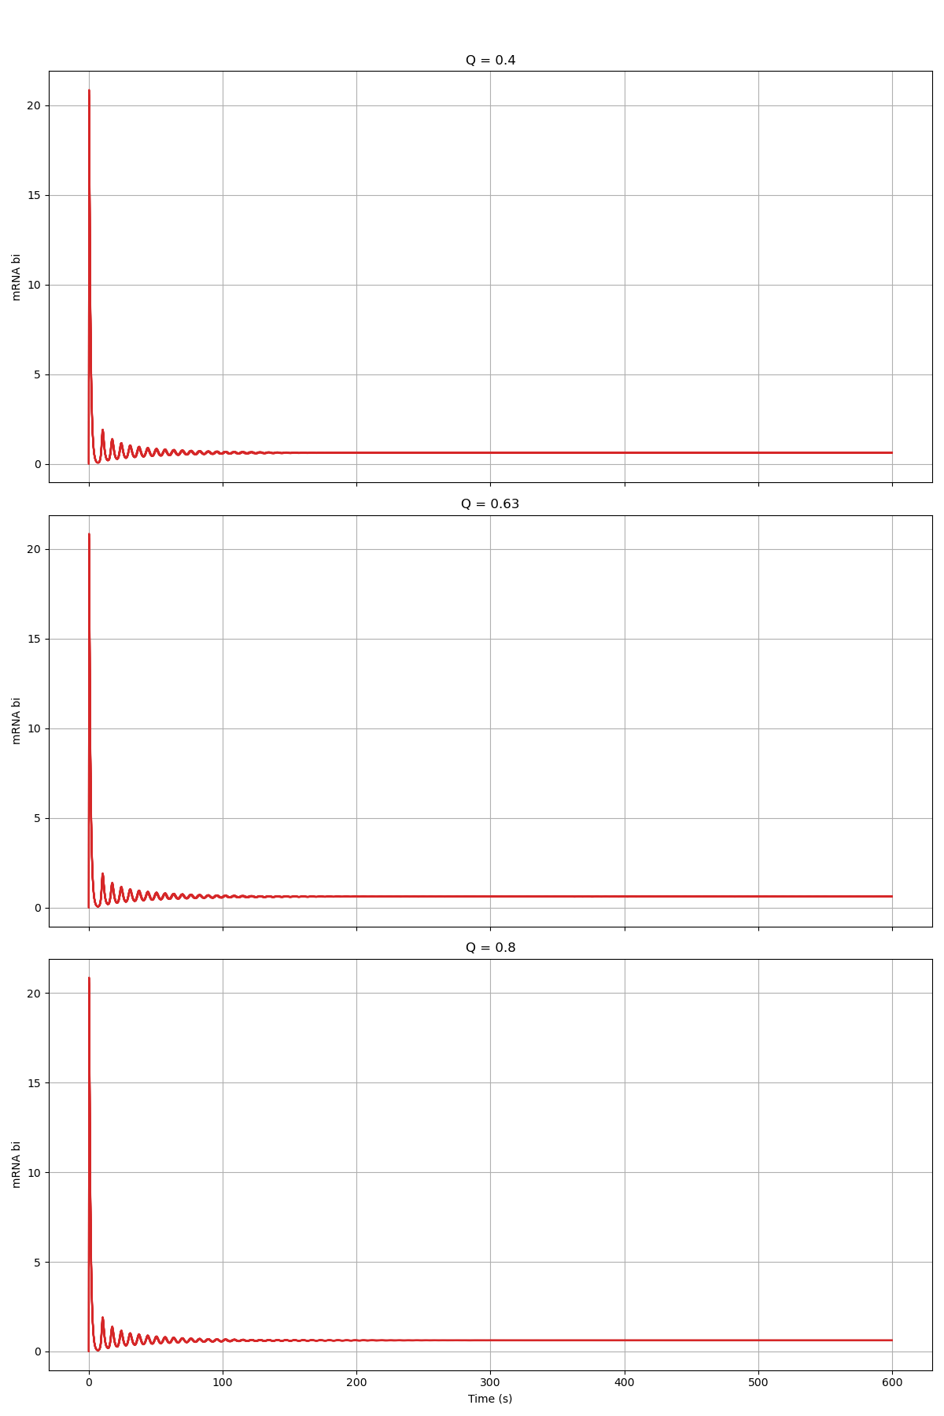
Alpha_W = 108

Slide 7
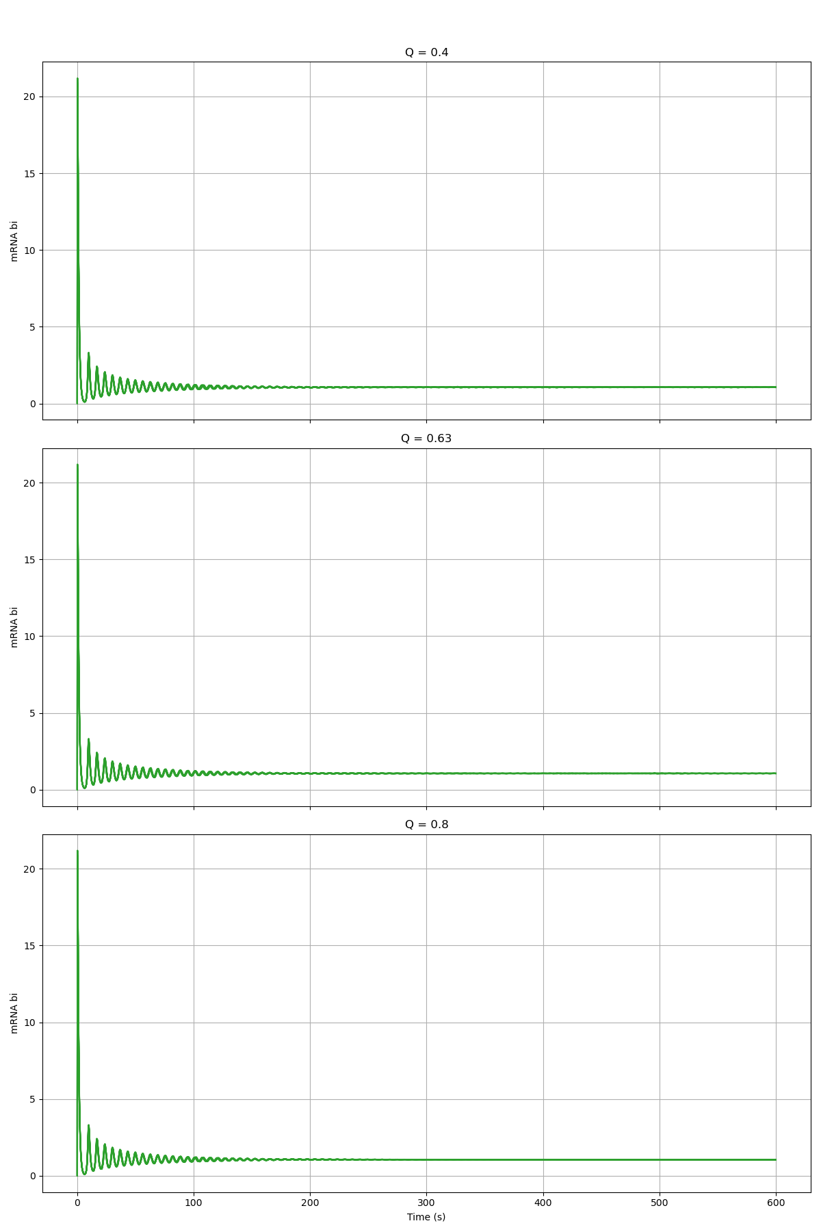
Alpha_W = 54

Slide 8
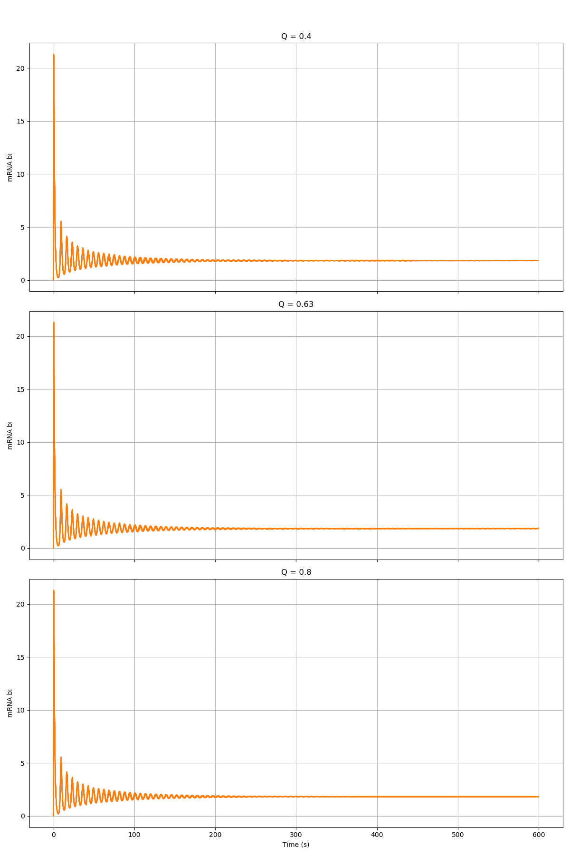
Alpha_W = 27

Slide 9
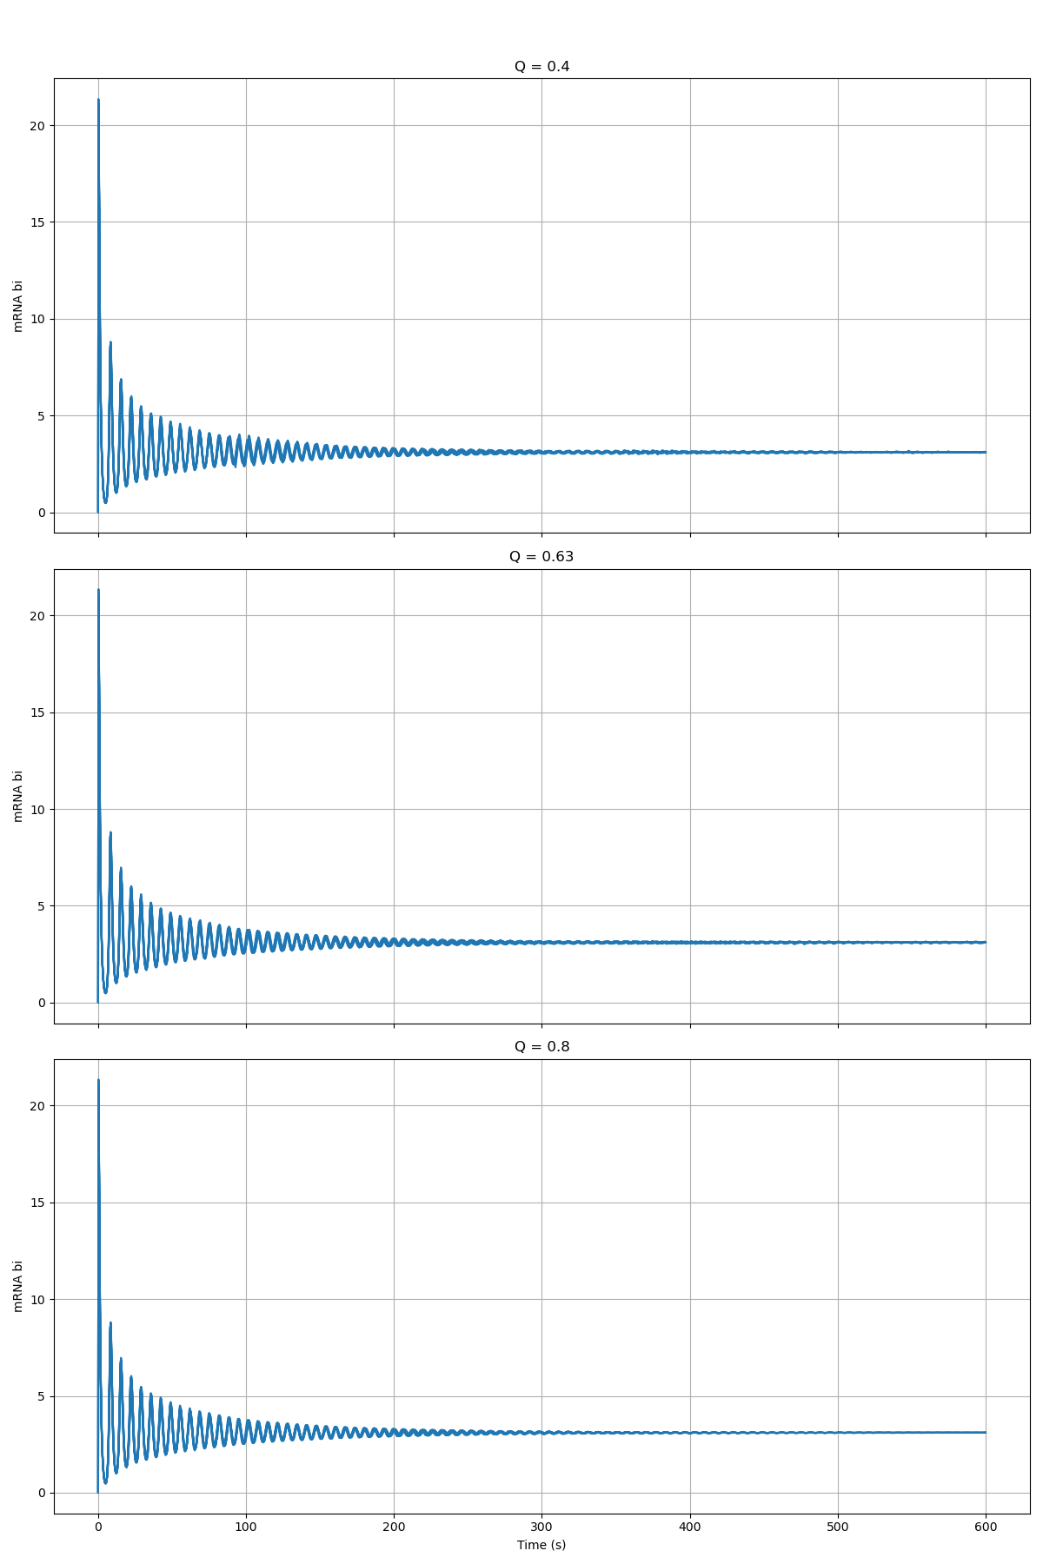
Alpha_W = 13.5

