Slide 1
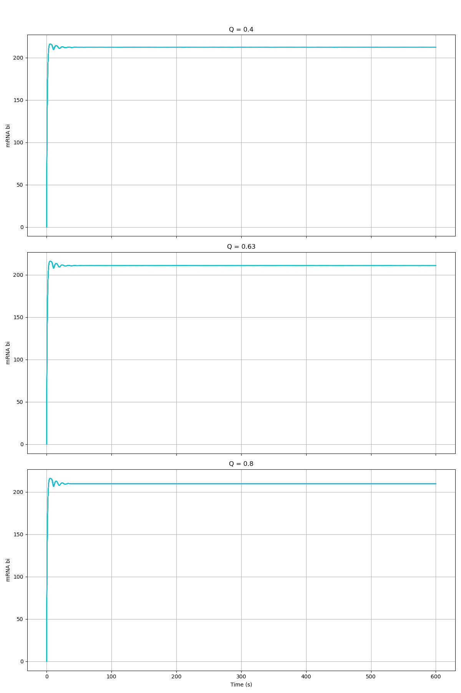
Alpha_X = 3456

Slide 2
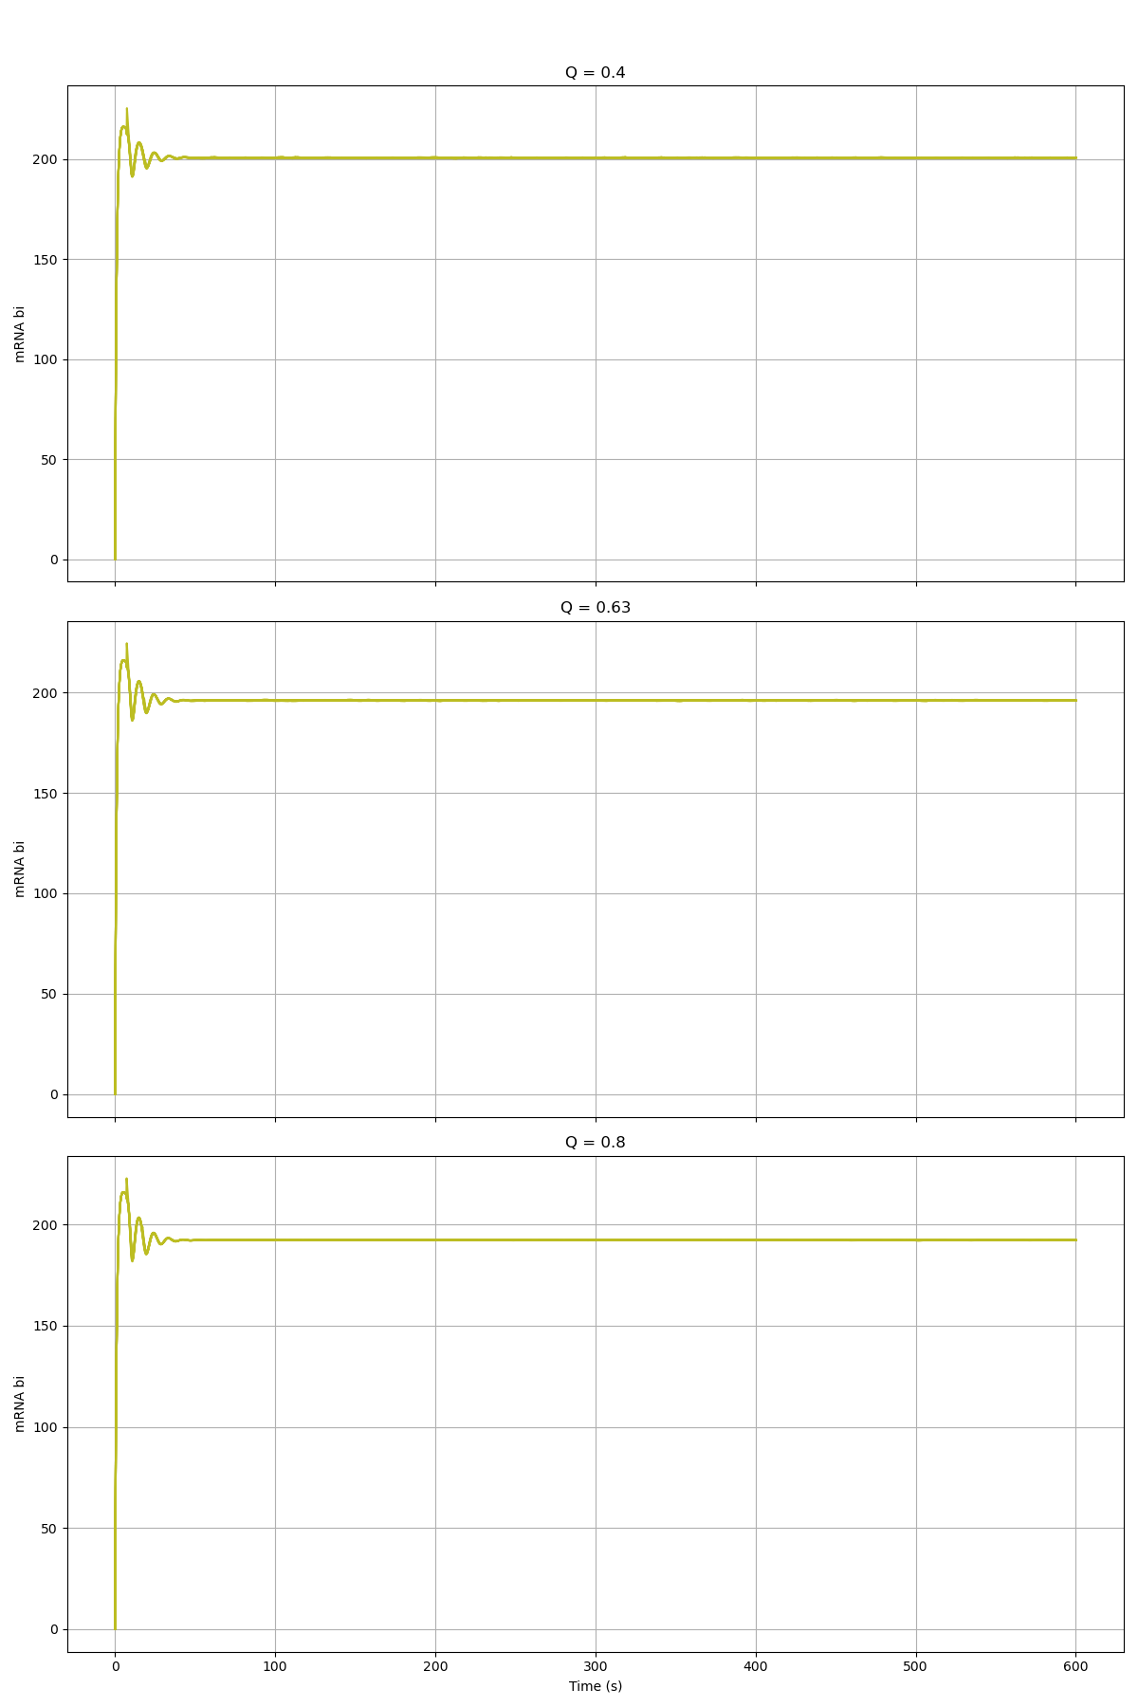
Alpha_X = 1728

Slide 3
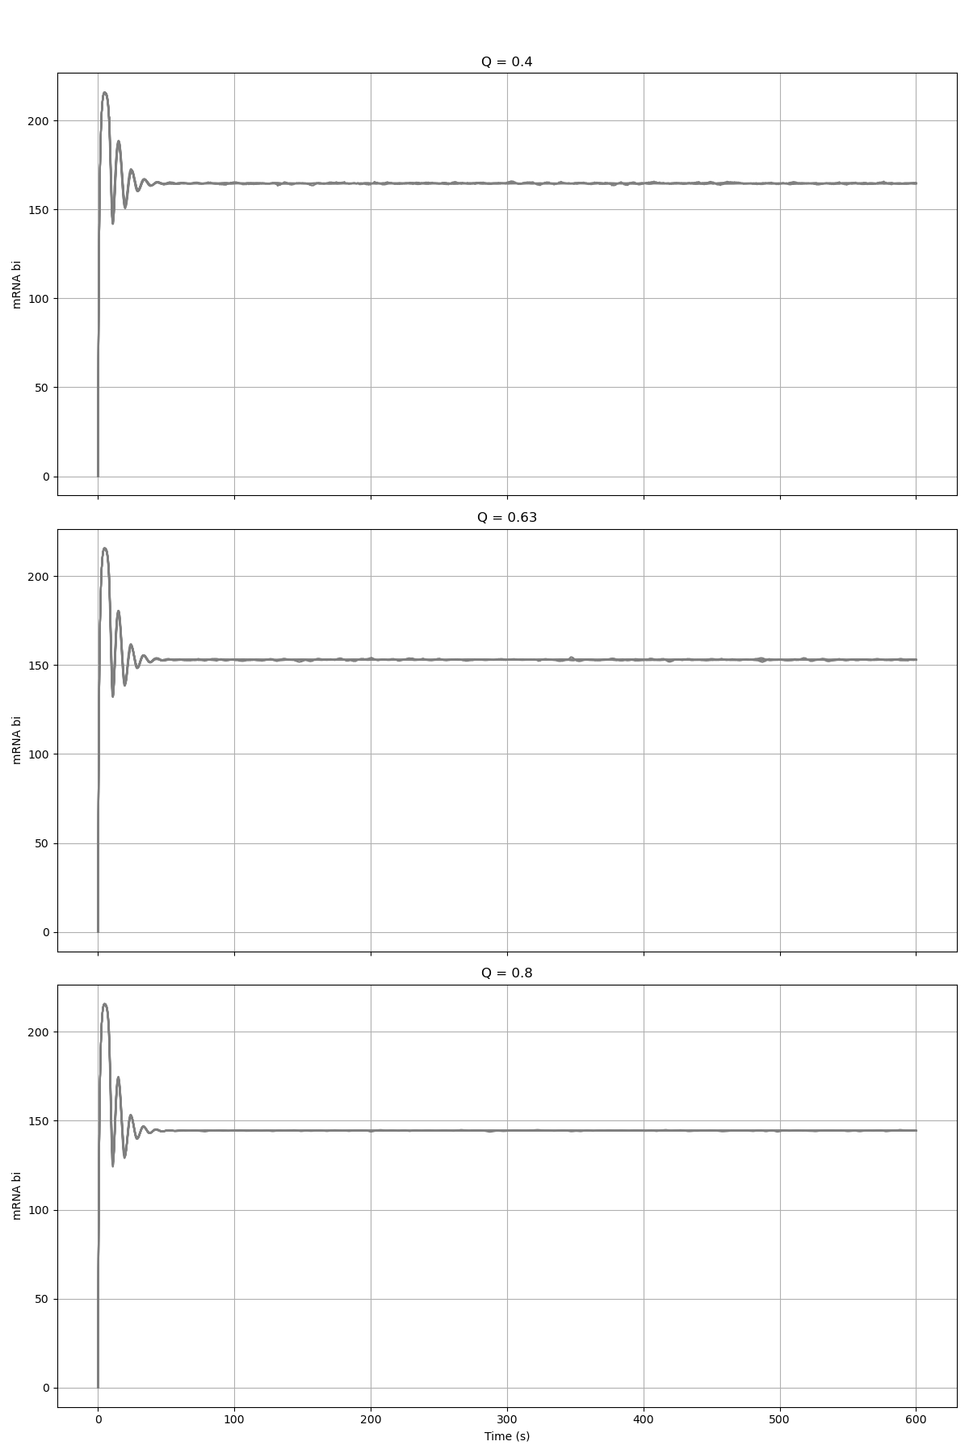
Alpha_X = 864

Slide 4
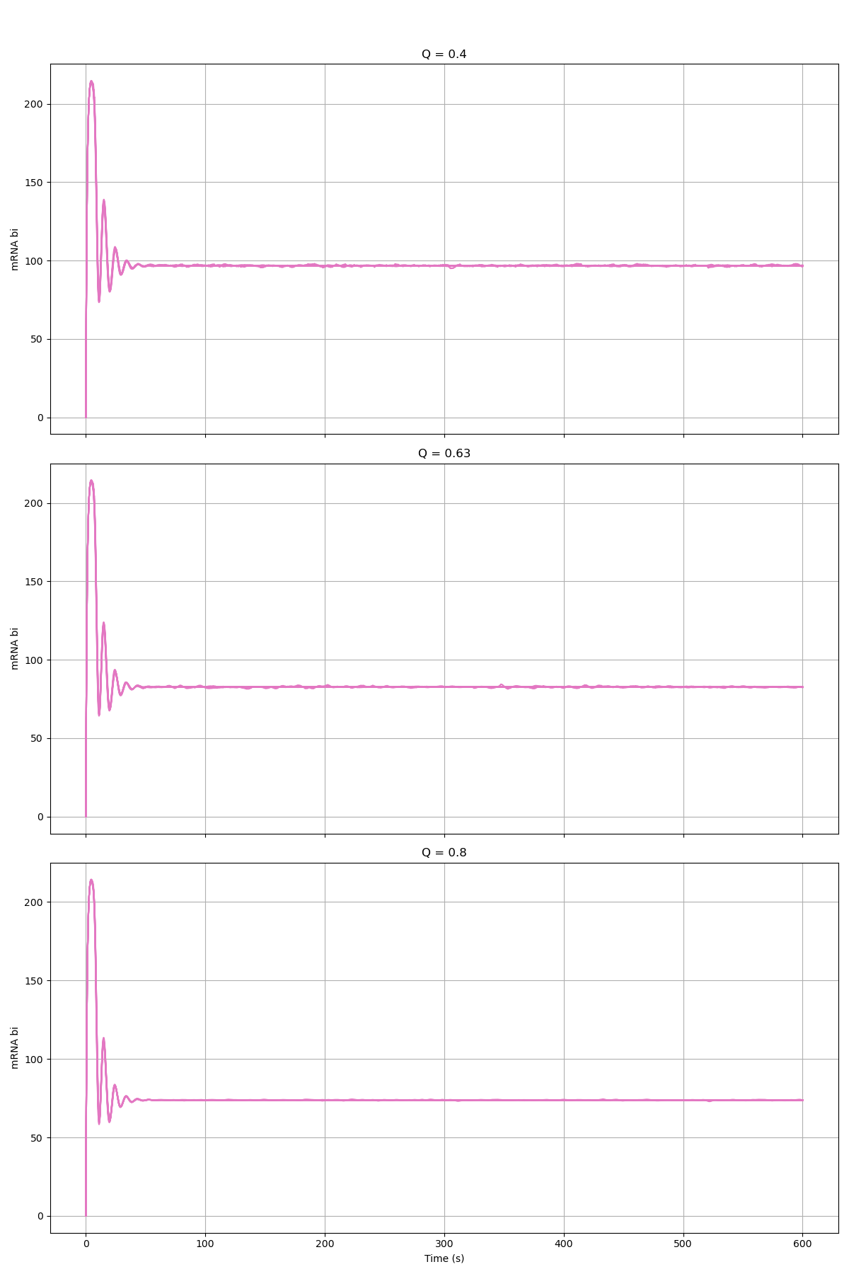
Alpha_X = 432

Slide 5
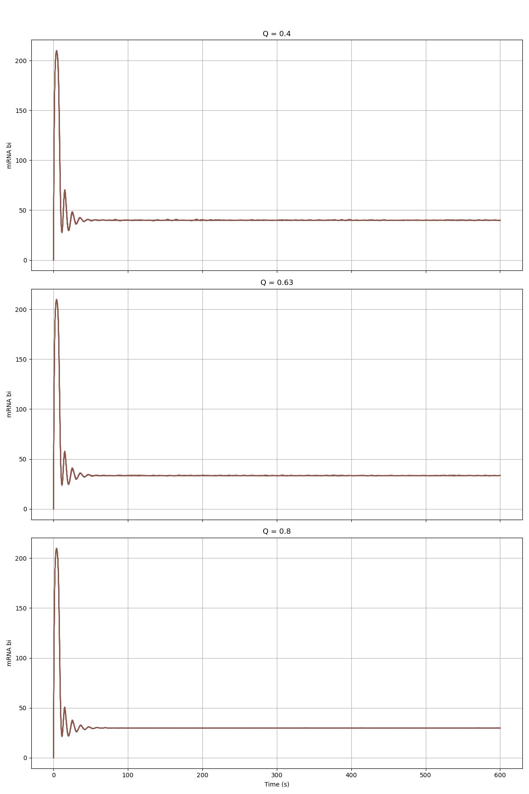
Alpha_X = 216

Slide 6
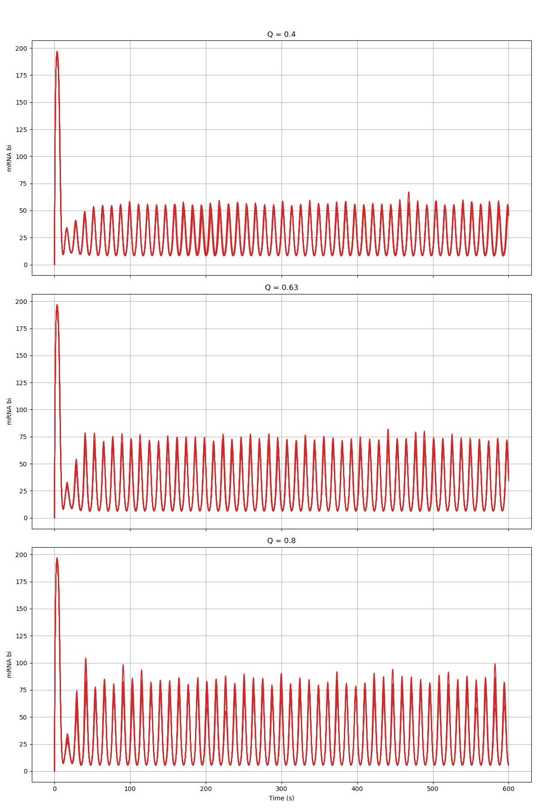
Alpha_X = 108

Slide 7
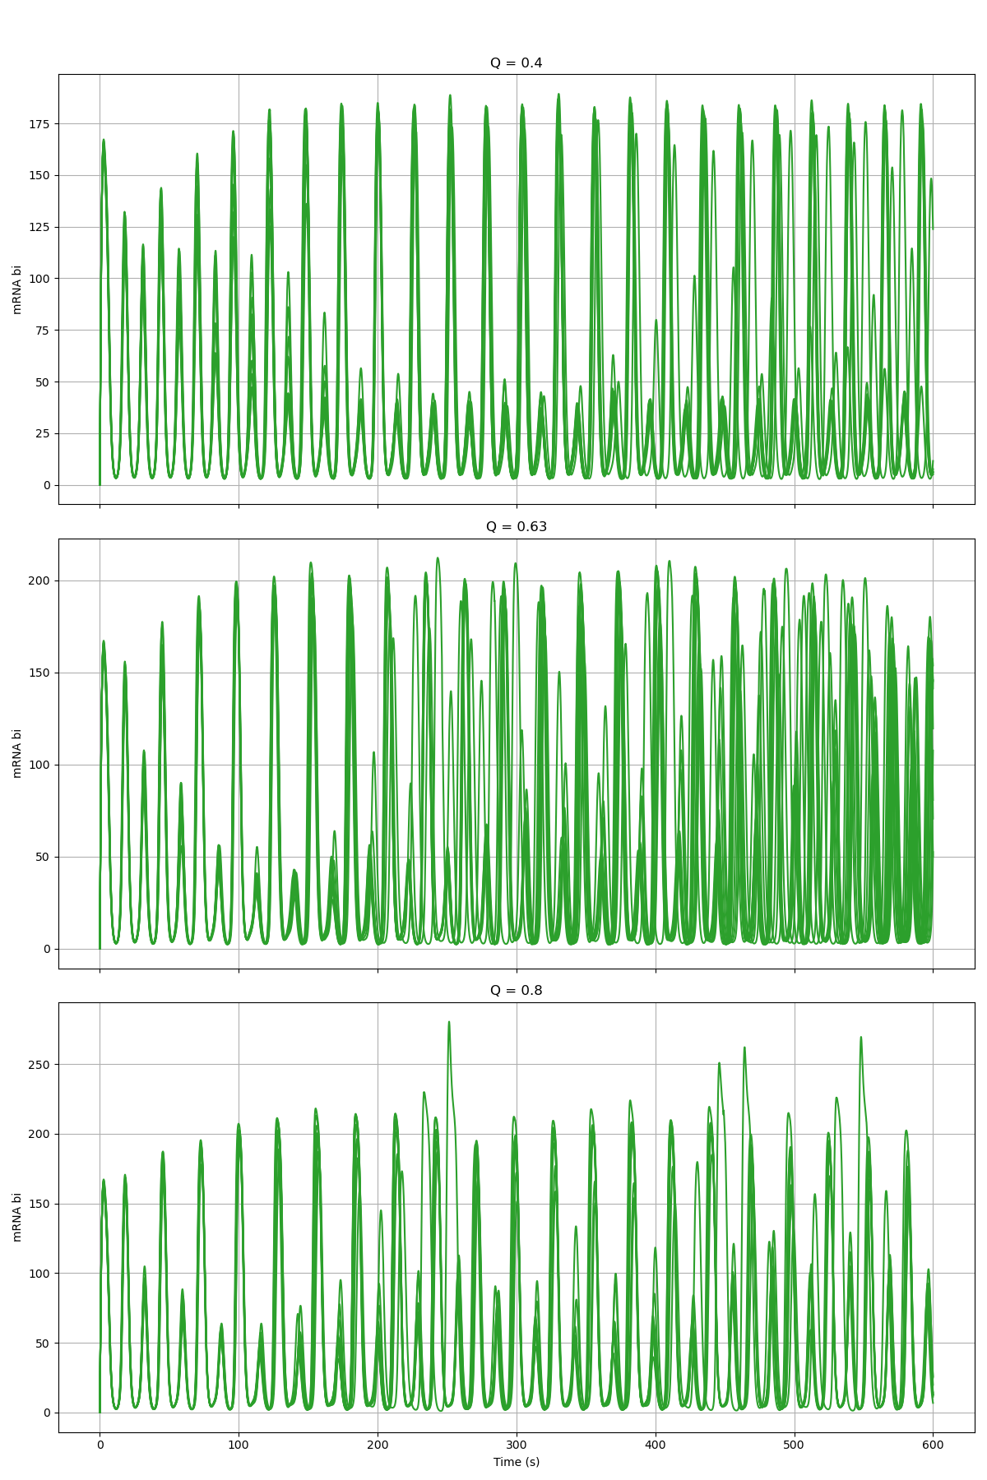
Alpha_X = 54

Slide 8
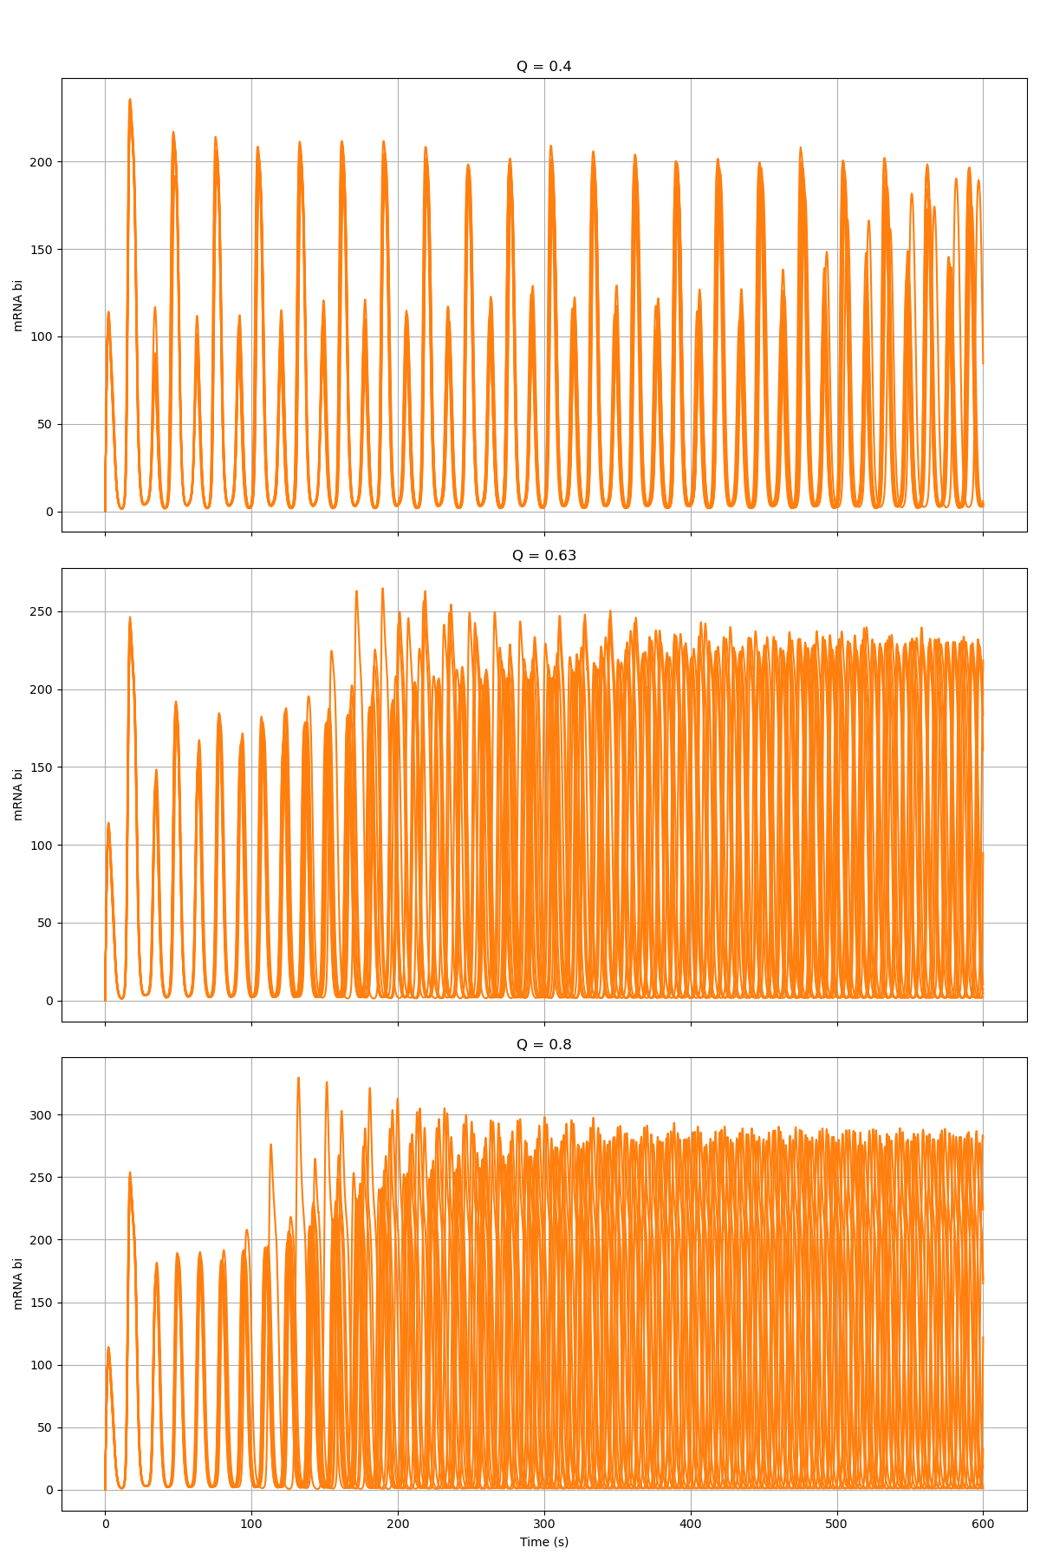
Alpha_X = 27

Slide 9
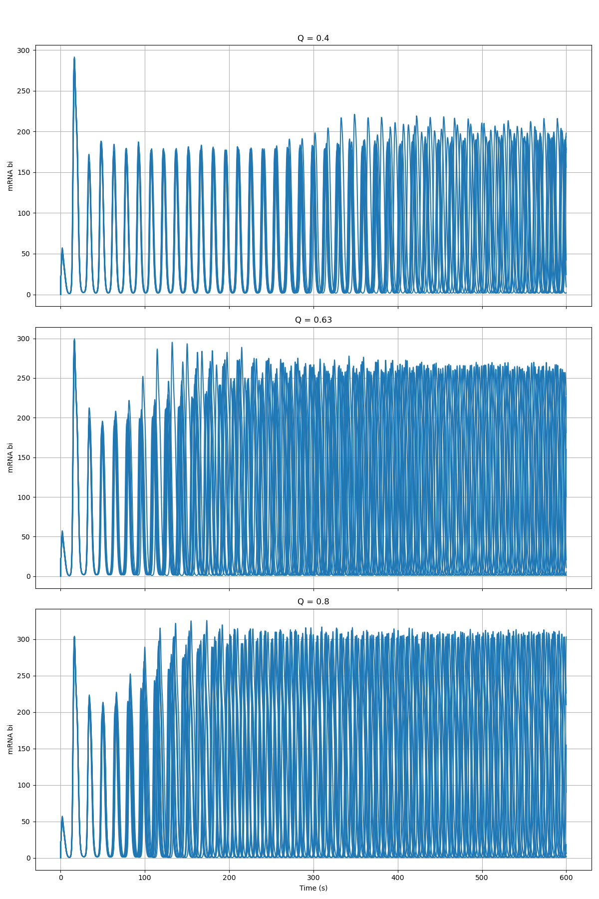
Alpha_X = 13.5

