Slide 1
Paper Model vs. Group Model Alpha_W = 0.01 Alpha_X = 0.01 Alpha_Y = 0.01 Alpha_Z = 0.01

Slide 2
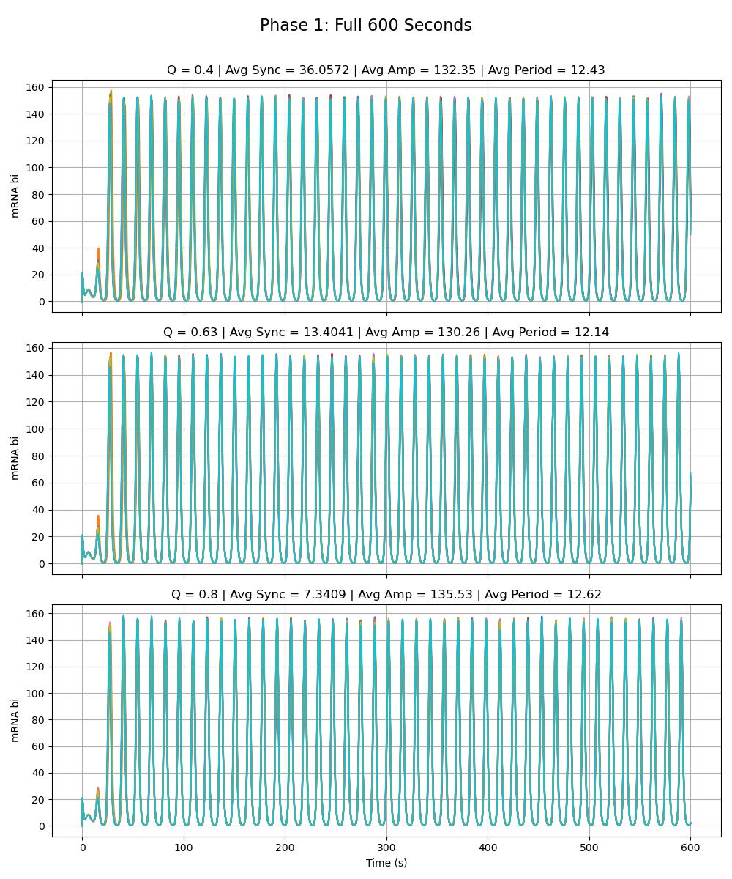
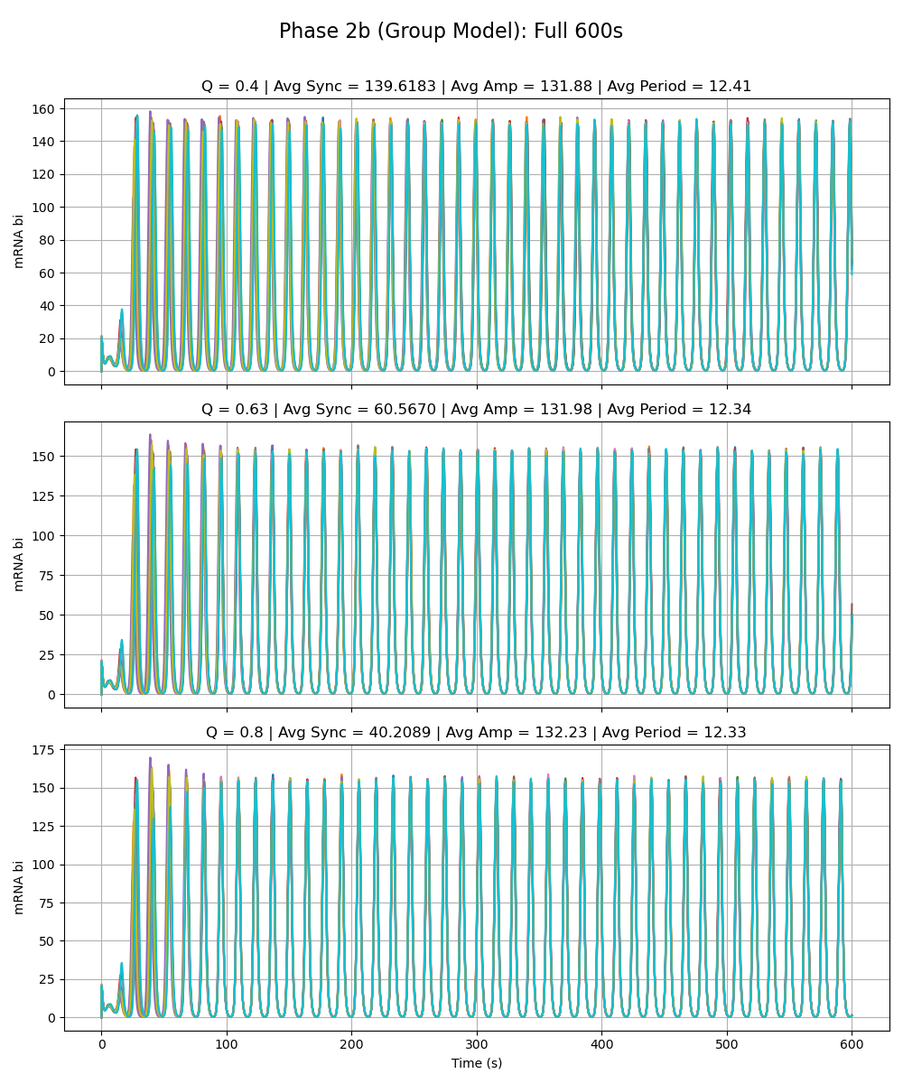
Notes:
All special alphas are 0.01

Slide 3
Adriana Phase 2a Model vs. Group Model Alpha_W = 216 Alpha_X = 0.01 Alpha_Y = 0.01 Alpha_Z = 0.01

Slide 4
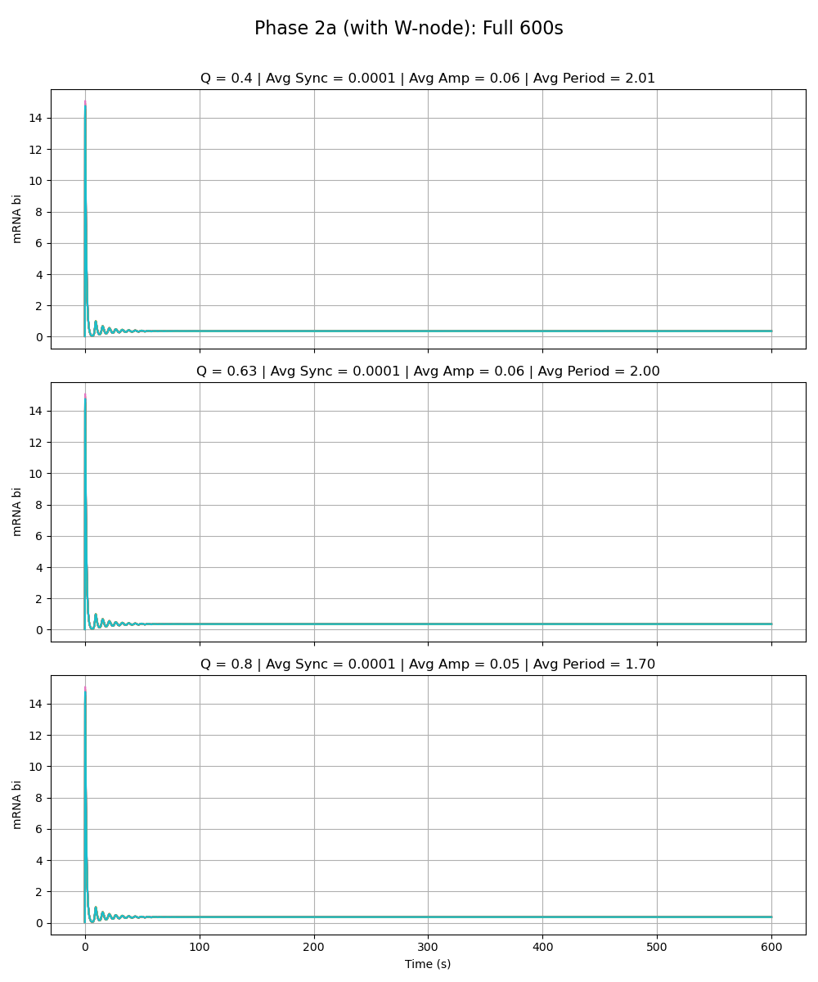
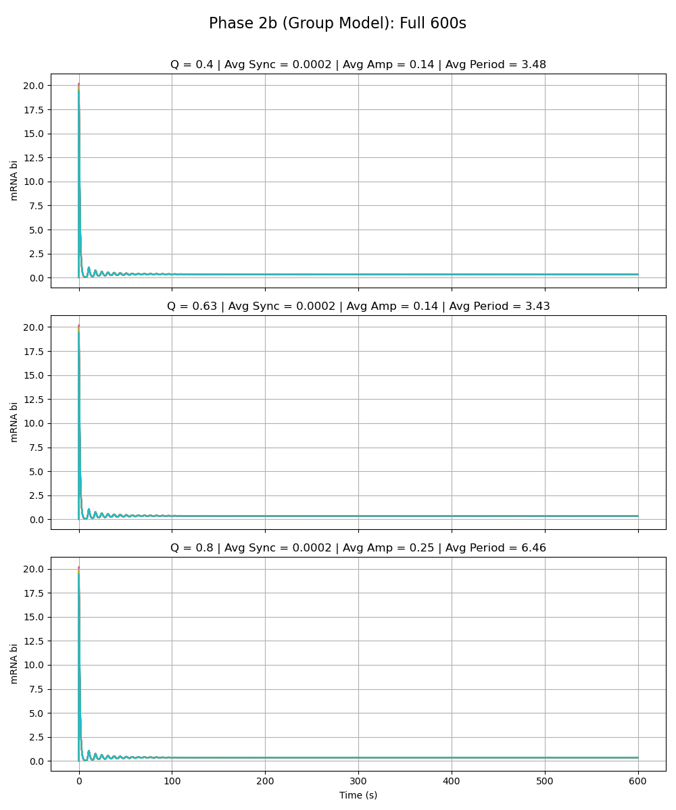
Notes:
alpha_w is 216

Slide 5
Sydney Phase 2a Model vs. Group Model Alpha_W = 0.01 Alpha_X = 216 Alpha_Y = 0.01 Alpha_Z = 0.01

Slide 6
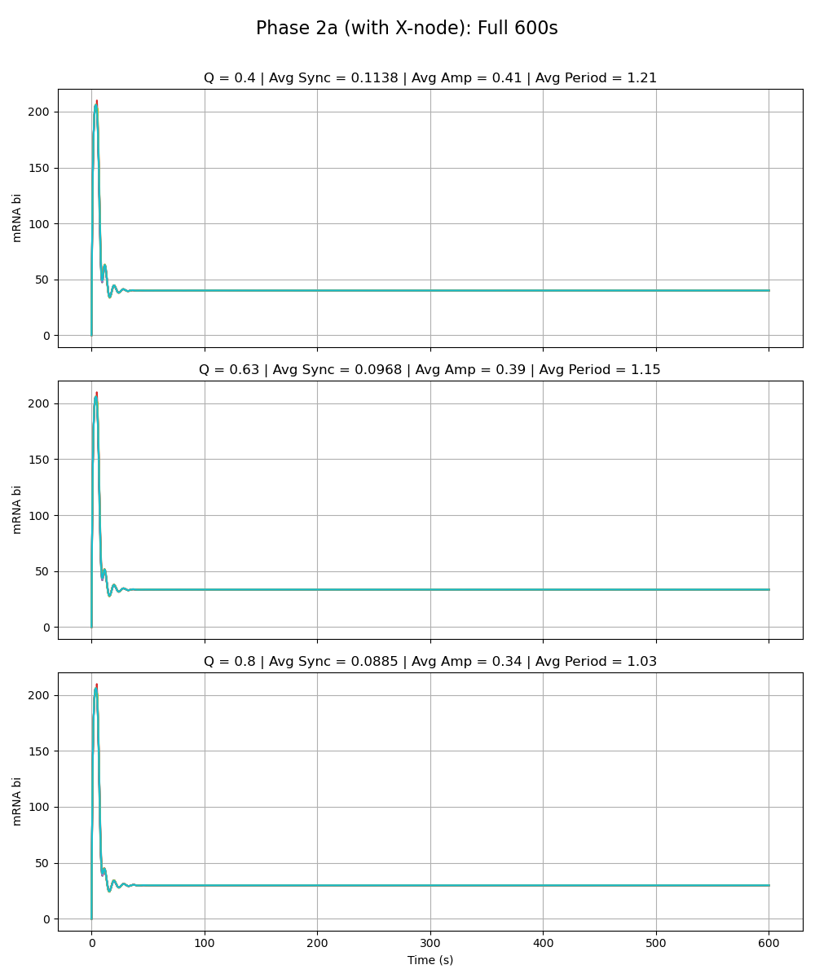
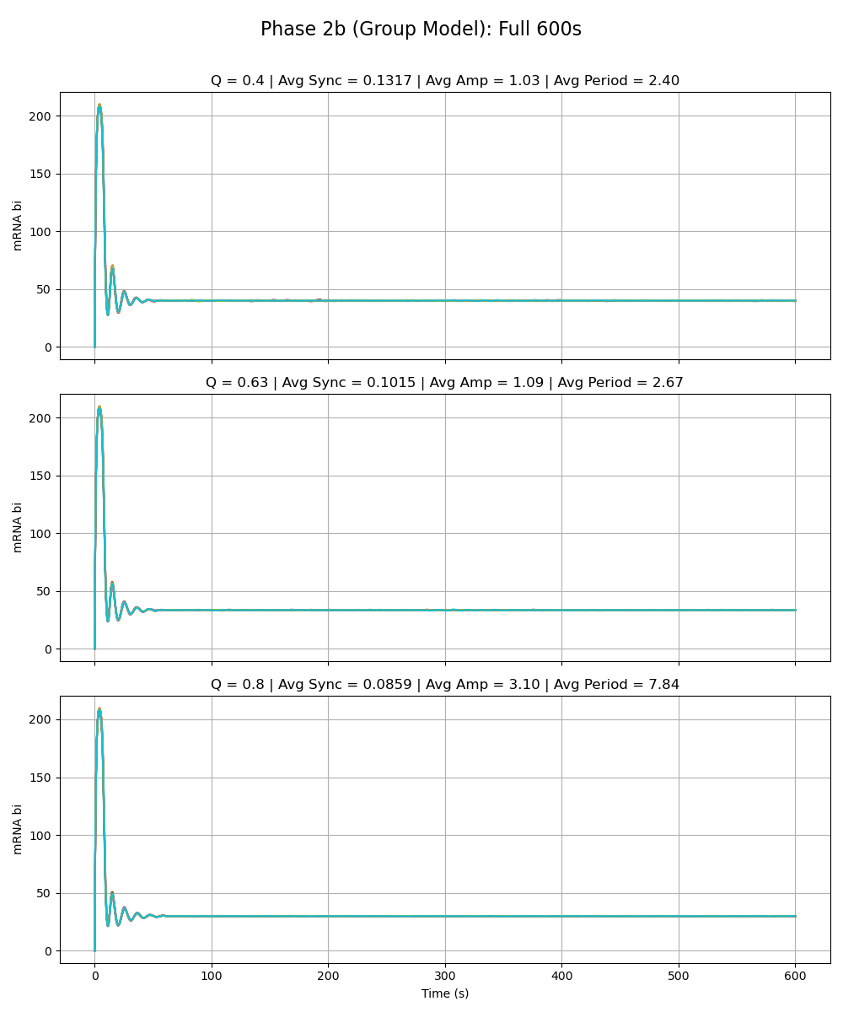
Notes:
alpha_x is 216

Slide 7
Sean Phase 2a Model vs. Group Model Alpha_W = 0.01 Alpha_X = 0.01 Alpha_Y = 216 Alpha_Z = 0.01

Slide 8
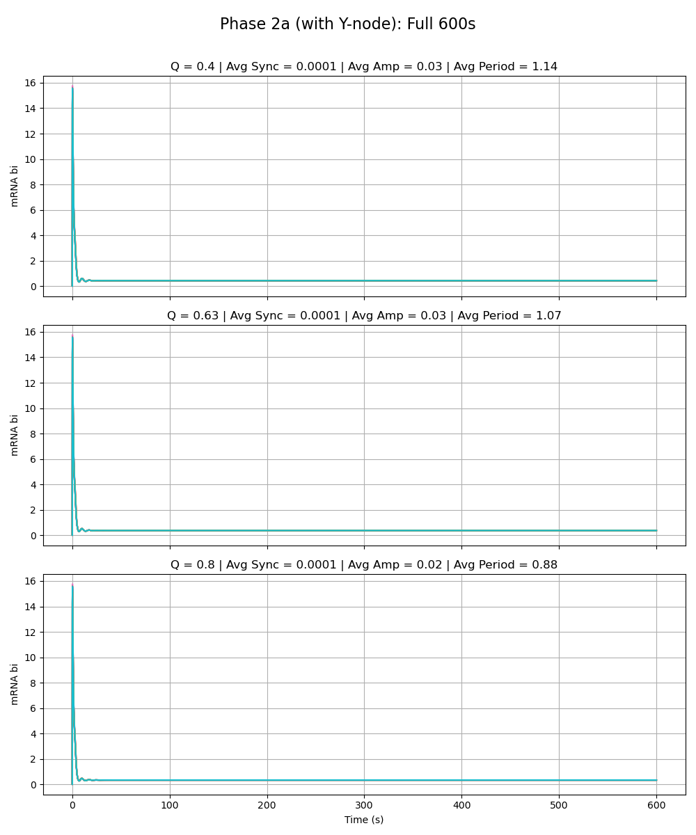
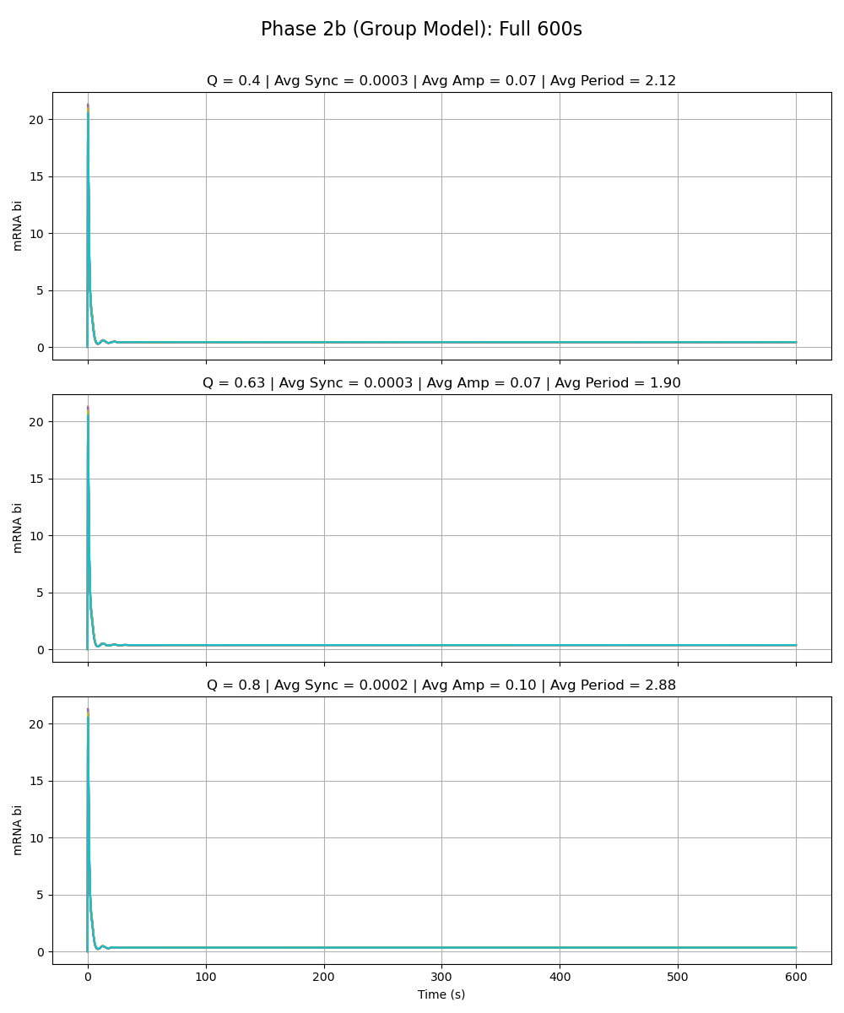
Notes:
alpha_y is 216

Slide 9
Olivia Phase 2a Model vs. Group Model Alpha_W = 0.01 Alpha_X = 0.01 Alpha_Y = 0.01 Alpha_Z = 216

Slide 10
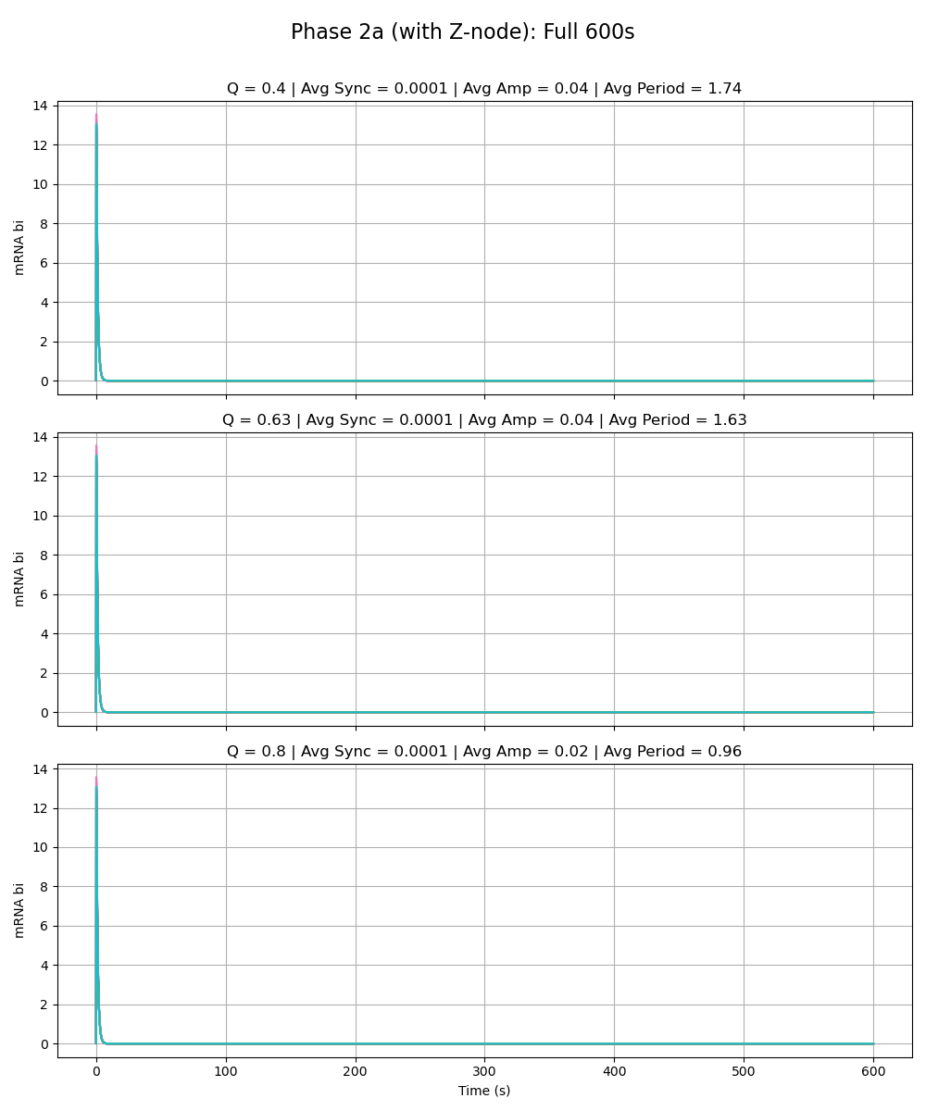
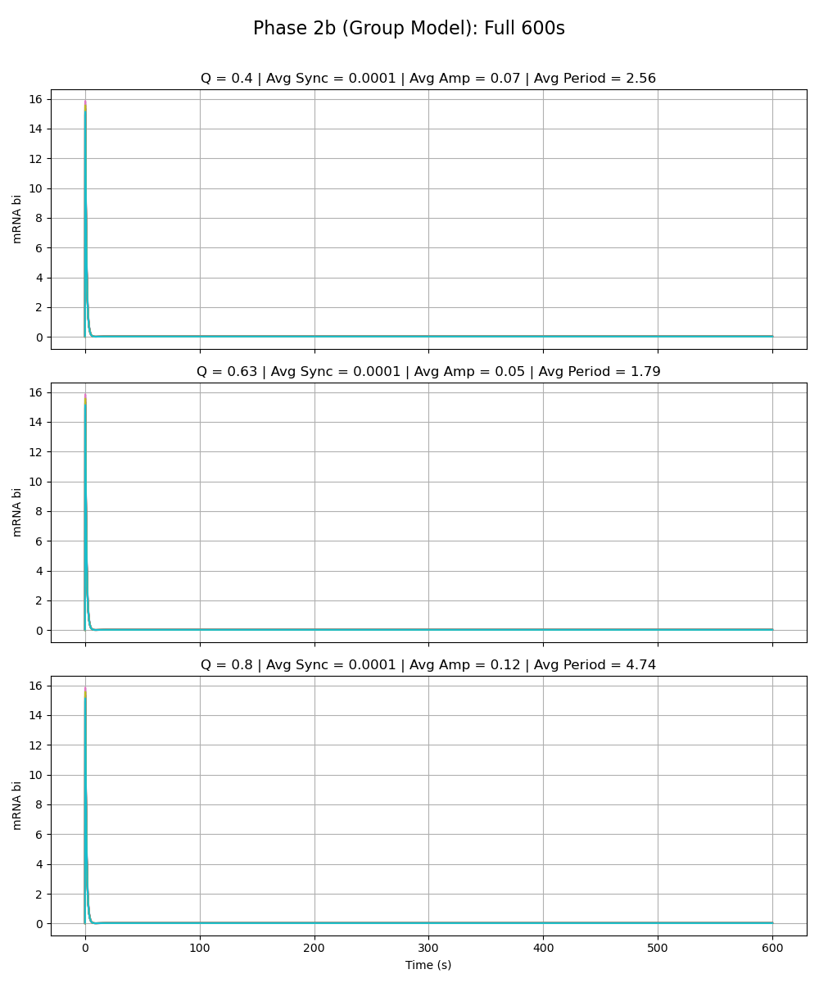
Notes:
alpha_z is 216

Slide 11
Paper Model vs. Group Model Alpha_W = 0.01 Alpha_X = 0.01 Alpha_Y = 0.01 Alpha_Z = 0.01

Slide 12
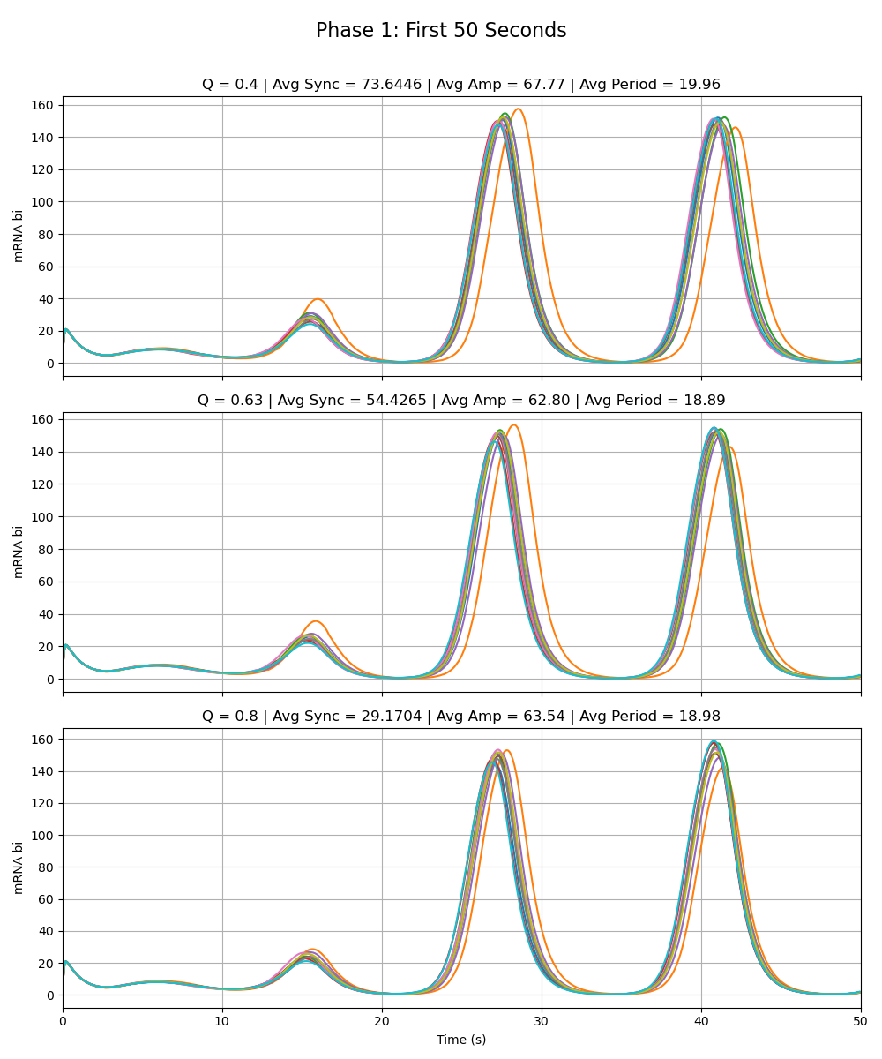
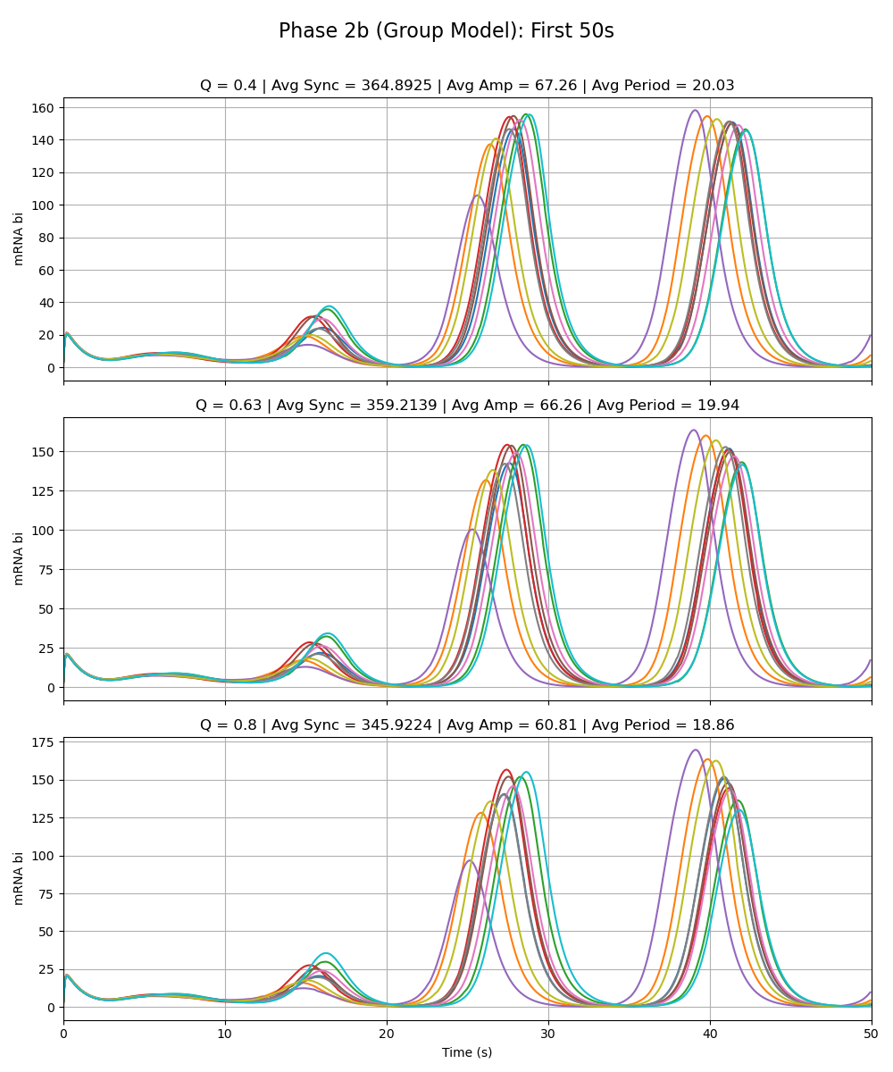
Notes:
All special alphas are 0.01

Slide 13
Adriana Phase 2a Model vs. Group Model Alpha_W = 216 Alpha_X = 0.01 Alpha_Y = 0.01 Alpha_Z = 0.01

Slide 14
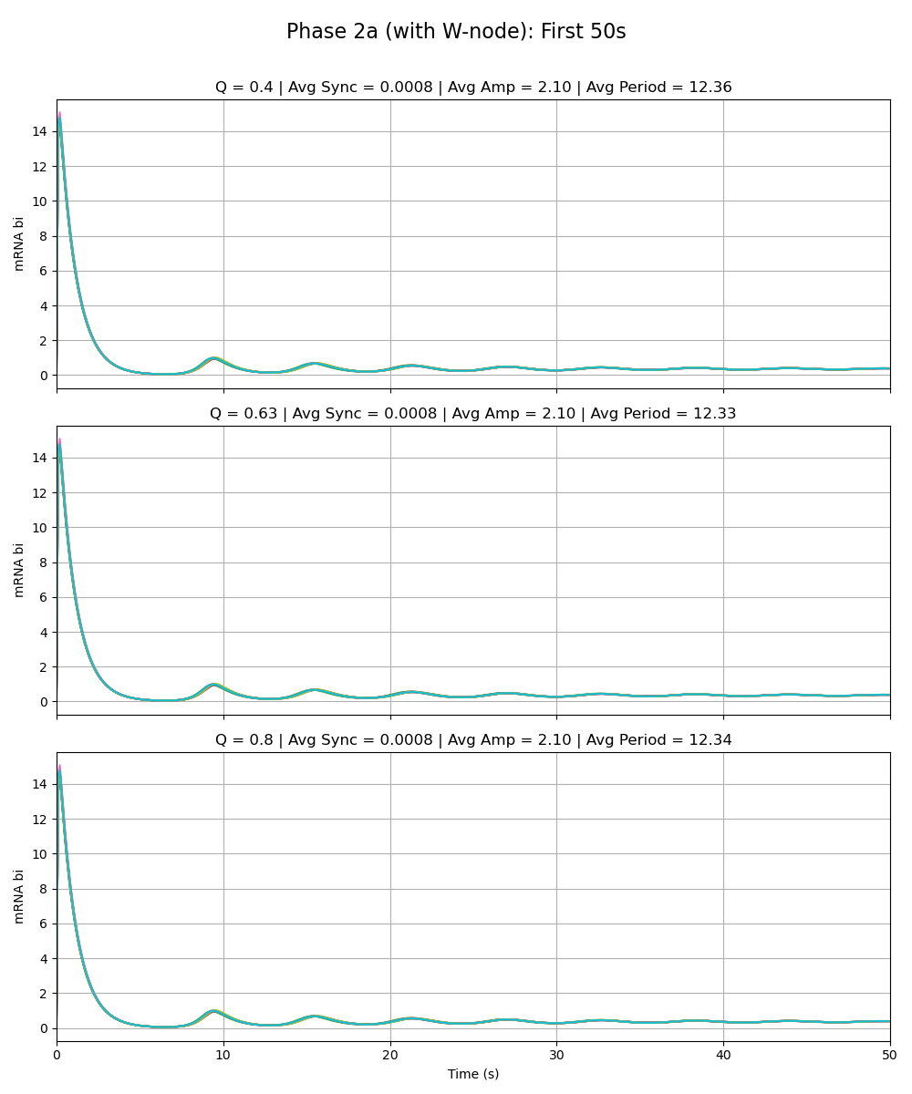
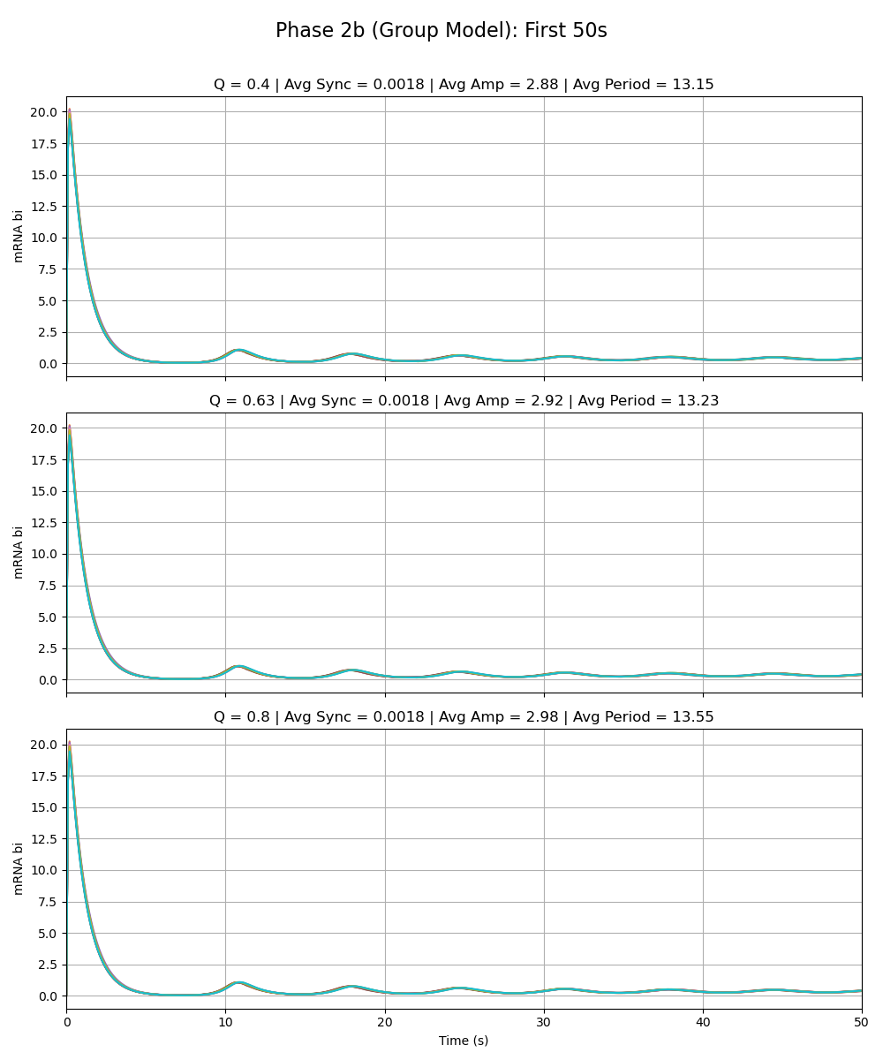
Notes:
alpha_w is 216

Slide 15
Sydney Phase 2a Model vs. Group Model Alpha_W = 0.01 Alpha_X = 216 Alpha_Y = 0.01 Alpha_Z = 0.01

Slide 16
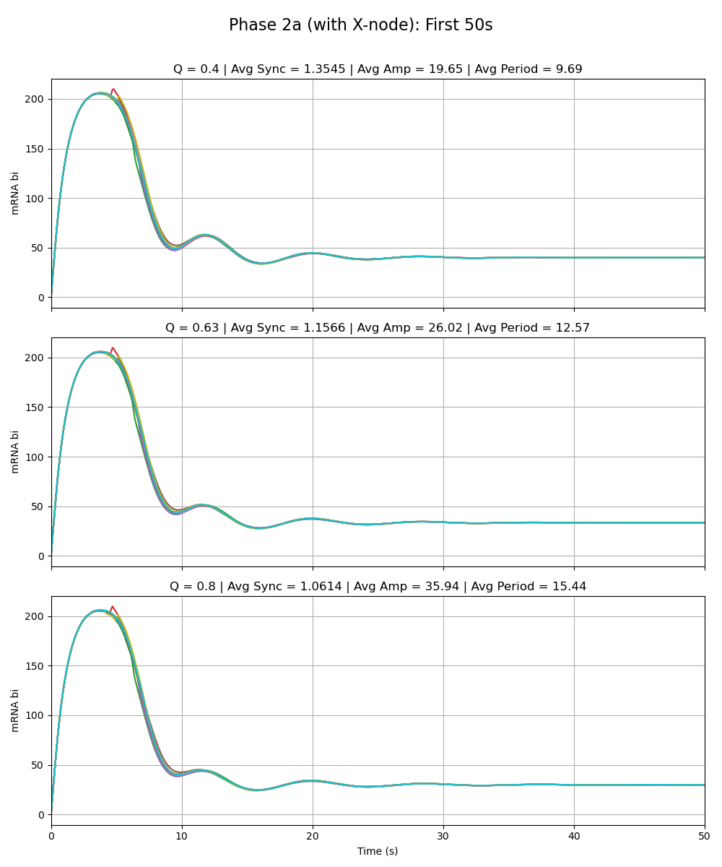
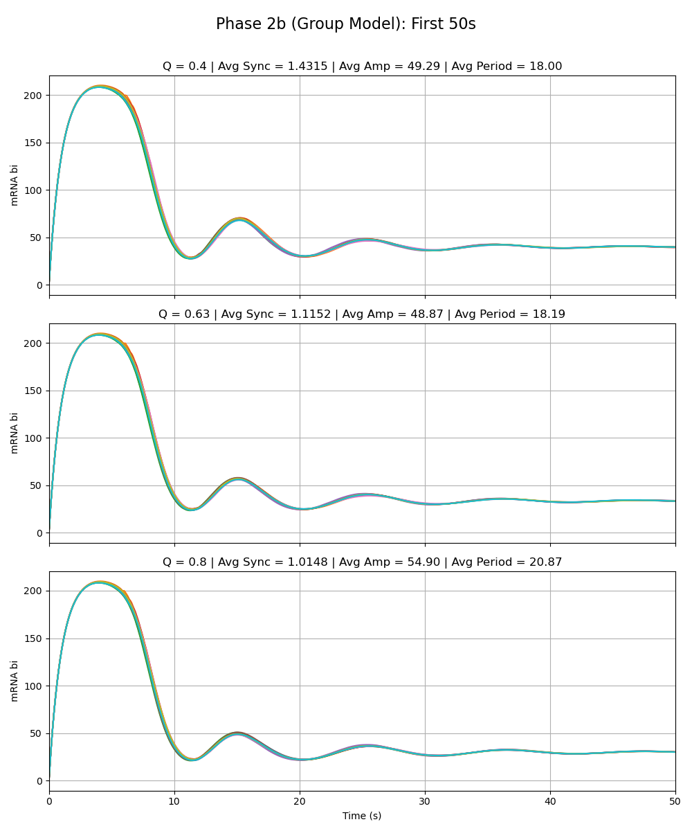
Notes:
alpha_x is 216

Slide 17
Sean Phase 2a Model vs. Group Model Alpha_W = 0.01 Alpha_X = 0.01 Alpha_Y = 216 Alpha_Z = 0.01

Slide 18
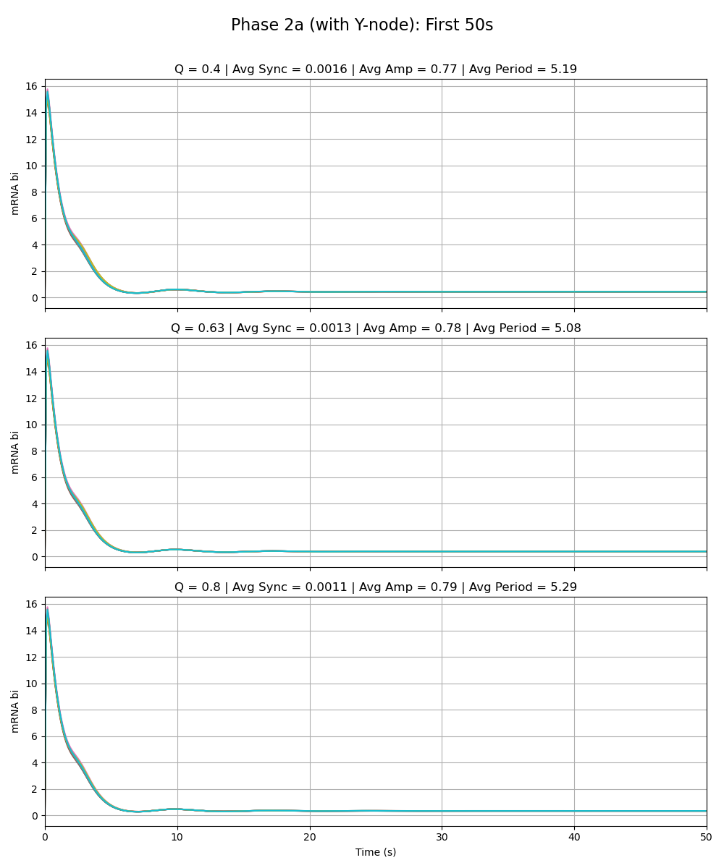
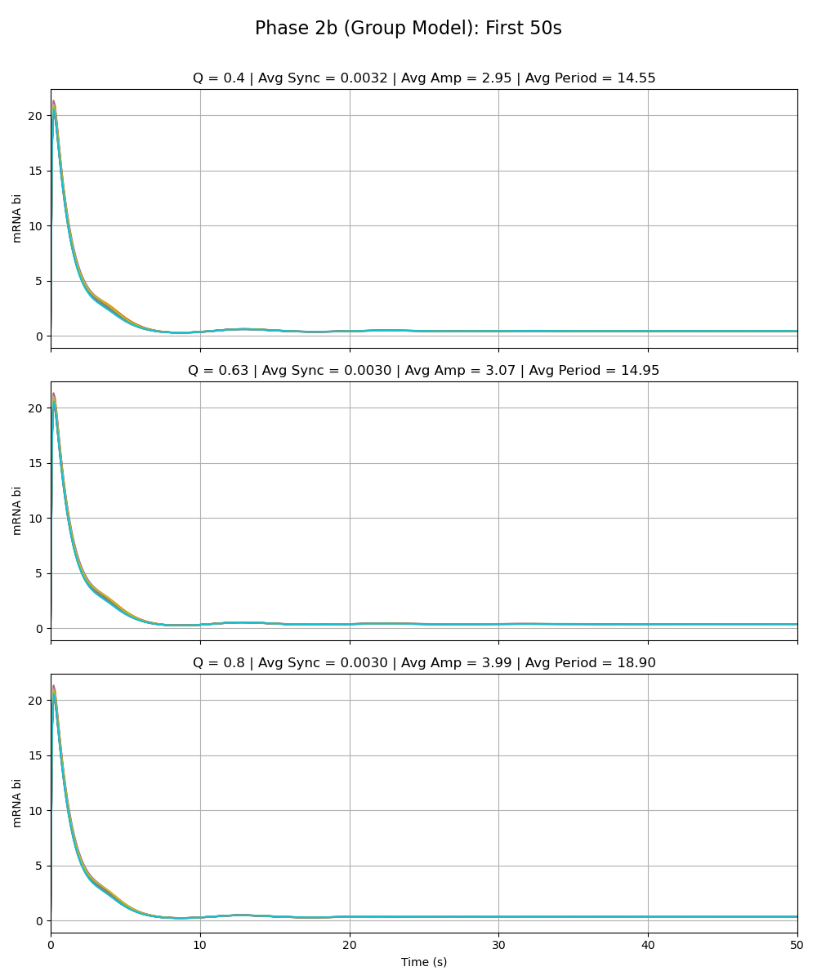
Notes:
alpha_y is 216

Slide 19
Olivia Phase 2a Model vs. Group Model Alpha_W = 0.01 Alpha_X = 0.01 Alpha_Y = 0.01 Alpha_Z = 216

Slide 20
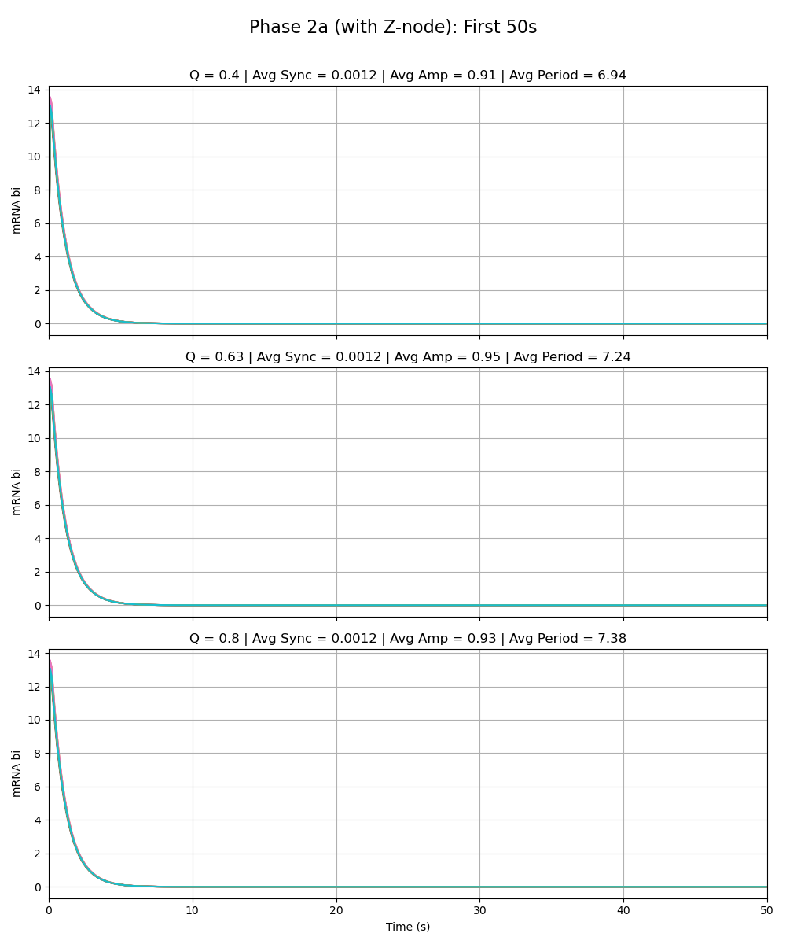
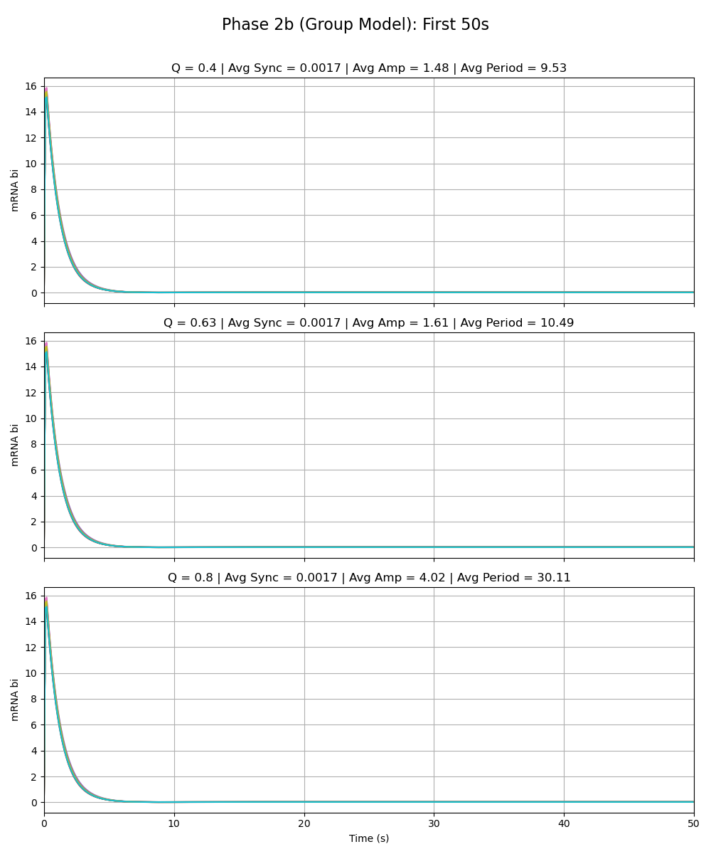
Notes:
alpha_z is 216

