Slide 1
Hierarchical Clustering of Differentially Expressed Genes in Pediatric Acute Lymphoblastic Leukemia (ALL) Patient-Derived Xenografts
Olivia Fernflores

Slide 2
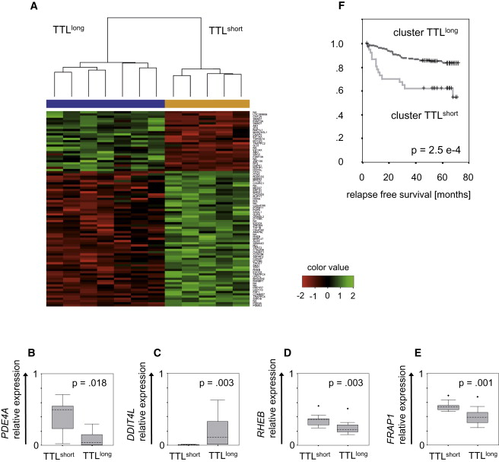
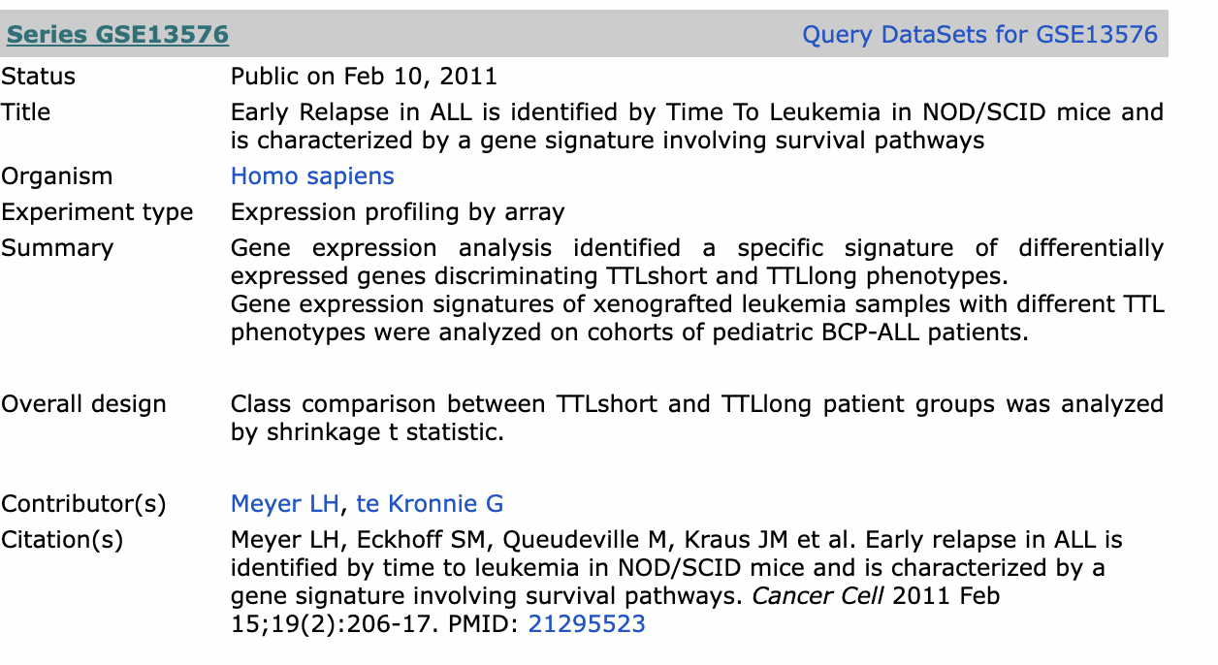
Notes:
ALL is the most common form of pediatric leukemia, overall accounts for about 30% of childhood cancers. My project is using a microarray dataset published in 2011 that contains samples from patients and patient derived xenografts.
The main goal of my project was to re-create a figure from the paper where this data was published. So this is a figure from the paper, and here they’ve done hierarchical clustering of differentially expressed genes in the xenograft samples.

Slide 3
Download, clean, and normalize microarray data
Match microarray probes to gene names using Ensembl Biomart tools
Calculate differentially expressed genes (probes)
Using a subset of the data including only genes found to be significantly differentially expressed:
PCA to reduce dimensionality to the top 10 components that explain variance in the dataset
K-means clustering with 2 (xenograft) and 3 (patient) clusters
Hierarchical clustering based on expression profile

Slide 4
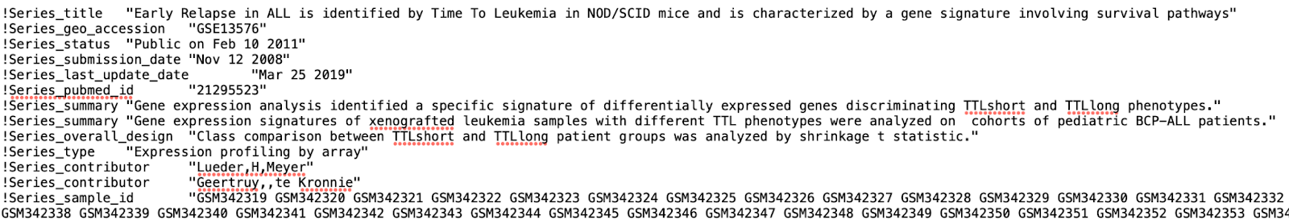
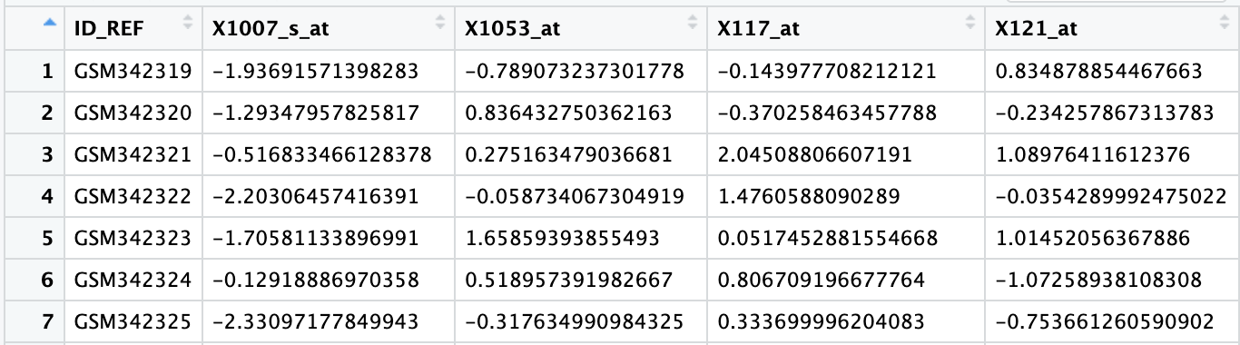
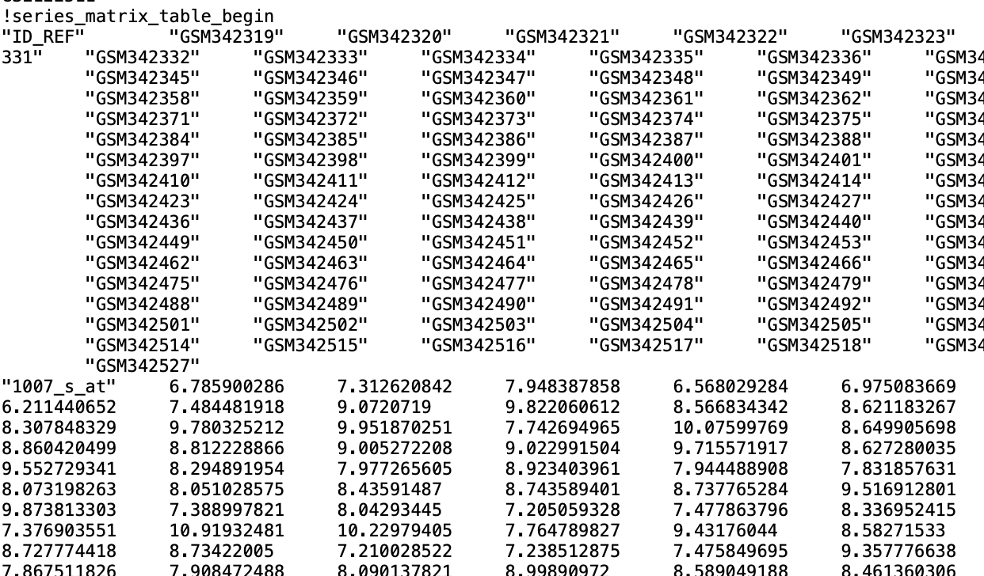
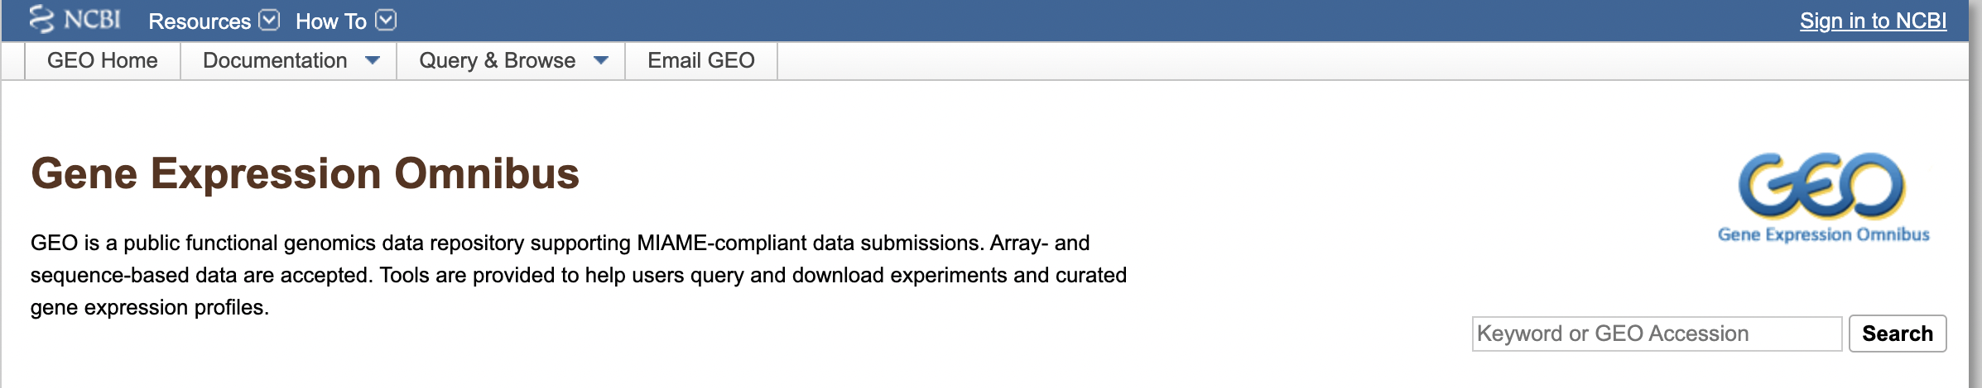
Notes:
This is what I started with. The GEO downloaded everything as a matrix stored in a text file with a bunch of headers, so I processed everything and cleaned up all the formatting in R. Then in order to be as close to the original paper as possible, I normalized everything, which basically just means putting everything on the same scale. At this point, I ran into a bit of an issue, because a single gene can be represented by multiple probes. So I needed to map the probes to their associated gene/genes, and then hopefully use that information for normalization.

Slide 5
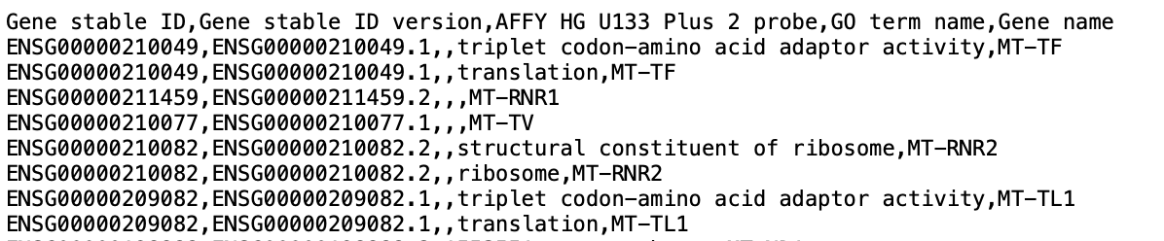
Download, clean, and normalize microarray data
Match microarray probes to gene names using Ensembl Biomart tools
Notes:
So I download another data set from Ensembl Biomart, and it basically just shows all the probes and what genes they match with. This is just a csv file, so I just manipulated the data to merge with my expression data, adding gene names to my dataframe.
I did normalize my data here, but just using a standard scalar. So in the original paper, they implemented a specific software that will normalize expression for each gene across multiple probes, but with just the file I had I couldn’t use that software. So this is my scaled data done with R, and most of the results are pretty similar so it doesn’t seem to have made much of a difference.
Now for the actual analysis

Slide 6
Download, clean, and normalize microarray data
Match microarray probes to gene names using Ensembl Biomart tools
Calculate differentially expressed genes (probes)

Slide 7
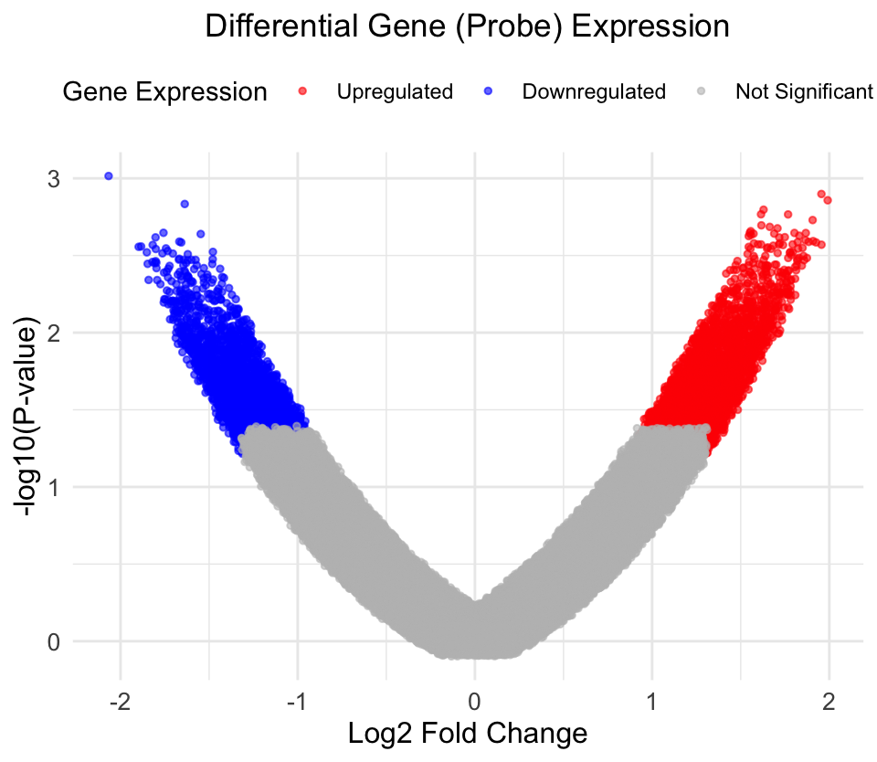
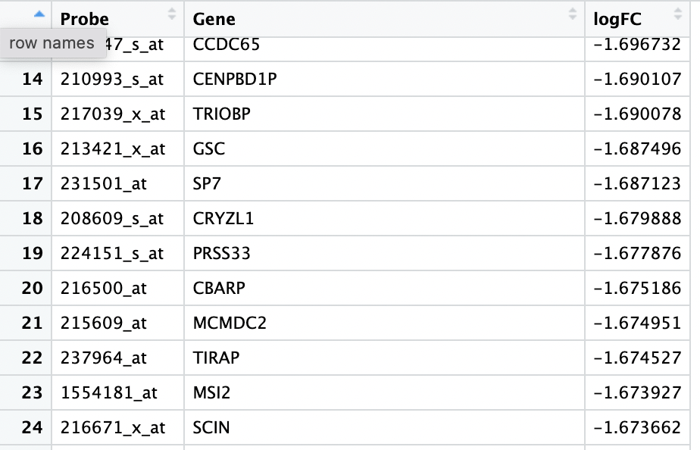
Fold Change Expression:
Comparing “short” vs. “long” time to leukemia
Value > 1 is upregulated in “short”
Value < -1 is downregulated in “short”
Notes:
To calculate fold change expression, I was basically just looking at each probe and saying what is the difference in expression between the samples with “short” time to leukemia and the samples with “long” time to leukemia.
Visually, that gives a plot like this, which you can read by looking at the colors.
In blue, I show significantly downregulated genes in ”short”. In red, I show genes significantly upregulated in “short”. And in grey are all the non-significant genes.
From this plot, I extracted a table of all the probe names that were significantly up or down regulated in the ”short”, because that’s the subset of the data that the authors used for their clustering.

Slide 8
Download, clean, and normalize microarray data
Match microarray probes to gene names using Ensembl Biomart tools
Calculate differentially expressed genes (probes)
Using a subset of the data including only genes found to be significantly differentially expressed:
PCA to reduce dimensionality to the top 10 components that explain variance in the dataset
Notes:
I used that table in the previous slide and the corresponding one for the upregulated probes to subset my data to get only the up and downregulated probes.
Then I did principal component analysis, which is a way of reducing the dimensionality of the dataset (at this point I have 5575 probes x 12 samples, so narrowing down to which probes cause the most variation across the 12 samples will be useful) to the components that contribute most to the variation in the data. This is a primer/gut check before doing clustering analysis.

Slide 9
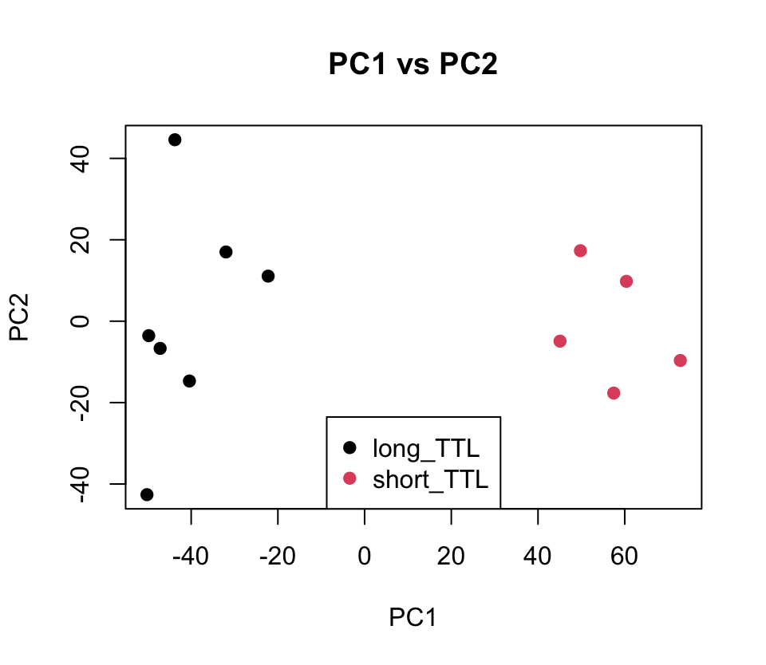
Notes:
PCA results. Clear distinction among the first principal component (explains the most variation in the dataset) between short and long time to leukemia samples. This is good if I am working towards reproducing a figure that ultimately separates the data into two clusters.

Slide 10
Download, clean, and normalize microarray data
Match microarray probes to gene names using Ensembl Biomart tools
Calculate differentially expressed genes (probes)
Using a subset of the data including only genes found to be significantly differentially expressed:
PCA to reduce dimensionality to the top 10 components that explain variance in the dataset
K-means clustering with 2 clusters
Notes:
Then I did k-means, which is a clustering algorithm that relies on an input number of clusters and basically assigns each data point to it’s “closest” (think most similar) cluster. I did 2 clusters because I know there to be 2 groups in my xenograft dataset (short and long time to leukemia).

Slide 11
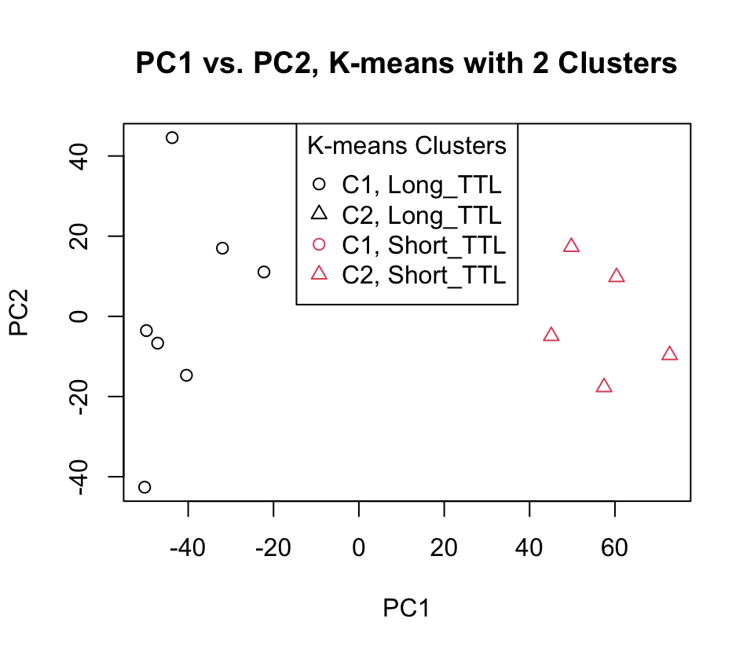
Notes:
K-means separates perfectly the short and long time to leukemia samples, and the separation is exactly the same as the separation along the first principal component from PCA. The authors did a modified k-means, that they claim is more robust, but did not publish the plot. So far so good though, because everything has separated the samples completely correctly according to the biological “truth”

Slide 12
Download, clean, and normalize microarray data
Match microarray probes to gene names using Ensembl Biomart tools
Calculate differentially expressed genes (probes)
Using a subset of the data including only genes found to be significantly differentially expressed:
PCA to reduce dimensionality to the top 10 components that explain variance in the dataset
K-means clustering with 2 (xenograft) and 3 (patient) clusters
Hierarchical clustering based on expression profile
Notes:
Final step, reproduce the figure. Time for hierarchical clustering. Hierarchical clustering basically is just another method of sorting data based on similarity. Will produce a tree showing relationships between each sample.

Slide 13
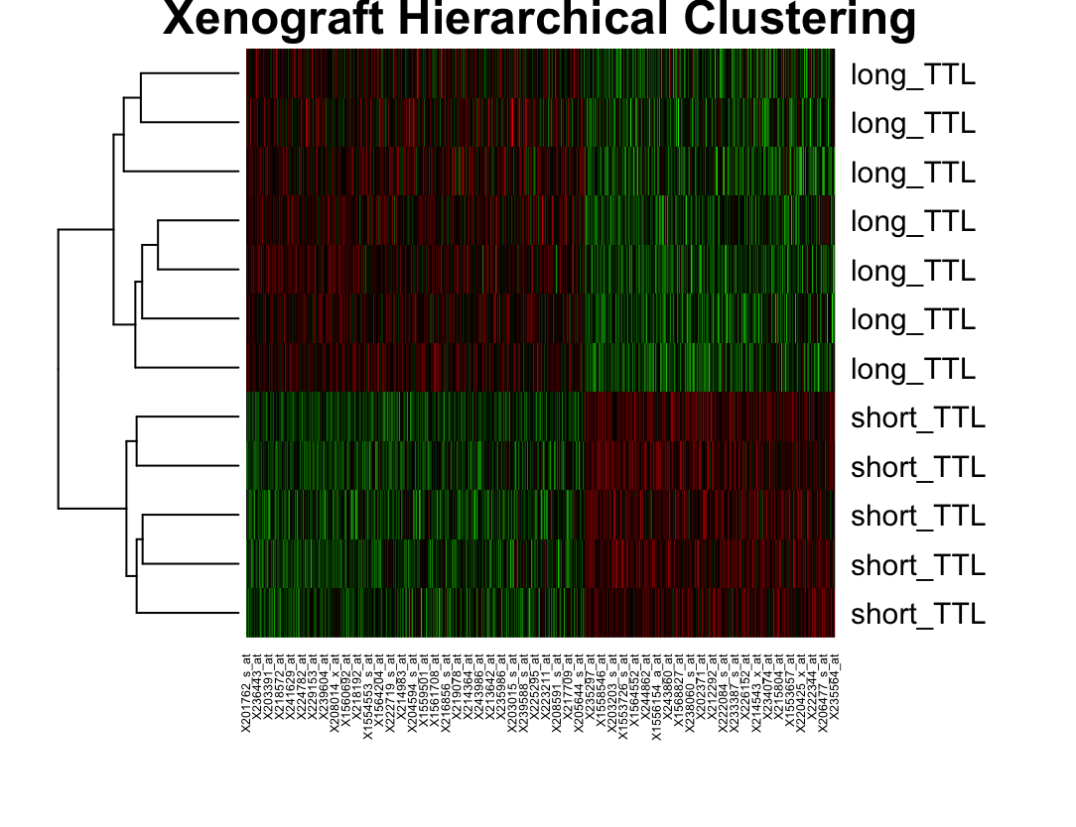
Notes:
So what I’m showing you here is the results of the hierarchical clustering, which was done based on the expression data. So on the far left, is the tree showing the relationships between each of the samples. On the right, the samples are labeled with their “true” status of short or long, and we see that short and long are perfectly separated down the middle of the tree at the outward most branch (so all the long samples are more similar to each other than they are to any of the short samples).
In the middle, you can see a heatmap of the differentially expressed genes. So red is genes that were downregulated in the short samples, green is upregulated in the short samples.

Slide 14
Notes:
If you compare to the original figure, despite the differences in how I had to normalize the data, the two analyses pick up the same patterns!
Now in their paper, they go on and use this information to build a classifier that can distinguish a new patient sample as being at high risk of relapse based on the expression profile of the genes that were here used for cluster assignment. I didn’t build my own classifier, but I did check that the patient samples separate based on these gene signatures.

Slide 15
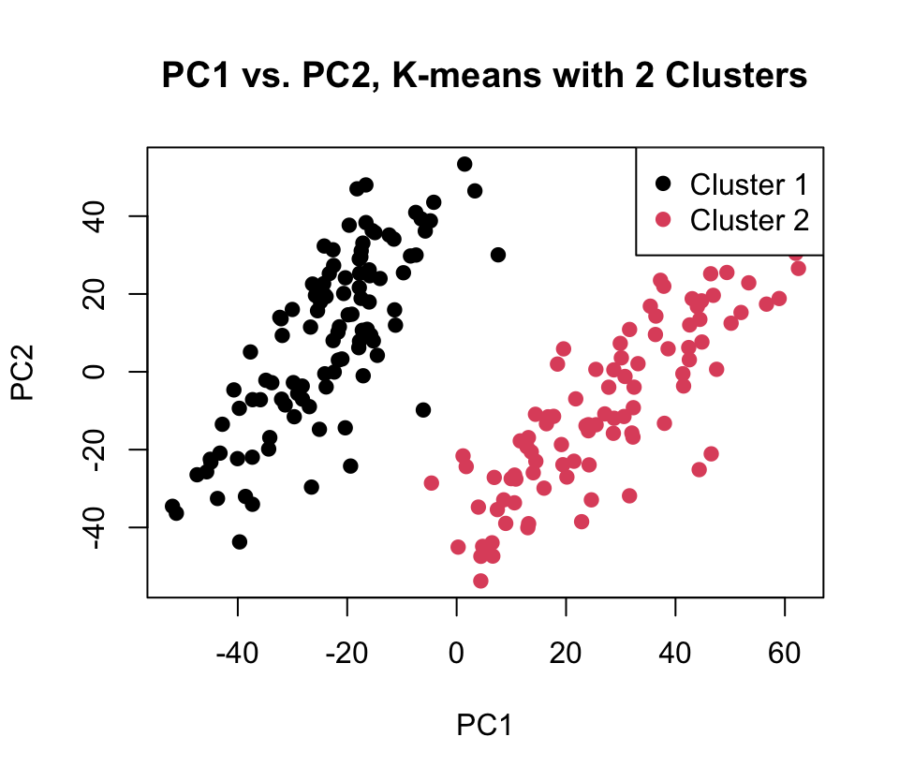
Patient sample normalized data
List of significantly up and down regulated genes from xenograft analysis
PCA and K-means analysis
Notes:
So I was curious if the separation they say in the patient samples corresponded to early vs late vs no relapse in the patients, so I did the same PCA and k-means.
Interestingly, the early vs. late vs. no relapse didn’t seem to correlate with the way the data separated along the first principal component.
But using k-means with 2 clusters, there is almost exactly the same separation as with the xenograft model.
And clinically, the patient samples with the “short” expression signature have significantly worse outcomes.
The authors claim that this is enough evidence to use this ”short” expression signature to train a classifier for patient samples, which they ultimately hope can be used to help refine treatment approaches.

Slide 16
Works Cited
Meyer, L. H., Eckhoff, S. M., Queudeville, M., Kraus, J. M., Giordan, M., Stursberg, J., Zangrando, A., Vendramini, E., Möricke, A., Zimmermann, M., Schrauder, A., Lahr, G., Holzmann, K., Schrappe, M., Basso, G., Stahnke, K., Kestler, H. A., Kronnie, G. T., & Debatin, K. (2011). Early relapse in ALL is identified by time to leukemia in NOD/SCID mice and is characterized by a gene signature involving survival pathways. Cancer Cell, 19(2), 206–217. https://doi.org/10.1016/j.ccr.2010.11.014
12.5 - R Scripts (K-means clustering) | STAT 897D. (2018). Pennsylvania State University. https://online.stat.psu.edu/stat857/node/125/
‌Jin Hwan Do, & Choi, D.-K. (2008). Clustering Approaches to Identifying Gene Expression Patterns from DNA Microarray Data. Molecules and Cells, 25(2), 279–288. https://doi.org/10.1016/s1016-8478(23)17582-0
‌Hierarchical Clustering in R: Dendrograms with hclust. https://www.datacamp.com/tutorial/hierarchical-clustering-R
‌Altman, N., & Krzywinski, M. (2017). Clustering. Nature Methods, 14(6), 545–546. https://doi.org/10.1038/nmeth.4299

