Slide 1
Guided Capstone Project Report

Slide 2
01
03
Problem Identification
Modeling Results & Analysis
02
04
Key Findings & Recommendation
Conclusion

Slide 3
Problem Identification
Goal of this project:
Build a predictive model for Big Mountain resort’s ticket price based on their facilities and properties, compared to other resorts in the market segment.
Big Mountain will be able to find out better pricing methods and future facility investment plans, including the ways to make up for the operating cost for the new chair lift.

Slide 4
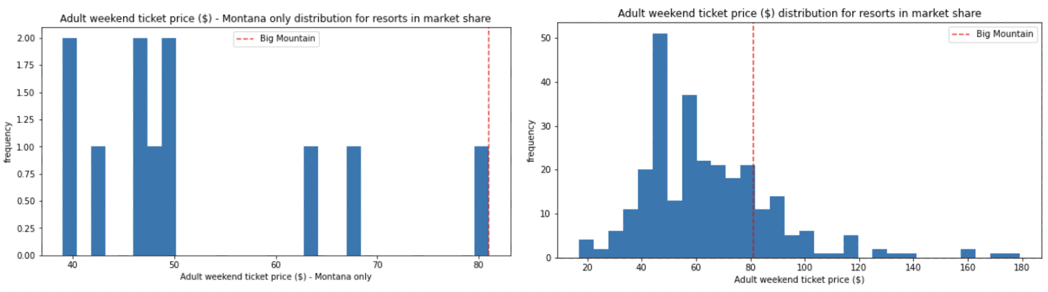
Key Findings & Recommendation
Montana’s average ticket price is about $50 and Big Mountain’s is $81. But does this mean we set a legitimate ticket price?
Regardless of what Montana’s average ticket price is, Big Mountain may have better facilities than other resorts, which could lead to a higher price.

Slide 5
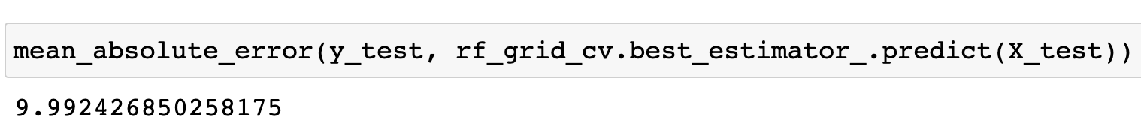
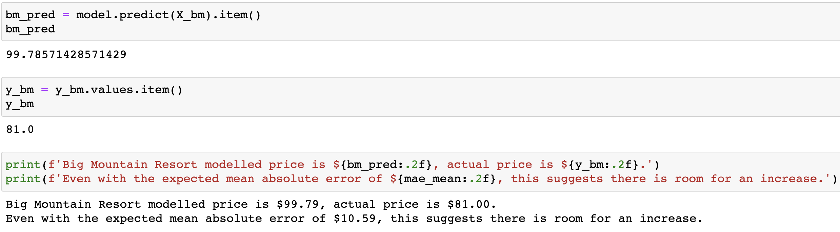
Model Results & Analysis
Random forest regression model performance: 9.99 mean absolute error
Model result (including all variables): We’ve built our model including all the features in all the competitor resorts. The result suggests that Big Mountain’s ticket price should have been $ 99.79, where our current price is $81
Recommendation: We would like to recommend raising the ticket price to $ 99.79

Slide 6
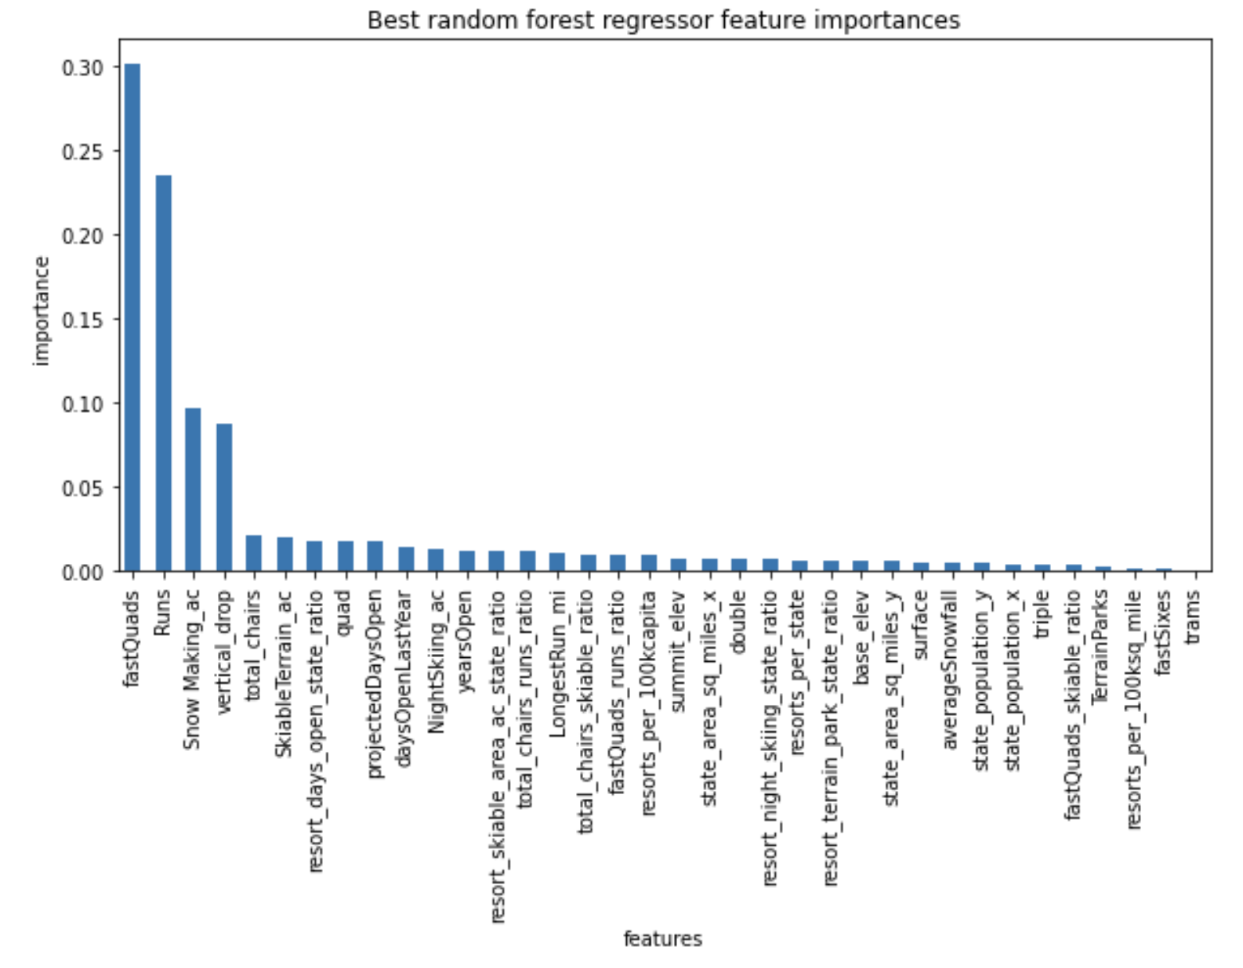
Model Results & Analysis
According to our model,
the dominant top 4 features contributing to setting the ticket price are:
fastQuads
Runs
Snow Making_ac
vertical_drop

Slide 7
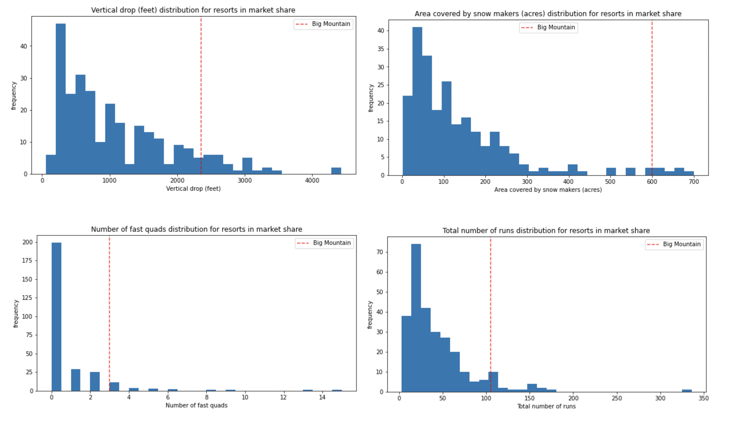
Model Results & Analysis
Big Mountain is ranked relatively high in all the most important features:
This proves that it is reasonable to set a higher price at Big Mountain.

Slide 8
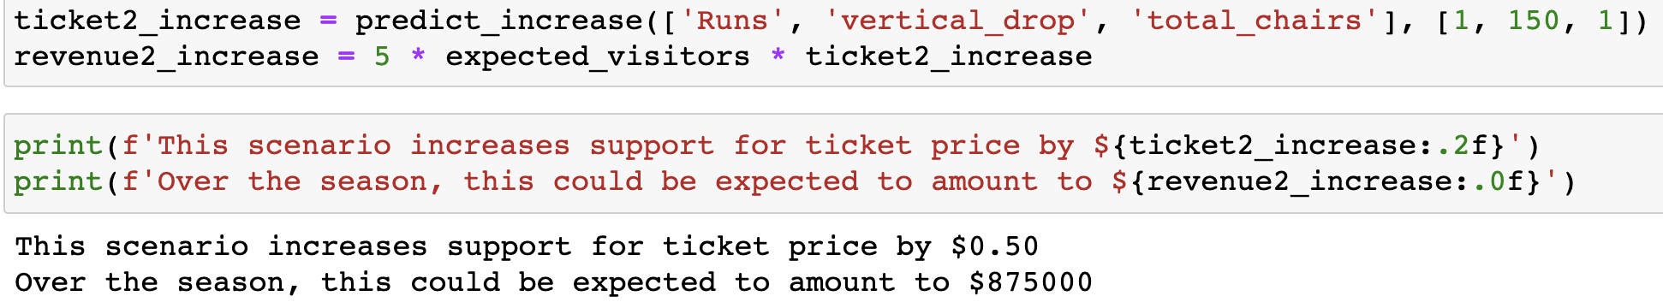
Model Results & Analysis
<Example Senario for Future Investment Plan>
Moreover, if we increase the number of runs and total_chairs by 1 and the length of vertical_drop by 150ft, supposing that the expected numer of visitors over the season is 350,000 and the visitors ski for five days, we can expect $875,000 revenue increase.

Slide 9
Conclusion
We would like to recommend raising Big Mountain’s ticket price to $ 99.79.
If we continue adjusting the features we should be able to find the point where we can cover the operating cost for newly added chair, $1,540,000.
Therefore, we should make more scenarios with the knowledge of other facilities’ operating cost and sales data for expected visitors for each month, measure its impact on our revenue, and find out the best scenario for our business.

