Slide 1
UNDP & UNICEF Staff Management Strategy with Performance Evaluation

Slide 2
Problem
The issue of insufficient attention to careers, staff development, and recruitment has been raised in the UN, leading to a staff morale crisis.
Many staff joins the UN enthusiastically in their late twenties or early thirties. Still, after a decade, they start to get disappointed and explore alternative career paths for better opportunities.
Staff often languish in the same headquarters or field post for years, unable to move or grow.
There is a concern over whether there is a fair sharing of the burden of service in difficult duty stations.

Slide 3
Solution
Analyze the performance and career success(promotion) of 15090 UNDP & UNICEF staff members evaluated in 2016~2019. Gender, a breath of work experience, work experience in hardship duty stations, and the total number of years of service will be the main variables for the analysis.
Build a predictive model for performance evaluation and identify important factors for performance score to 1) help HR find more qualified staff and shorten the staff selection process when filling vacant positions and 2) encourage staff members to have successful career planning.

Slide 4
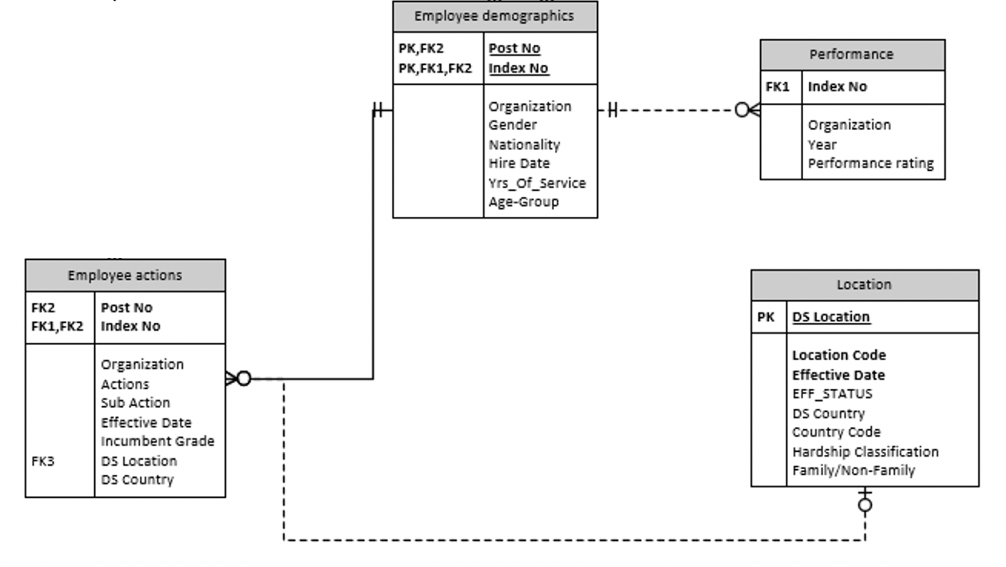
Data Cleaning [link]
10 years’ worth of employees datasets provided by UNICEF and UNDP were merged and cleaned for this analysis.

Slide 5
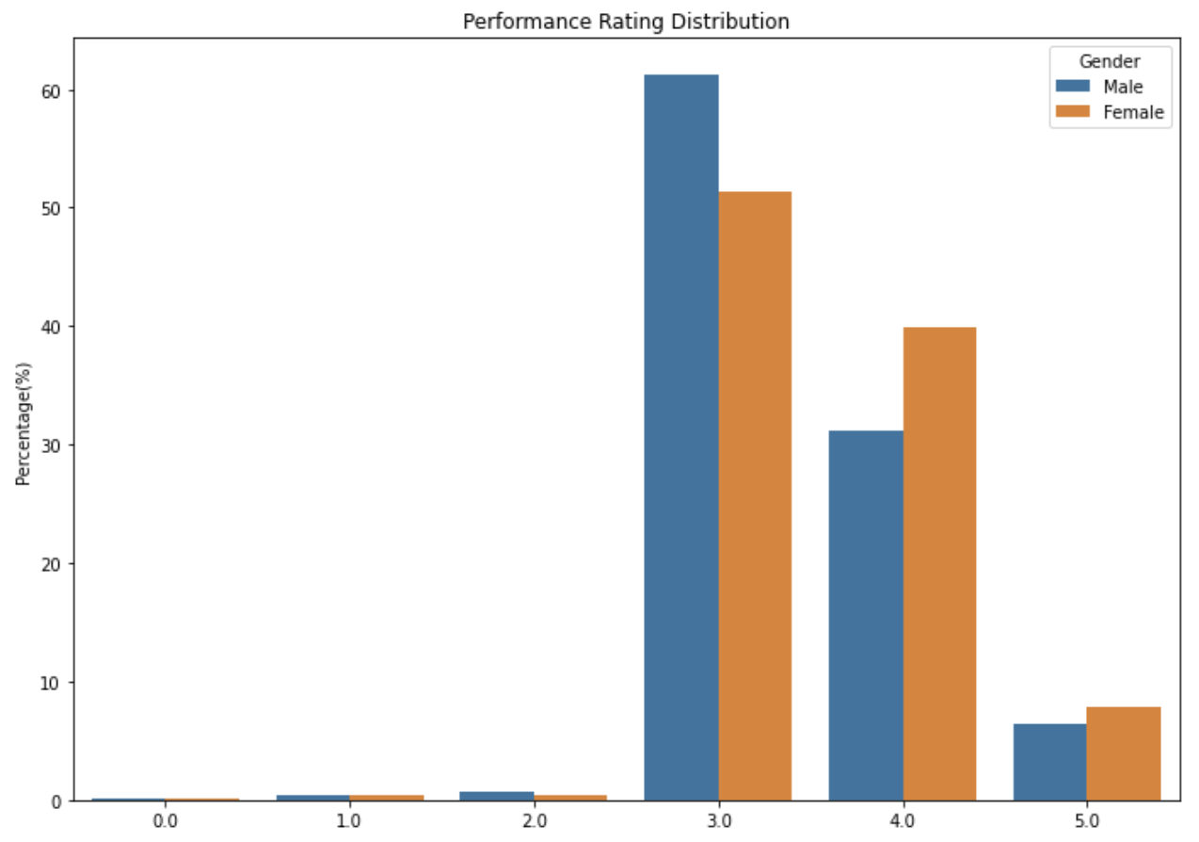
Exploratory Data Analysis [link]
Most UN staff get three or higher scores in the performance evaluation.
Female staff tends to get higher scores, such as 4 or 5, than male staff.

Slide 6
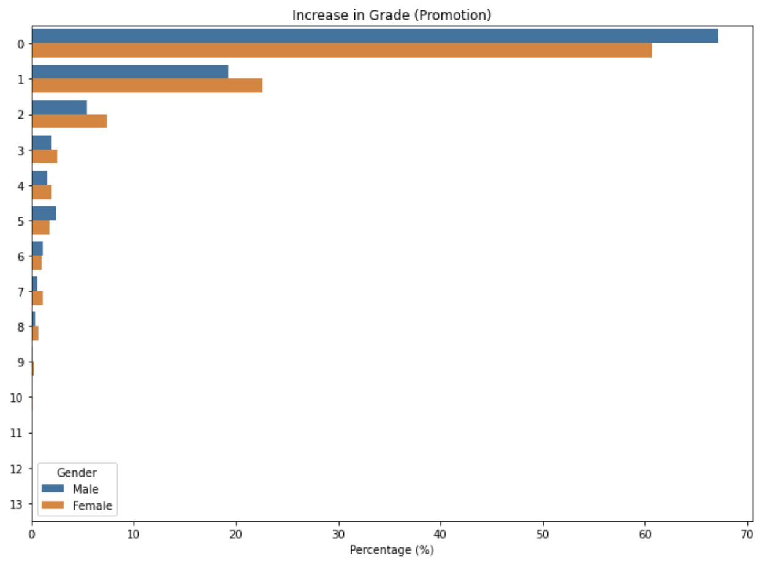
The majority of men and women couldn't get a chance to be promoted, as most of them are ranked in 0.
Female staffs are more likely to get promoted during their years of service.

Slide 7
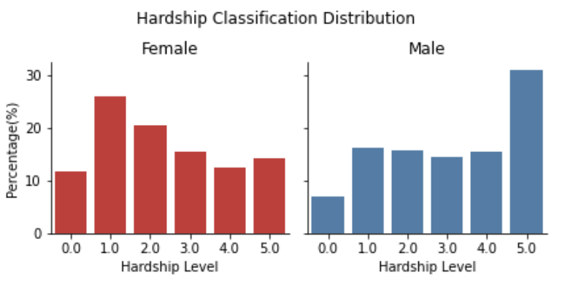
1 is Hard 5 is the hardest, and 0 is for HQ duty station.
A higher percentage of female staff worked only in HQ (level 1) than male staff.
About 50% of female staff worked at level 1 or 2.
More than 30% of Male staff has worked in the level 5 hardship duty station, whereas only about 13% of Female staff has been in level 5.

Slide 8
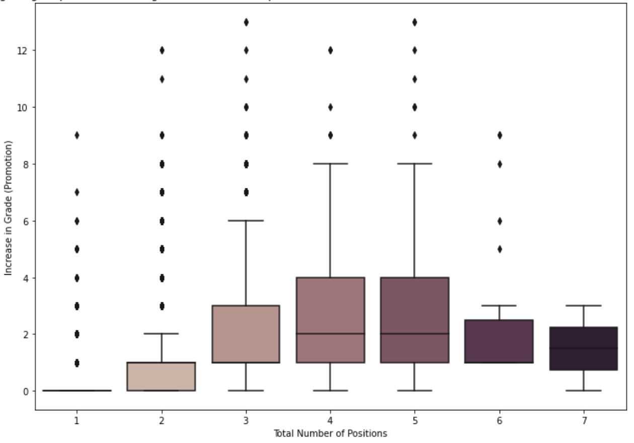
Most staff tend to get higher promotions with a greater breadth of experience, but some took more roles but did not get promoted.

Slide 9
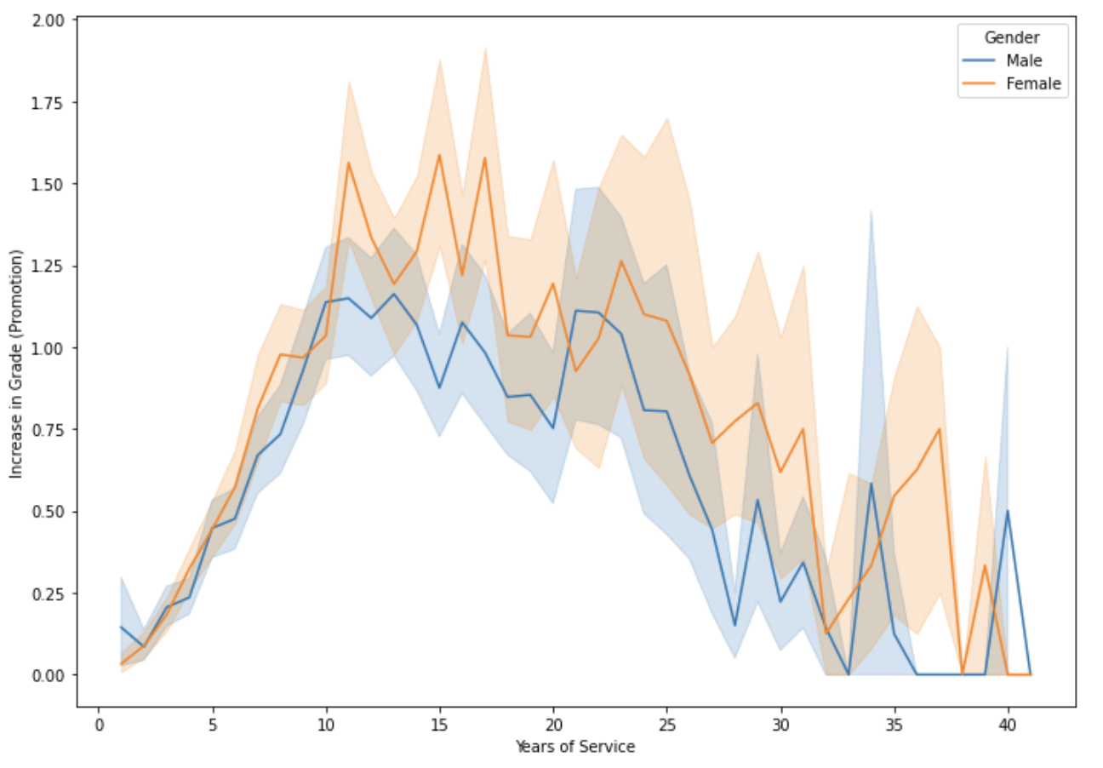
The degree of promotion increases till the staff has 10 years of service and decreases as the years of service increase.
People who have worked 10-17 years got more promotions than the others.

Slide 10
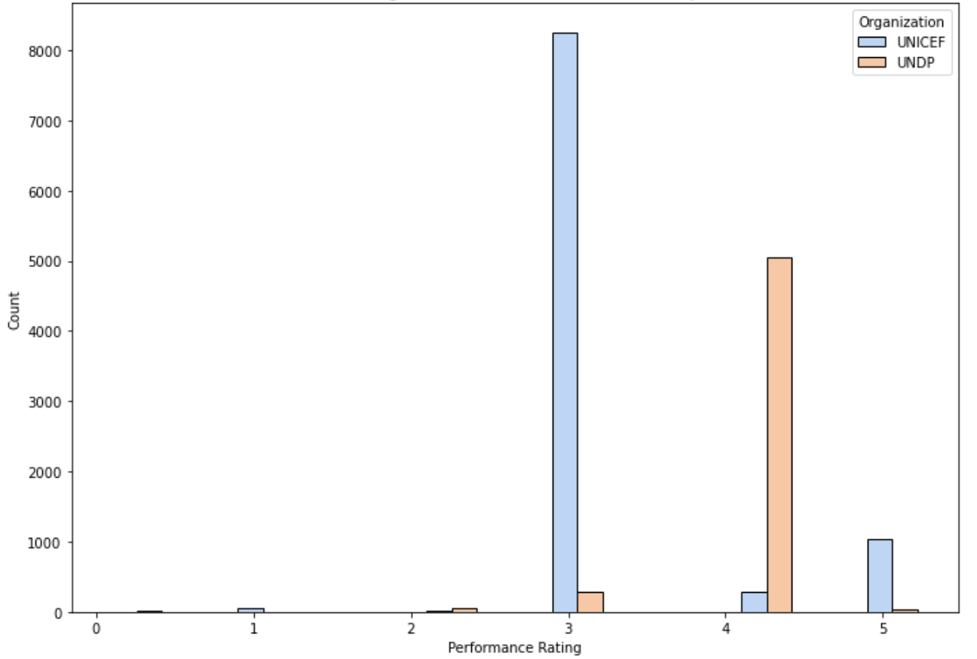
UNDP staffs tend to receive a higher score than UNICEF staff in the performance evaluation.

Slide 11
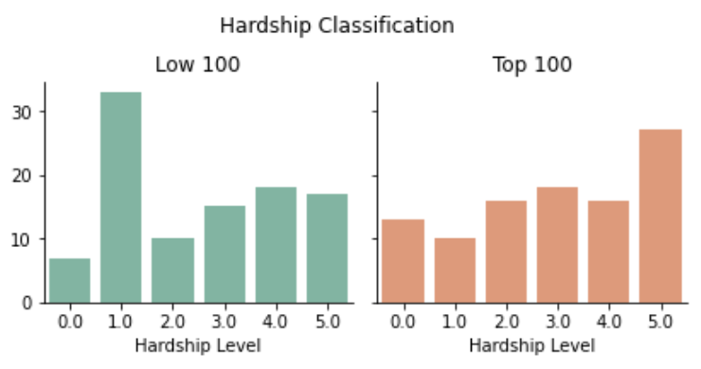
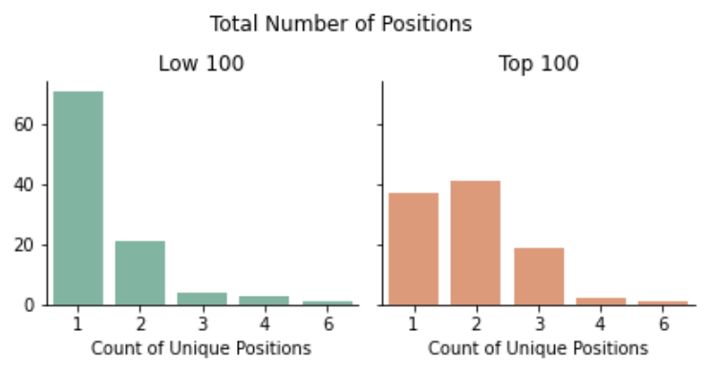
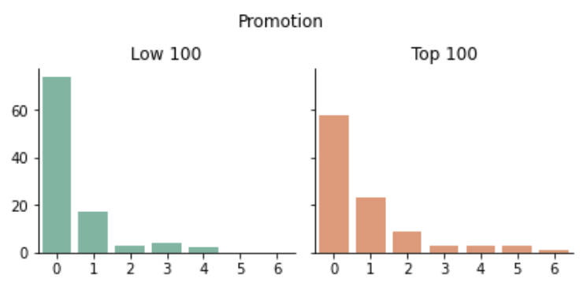
Comparison of Top Performers & Low Performers

Slide 12
Comparison of Top Performers & Low Performers
Top performers have working experience in more challenging locations than low performers, though most of the low performers have experience in hardship duty stations at least once.
While most low performers had experience in only one position, more than half of top performers tried to work in multiple positions.
Although more top performers received more than one promotion, most of them have remained in the same grade compared to the low performers.

Slide 13
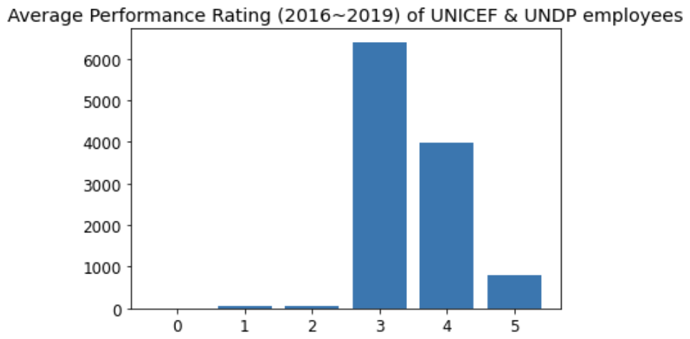
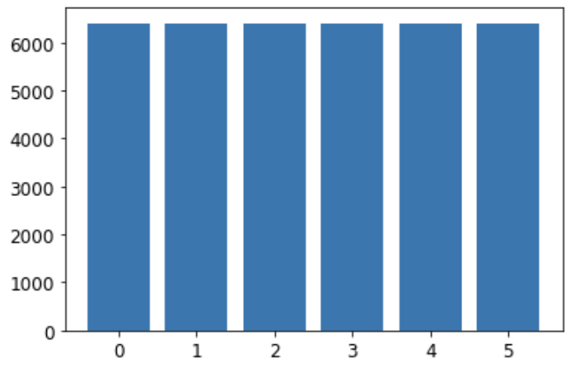
Performance Score Prediction Model [link]
Distribution of Target Variable: Average Performance Score
Imbalanced Classification
Balanced Classification
* Using SMOTE, the imbalanced data issue has been fixed.

Slide 14
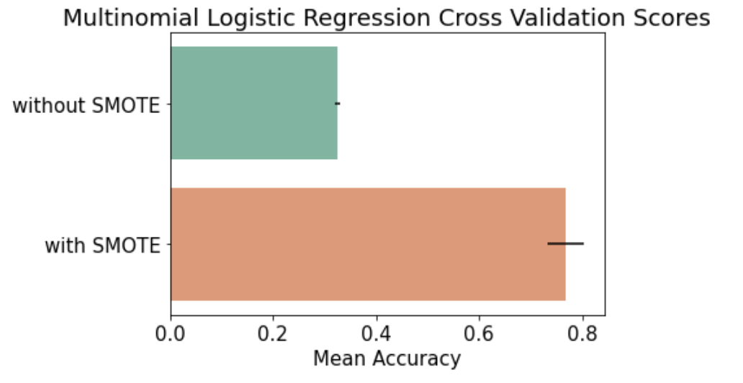
Using SMOTE to deal with imbalanced data issue significantly improves the cross validation accuracy score up to 0.768.

Slide 15
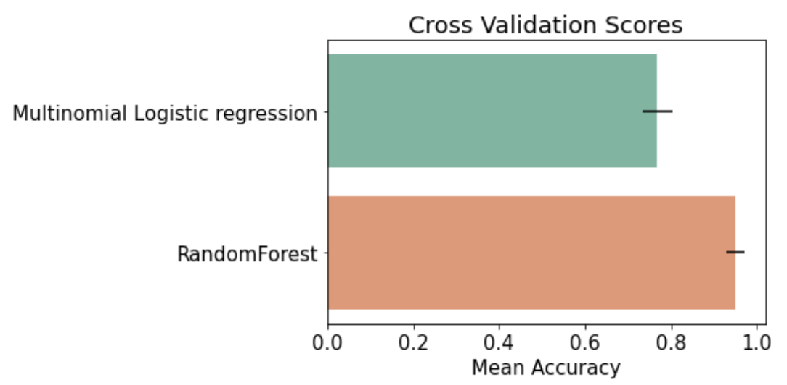
Mean Cross Validation Score of Random Forest Classifier without tuning parameters is 0.95, which is greatly improved (18% increase) compared to multinomial logistic regression, but it might be overfitting in the training data.

Slide 16
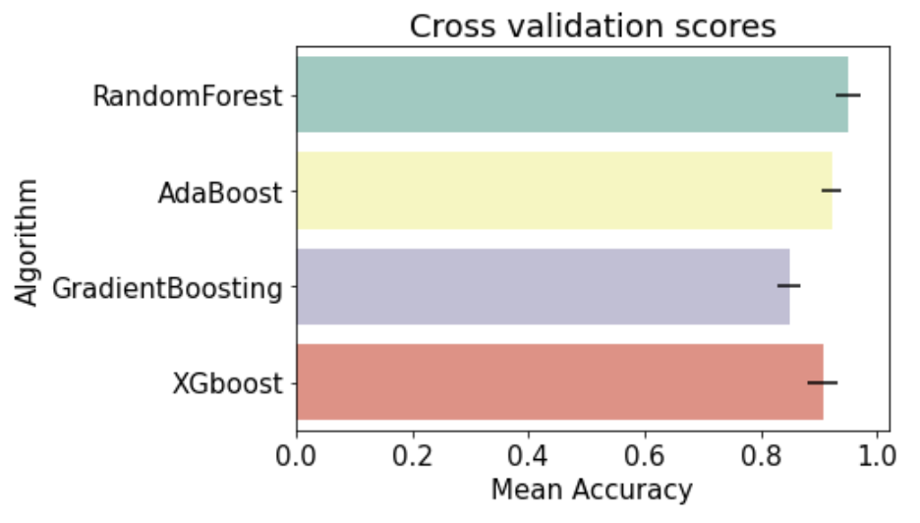
Random Forest Classifier had the highest cross validation score, compared to other models.
Mean Cross Validation Score has been improved by 0.6% (0.950 --> 0.956) by tuning parameters of Random Forest model

Slide 17
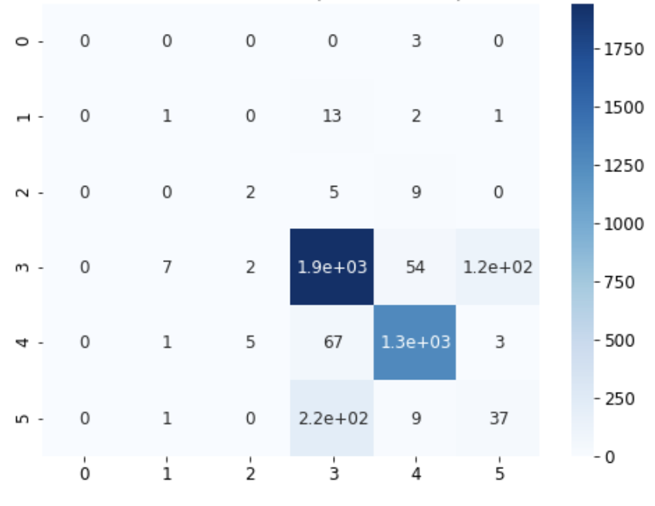
Confusion Matrix
X-axis represents the predicted performance score.
Y-axis means the actual performance score.

Slide 18
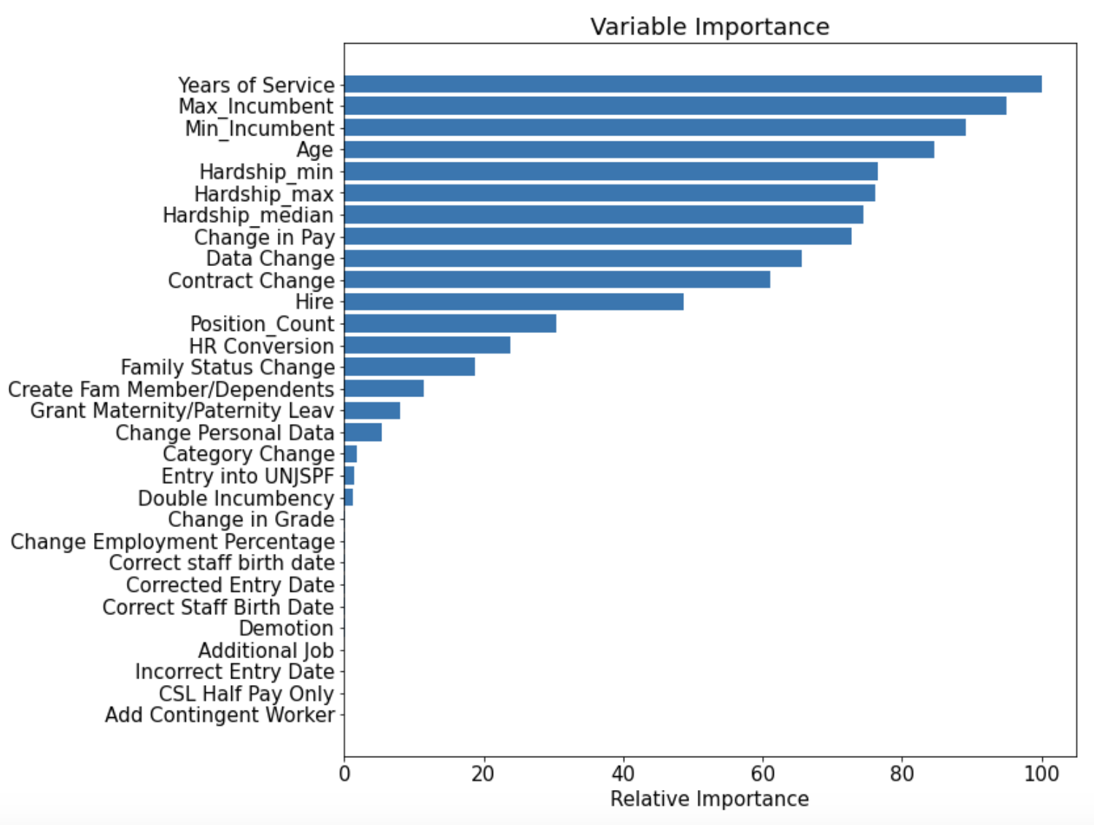
This shows how much our model used each variable to make accurate predictions.

Slide 19
Further Analysis
To prevent overfitting, applying a smaller 'max_depth' in the tuning parameter stage could lead to a better result.
Other datasets, such as the UN staff members' job application history or the history of internal mobility, could be used to increase the accuracy and to understand the relationship between internal mobility and performance.

