Slide 1
Case data analytics
Presented by wang peiyu

Slide 2
Background/introduction
I am very legal inclined
American has Common Law System
Everyone has preferences/patterns/biases
You can expect what has happened to happen again

Slide 3
Variable Explanation
Case # : general case number, or a unique value to mark the case differently, like key value in database
Word_count : the count of the words in the court’s opinion
Outcome: the outcome of the case, 0- if the appellant won, 1- if the appellant lost
Weights: the weight of a certain case when analyzing them

Slide 4
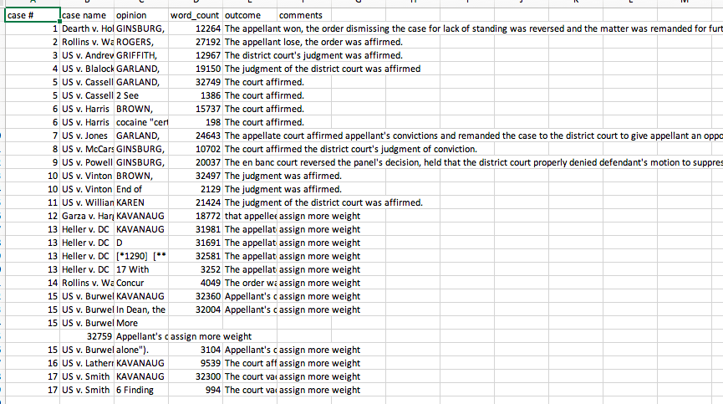
Dataset

Slide 5
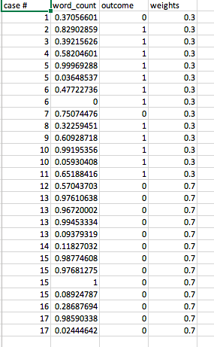
Dataset

Slide 6
Normalize the data
Formula:

Slide 7
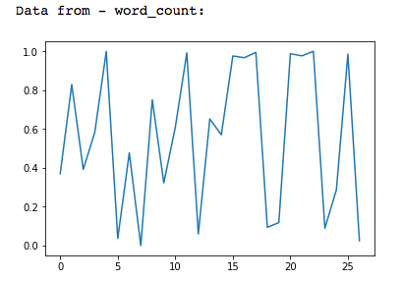
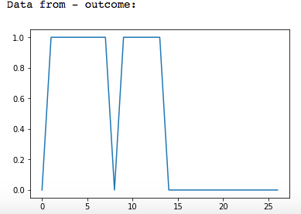
Analysis
Does word_count affect outcome?
Plot graph:

Slide 8
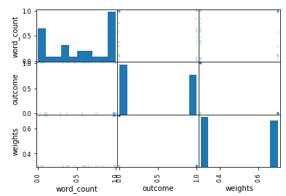
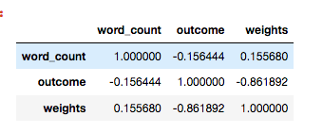
Analysis
Does word_count affect outcome?

Slide 9
Other graphs display
https://oliviapy960825.github.io/

Slide 10
Close
Don’t have a lot of data but it’s less of a problem
Case files are hard to be read into CSV files, for encoding issues and also the length
They are hard to be analyzed, text analyzing /NLP knowledge may apply

