Slide 1
Trade-off Between Debiasing & Word Embedding Quality
Farhana Faruqe, Luming Wang, Peiyu Wang and Wei Guo
Bias in AI | Spring 2020

Slide 2
Roadmap
Introduction
Related Work
Motivation
Problem Statement
Data
Method
Experiment & Result
Future Work
Conclusion

Slide 3
Introduction
Debiasing word embedding is at the center of attention
Some previous research showed promises, but later research overturned the results

Slide 4
Related work
Bolukbasi et al. (2016)
Caliskan et al. (2017)
Gonen and Goldberg (2019)
Karve et al. (2019)

Slide 5
Motivation
The potential amplification of bias embedded in word embedding has become a major concern in the relevant research field.
Many researchers have been focusing on finding systematic approaches of debiasing word embeddings while maintaining their quality.

Slide 6
Problem Statement
The focus of our project is to find out whether including more principal components into the debiasing process is a better way of debiasing.
We would also like to quantify the trade-offs between incorporating more principle components in the debiasing process and the linguistic property preservation ability of the word embedding after debiasing.

Slide 7
Data: Word Embedding
Corpus of Historical American English (COHA)
Contains fiction, popular magazine, newspaper, and non-fiction books in American English.
We focus on data corpus from 1990s

Slide 8
Data: Evaluation
For Intrinsic Evaluation
Word list from Caliskan et al.
Google analogy dataset
Dataset from Gonen et al.
Dataset from Bolukbasi et al.
For Extrinsic Evaluation
Movie review dataset from Maas et al.

Slide 9

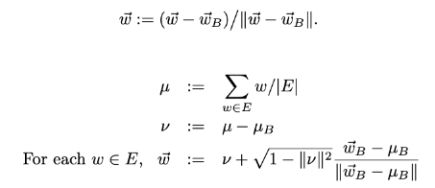
Method: Hard-Debiasing
We use the hard-debiasing method from Bolukbasi et al.
Step 1: identify the gender subspace
Step 2: neutralize and equalize

Slide 10
Method: Evaluation
Intrinsic
Word Embedding Association Test (WEAT)
Concept Categorization
Analogy
Extrinsic
Sentimental Classification

Slide 11
Experiments
&
Results

Slide 12

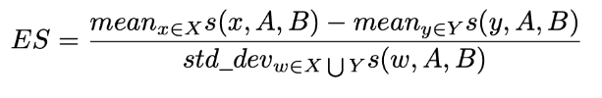

Experiment: Word Embedding Association Test (WEAT)
We use WEAT to measure the social biases in original and debiased COHA word embeddings
Test statistics

Slide 13
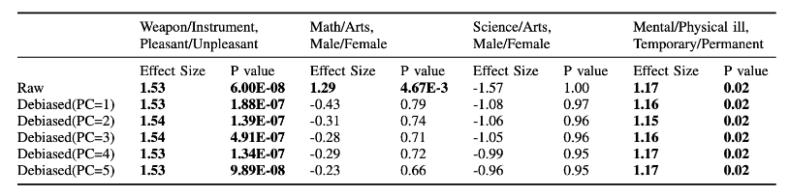
Result: WEAT
Hard Debiasing method decreases the effect size of gender bias and doesn’t influence the effect size of other bias.
Including more principal components decreases the association differences of target groups with the attribute groups.

Slide 14
Experiment: Concept Categorization
Four experiments or tests are conducted for the concept categorization:
Clustering female-biased and male-biased words
Bias-by-projection and bias-by-neighbors correlation
Profession words_ bias-by-neighbors
Classifying female-biased and male-biased words
Notes:
We have followed the approach proposed by Gonen and Goldberg[8] and conducted four experiments:

Slide 15
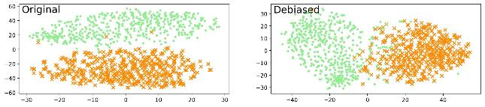
Result: Clustering Female-biased & Male-biased Words
Figure1: Before and after debiasing, 1000 most biased words represented into two clusters [debiased PC=1]
Clustering female-biased and male-biased words
 | Accuracy
Raw | 99%
Debiased(PC=1) | 95%

Slide 16
Result: Bias-by-projection & Bias-by-neighbors and Profession
 | Profession (bias-by-neighbors) |  | Bias-by-projection & bias-by-neighbors
 | Correlation | P-value | Correlation | P-value
Raw | 0.74 | 6.88E-41 | 0.69 | 0.00
Debiased(PC=1) | 0.71 | 9.81E-37 | 0.66 | 0.00
Debiased(PC=3) | 0.74 | 4.31E-41 | 0.69 | 0.00
Debiased(PC=4) | 0.74 | 4.31E-41 | 0.69 | 0.00
Debiased(PC=5) | 0.73 | 2.06E-39 | 0.68 | 0.00

Slide 17
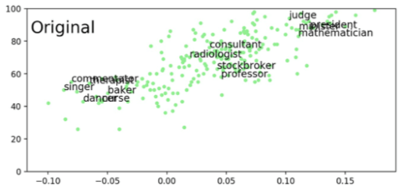
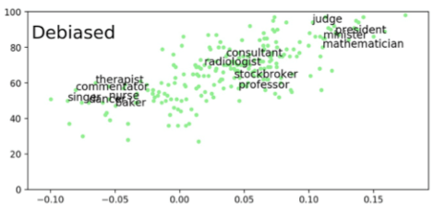
Plot: Profession
Figure 2: Only a limited number of professions are on the plot to make it readable. X is original bias and Y is number of male neighbors (before and after debiasing [PC=1]).

Slide 18
Result: Classifying Female-biased and Male-biased Words
Top 5000 female-biased and male-biased words are sampled. Applied SVM.
Training dataset: subset of 1000.
Test and evaluation: 4000 words
Classifying female-biased and male-biased words
 | Accuracy
Raw | 94%
Debiased(PC=1) | 92%

Slide 19
Experiment: Analogy
Gender specific analogies on female-male direction
Gender neutral analogies on female-male direction

Slide 20
Result: Gender Specific Analogy
% of sucessful generation
% of non-rational analogies
Average rating for rational analogies
Average ratings for all analogies
Inter-coder reliability score

Slide 21
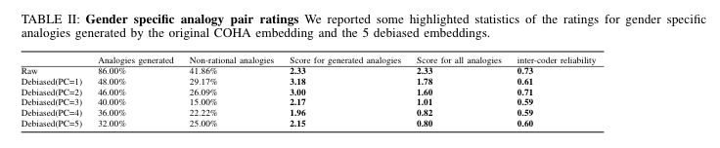
Result: Gender Specific Analogy (cont.)

Slide 22
Result: Gender Neutral Analogy
% of sucessful generation
% of non-rational analogies
% of non-stereotypical analogies
Average ratings for rationality in analogies
Average ratings for stereotypes in analogies

Slide 23
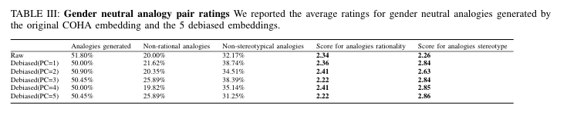
Result: Gender Neutral Analogy (cont.)

Slide 24
Experiment: Extrinsic Evaluation
Sentimental Classification:
Compare original word embeding result with debiased word embedding result
Applied movie reviews from Maas et al.
Debiased word embeddings show classification improvement `

Slide 25
Result: Extrinsic Evaluation
Linear Regression Classifier
 | Accuracy | Recall Rate | True Negative | True Positive
PC=1 | 82.20% | 81.57% | 81.92% | 82.48%
PC=2 | 82.42% | 81.81% | 82.16% | 82.68%
PC=3 | 82.44% | 81.57% | 81.92% | 82.96%
PC=4 | 82.10% | 81.28% | 81.64% | 82.56%
PC=5 | 82.32% | 81.53% | 81.88% | 82.76%
Origin | 80.54% | 81.26% | 81.28% | 79.80%
SVM Classifier with RBF Kernel
 | Accuracy | Recall Rate | True Negative | True Positive
PC=1 | 82.20% | 81.57% | 81.92% | 82.48%
PC=2 | 82.42% | 81.81% | 82.16% | 82.68%
PC=3 | 82.44% | 81.57% | 81.92% | 82.96%
PC=4 | 82.10% | 81.28% | 81.64% | 82.56%
PC=5 | 82.32% | 81.53% | 81.88% | 82.76%
Origin | 80.54% | 81.26% | 81.28% | 79.80%

Slide 26
Future Work
Different Representations of multiple principal components
More evaluation methods should be taken into consideration.
Different types of word embeddings should be evaluated in the future.

Slide 27
Conclusion
Incorporating more principal components into the gender subspace do not always improve the quality of the debiased word embeddings or their performance in downstream NLP tasks.

Slide 28
References
[1] A. Bakarov, “A survey of word embeddings evaluation methods,”arXivpreprint arXiv:1801.09536, 2018.[2] W. Bin, W. Angela, C. Fenxiao, W. Yunchen, and K. CC, Jay, “Evaluat-ing word embedding models: Methods and experimental results,” 2019.[3] T. Bolukbasi, K.-W. Chang, J. Y. Zou, V. Saligrama, and A. T. Kalai,“Man is to computer programmer as woman is to homemaker? debiasingword embeddings,” inAdvances in neural information processingsystems, 2016, pp. 4349–4357.[4] E. Bruni, N. Tran, and M. Baroni, “Multimodal distributional seman-tics,”Journal of Artificial Intelligence Research 49(1):1–47, 2014.[5] A. Caliskan, J. J. Bryson, and A. Narayanan, “Semantics derived au-tomatically from language corpora contain human-like biases,”Science356(6334):183–186., 2017.[6] M. Davies,The corpus of historical american english: COHA. BYE,Brigham Young University, 2010.[7] H. Gonen and Y. Goldberg, “Lipstick on a pig: Debiasing methods coverup systematic gender biases in word embeddings but do not removethem,”arXiv preprint arXiv:1903.03862, 2019.[8] Z. Jieyu, Z. Yichao, L. Zeyu, W. Wei, and C. Kai-Wei, “Learninggender-neutral word embeddings,” inIn Proceedings of EMNLP), 2018,p. 4847–4853.[9] S. Karve, L. Ungar, and J. Sedoc, “Conceptor debiasing of wordrepresentations evaluated on weat,”arXiv preprint arXiv:1906.05993,2019.[10] J. R. Landis and G. G. Koch, “The measurement of observer agreementfor categorical data,” 1977.[11] d. M. Laurens, van and H. Geoffrey, “Visualizing data using t-sne.journal of machine learning research,”machine learning research,9(Nov):2579–2605, 2008.[12] A. L. Maas, R. E. Daly, P. T. Pham, D. Huang, A. Y. Ng, and C. Potts,“Learning word vectors for sentiment analysis,” inACL, 2011.[13] T. Mikolov, K. Chen, G. Corrado, and J. Dean, “Efficient estimation ofword representations in vector space,”arXiv preprint arXiv:1301.3781,2013.[14] K. Radinsky, E. Agichtein, E. Gabrilovich, and E. Markovitch, “Aword at a time: Computing word relatedness using temporal semanticanalysis,” inthe 20th International World Wide Web Conference, 2011,p. 337–346.[15] T. Schnabel, I. Labutov, D. Mimno, and T. Joachims, “Evaluationmethods for unsupervised word embeddings,” inProceedings of the2015 conference on empirical methods in natural language processing,2015, pp. 298–307

Slide 29
Thank you
&
Stay safe!

