Slide 1

District Heating Network
901_protSPS.csv Heat station (store, pumps, etc.)
2901_protWZ.csv Wood-fired boiler
3901_protWZ.csv Gas-fired boiler 1
4901_protWZ.csv Gas-fired boiler 2
Heat
Station
8
350 kW (07/2018)
8_prot.csv
9
60 kW (10/2018)
9_prot.csv
850 kW
1006_protWZ.csv
6_protSPS.csv¹
Main feeder
1901_protWZ.csv
6
30 kW (01/2018)
7_prot.csv
7
1
650 kW
1_prot.csv
Hints
The CSV files contain data for the years 2018 and 2019. Note that there may be gaps (e.g., because certain consumers have been attached only later, etc.) in the data: use the timestamps!
You find the schematics of the central heat station and of all consumer interfaces on the following pages.
Historical weather data has been obtained from two publicly available sources². Thus, the locations of the weather stations are in the same greater region as the district heating network, yet not necessarily nearby.
2
90 kW
2_prot.csv
3
160 kW
3_prot.csv
4
60 kW
4_prot.csv
Legend:
¹ See schematic on p. 8: this consumer can be shut off (load shedding). Therefore, there is a local backup oil-fired boiler. The corresponding details are given in 6_protSPS.csv.
² http://www.agrometeo.ch/de/meteorology/datas
X
<nominal power> (<date of connection>)
<data file>
5
100 kW
5_prot.csv

Slide 2
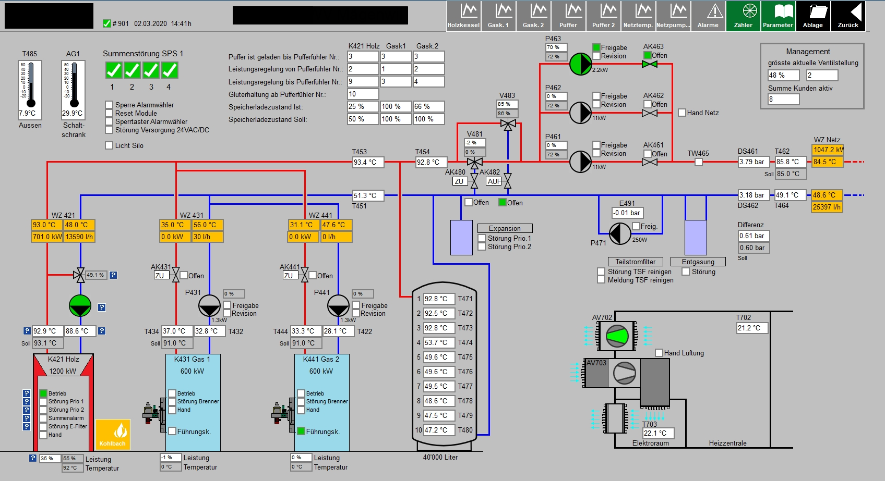
Heat Station
1901_protWZ.csv
2901_protWZ.csv
3901_protWZ.csv
4901_protWZ.csv

Slide 3
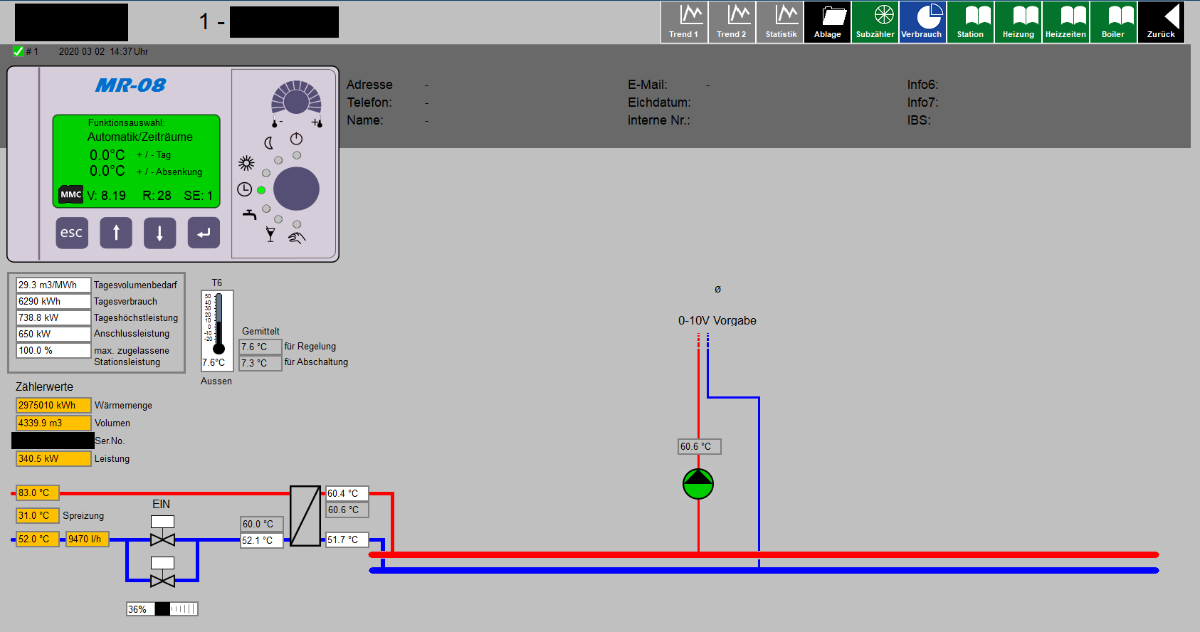
Consumer 1

Slide 4
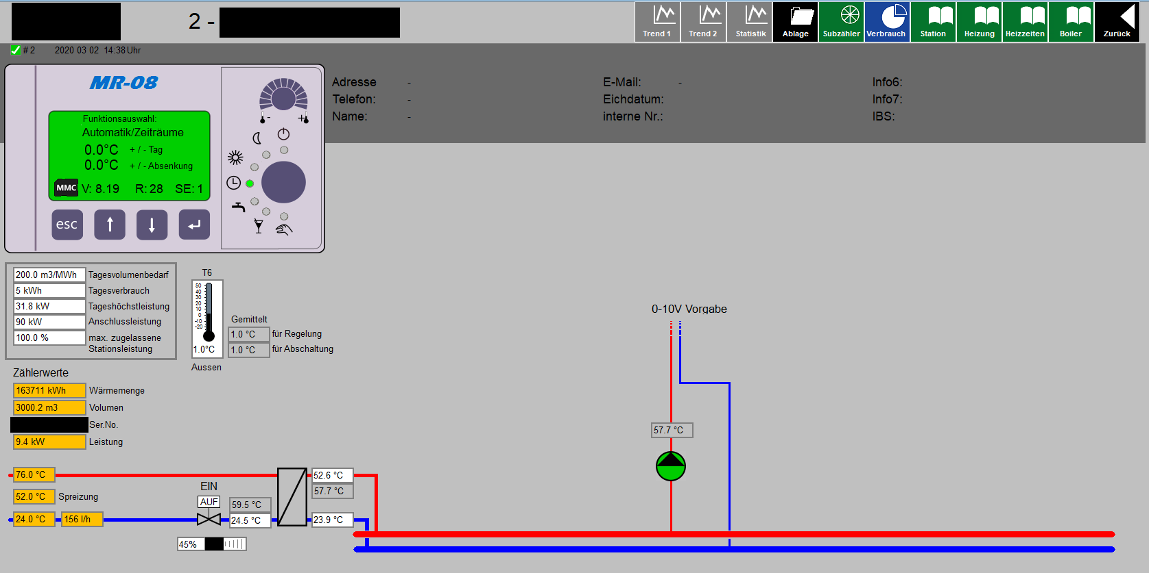
Consumer 2

Slide 5
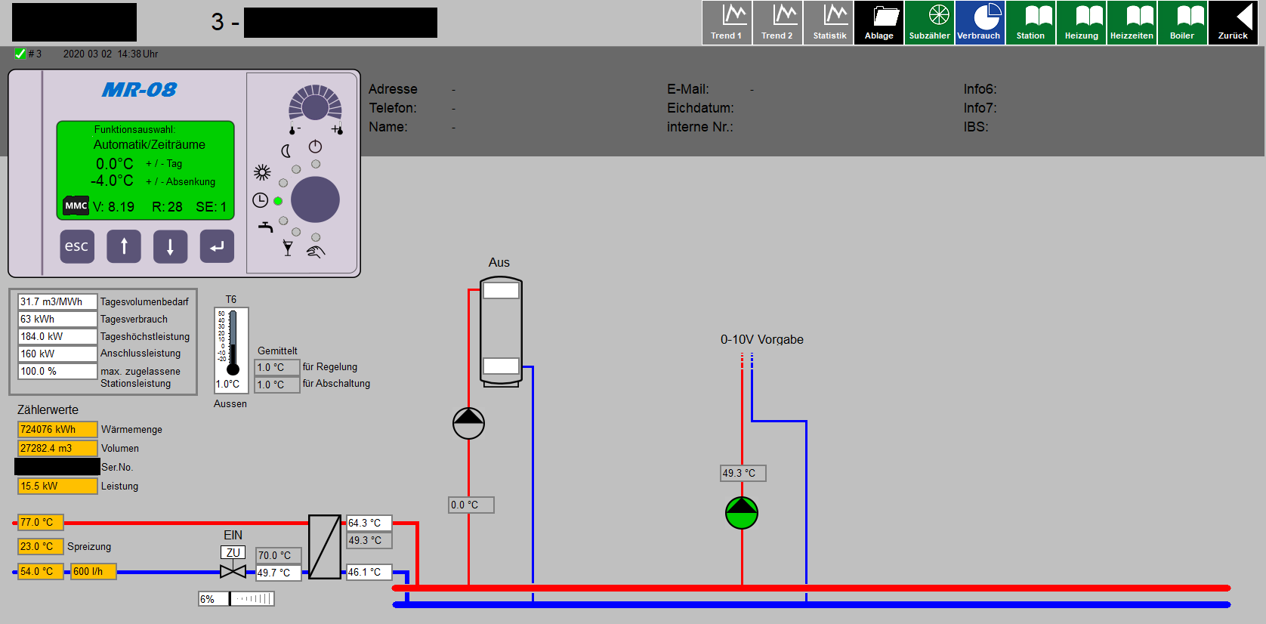
Consumer 3

Slide 6
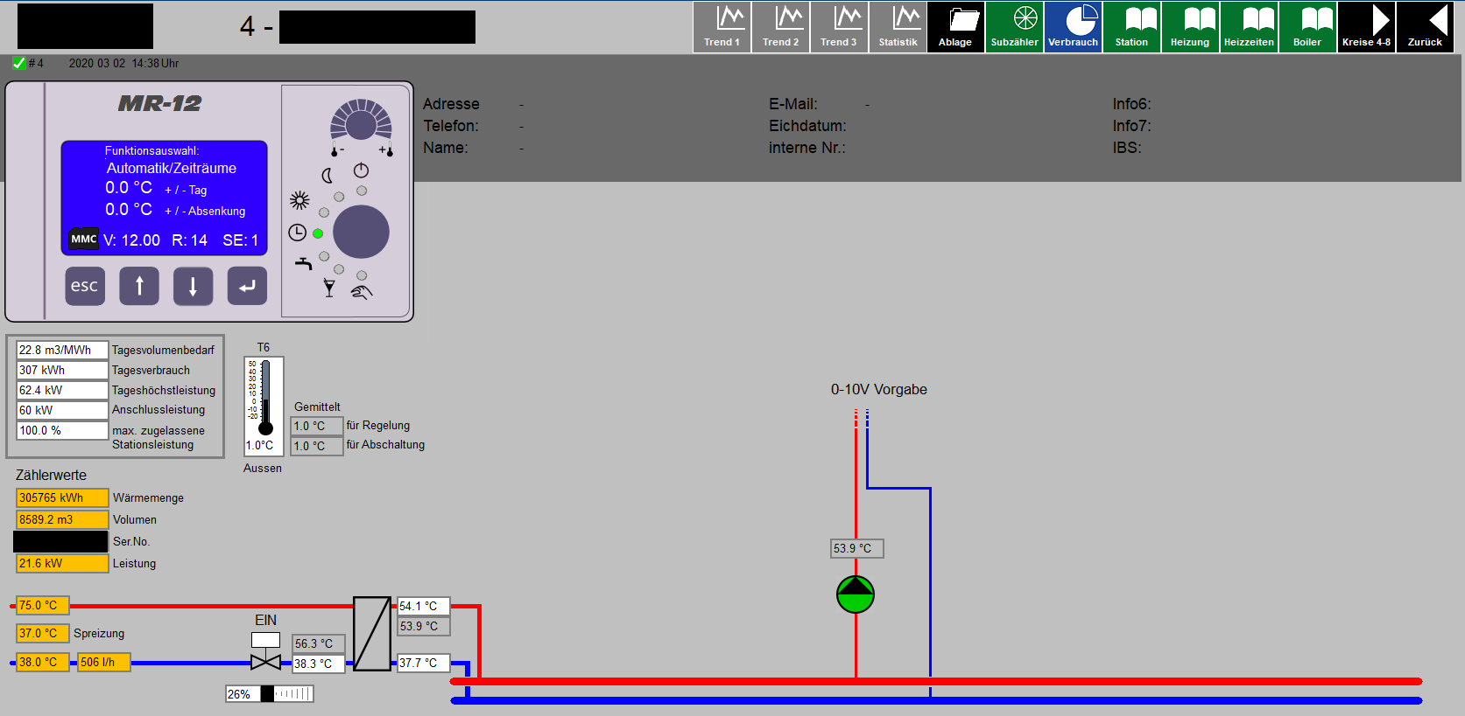
Consumer 4

Slide 7
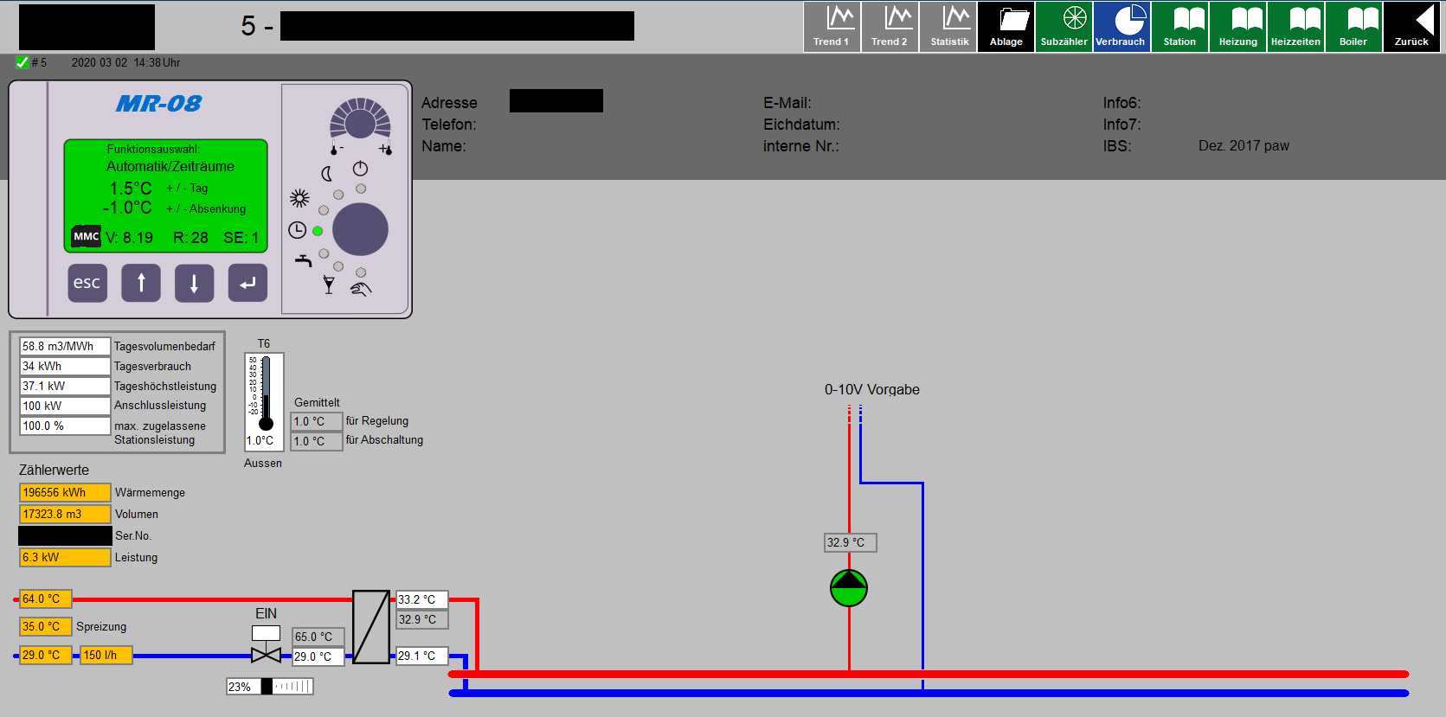
Consumer 5

Slide 8
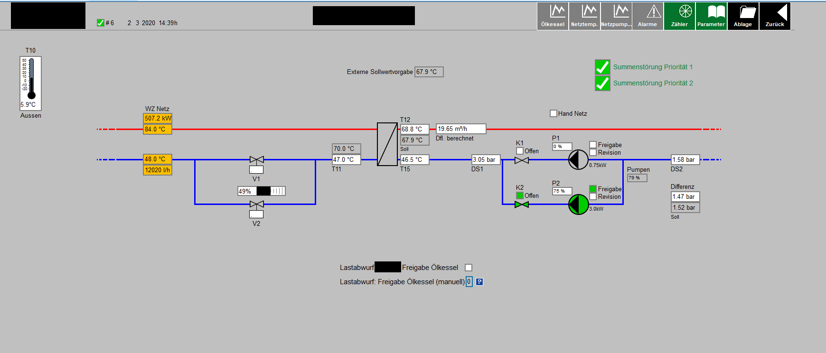
Consumer 6
Bei diesem Anschluss mit hoher Nennleistung von 850 kW verfügt der Fernwärmenetzbetreiber über die Möglichkeit, den Anschluss abzuschalten (Lastabwurf)
Daher ist lokal noch eine Ölheizung vorhanden, die übernimmt, wenn der Fernwärmeverbund den Anschluss deaktiviert
Es erfolgt nie eine Rückspeisung von der Ölheizung in das Fernwärmenetz

Slide 9
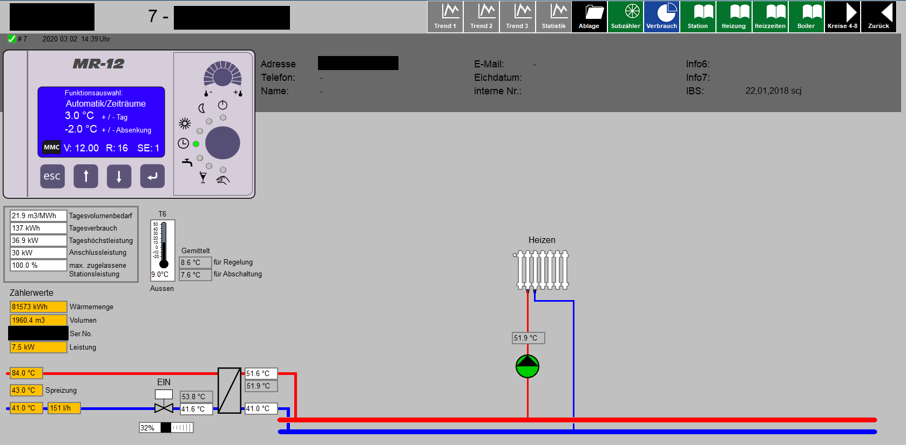
Consumer 7

Slide 10
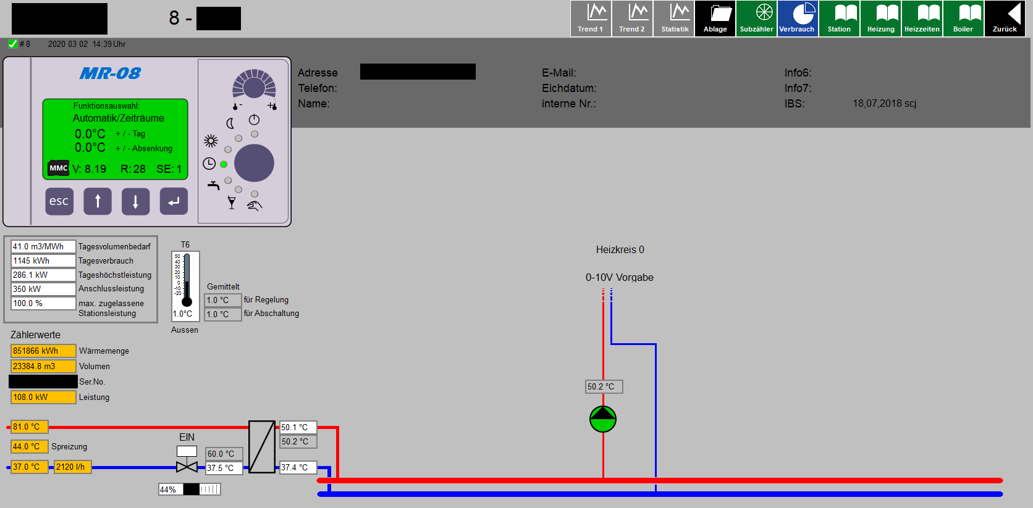
Consumer 8

Slide 11
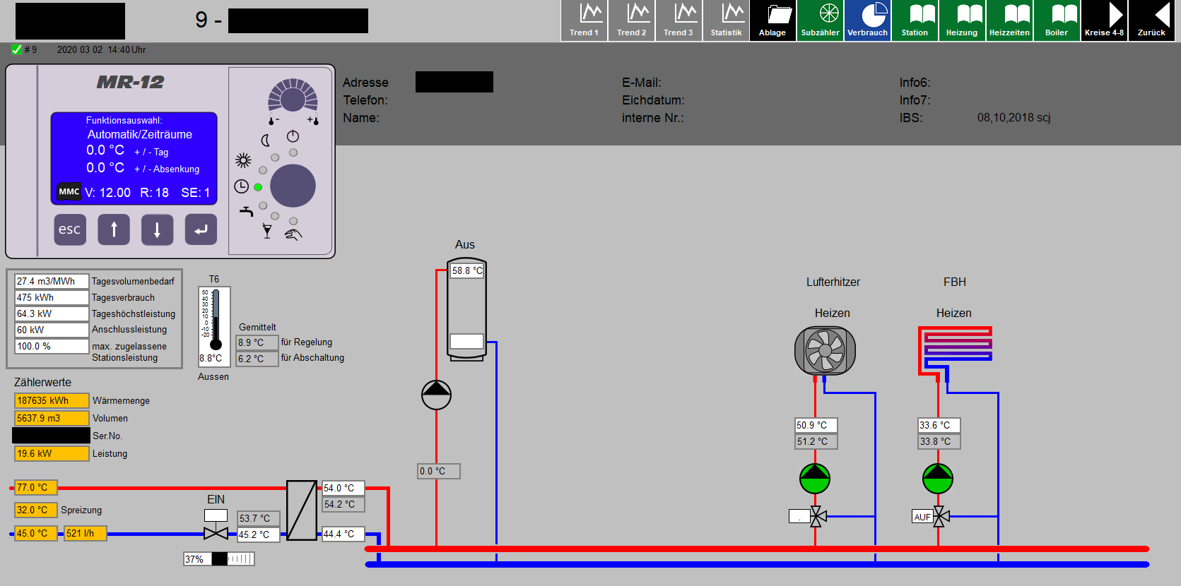
Consumer 9

