Slide 1


Report on localization with ROS (4 points)
Olivier Aycard
Associate Professor at University of Grenoble1
Laboratoire d’Informatique de Grenoble
http://membres-liglab.imag.fr/aycard

Slide 2
Outline
Requirements for the lab on localization
Report

Slide 3
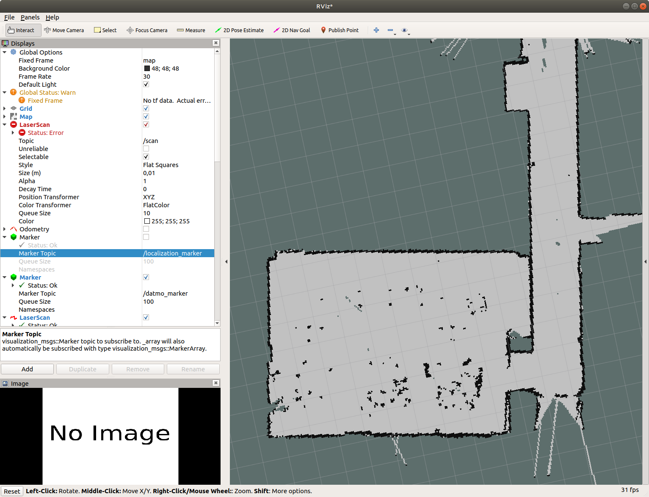
Requirements for the lab on localization
You will download the map of the 2nd floor of UFR IM2AG;
You will download a rosbag to test your localization node: localization_test_2nd_floor_UFR_IM2AG.bag;
The initial position is roughly inside the green circle;
The rosbag is huge and sometimes robair does not move for a long time (i.e. more than 30 seconds);
When your node performs relocalization, you should put your rosbag on “pause” to avoid that robair still moves.
P(S₄ = 10) = 1
P(S₅ = 11) = 1

Slide 4
Report on localization (4 points + 2 pages maximum)
Your report should show the path done by robair and the relocalization process to avoid drift of odometry:
2-3 snapshots showing that your node find the precise initial position + explanation of trace
3-4 snapshots showing the successive positions of robair + explanation
We should be able to see the path (ie, important successive positions) done by robair in the rosbag.
P(S₄ = 10) = 1
P(S₅ = 11) = 1

