Slide 1


Connection to robair
Olivier Aycard
Professor
Grenoble INP - PHELMA
GIPSA Lab
https://www.gipsa-lab.grenoble-inp.fr/user/olivier.aycard
olivier.aycard@grenoble-inp.fr

Slide 2
Outline
Change the configuration to run our nodes on robair;
ROS on robair;
Tests of connection to robair.

Slide 3
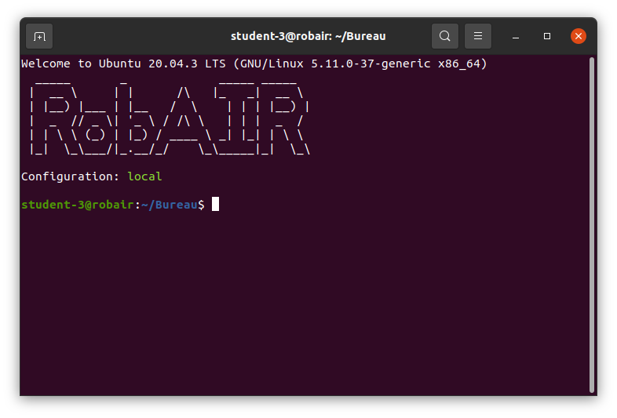
Change the configuration
You can run ROS nodes on your computer or on robair;
Nodes are running on your computer

Slide 4

Change the configuration
You can run ROS nodes on your computer or on robair;
Nodes are running on robair

Slide 5
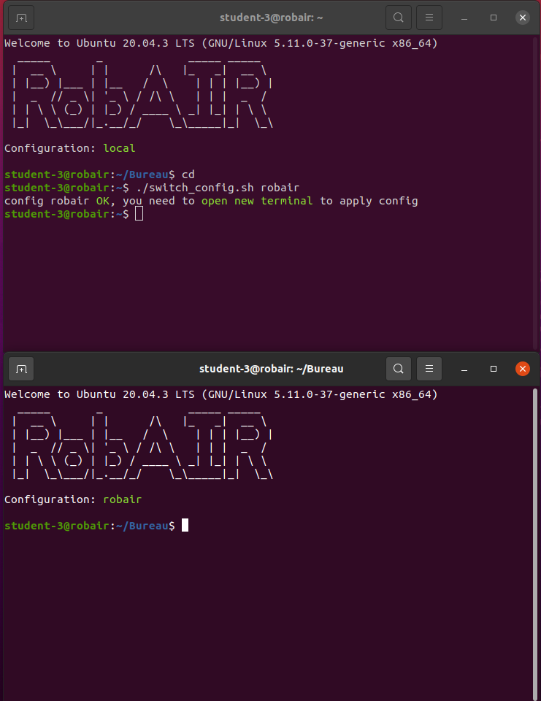
Change the configuration
To change your configuration, run switch_config.sh in ~
Nodes were running on your computer
Nodes are now running on robair

Slide 6
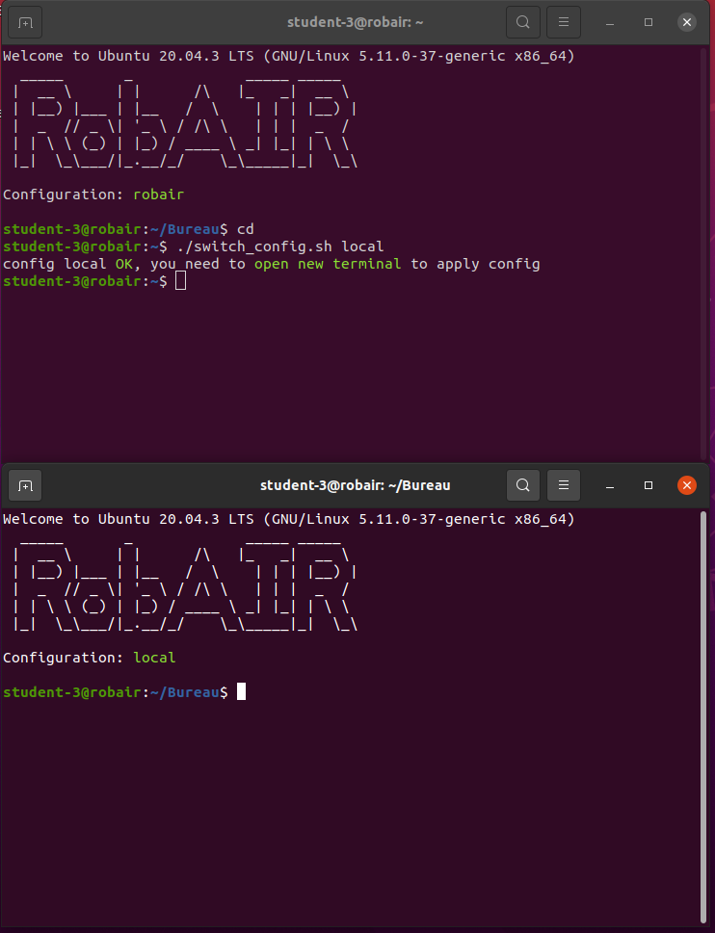
Change the configuration
To change your configuration, run switch_config.sh in ~
Nodes were running on ROS
Nodes are now running on your computer

Slide 7
Outline
Change the configuration to run our nodes on robair;
ROS on robair;
Tests of connection to robair.

Slide 8
ROS on robair (1/5)
You must be connected to robair with a wire to run nodes on robair
Roscore is running on robair:
  You do not have to run “roscore” on your laptop
Each robair publishes:
  /scan (laserscanner data);
  /odom (odometry).
Each robair subscribes to:
  /cmd_vel to command robair in translation and/or rotation.

Slide 9
ROS on robair (2/5)
robair
laptop
base
node
publish
/odom
subscribe
ros master
/cmd_vel
commands
laser
node
publish
/scan
data

Slide 10
ROS on robair (3/5)
robair
laptop
base
node
publish
/odom
registration
subscribe
ros master
teleoperation
node
/cmd_vel
registration
commands
laser
node
vizualization
node
publish
/scan
data
The 2 nodes running on your laptop will register to the master on robair

Slide 11
ROS on robair (4/5)
robot
laptop
base
node
publish
/odom
subscribe
registration
subscribe
publish
ros master
teleoperation
node
/cmd_vel
registration
commands
laser
node
vizualization
node
publish
/scan
subscribe
data
Rviz will subscribe to /scan and /odom

Slide 12
ROS on robair (5/5)
robot
laptop
base
node
publish
/odom
subscribe
registration
subscribe
publish
ros master
teleoperation
node
/cmd_vel
registration
commands
laser
node
vizualization
node
publish
/scan
subscribe
data
Teleoperation node will publish /cmd_vel (ie, rotation and translation)

Slide 13
Outline
Change the configuration to run our nodes on robair;
ROS on robair;
Tests of connection to robair.

Slide 14
Tests of connection on robair
You do not have to run “roscore” on your laptop
  Roscore is now on robair
We will check if you are able to receive the laser data (/scan topic) and send motion to robair (/cmd_vel topic)
Open a terminal and run rviz
  You should see the data of the laser scanner
Open a terminal and run “rosrun teleoperation teleoperation_node.py”
  Use the keyboard to move robair
  You should see robair moving

