Slide 1


Connection to robair in the gipsa lab
Olivier Aycard
Associate Professor
University of Grenoble
Laboratoire d’Informatique de Grenoble
http://membres-liglab.imag.fr/aycard
olivier.aycard@imag.fr

Slide 2
Outline
Configuration of wired connection on robair;
ROS on robair;
Tests of connection to robair.

Slide 3
Configuration of wired connection on robair(1/3)
Download setup_gipsa.sh;
Copy it ~/catkin_ws/devel;
In ~/catkin_ws/devel, copy setup.sh in setup_default.sh;
If you want to use a real robair:
  In ~/catkin_ws/devel, copy setup_gipsa.sh in setup.sh;
If you want to use ros on your laptop:
  In ~/catkin_ws/devel, copy setup_default.sh in setup.sh

Slide 4
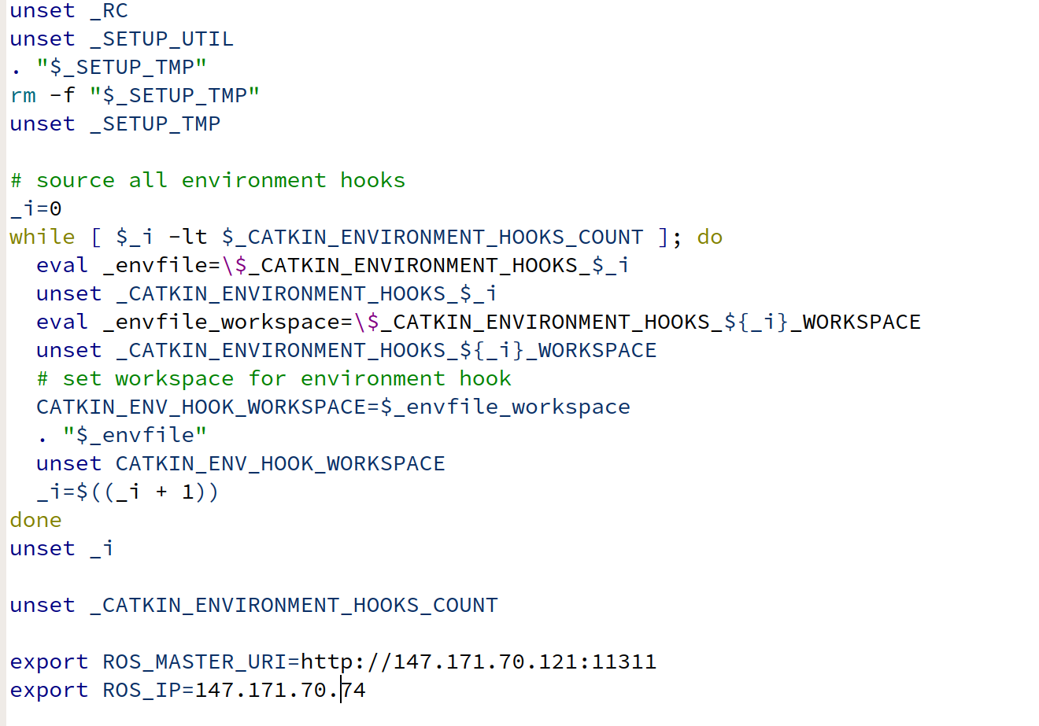
Configuration of wired connection on robair (2/3)
Edit setup_gipsa.sh;
Numero of robair
IP of your computer

Slide 5
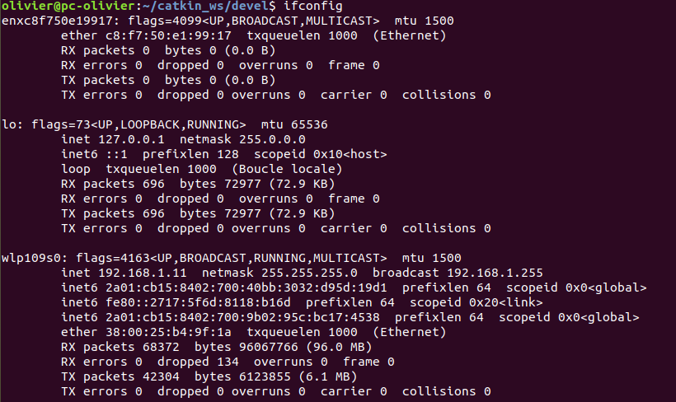
Configuration of wired connection on robair (3/3)
To know the ip of your computer, use the command “ifconfig” or “ip a”
IP of your computer

Slide 6
Outline
Configuration of wired connection on robair;
ROS on robair;
Tests of connection to robair.

Slide 7
ROS on robair (1/5)
Roscore is running on robair:
  You do not have to run “roscore” on your laptop
Each robair publishes:
  /scan (laserscanner data);
  /odom (odometry).
Each robair subscribes to:
  /cmd_vel to command robair in translation and/or rotation.

Slide 8
ROS on robair (2/5)
robair
laptop
base
node
publish
/odom
subscribe
ros master
/cmd_vel
commands
laser
node
publish
/scan
data

Slide 9
ROS on robair (3/5)
robair
laptop
base
node
publish
/odom
registration
subscribe
ros master
teleoperation
node
/cmd_vel
registration
commands
laser
node
vizualization
node
publish
/scan
data
The 2 nodes running on your laptop will register to the master on robair

Slide 10
ROS on robair (4/5)
robot
laptop
base
node
publish
/odom
subscribe
registration
subscribe
publish
ros master
teleoperation
node
/cmd_vel
registration
commands
laser
node
vizualization
node
publish
/scan
subscribe
data
Rviz will subscribe to /scan and /odom

Slide 11
ROS on robair (5/5)
robot
laptop
base
node
publish
/odom
subscribe
registration
subscribe
publish
ros master
teleoperation
node
/cmd_vel
registration
commands
laser
node
vizualization
node
publish
/scan
subscribe
data
Teleoperation node will publish /cmd_vel (ie, rotation and translation)

Slide 12
Outline
Configuration of wired connection on robair;
ROS on robair;
Tests of connection to robair.

Slide 13
Tests of connection on robair
You do not have to run “roscore” on your laptop
  Roscore is now on robair
We will check if you are able to receive the laser data (/scan topic) and send motion to robair (/cmd_vel topic)
Open a terminal and run rviz
  You should see the data of the laser scanner
Download teleoperation.zip and extract it in ~/catkin_ws/src
Open a terminal and run “rosrun teleoperation teleoperation.py”
  Use the keyboard to move robair
  You should see robair moving

