Slide 1


Display laser data with ROS
Olivier Aycard
Professor
Grenoble INP - PHELMA
GIPSA Lab
https://www.gipsa-lab.grenoble-inp.fr/user/olivier.aycard
olivier.aycard@grenoble-inp.fr

Slide 2
Display laser data with ROS (1/4)
Download RosBag data files and ROS packages : Open a terminal and run these commands :
  cd ~/ros2_ws
  git clone https://gricad-gitlab.univ-grenoble-alpes.fr/tp_ros2/data_for_labs.git
  cd src
  git clone https://gricad-gitlab.univ-grenoble-alpes.fr/tp_ros2/tutorial_ros.git
  git clone https://gricad-gitlab.univ-grenoble-alpes.fr/tp_ros2/smooth_teleop.git
    Make sure you see the data_for_labs folder in ros2_ws ; and tutorial_ros and smooth_teleop folders in ros2_ws/src.
To play recorded data: Open two terminals
    One terminal to run Rviz :
    ros2 run rviz2 rviz2
    One terminal to play the rosbag file:
    cd ~/ros2_ws/data_for_labs/follow_me/detection/old_laser
    ros2 bag play <data_file>.bag2
    Replace <data_file>.bag2 with the name of the file to play,
    for instance : detection01.bag2
    You will use these rosbag files to develop and test your code later.

Slide 3
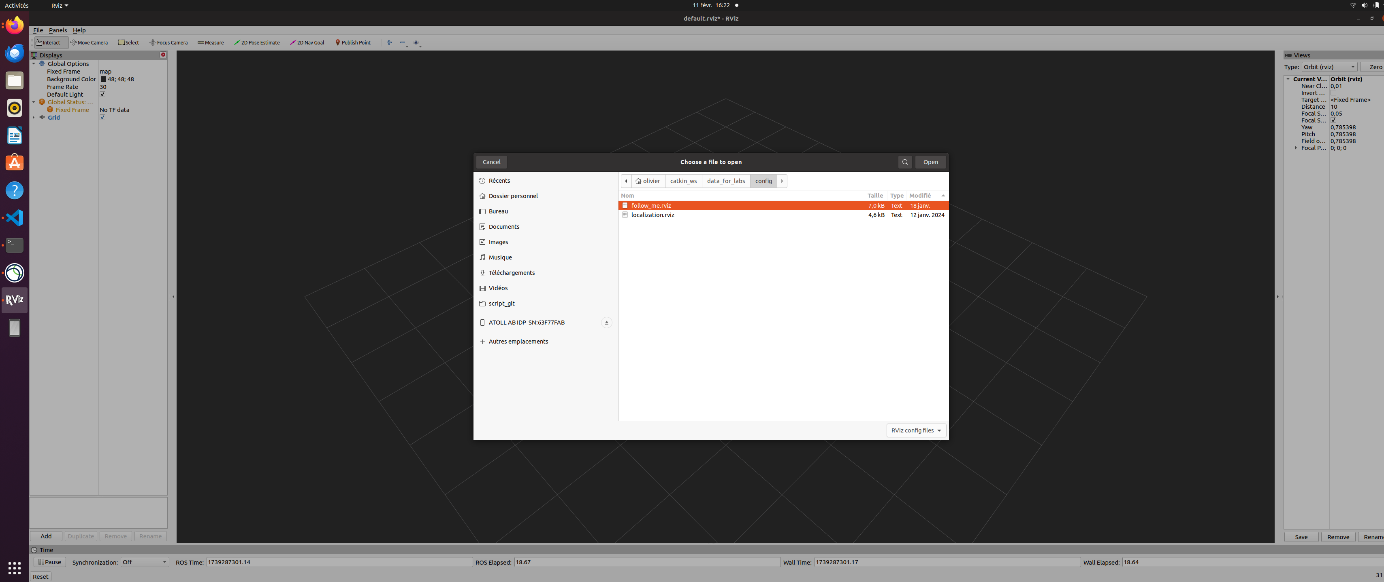
Display laser data with ROS (2/4)
  Rviz: the vizualization tool of ROS;
    Open the configuration file (File→Open Config) :
    ~/ros2_ws/src/tutorial_ros/config/laser_only.rviz

Slide 4
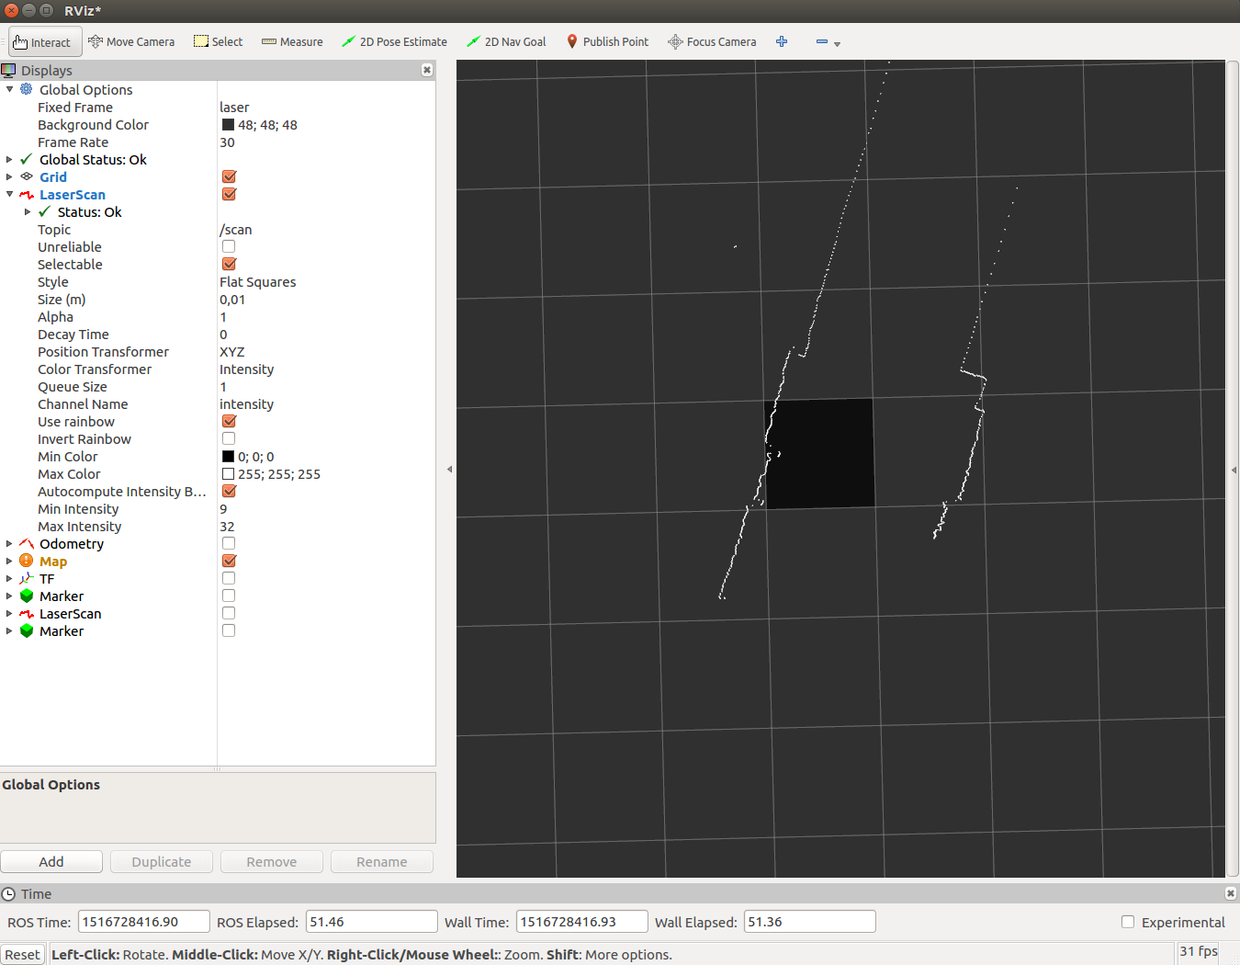
Display laser data with ROS (3/4)

Slide 5
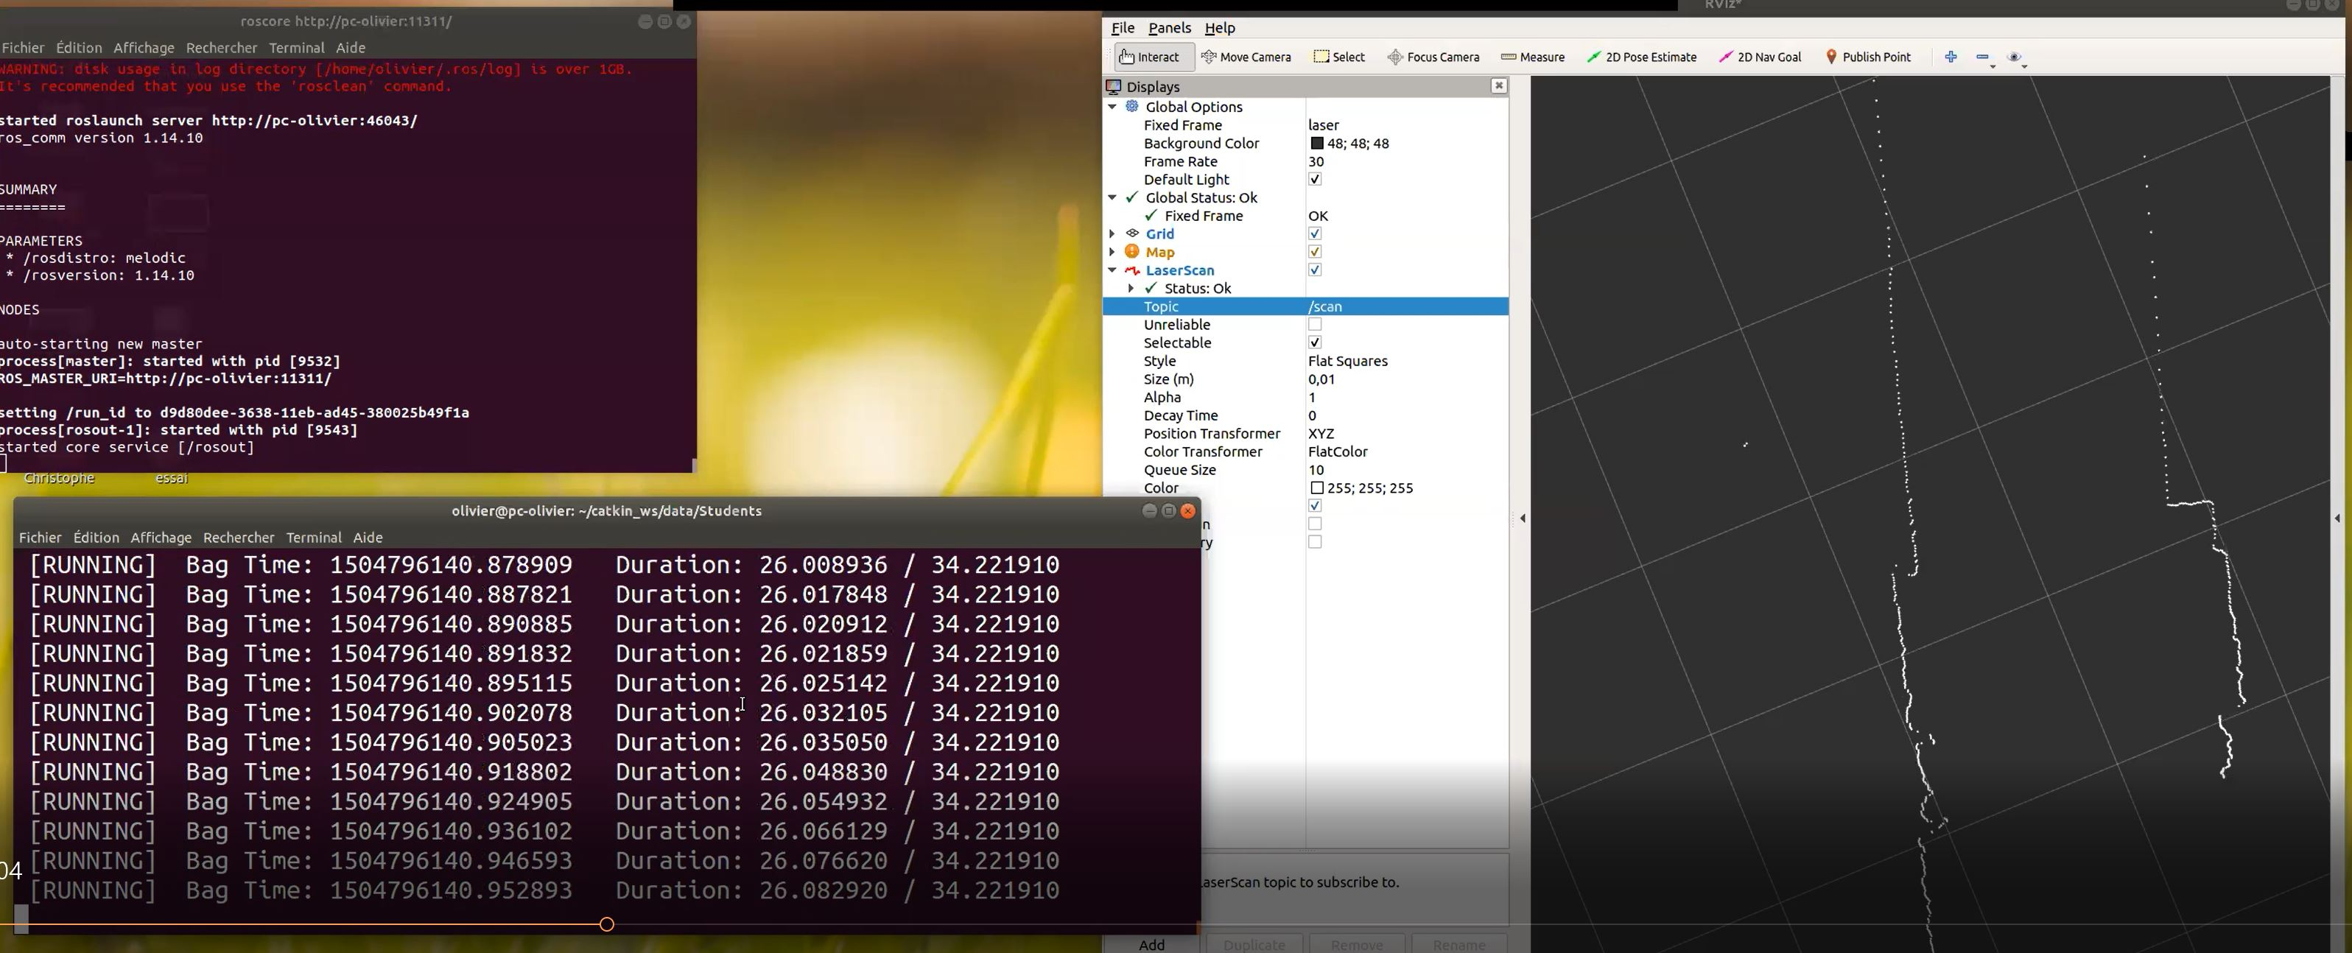
Display laser data with ROS (4/4)
Tip: Put the terminal and Rviz side-by-side so you can easily observe the data and pause the rosbag playback.
You can control the data playback by clicking in the ros2 bag play terminal and pressing keys :
    To pause a rosbag, press space
    To run a rosbag step by step, press right arrow =>

