Slide 1


Tutorial on ROS
Olivier Aycard
Professor
Grenoble INP - PHELMA
GIPSA Lab
https://www.gipsa-lab.grenoble-inp.fr/user/olivier.aycard
olivier.aycard@grenoble-inp.fr

Slide 2
Outline
Our first node in ROS;
Compile and run nodes.

Slide 3
Our first node
In order to demonstrate how a ROS node is implemented, let’s look at a simple example which does the following :
Interfaces with a sensor :
    receives laser data from the LIDAR scanner
    stores it in some data structures
Does something with the sensor data:
    reads the range values
    displays them as text on the terminal
Sends some data from this node to other nodes :
    sends graphical display points so that we can display them on the RVIZ graphical interface

Slide 4
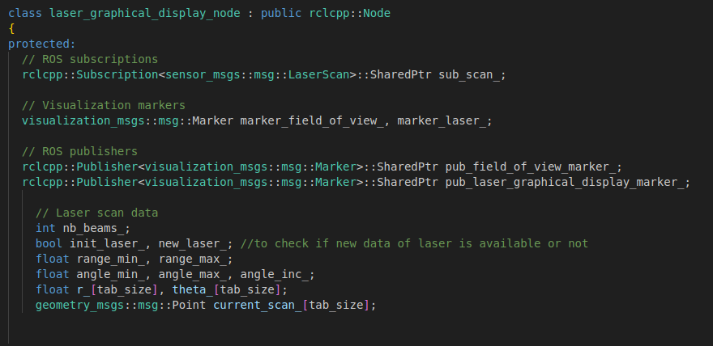
Our first node
Let’s see how a simple node can be implemented !
Right click on the folder Home/ros2_ws/src/tutorial_ros
and open it with VSCode
Open src/laser_graphical_display_node.cpp
Creation of a node subclass
Declaring subscribers/publishers
to receive/send data between nodes
Data structures to store laser data

Slide 5

Our first node
Our first node will subscribe to the topic called « scan »;
« scan » is the topic on which messages are published by the laser, containing the laser data;
Each time a new message is published on the topic called « scan », our first node will receive and store this message with the method « scanCallback »

Slide 6
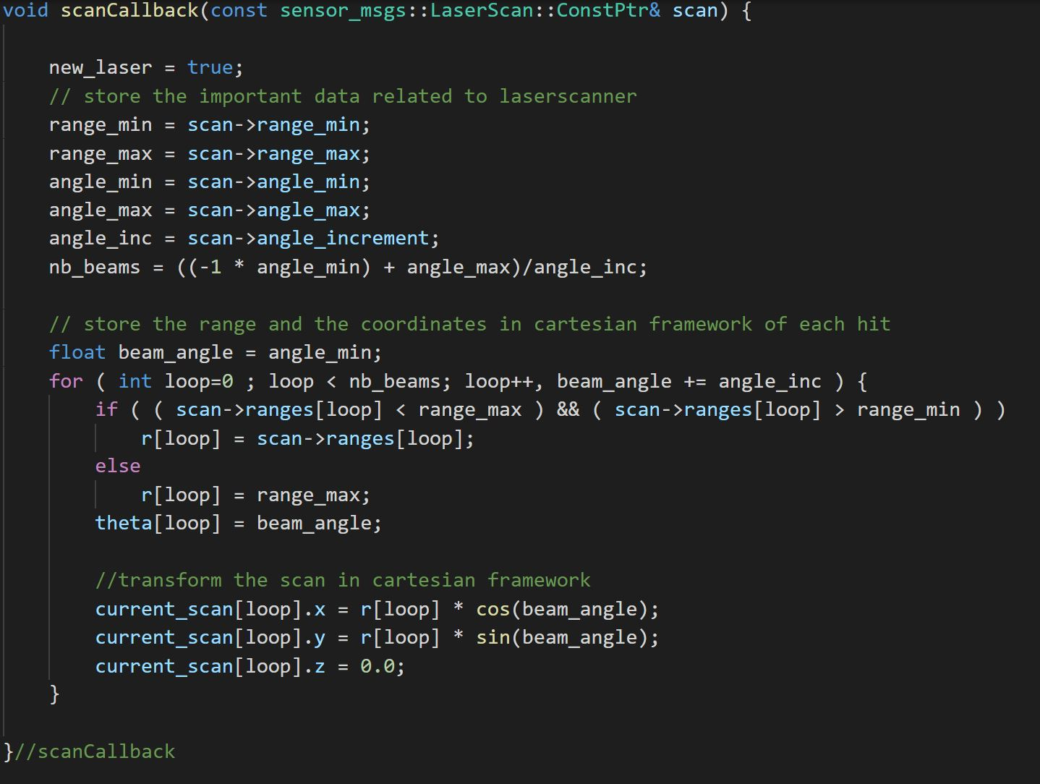
Our first node
The type of messages
published by the laser

Slide 7
Our first node
Our first node will publish to the topic called « laser_graphical_display_marker »;
It is a topic on which messages are published by our node so that other ROS nodes can receive them;
The type of the message is visualization_msgs::msg_marker, which represents visual marker points with colours.

Slide 8
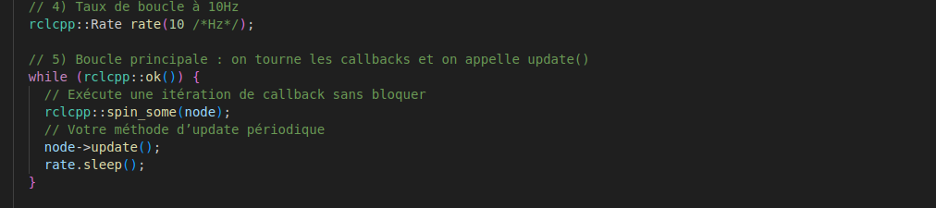
Our first node
Our first node is an infinite loop that will run at 10 hz
It will check if a new message from the laser has been published (spin_some);
If a new message has been received on the scan topic, it will call the method scanCallback to collect the data of the laser;
The method « update » will process the data of the laser

Slide 9
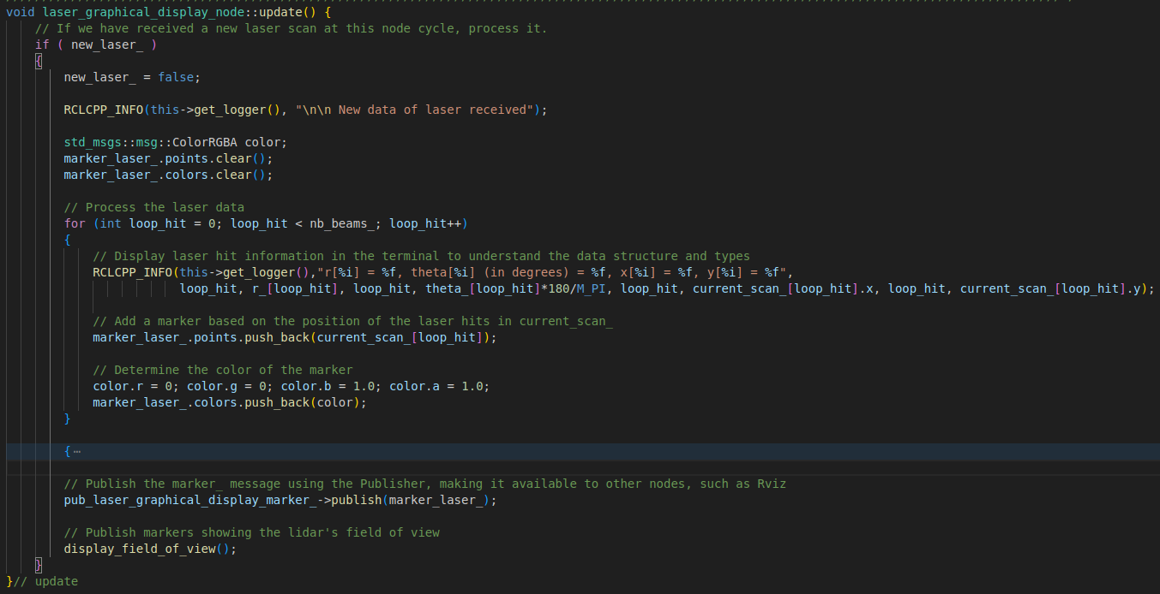
Our first node
The method « update » will check if new message of the laser has arrived with the boolean new_laser;
It will loop over the beams, display their data in the terminal, and publish a marker corresponding to the hits;
Function to print
information on the terminal
Add a new point to
the marker array
Publish the
the marker array

Slide 10
Outline
Our first node in ROS;
Compile and run nodes.

Slide 11
Compile and run nodes
Now we’ve seen what a ROS node looks like, how do we compile and run them ?
To compile the node: open a terminal*
cd ~/ros2_ws
colcon build
To run the node: open a terminal
cd ~/ros2_ws
source install/local_setup.bash
ros2 run tutorial_ros laser_graphical_display_node
*note: the terminal in which you compile using colcon build should NOT
be one where you have previously executed source install/local_setup.bash.
We recommend you always keep the same terminal open for compiling, and use it ONLY for compiling.

Slide 12
Compile and run nodes
Our node is now running, but we need to pass laser data to it as input, and we want to visualise the graphical markers it publishes as output.
To run rviz : open a terminal :
ros2 run rviz2 rviz2
In Rviz, Open the config file located in
~/ros2_ws/src/tutorial_ros/config/laser_only.rviz
To run a rosbag : open a terminal :
ros2 bag play <data_file>.bag2
Replace <data_file>.bag2 with the name of the file to play,
for instance : detection01.bag2

Slide 13
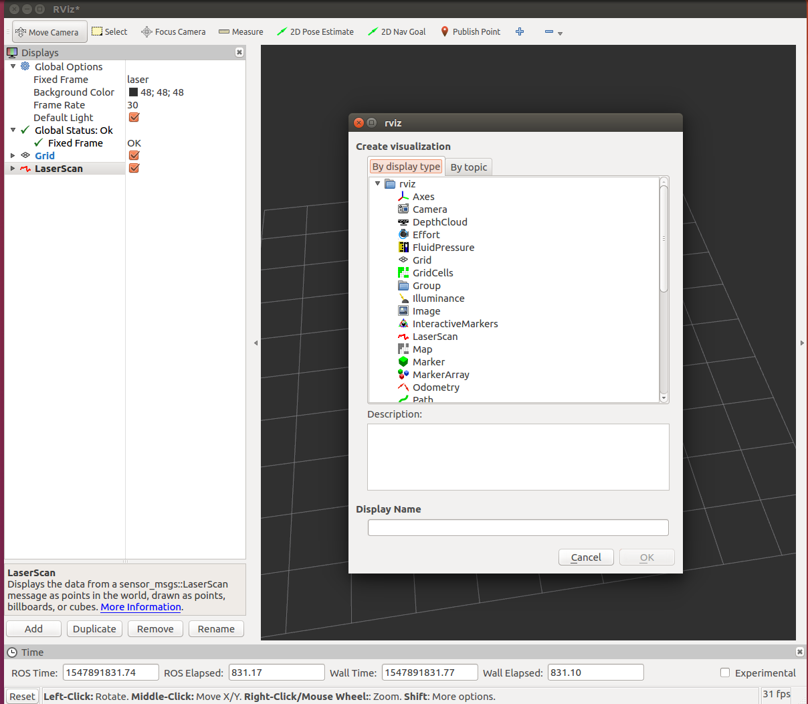
Rviz configuration : adding markers
2.
1.

Slide 14
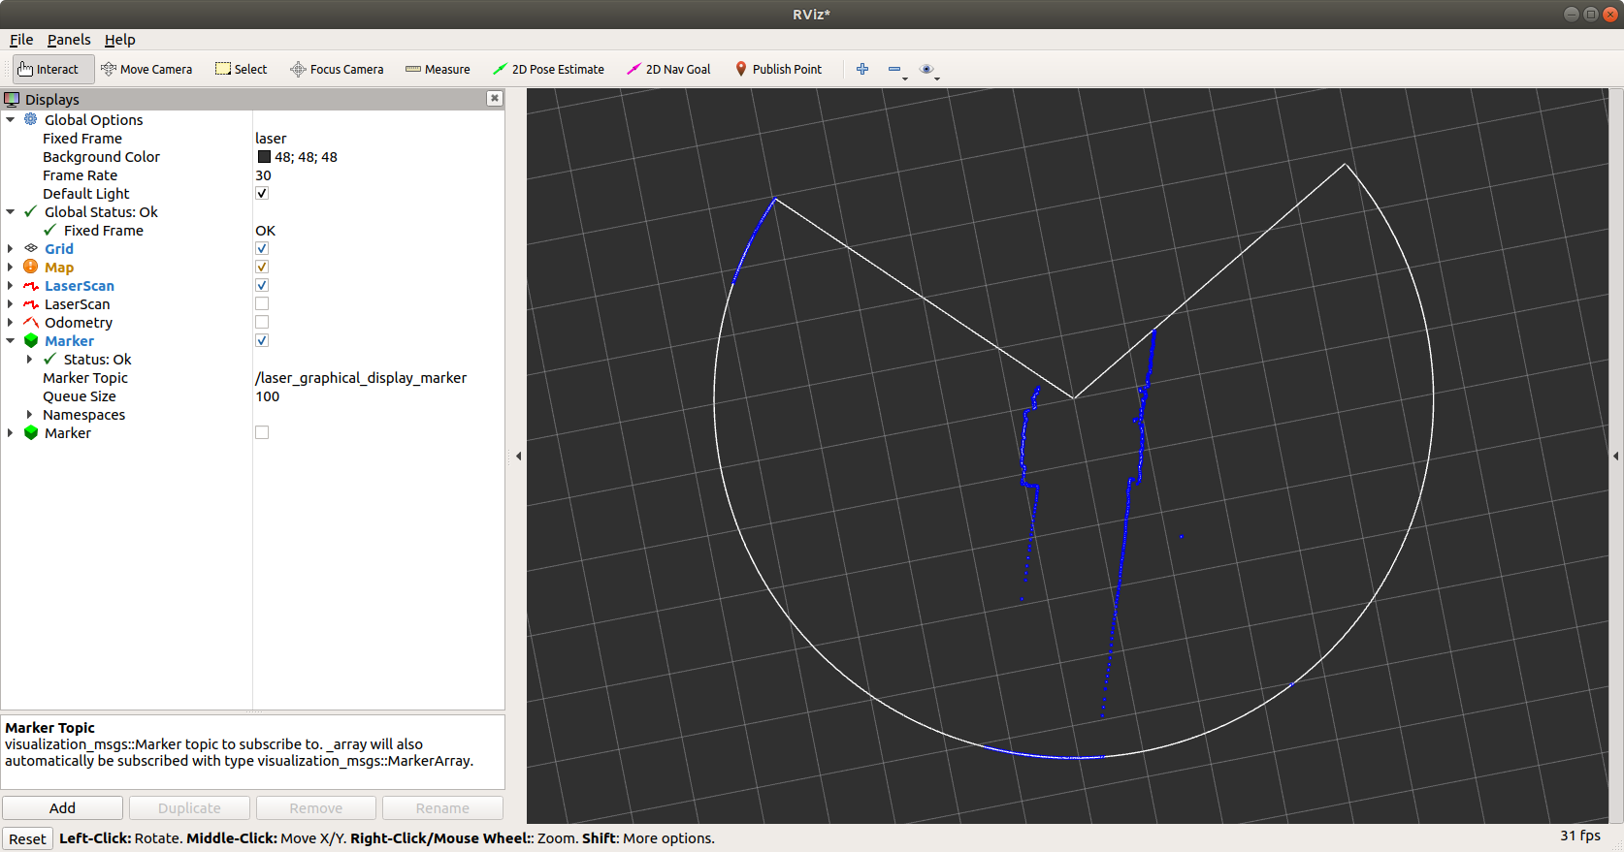
Rviz configuration : adding markers
3.

Slide 15
General reminders and information :
A folder in ~/ros2_ws/src is called a package;
A package contains some source files;
These source files will be compiled to create nodes;
To compile: colcon build from ~/ros2_ws
For instance, in the package tutorial_ros, there is one source file that will generate one node.
To run a node:
ros2 run <package_name> <node_name> from ~/ros2_ws, after having done the source command once in that terminal.
For instance, we used the command
ros2 run tutorial_ros laser_graphical_display_node
to run the node laser_graphical_display_node which is part of the package tutorial_ros.

Slide 16
Before moving on :
Make sure you understand how the laser data is stored :
  Which function is used to receive the data ?
  When is it called ?
  In which variables does it store the positions of hits ?
Make sure you understand how the laser data is used :
  On Rviz, you see that there is a blue marker for each hit of the laser. Which line of code uses the laser point coordinates to create the corresponding marker point ?
  Are the points passed as cartesian (x,y) or polar (r, theta) points ?
  If you wanted to create marker points only for the laser hits which have an .x coordinate less than 1m, how would you need to change the code ?

