Slide 1


Basic perception
Olivier Aycard
Professor
Grenoble INP - PHELMA
GIPSA Lab
https://www.gipsa-lab.grenoble-inp.fr/user/olivier.aycard
olivier.aycard@grenoble-inp.fr

Slide 2
Lab on basic perception
To be sure, you have the last release of the code, download it on git:
  Cd ~/catkin_ws/src
  \rm –r follow_me
  Git clone https://gricad-gitlab.univ-grenoble-alpes.fr/aycardol/follow_me.git

Slide 3
Lab on basic perception
We will implement and test:
  The detection of motion algorithm described during the lecture on DATMO;
  The clustering of objects algorithm described during the lecture on DATMO.

Slide 4
Detection of motion
Edit and modify datmo.cpp in ~/catkin_ws/src/follow_me;
  You should implement and understantd the functions « store_background », « reset_motion » and « detect_current_motion »
  You should implement the function « detect_motion » and complete what robair should do in the 4 different cases ;
Edit datmo.h to see the data structure and prototypes of functions
Edit detection_node.cpp in ~/catkin_ws/src/follow_me;
  You should have a look on the source file;
  This is the main node that will be used to detect a moving person ;
Check the results in a terminal and rviz

Slide 5
Tests(1/3)
Open 5 terminals:
  Roscore: the ROS master;
  Rosbag play data_file.bag: to play a saved file;
  Rosrun follow_me detection_node;
  Rosrun follow_me robot_moving_node;
    The laser data are only processed when the robot does not move;
    This is automatically taken into account by the node robot_moving_node;
    You do not have to take care about this issue.
  Rviz: the vizualization tool of ROS.
    To have a graphical display of the processing;
    See screenshots on next slides

Slide 6
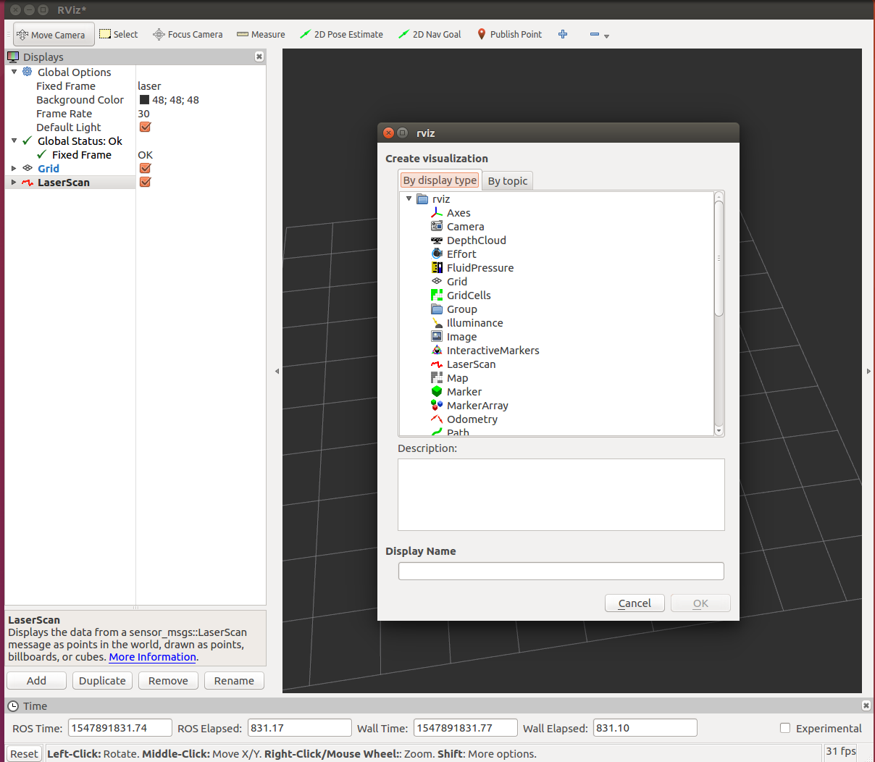
Tests(2/3)

Slide 7
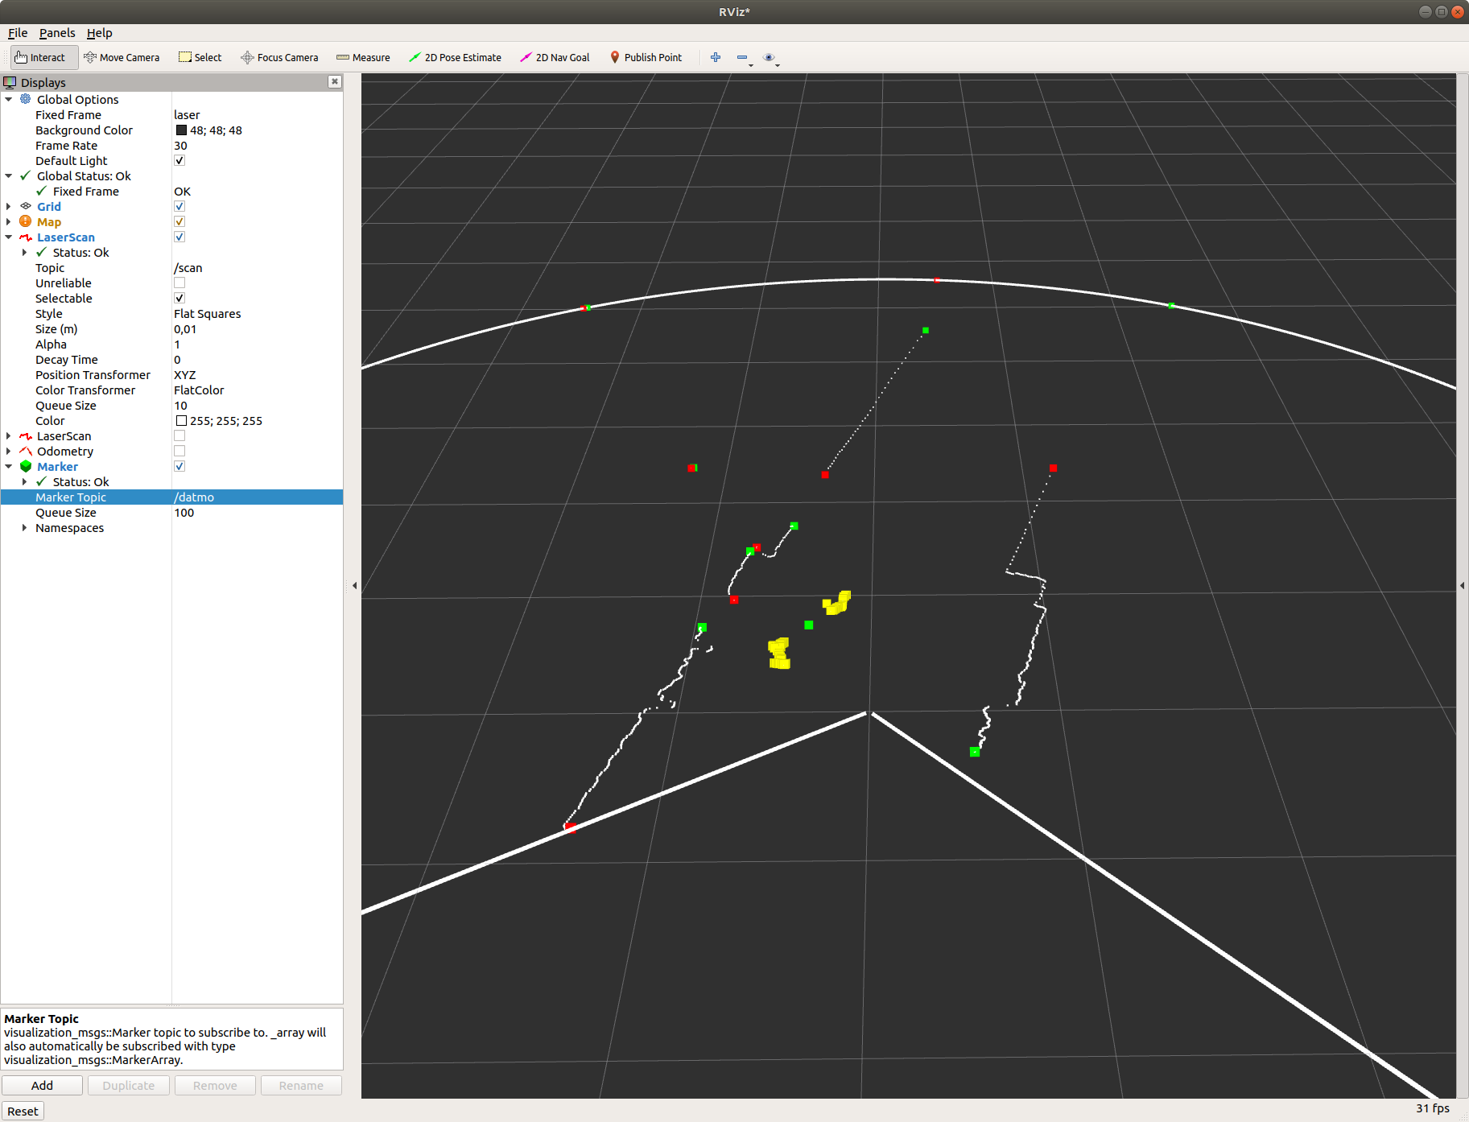
Tests(3/3)

Slide 8
Lab on basic perception
We will implement and test:
  The detection of motion algorithm described during the lecture on DATMO;
  The clustering of objects algorithm described during the lecture on DATMO.

Slide 9
Clustering
Edit and modify datmo.cpp in ~/catkin_ws/src/follow_me;
  You should implement the function « perform_basic_clustering »
Edit datmo.h to see the data structure and prototypes of functions
Check the results in a terminal and rviz

Slide 10
Tests(1/3)
Open 4 terminals:
  Roscore: the ROS master;
  Rosbag play data_file.bag: to play a saved file;
  Rosrun follow_me perform_clustering_node;
  Rviz: the vizualization tool of ROS.
    To have a graphical display of the processing;
    See screenshots on next slides

Slide 11
Tests(2/3)

Slide 12
Tests(3/3)

