Slide 1


Follow me behavior
(detection part)
Olivier Aycard
Professor
Grenoble INP - PHELMA
GIPSA Lab
https://www.gipsa-lab.grenoble-inp.fr/user/olivier.aycard
olivier.aycard@grenoble-inp.fr

Slide 2
Follow me behavior (perception part): definition (1/2)
The goal of the lab is to implement the laser processing to detect a moving person;
A moving person has:
  Two legs that are moving;
  Two legs with a maximum distance of 70cms between them;
  A leg is a cluster with a size between 5cms and 25cms;
  A moving cluster is a cluster that has at least 75% of its hits that are dynamic;
  A moving person is a person with

Slide 3
Follow me behavior (perception part): definition (2/2)
Perception
Decision
Action
Sensors
Actuators
Laser data
Store
background
Detect
motion
Perform
clustering
Detect
legs
Detect
persons
Detect
a moving
person
Position (x, y) of the moving person
    Each time, we receive new laser data, this process is done

Slide 4
Follow me behavior (perception part): installation + implementation
In ~/catkin_ws/src/follow_me/src/datmo.cpp: you have to implement the methods:
  Detect_motion (previously done);
  Perform_clustering (previously done);
  Detect_legs;
  Detect_persons;
  Detect_a_moving_person;
  Modify the method « update » to detect_motion only when robair doesnt move.
In ~/catkin_ws/src/follow_me/src/detection_node.cpp: you have to check and understant the method update

Slide 5
Follow me behavior (perception part): tests(1/3)
Open 5 terminals:
  Roscore: the ROS master;
  Rosbag play data_file.bag: to play a saved file;
  Rosrun follow_me detection_node;
  Rosrun follow_me robot_moving_node;
    The laser data are only processed when the robot does not move;
    This is automatically taken into account by the node robot_moving_node;
    You do not have to take care about this issue.
  Rviz: the vizualization tool of ROS.
    To have a graphical display of the processing;
    See screenshots on next slides

Slide 6
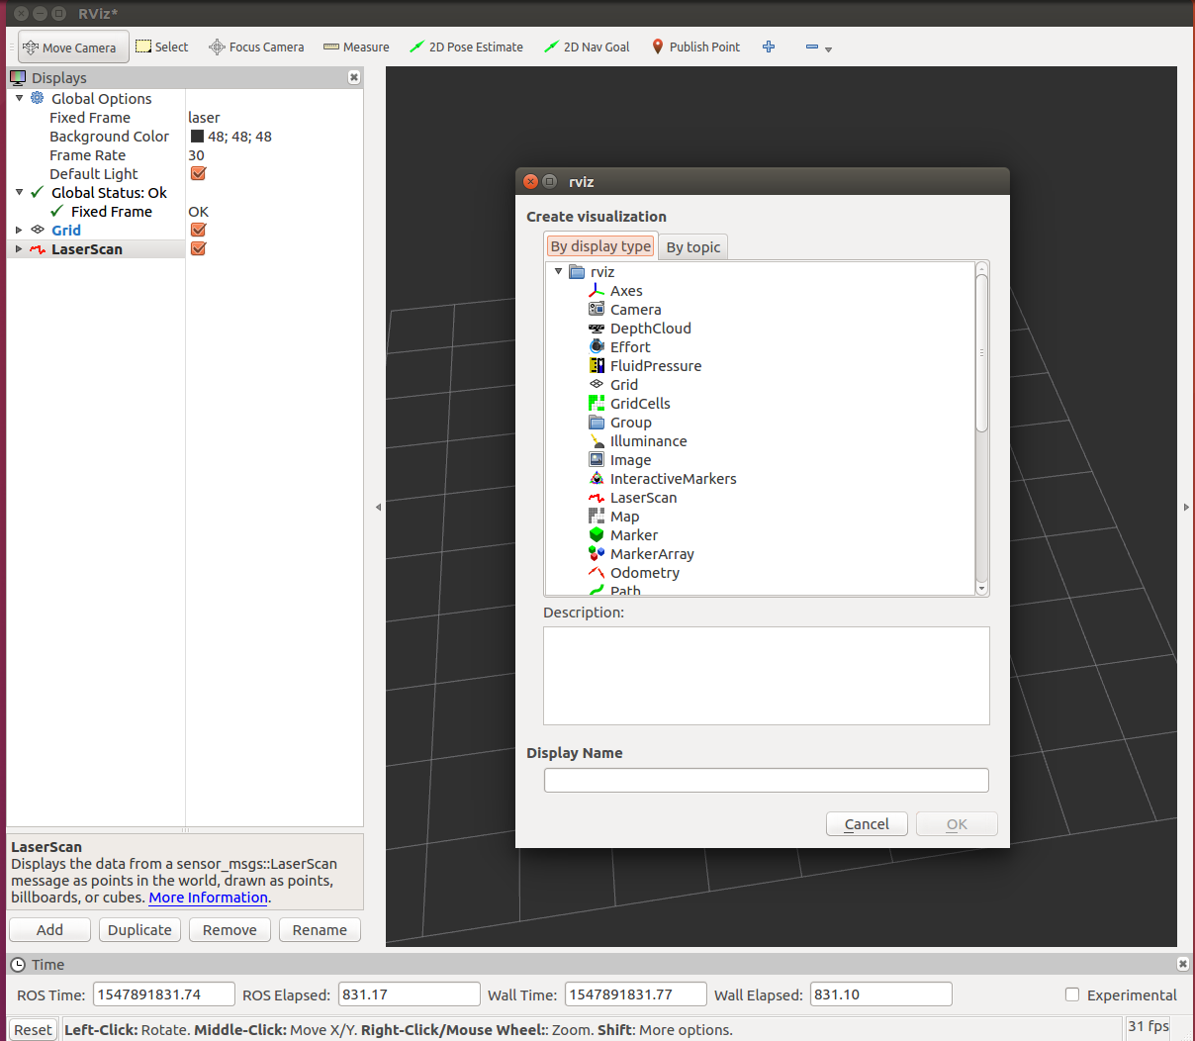
Follow me behavior (perception part): tests(2/3)

Slide 7
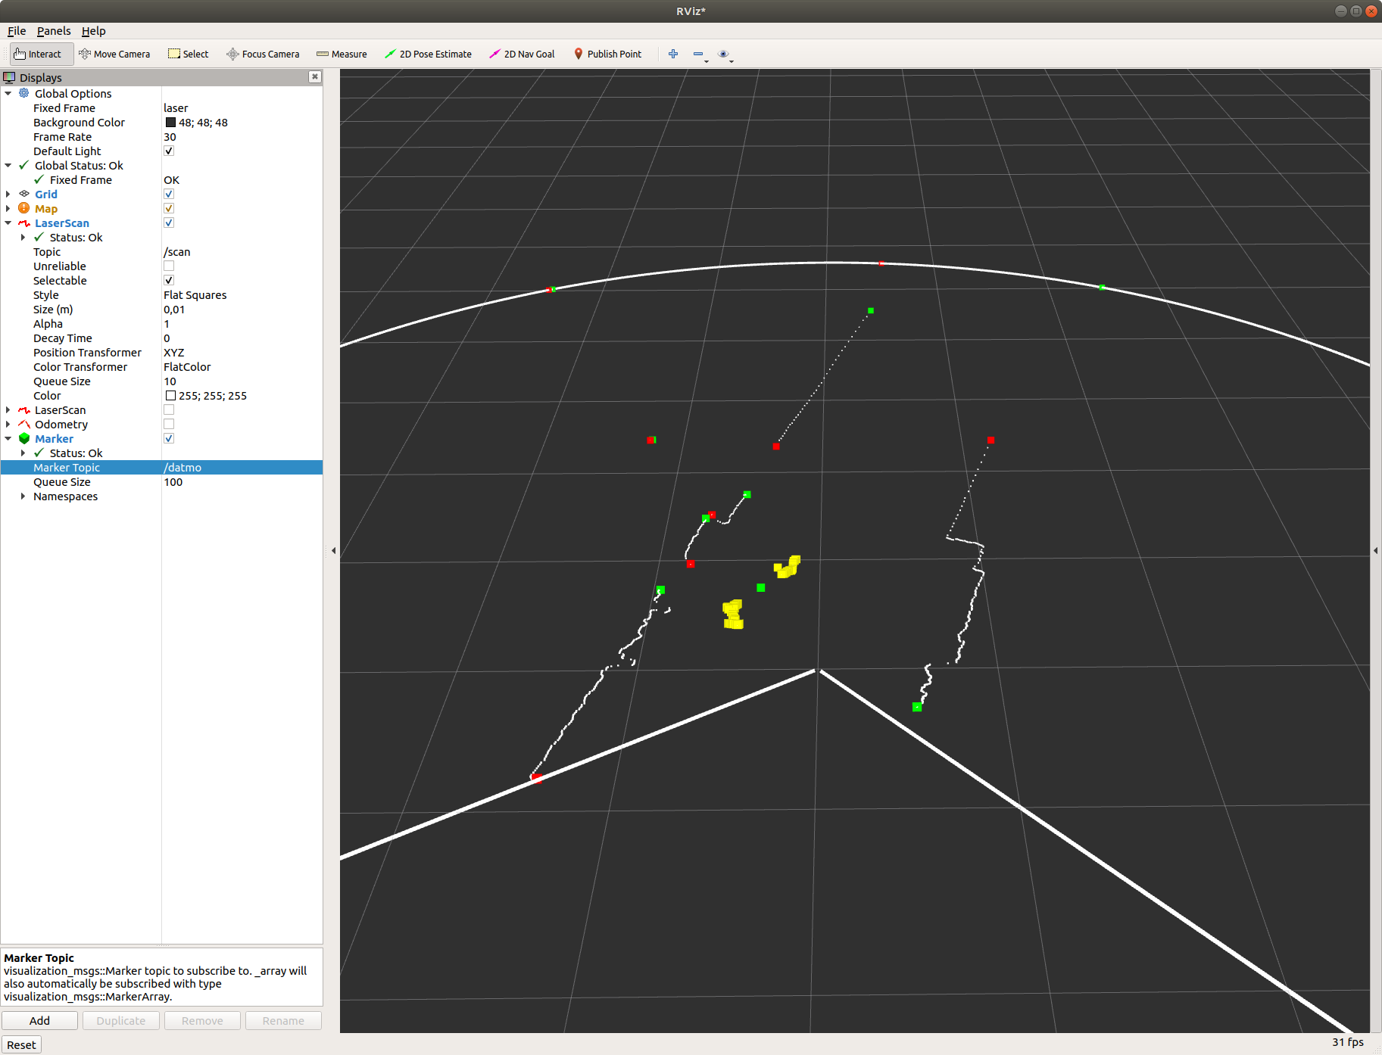
Follow me behavior (perception part): tests(3/3)

