Slide 1


Follow me behavior
(detection part)
Olivier Aycard
Professor
Grenoble INP - PHELMA
GIPSA Lab
https://www.gipsa-lab.grenoble-inp.fr/user/olivier.aycard
olivier.aycard@grenoble-inp.fr

Slide 2
Follow me behavior (perception part): definition (1/2)
The goal of the lab is to implement the laser processing to detect a moving person;
Our model of a moving person has:
  Two legs that are moving;
  Two legs with a maximum distance of 70cms between them;
  A leg is a cluster with a size between 5cms and 25cms;
  A moving cluster is a cluster that has at least 75% of its hits that are dynamic;

Slide 3
Follow me behavior (perception part): definition (2/2)
Perception
Decision
Action
Sensors
Actuators
Laser data
Store
background
Detect
motion
Perform
clustering
Detect
legs
Detect
persons
Detect
a moving
person
Position (x, y) of the moving person
    Each time, we receive new laser data, this process is done

Slide 4
Follow me behavior (perception part): installation + implementation
In ~/ros2_ws/src/follow_me/src/detection_node.cpp:
Nothing to implement here. This is the main node update loop which calls the functions implemented in datmo.cpp.
You have to read and understand the method Update.
In ~/ros2_ws/src/follow_me/src/datmo.cpp:
You have to implement all the methods in the file
  Store_background ;
  Reset_motion ;
  Detect_current_motion ;
  Detect_motion;
  Perform_basic_clustering ;
  Perform_advanced_clustering;
  Detect_legs;
  Detect_persons;
  Detect_a_moving_person;

Slide 5
Follow me behavior (perception part): How to run
Open 2 terminals:
  Terminal to run your nodes and Rviz :
  cd ~/ros2_ws/src/follow_me/scripts
  ./start_robair_detection_only.sh
  [Optional] Terminal to play a rosbag file if a robot is not available :
  cd ~/ros2_ws/data_for_labs/follow_me/detection/old_laser
  ros2 bag play <data_file>.bag2
Alternative option :
Instead of one terminal for all ros nodes using the script, you can also create one tab for each node in a terminal, and run the command for each node and Rviz individually.
Open the scripts under follow_me/src/scripts to find the commands of the form :
ros2 run <package_name> <node_name>

Slide 6
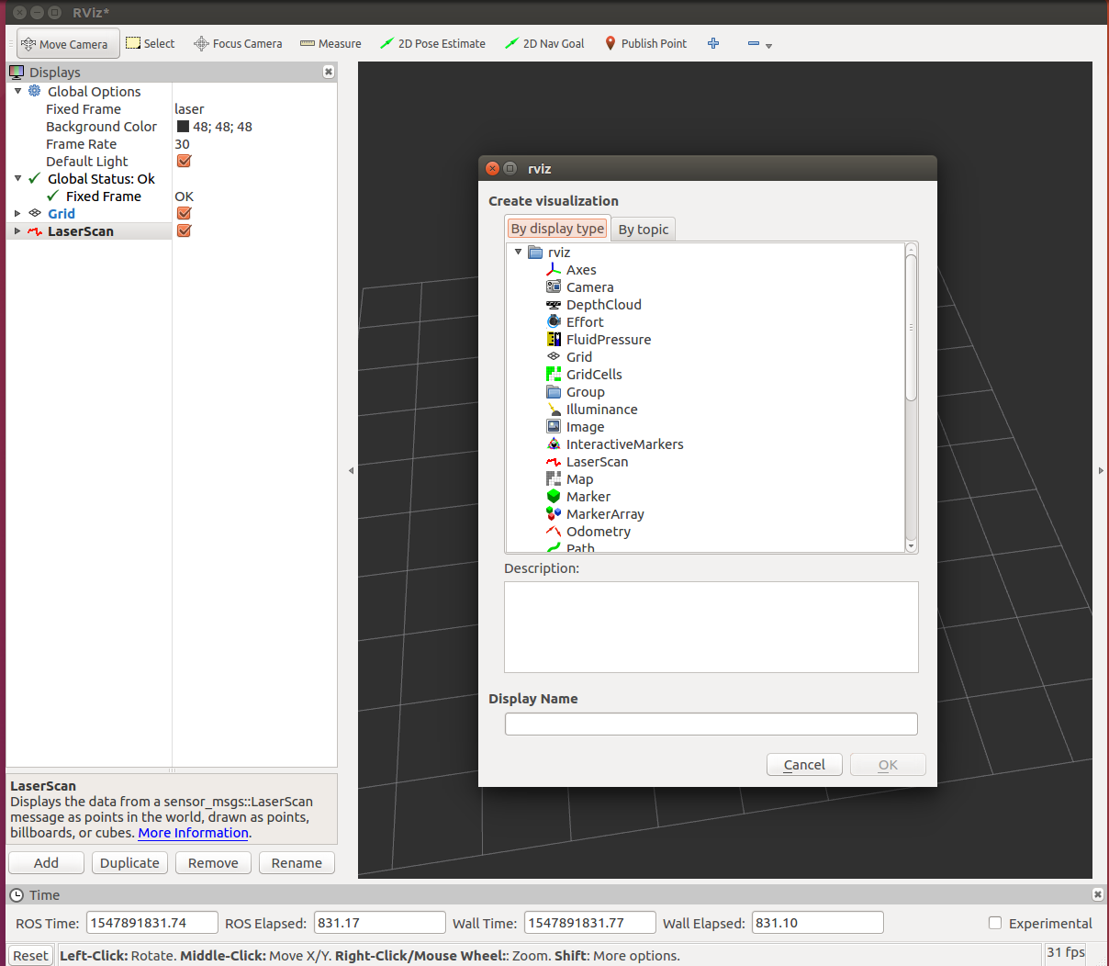
Follow me behavior (perception part): Rviz

Slide 7
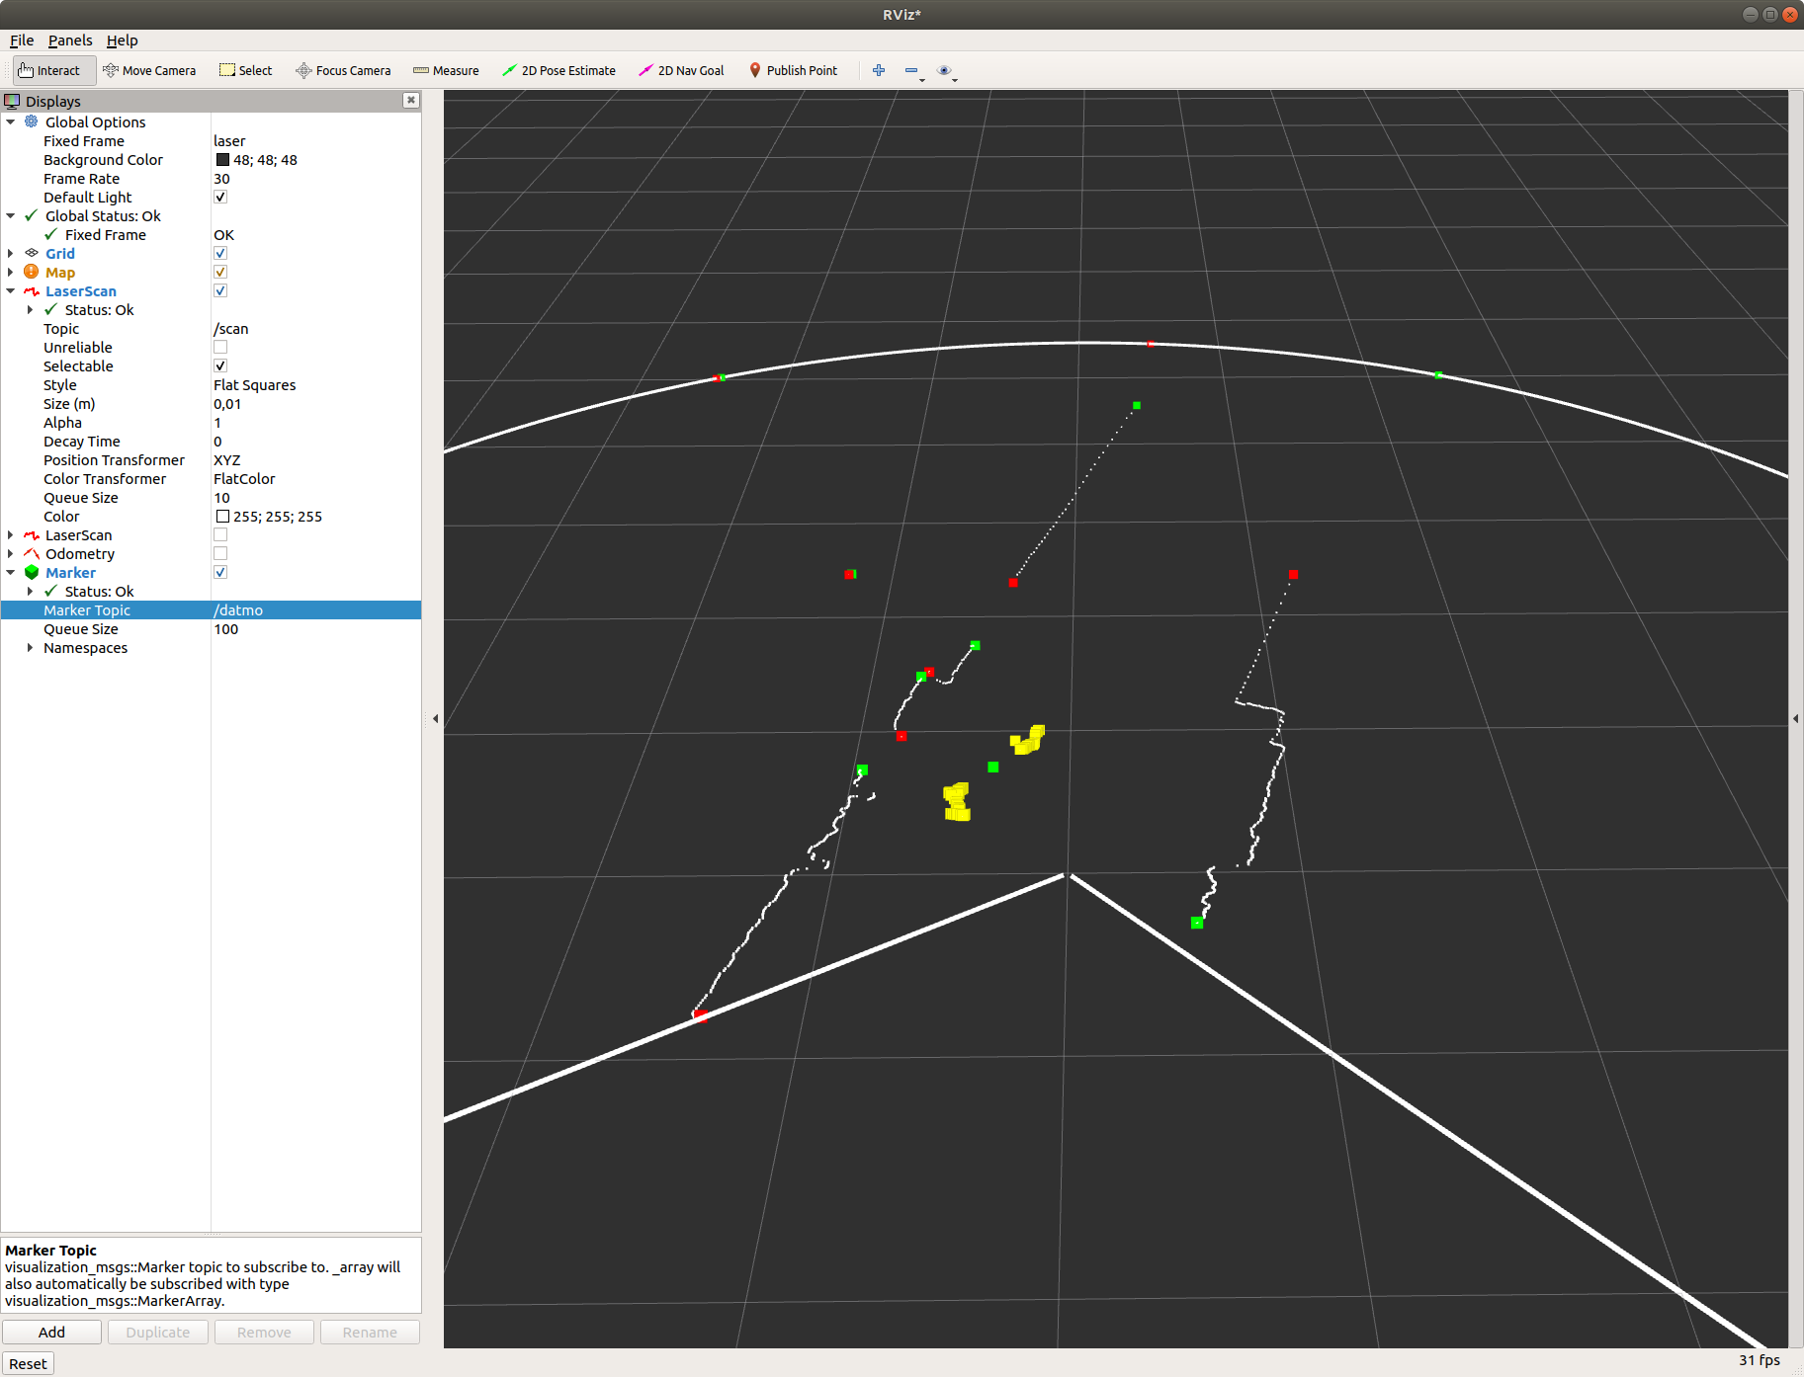
Follow me behavior (perception part): Rviz

