Slide 1


Lab on basic control
Olivier Aycard
Associate Professor
University of Grenoble
Laboratoire d’Informatique de Grenoble
http://membres-liglab.imag.fr/aycard
olivier.aycard@imag.fr

Slide 2
Outline
Rotation_done_node
Rotation_node + tests
Tests of basic follow_me behavior

Slide 3
Rotation_done_node
In the package « tutorial_ros », you have a node named « rotation_done_node »;
Check and complete the source code to estimate the « rotation_done »
To test your node, run « rosrun teleoperation teleoperation_node.py »
Move robair only in rotation with your keyboard;
Check the rotation_done.

Slide 4
Rotation_node: implementation
We will implement a pid controller to control the rotation of robair while it is following a moving person;
In this lab, we will not implement a complete pid controller to control both rotation and translation;
In the package « follow_me », you have a node named « rotation_node »;
  Complete the method « init_rotation » to initialize the different variables needed to control robair in rotation;
  Implement a pid controller to control the rotation of robair in the method « compute_rotation ».

Slide 5
Rotation node: tests (1/2)
You should be connected to a platform;
In a first terminal, we will run the rotation_node;
In a second terminal, we will publish a /goal_to_reach.
We will watch the mobile robot performing the /goal_to_reach and the output of the rotation_node.

Slide 6
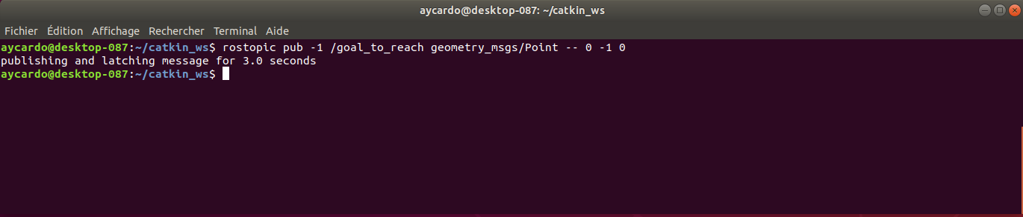
Rotation node: tests (2/2)
Display of the second terminal
We publish a /goal_to_reach at position(x = 0, y = -1, z = 0)

Slide 7
Tests of basic follow_me behavior
You should be connected to a platform;
For the perception part:
  In a first terminal, we will run the datmo_node;
For the control part:
  In a second terminal, we will run the rotation_node;
We will watch the mobile robot detect a moving person and rotate to be face to this moving person.

Slide 8
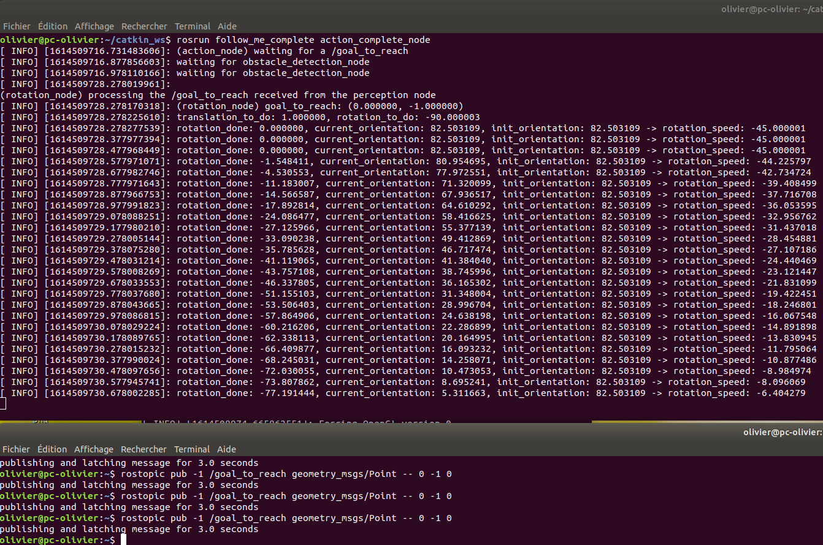
Rotation node: tests (3/3)
Display of both terminals after execution

