Slide 1

US Census Analysis
december 11th 2024
Olivier Lapabe-goastat

Slide 2
Executive Summary
Based on the US Census dataset, the goal is to predict whether an individual is earning more than 50k$ per year
This is a first baseline – focus was on making the code modular for further improvement
From 36 features down to 12: EDA helped to select and regroup main features
Best model:
LightGBM (with num_leaves=50, max_depth=7, learning_rate=0.1, n_estimations=200)
Results on Val Dataset: F1-score=0.91, Recall=0.93, Precision=0.89
Results on Test Dataset: F1-score=0.88, Recall=0.88, Precision=0.88
Top 3 feature importance : Age, Occupation (work), Capital income

Slide 3
Agenda
Context and Goal
Proposed metrics
EDA and Feature Engineering
Data prep : Encoding, Scaling and Resampling
Model evaluation and selection
Ideas for further improvements

Slide 4
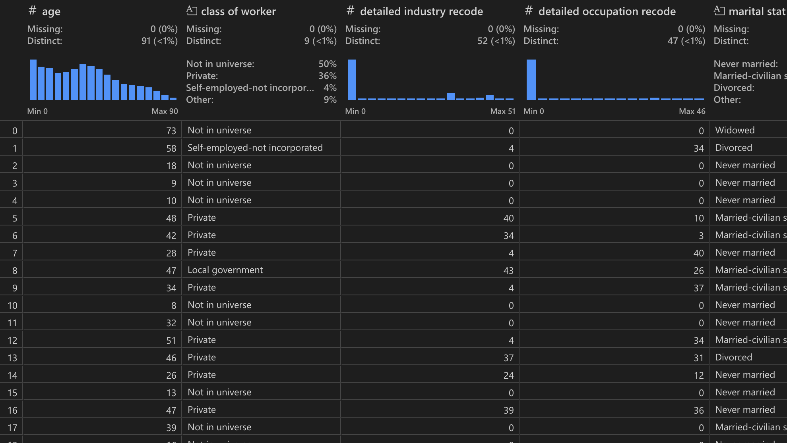
1. Context and Goal
Context: US Census dataset containing detailed information for ~300,000 individuals (e.g., age, occupation)
Goals:
Identify characteristics that are associated with a person making more or less than $50,000 per year
Build a classification model that identifies if a person is making more or less than $50,000 per year

Slide 5
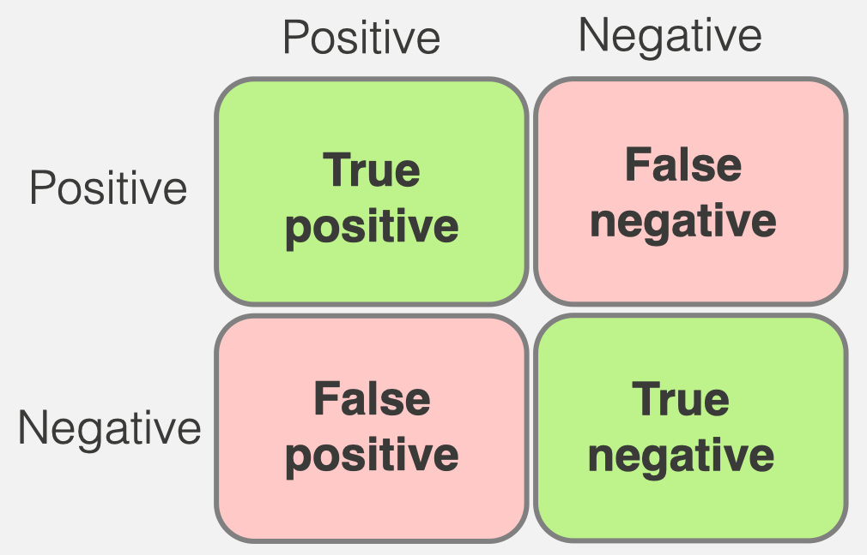
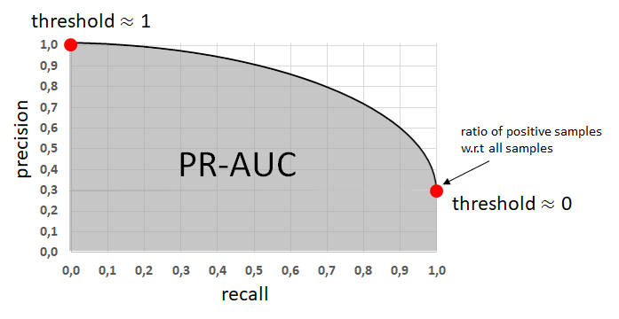
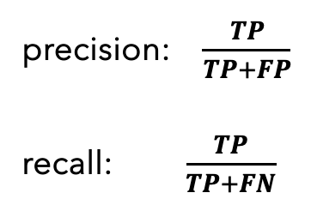
2. Proposed metrics
Ground Truth
Prediction
Hypothesis : False Positives and False Negatives are equally bad (to be discussed)
1st step : Metric for model selection PR-AUC: Area under the curve precision x recall
2nd step : Metric for threshold optimization F1 score : Harmonic mean between precision and recall
precision: $\frac{TP}{TP+FP}$
recall: $\frac{TP}{TP+FN}$
F1 score : harmonic mean between both

Slide 6
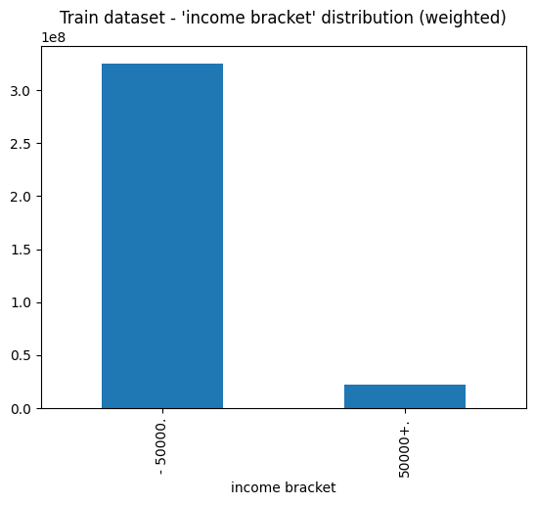
3. EDA and Feature Engineering – Target : ‘income bracket’
~200,000 individuals in train dataset
Used ‘instance weight’ indicating the weight of each observation to represent the full US population
6% of the US population earns more than 50k$ - The dataset is unbalanced → Necessity to resample for training

Slide 7
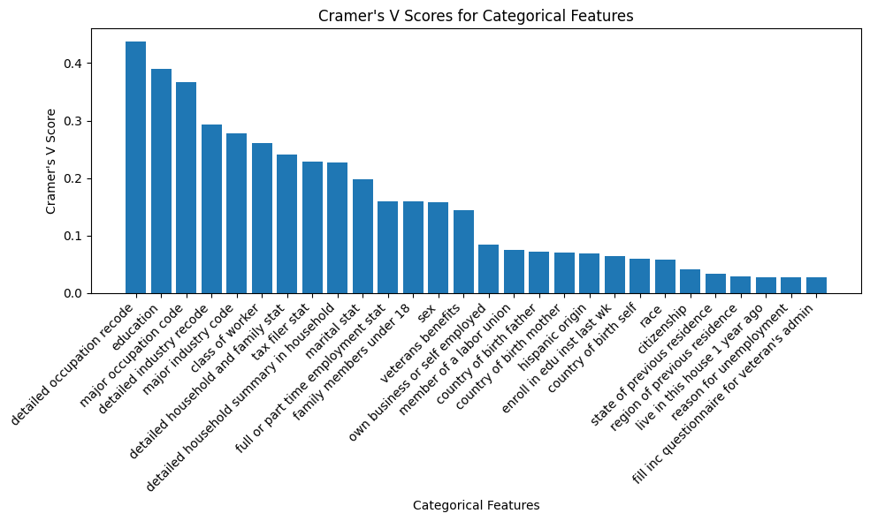
3. EDA and Feature Engineering – Categorical data (1/3)
4 features about migration with 50%+ of data missing → Remove migration features
Cramer’s V Score indicate correlation of features with income bracket → Keep features above score of 0.2 for baseline

Slide 8
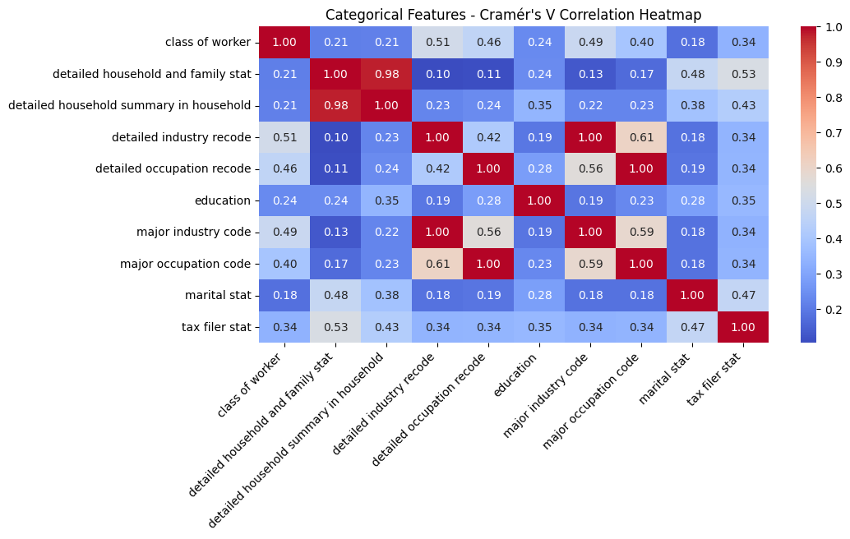
3. EDA and Feature Engineering – Categorical data (2/3)
2 features about household indications are strongly correlated → Keep ’detailed household and family stat’ (no losing of information)
Same for industry indications → Keep ‘detailed industry recode’
Same for occupation indications → Keep ‘detailed occupation code’

Slide 9
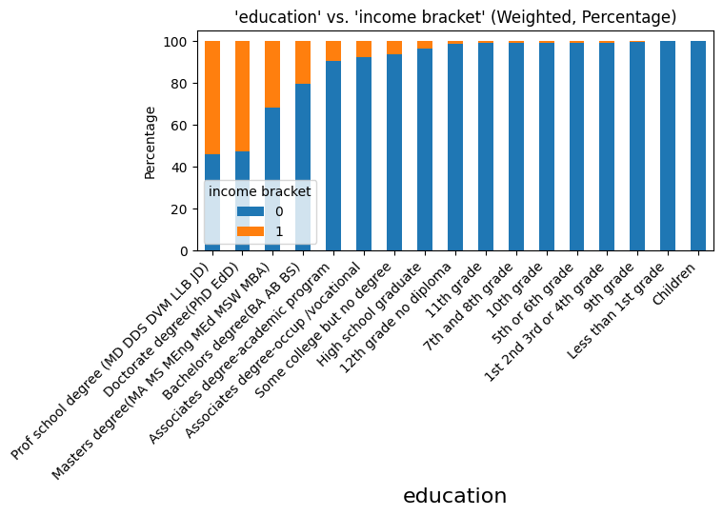
3. EDA and Feature Engineering – Categorical data (3/3)
Education feature can be simplified by grouping some labels without losing too much information:
Below 12th grade
Associates degrees
Prof school and Doctorate degrees

Slide 10
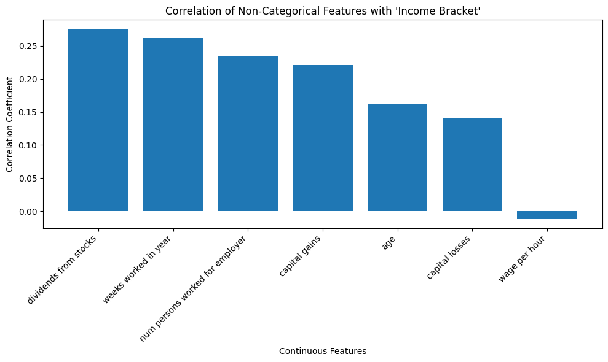
3. EDA and Feature Engineering – Non-categorical data (1/3)
‘wage per hour’ is not much correlated with our target → We remove this feature

Slide 11
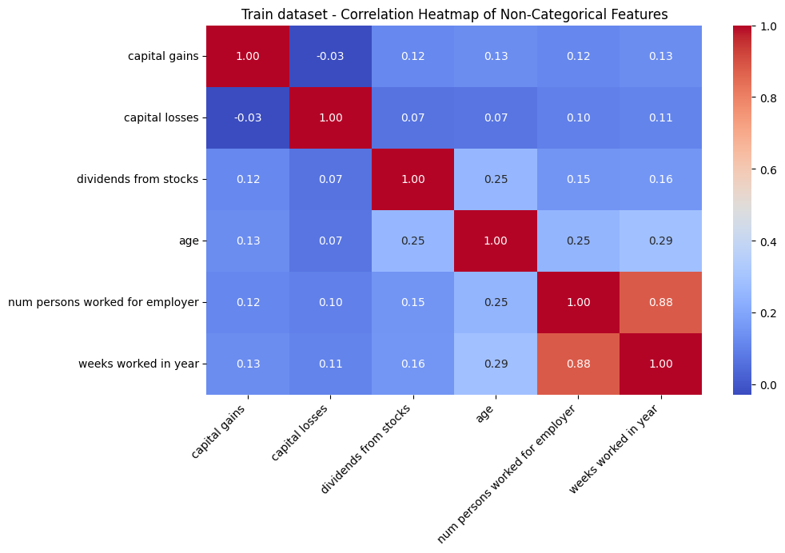
3. EDA and Feature Engineering – Non-categorical data (2/3)
2 features are correlated : ‘nums persons worked for employer’ and ‘weeks worked in year’
But no clear sign of causality link between both → We keep both features

Slide 12
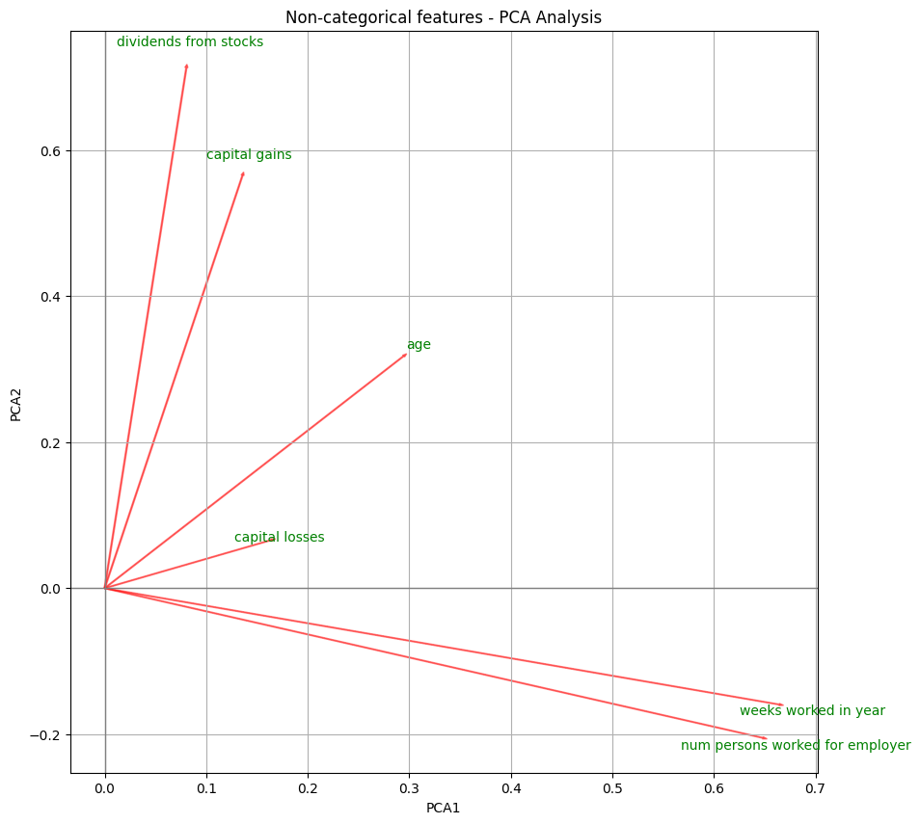
3. EDA and Feature Engineering – Non-categorical data (3/3)
The first principal component is explained by the 2 previously seen features → No action for now
The second principal component is mainly explained by ‘dividends from stocks and capital gains’ → We add these two features into a new one: ‘capital income’

Slide 13
4. Data prep : Encoding, Scaling and Resampling
Action
Details
Remove rows with missing values
Split train dataset into train / val
Encode categorical features (without data leakage)
Scale non-categorical features (without data leakage)
Sampling and weighting
0 missing values
80/20 split, stratified according to target
One-hot encoding for lower cardinality (<=10)
Target encoding for high cardinality (>10)
MinMax scaling used (data not following gaussian distribution) → Features between [0, 1]
Oversampling of under-represented ‘1’ target
Weighting according to ‘instance weight’

Slide 14
5. Model evaluation and selection – Selected models for first baseline
Option 1: GOFAI models, e.g.:
Logistic Regression
Decision Trees-based
Support Vector Classifier
Option 2: Neuronal Networks, e.g.:
Multi-Layer Neuronal Network
Transformer-based models (e.g., TabTransformer)
Logistic regression:
Simple and fast baseline
Good explainability
Does not handle high-dimensional data well
Random Forest:
Copes with non-linearity
Handles well high-dimensional data
Medium explainability with feature importance
XGBoost (Level-wise growth):
Often powerful for binary classification tasks
Slower and requires careful tuning of hyperparameters
LightGBM (Leaf-wise growth):
Lighter than XGBoost
More prone to overfitting than XGBoost

Slide 15
5. Model evaluation and selection – Results
Hypothesis : False Positives and False Negatives are equally bad (to be discussed)
1st step – Metric for model selection : PR-AUC (Area under the curve precision x recall)
2nd step - Metric for threshold optimization : F1 score : Harmonic mean between precision and recall
Results on Validation Dataset | Logistic Regression | Random Forest | XGBoost | LightGBM
PR-AUC | 0.94 | 0.95 | 0.96 | 0.96
Best Threshold | 0.41 | 0.47 | 0.44 | 0.50
F1-score | 0.88 | 0.89 | 0.89 | 0.91
Recall | 0.93 | 0.93 | 0.93 | 0.93
Precision | 0.83 | 0.86 | 0.86 | 0.89

Slide 16
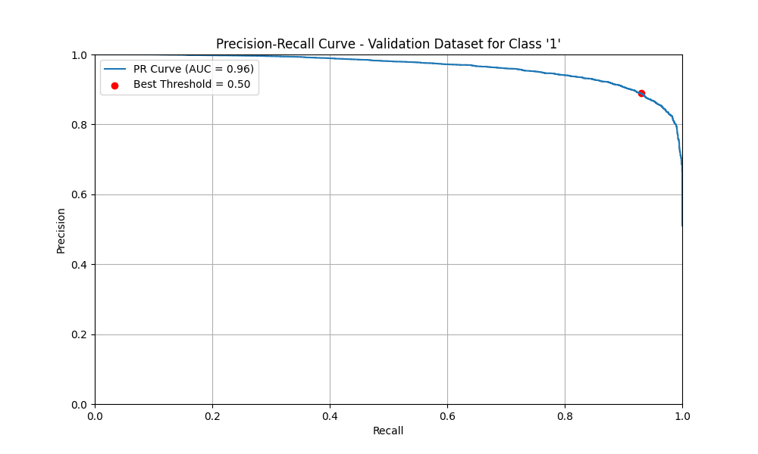
5. Model evaluation and selection – LightGBM results (1/2)
Hyperparameters Grid Search (optimum in bold):
num_leaves: 10, 30, 50, 70, 90
max_depth: 3, 5, 7, 10
learning_rate: 0.01, 0.05, 0.1, 0.3, 0.5
n_estimators: 50, 100, 200, 500
 | LightGBM - Val | LightGBM - Test
PR-AUC | 0.96 | -
Best Threshold | 0.50 | -
F1-score | 0.91 | 0.88
Recall | 0.93 | 0.88
Precision | 0.89 | 0.88

Slide 17
5. Model evaluation and selection – LightGBM – Top 10 feature importance
Age, capital income and job description (occupation and industry) are the main drivers to evaluate if an individual is earning more than 50k$ per year

Slide 18
6. Ideas for further improvement
Data preparation:
Feature Engineering: Reduce or increase number of features, ITW with US CENSUS office
Encoding: Try hashing encoding for high cardinality features
Resampling: Try SMOTE (create synthetic examples of minority class)
Scaling: Try other scaling (e.g., Standard)
Train / Val split : Try Cross-Validation
Model evaluation and selection:
Try custom cost functions (to penalize more FP and/or FN)
Try to optimize other hyperparameters (e.g., min_child_weight)
Try other other models, e.g.,:
Support Vector Classifier
Multi-Layer Neuronal Network
Transformer-based models (e.g., TabTransformer)
Model deployment (e.g., CI/CD, API and endpoint for inference)

Slide 19
Annexes

Slide 20
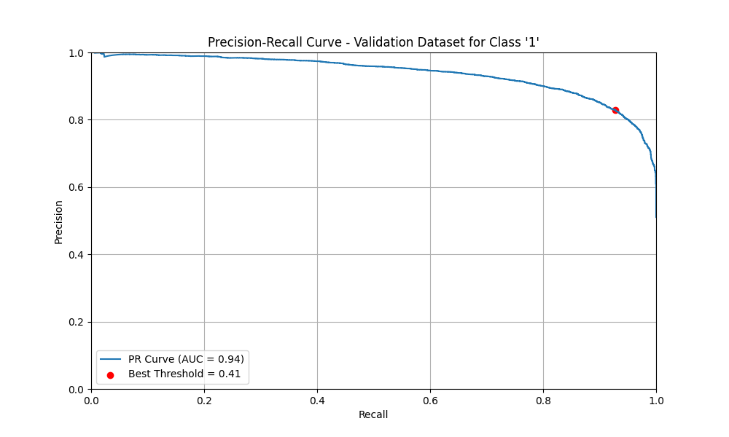
5. Model evaluation and selection – Logistic Regression
Hyperparameters Grid Search (optimum in bold):
C: 0.01, 0.1, 1
penalty: l1, l2
Solver : libnear
 | LogReg - Val | LogReg - Test
PR-AUC | 0.94 | -
Best Threshold | 0.41 | -
F1-score | 0.88 | 0.87
Recall | 0.93 | 0.92
Precision | 0.83 | 0.82

Slide 21
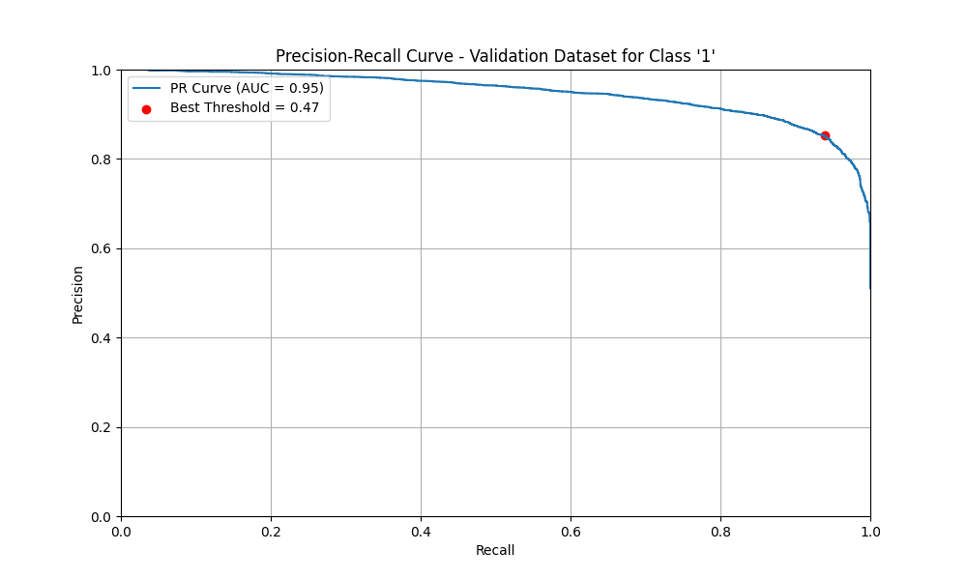
5. Model evaluation and selection – Random Forest
Hyperparameters Grid Search (optimum in bold):
max_depth: 5, 7, 10, 50
n_estimators: 50, 100, 200, 500
 | RForest - Val | RForest - Test
PR-AUC | 0.95 | -
Best Threshold | 0.47 | -
F1-score | 0.89 | 0.87
Recall | 0.93 | 0.9
Precision | 0.86 | 0.85

Slide 22

5. Model evaluation and selection – XGBoost
Hyperparameters Grid Search (optimum in bold):
max_depth: 3, 5, 7, 10
learning_rate: 0.01, 0.05, 0.1, 0.3, 0.5
n_estimators: 50, 100, 200, 500
 | XGBoost - Val | XGBoost - Test
PR-AUC | 0.96 | -
Best Threshold | 0.44 | -
F1-score | 0.89 | 0.88
Recall | 0.93 | 0.91
Precision | 0.86 | 0.85

