Slide 1
Low-cost weather and air quality stations for micro-climate monitoring
O. Boiron, M. Ghiss, Y. Knapp & I. Mazouzi

Slide 2
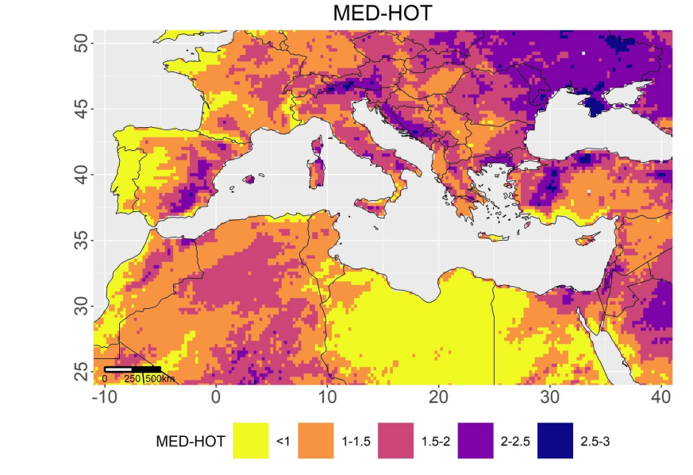
Context
Mediterranean region is an « hot-spot » for climate change
The MED-HOT index is designed to assess climate vulnerabilities in the Mediterranean region by integrating changes in the frequency and intensity of four extreme climate indicators: extreme maximum temperature (TX90), extreme high minimum temperature (TN90), extreme precipitation (P95), and consecutive dry days (CDD). This index reflects the primary climate challenges faced in the region, including heatwaves and droughts.
(Lazoglou et al, 2024, doi.org/10.1038/s41598-024-80139-1)

Slide 3
Why monitoring weather and air quality ?
To have a better knowledge of the meteo parameters (extreme values, variability, ..).
To process accurate weather forecasts.
To design solutions for trying to mitigate local warming at ESIM

Slide 4
How ?
Weather monitoring is essential for assessing accurate strategies of local CC mitigation.
Professional WS ~ 5-10k€
Low-cost DIY WS ~ 100-150€

Slide 5
The project
Building a network of 4 WS at ESIM
  MCU Espressif ESP32
  Temperature, Relative Humidity & Particulate Matter sensors
Network mastered by a Single Board Unit (SBU) equipped with:
  a Time Series Data Base (TSDB)
  a (small) local storage capacity
  WAN connection for data transmission
  A local processing and displaying application

Slide 6
Work plan
3
Wiring
Basic programme for Real Time Clock
Others sensors
Setting up communication with the RTDB InfluxDB
Connection with the server
Deployment of stations outdoors and testing

Slide 7
Work plan
3 groups
A – with Olivier – Building Weather stations
B – with Yannick - Selection of outdoor locations and installation
C – with Imed – Server setup and configuration
Everything must be working by Thursday morning!

Slide 8



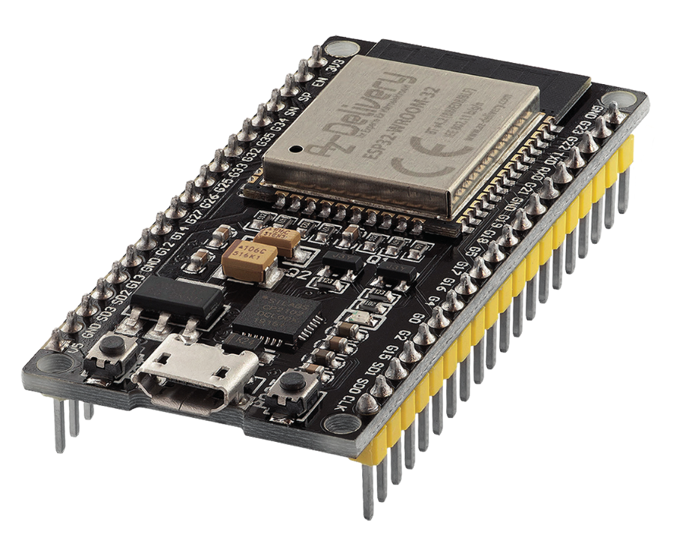
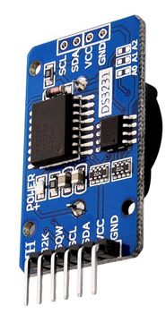
The project
DIY WS unit
AM2302
Temperature & RH
sensor
I²C
1-wire
Real Time Clock
DS3231
Sensirion SPS30
PM sensor
I²C
Micro Controler Unit
ESP32

Slide 9

The project
Solar shield
Solar panel
The solar shield blocks
direct and reflected
sunlight, then preventing
the sensors from heating
up.
Fan
Internal airflow

Slide 10
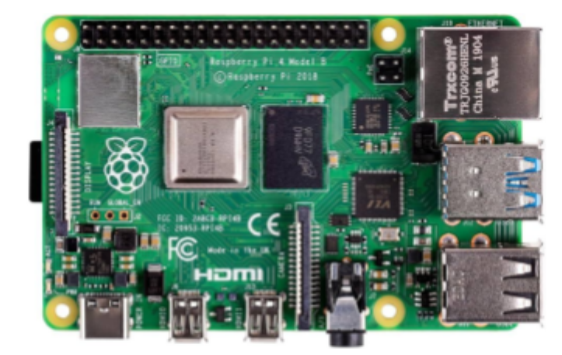
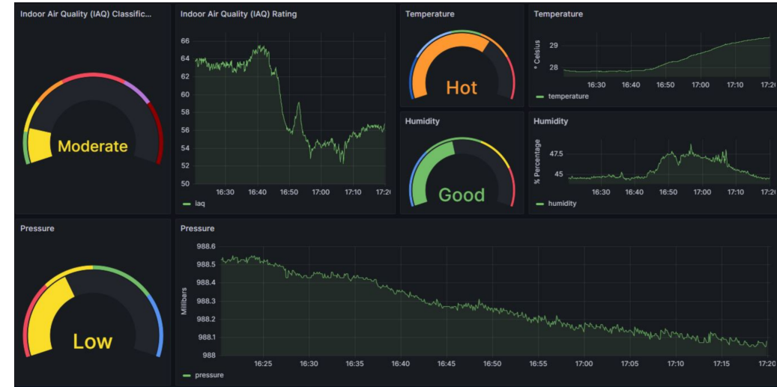


The project
WAN
DIY master Single Board Unit
Data
Raspberry Pi5-16Go
Massive storage
on remote NAS

Slide 11
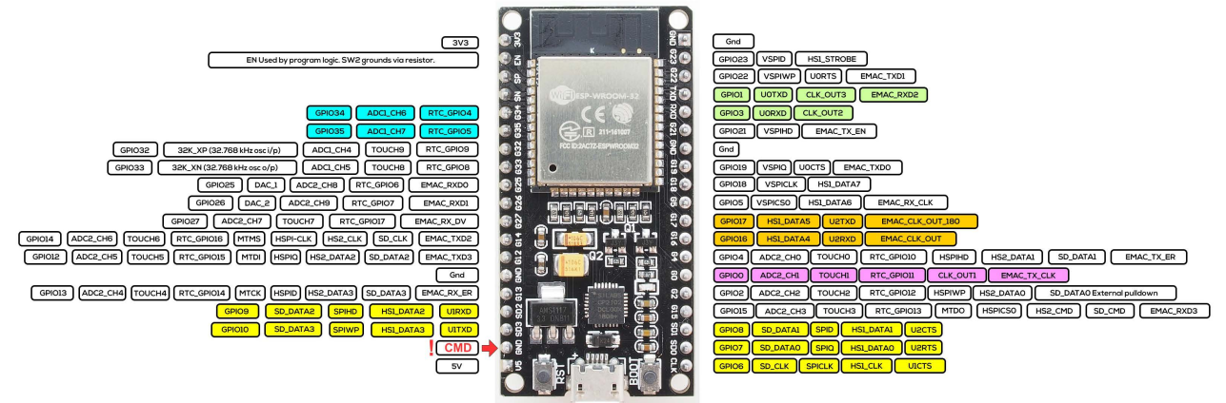
WS unit
Tensilica Xtensa LX6@240MHz
4MB flash, 520k SRAM
Wifi & Bluetooth
Low
ESP32 MCU
5V
UART
1-wire
I²C
SPI
PWM
1 analog
Hold at power
up to flash
Reset

Slide 12
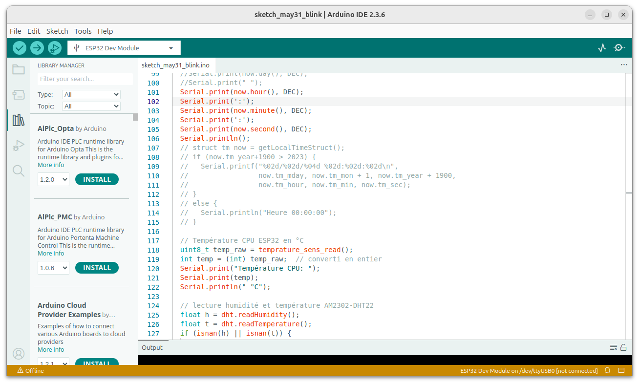
WS unit
ESP32 MCU coding
ESPHome (yaml file)
HomeAssistant (yaml file)
IDE Arduino – C language
Arduino IDE

Slide 13

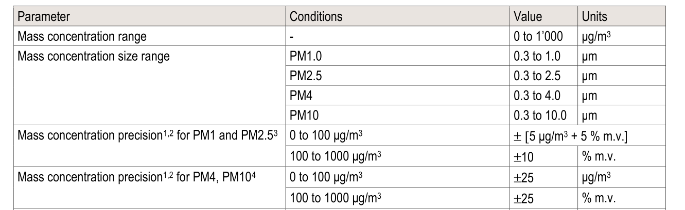
WS Unit
Sensirion SPS30 Particulate Matter sensor
Optical measurement – Mie scattering theory
λ=660nm
Internal fan
I²C interface with
ESP32

Slide 14
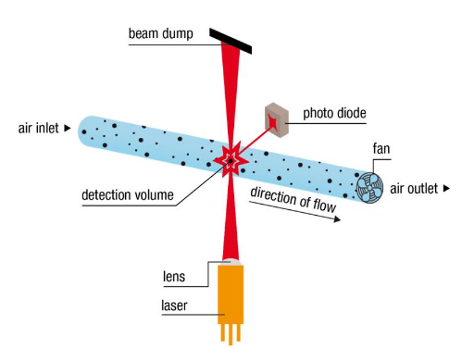
WS Unit
Sensirion SPS30 Particulate Matter sensor
Measurement principle
    Rp<<λ Rayleigh scattering for
    nanometric particles
    Rp~λ Mie scattering
    Adapted for PM1-10
    Intensity % Rp² to Rp³
    Theory for spherical particles
    so in real life empirical laws….
θ

Slide 15
WS Unit
Sensirion SPS30 Particulate Matter sensor
Measurement principle
    Theory for spherical particles
    so in real life empirical laws….
    PM sensors measure diameters
    Knowing the flow rate generated by
    the inernal fan they deduce volumic concentrations in µm³/m³
    And then mass concentrations assuming a density of 1.6-1.7 g.cm⁻³
EU Air quality standart 2008/50/EC
Pollutant | Concentration | Averaging period | Permitted excidence/yr
PM2.5 | 20µg.m⁻³ | 1 yr | n/a
PM10 | 40µg.m⁻³ | 1 yr | n/a
O3 | 120µg.m⁻³ | 8hr | 25days/3yrs
NO2 | 200µg.m⁻³ | 1hr | 18

Slide 16
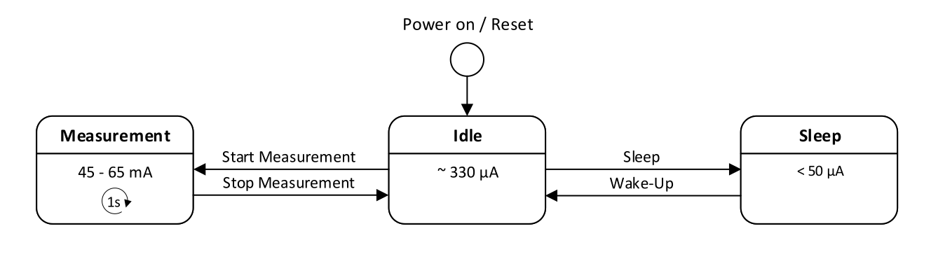
WS Unit
Sensirion SPS30 Particulate Matter sensor
  Operating modes
~50€
Fan & laser switched on
Facq~1 Hz
Fan autocleaning ~ every week
during 10s
Fan & laser switched off
Fan, laser, I²C
switched off

Slide 17
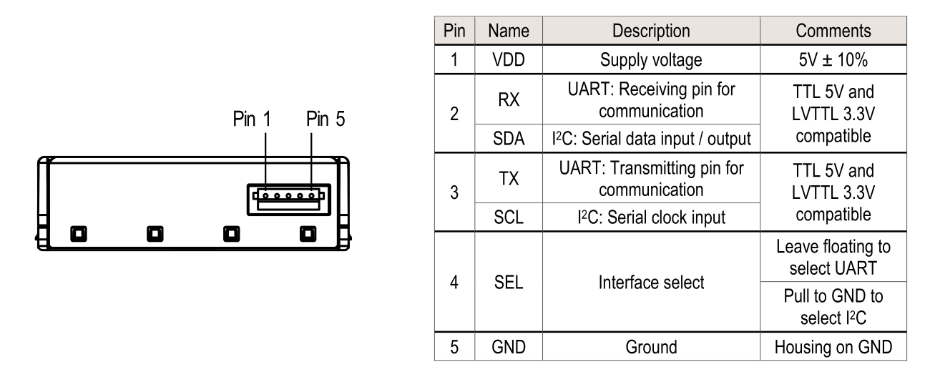
WS Unit
Sensirion SPS30 Particulate Matter sensor
  Wiring
ESP32
5V
GPIO21
GPIO22
GND

Slide 18
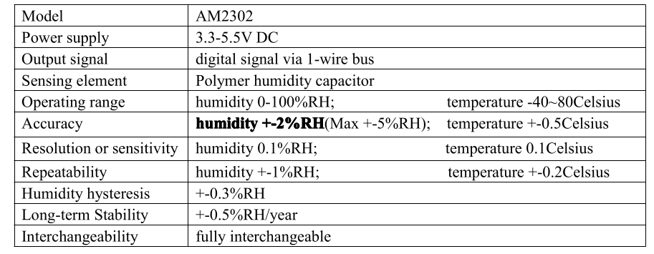
WS Unit
AM2302 Temp & RH sensor
  Specifications

Slide 19

WS Unit
AM2302 Temperature & RH sensor
  Wiring
ESP32
3V3
GPIO19
GND

Slide 20
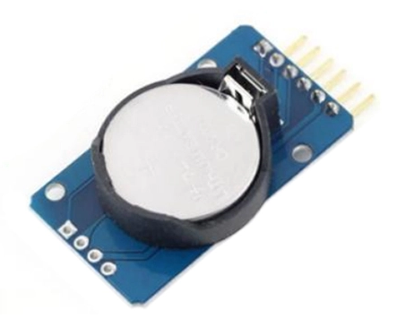
WS Unit
Real Time Clock DS3231
The DS3231 is a low-cost, extremely accurate I²C
real-time clock (RTC) with an integrated temperature-
compensated crystal oscillator (TCXO) and crystal.
Needs to be set once to correct time !
CR2032
We use NTP protocol to get it !

Slide 21
WS Unit
Real Time Clock DS3231
Wiring
GPIO22
GPIO21
3V3
GND

Slide 22

WS Unit
Connection between IDE Arduino & MCU
USB
Micro USB

Slide 23
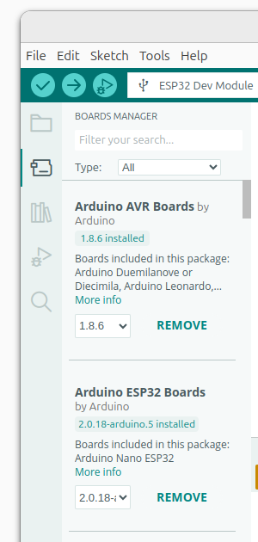

WS Unit
IDE Arduino config for ESP32
Tools/Boards manager
To install
Then choose « ESP32 Dev module »

Slide 24
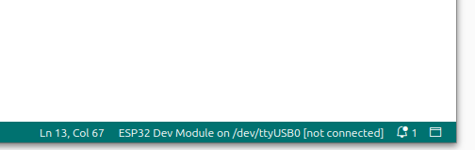
WS Unit
ESP32 connexion
Connexion by Serial Port COM1, COM2, ...

Slide 25
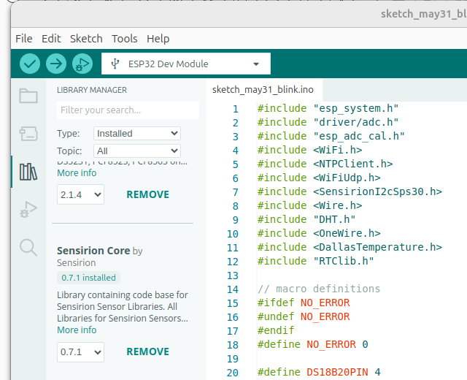
WS Unit
Programme
  Needed librairies
    NTPClient by Fabrice Weinberg v3.2.1
    Adafruit BusIO v1.17.2
    Adafruit Unified Sensor v1.1.15
    DHT sensor lib. by Adafruit v1.4.6
    Dallas Temperature by Miles Burton v4.0.5
    OneWire by J.Studt, T. Pollard,..v2.3.8
    RTClib by Adafruit v2.1.4
    Sensirion Core by Sensirion v0.7.1
    Sensirion I2C SPS30 by Sensirion v1.0.1

Slide 26
First step : setting up the Real Time Clock
The RTC needs to be set at exact time (UTC+
Exact time is retrieved by internet via Network Time Protocol (NTP)
NTP server : Centrale Méditerranée ntp.ec-m.fr

Slide 27

First step : setting up the Real Time Clock
Needed libraries
Setting up wifi
// === CONFIG WIFI ===
const char* ssid = "XXXX";
const char* password = "YYYY";
#include <Wire.h>
#include "RTClib.h"
#include <WiFi.h>
#include <NTPClient.h>
#include <WiFiUdp.h>
NTP server @
Setting up NTP
// === CONFIG NTP ===
WiFiUDP ntpUDP;
NTPClient timeClient(ntpUDP, "ntp.ec-m.fr", 7200, 60000); // UTC+2
3600x2 = UTC+2

Slide 28
First step : setting up the Real Time Clock
Program available here

