Slide 1
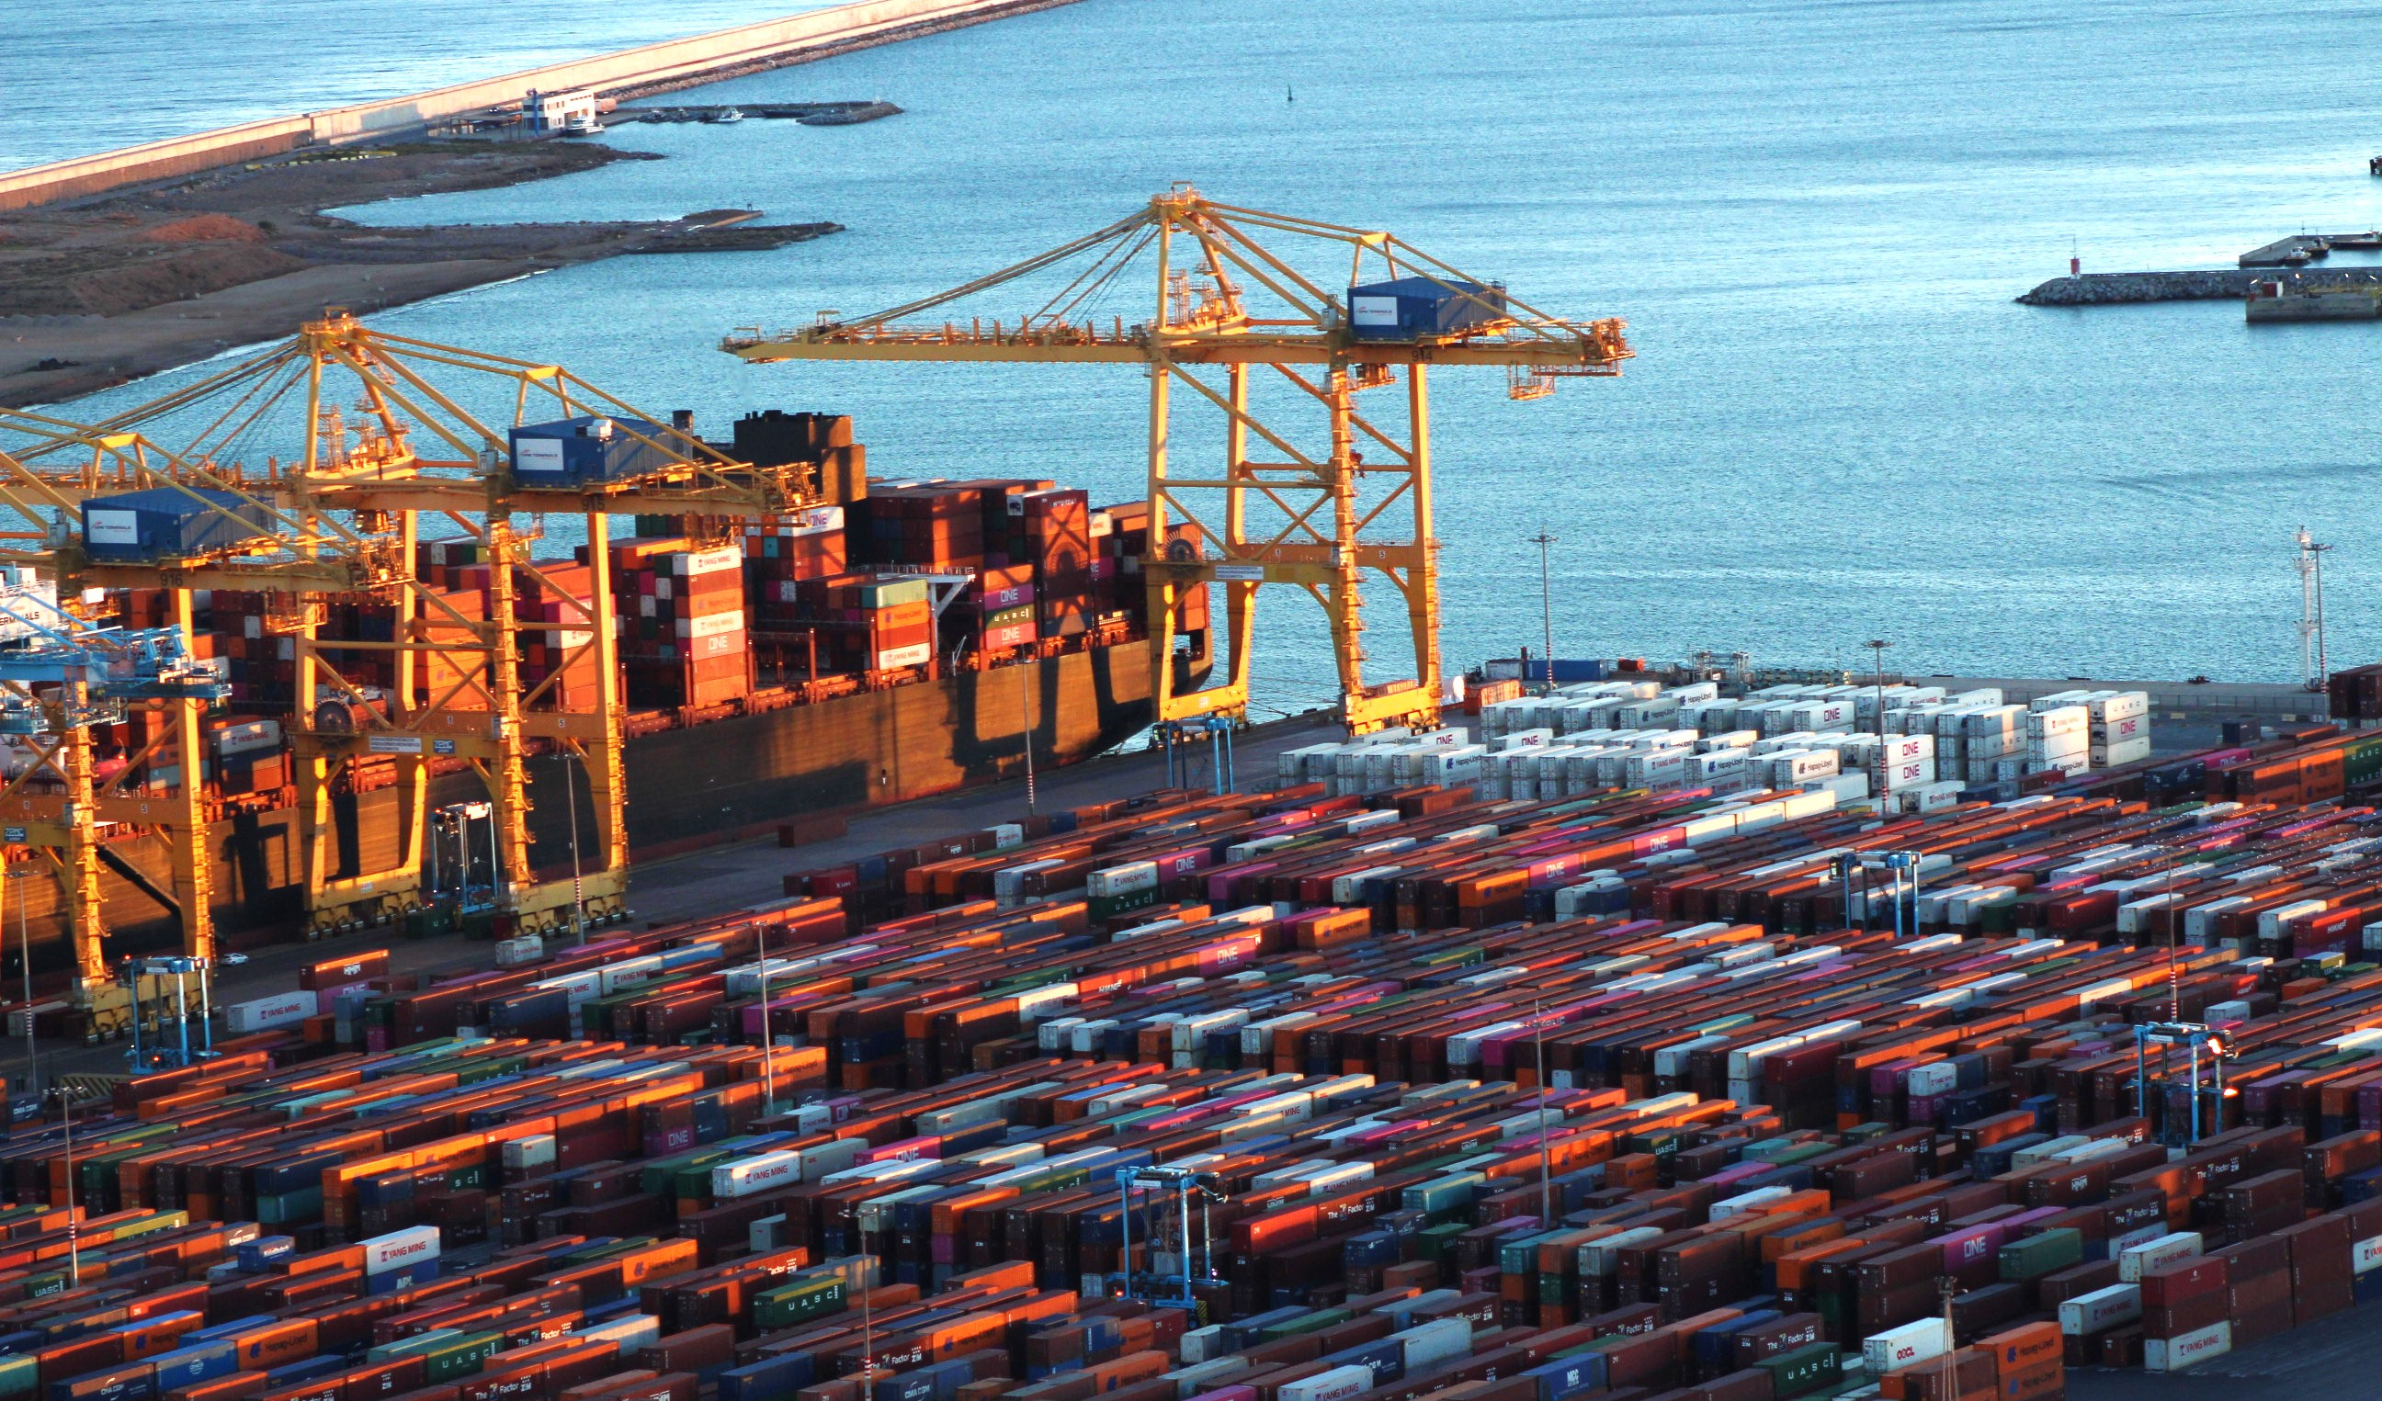
Barcelona-2023_byBpiereck

Slide 2



Know more
Introduction to Docker for
reproducible analysis
Introduction to Docker for
reproducible analysis

Slide 3
What are CONTAINERS ?
Common definition: Object to HOLD and TRANSPORT something
How are containers related to informatics ?
Co-relation in informatics: It is a PORTABLE package HOLDING applications and all its necessary means.

Slide 4
What is a DOCKER ?
Common definition: Person working in a port, responsible for LOADING and UNLOADING containers.
How is a DOCKER related to (bio)informatics?
Co-relation in informatics: It is an open-source platform to
CREATE (loading),
MANAGE (running)
SHIP (sharing) containers with their applications.

Slide 5

What is a container ?
“
A container image is a lightweight, stand-alone, executable package of a piece of software that includes everything needed to run it: code, routine, system, tools, libraries, settings
”
- https://www.docker.com/what-container -
Notes:
Logo guideline: https://www.docker.com/company/newsroom/media-resources/

Slide 6

“Well, it works on my machine…”
by @Freepik
Potential general barriers
Different Operational system
Different hardware
Different software versions
Technical ability
Notes:
From the perspective before containers
https://www.freepik.com/icon/settings_6541015#fromView=search&page=1&position=78&uuid=a1d1dccf-4f18-4f35-8009-683e1222c59f

Slide 7





Docker use cases
Web application
Galaxy, GitLab
Analysis pipeline
Nextflow, Snakemake
Testing & continuous integration
Jenkins, Drone CI
Difficult to compile apps
PennCNV, hap.py
Need for reproducible environments
Jupyter notebooks
by @Freepik
by @Irfansusanto20
by @kerismaker
by @Freepik
by @Creaticca Creative Agency
Notes:
[www global icon] - https://www.freepik.com/icon/world-wide-web_1927656
[workflow icon] - https://www.freepik.com/icon/prioritize_12283476
[continuos integration icon ] - https://www.freepik.com/icon/proactive_4824225
[difficult to compile icon] - https://www.freepik.com/icon/confused_5662983
[jupyter notebook icon] - https://www.freepik.com/icon/notebook_503635

Slide 8
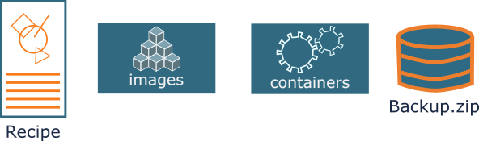
How does it work?
Important concepts
Dockerfile: Your recipe
Docker image: Static artifact
Container: Running image (functional)
Backup.tar: Compacted file
Docker engine: ‘Manager’
File you can create using the docker engine (rarely used)
your recipe to build the Docker image

Slide 9
How does it work?
Important concepts
Dockerfile: Your recipe
Docker image: Static artifact
Container: Running image (functional)
Backup.tar: Compacted file
Docker engine: ‘Manager’
Used as base
Long-term storage
Based on image
Short lived

Slide 10
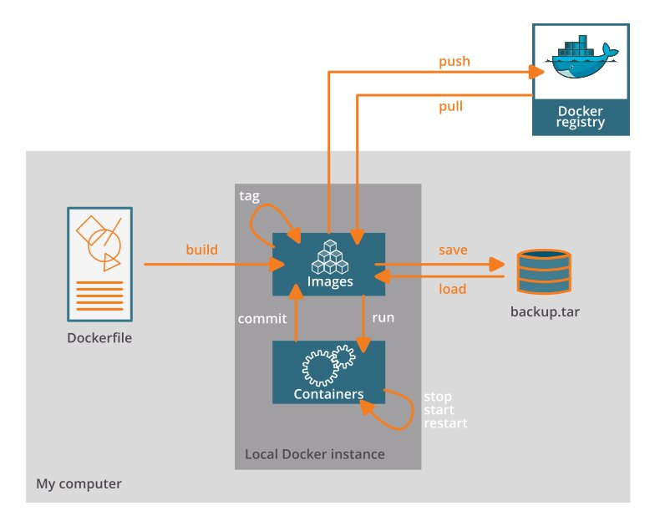
How does it work?
Important concepts
Dockerfile: Your recipe
Docker image: Static artifact
Container: Running image
Backup.tar: Compacted file
Docker engine: ‘Manager’

Slide 11
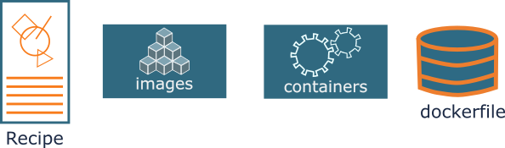
How does it work?
Important concepts
Dockerfile: Your recipe
Docker image: Static artifact
Container: Running image
Backup.tar: Compacted file
Docker engine: ‘Manager’

Slide 12
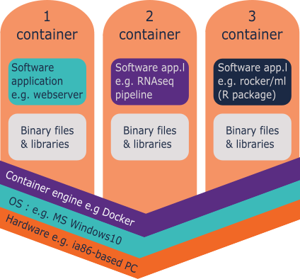
How is it organized?
General components
Docker images layers
Recipe
Image
Image
FROM ubuntu:18.04
RUN apt update && apt –y upgrade
RUN apt install –y wget
3
2
1

Slide 13
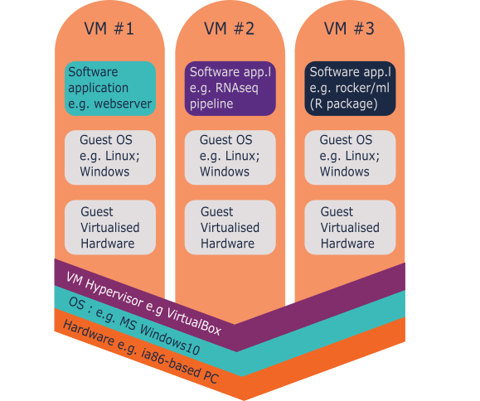
How is it organized?
General components
Docker images layers

Slide 14
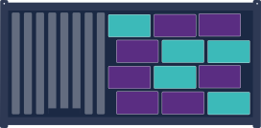




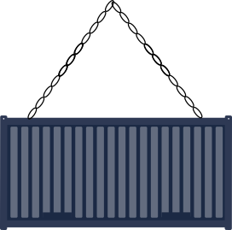
Advantages
Bundled Dependencies
Contain all their own dependencies = no need of installing hurdles
Cross-platform Installation
Contain their own operating system = run on any platform (even Windows!)
Easy Distribution
Shared on Docker Hub or as ‘image.tar’ file
by @Roundicons Premium
by @Freepik
by @Freepik
Notes:
https://www.freepik.com/icon/social_14051772 [Windows icon]
https://www.freepik.com/icon/apple_546060 [Apple icon]
https://www.freepik.com/icon/linux_546061 [Linux icon]

Slide 15


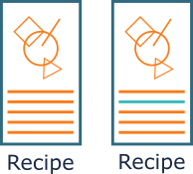
Advantages
Safety
Can’t access files on the host machine
Ease-of-Use
Can always be run using one single command
Easy Upgrades
Easily swapped out for newer versions
All persistent data can be retained in a data volume

Slide 16




Other container softwares

Slide 17
Using and Reusing
available docker images
Using and Reusing
available docker images
Barcelona-2023_byBpiereck

Slide 18


Where can we storage and find Docker images?
Local storage
Registry

Slide 19
Where can we storage and find Docker images?
Local storage
Registry
Preferable

Slide 20


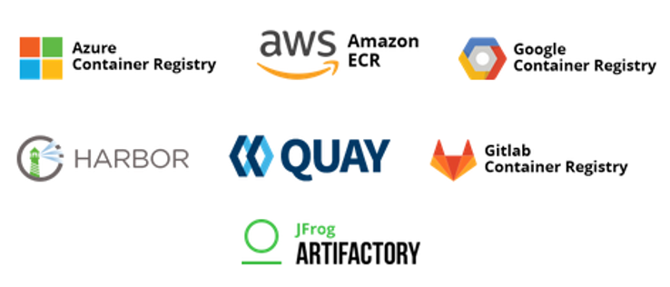


Container Registries
Main registry for DOCKER containers
Alternative registries

Slide 21

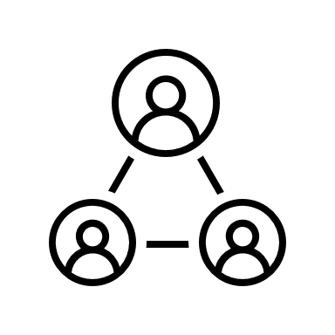
Container Registries
Main registry for DOCKER containers
Alternative registries

Slide 22
How do we get a container image?

Slide 23

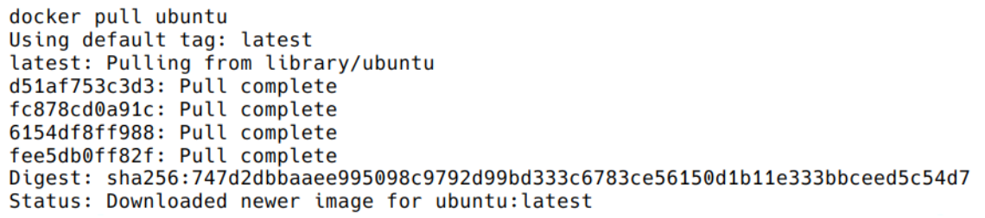
How do we get a container image?
docker pull <image>
docker pull <registry/image>
Example: getting Ubuntu image
$ docker pull ubuntu

Slide 24
How do we get a container image?
docker pull <image>
docker pull <registry/image>
Example: getting Ubuntu image
Example: Get a specific version
$ docker pull ubuntu
$ docker pull ubuntu:18.04

Slide 25
How do we get a container image?
Is there a better way to ‘pull’ ??
If yes, which one?
docker pull ubuntu
docker pull ubuntu:18.04
Why?

Slide 26
How do we get a container image?
Pull ubuntu in your computer:
Version 18.04
Pull from Biocontainers
Fastqc (A quality control tool for high throughput sequence data)
Version 0.11.9_cv7

Slide 27
What else can we do?
Check all images that you have
$ docker images
$ docker image ls $ docker images -a
Run a container with your analysis
$ docker run [docker_options] <container> [container_arguments]
run

Slide 28
List your imaged
List all the images you have pulled or build

Slide 29
Run your 1st image
You can execute any program/command that is stored inside the image. What happens if you execute ls in your current working directory: is the result the same?
List all the images you have pulled or build
You can execute any program/command that is stored inside the image.
Run your 1st container
$ docker run ubuntu:18.04 /bin/ls $ docker rum ubuntu:18.04 /bin/whoami $ docker run ubunu:18.04 /

Slide 30

Run your 1st image
List all the images you have pulled or build
You can execute any program/command that is stored inside the image.
Run your 1st container
$ docker run ubuntu:18.04 /bin/ls
If you run ls in your current directory, do you have the same?
Why?
Computer
Docker engine
ls
ls

Slide 31
Docker detach, what does It do?
Note: Question for them … let them answer

Slide 32
Docker detach, what does It do?
Run in the background
Detached from the shell
$ docker run [docker_options] <container> [container_arguments] $ docker run --detach <container> [container_arguments]
Name your container to check later
$ docker run --detach --name <my_ctn_name> <container> [container_arguments]

Slide 33
Challenge: How do you list running containers?
Run the following without naming it:
$ docker run --detach nginx
Run again naming it
$ docker run --detach --name MyUbuntu nginx

Slide 34
Challenge: How do you list running containers?
Run the following without naming it:
$ docker run --detach nginx
Run again naming it
$ docker run --detach –name MyUbuntu nginx
List running containers
$ docker ps
List all containers (whether or not running)
$ docker ps -a

Slide 35
What are IDs and Names useful for?

Slide 36
What are IDs and Names useful for?
Stop a container
Restart a container
run
stop
restart

Slide 37
Tagging
Name your image!
Version of your image
docker tag <image ID> <tag_name>
Let’s try to do it!

Slide 38
Tagging
Name your image!
Version of your image
docker tag <image ID> <tag_name>
Check the ID of your images
Chose one of them to change or add a tag
Let’s try to do it!

Slide 39
Naming objects in Docker
What is the difference between … ?
Tag
--name

Slide 40
Naming objects in Docker
What is the difference between … ?
Tag
--name
Name the container (docker run –name ….)
One image can create +1 container
Name an image
Define the version of an image (docker tag <image ID> …..)

Slide 41
Docker and disk space
Docker objects are not automatically removed
Images
Containers
Networks
Volumes
Check system space
Pruning the system
The whole system
Dangling images
Not tagged
No references
All images not associated to a container
My_image

Slide 42
Docker and disk space
Docker objects are not automatically removed
Images
Containers
Networks
Volumes
Check system space
Pruning the system
The whole system
Dangling images
Not tagged
No references
All images not associated to a container
???
+
My_image

Slide 43
Docker and disk space
Dangling image
Docker objects are not automatically removed
Images
Containers
Networks
Volumes
Check system space
Pruning the system
The whole system
Dangling images
Not tagged
No references
All images not associated to a container
???
+
My_image

Slide 44
Docker and disk space
Docker objects are not automatically removed
Images
Containers
Networks
Volumes
Check system space
Pruning the system
The whole system
Dangling images
Not tagged
No references
All images not associated to a container
run

Slide 45
Docker and disk space
Image:version
Docker objects are not automatically removed
Images
Containers
Networks
Volumes
Check system space
Pruning the system
The whole system
Dangling images
Not tagged
No references
All images not associated to a container
run
Ref: Image:version

Slide 46
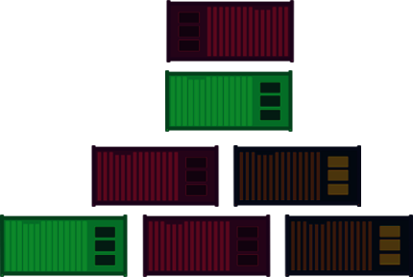
Docker and disk space
Check space usage (Disk inFo)
Output
Type object
Total number of objects
Size
etc
$ docker system df

Slide 47

Docker and disk space
Clean up
Remove (rm)
Specify
Image
Container
Check space usage (Disk inFo)
Output
Type object
Total number of objects
Size
etc
$ docker system df
$ docker rm –f <container>
$ docker rmi <image>

Slide 48
Docker and disk space
Clean up
Remove (rm)
Specify
Image
Container
$ docker rm <container>
$ docker rmi <image>
Major clean up
Clean all dangling objects
$ docker system prune
Clean all dangling images
$ docker image prune
Clean unused containers
$ docker container prune
Check space usage (Disk inFo)
Output
Type object
Total number of objects
Size
etc
$ docker system df

Slide 49
Docker and disk space
Clean up
Remove (rm)
Specify
Image
Container
$ docker rm –f <container>
$ docker rmi <container>
Major clean up
Clean all dangling objects
$ docker system prune
Clean all dangling images
$ docker image prune
Clean unused containers
$ docker container prune
Check space usage (Disk inFo)
Output
Type object
Total number of objects
Size
etc
$ docker system df
Clean all UNUSED objects
$ docker system prune –a
Use it carefully !!!

Slide 50
Check and clean
Check how much disk space you’ve used
Clean stopped or unused containers
Can you combine docker options?
run
rm
prune
tag

Slide 51
Working interactively
When to do it?
Debug
How to do it:
docker run –it <image> <command>
dokcer run –it –rm <image> <command>
dockcer exec <containerr>

Slide 52
Activity 1.1
Get the data (https://github.com/vibbits/containers-workshop/)
You will need fastqc
check all your images
Pull image if needed
Run fastqc –h
Activity 1.2
Check for running containers
Remove the container
Run the container interactively
Start it with bash

Slide 53
Docker a closed environment

Slide 54

Docker a closed environment
Mounting volumes
Using Ports

Slide 55
Volume mounting: I/O
Activity 2 -3 and 4.1-3
Container is isolated from host
X
DATA

Slide 56
Volume mounting: I/O
Activity 2 -3 and 4.1-3
Container is isolated from host
Data in the container is NOT kept
DATA

Slide 57
Volume mounting: I/O
Activity 2 -3 and 4.1-3
Container is isolated from host
Data in the container is NOT kept
Solution:
Biding volume -v /path/in/host:/path/in/container docker run --detach \ --volume path/in/host/datatest:/path/in/container/dataset \ --name <container_name> <container:version> <container_options>
DATA

Slide 58
Volume mounting: I/O
Activity 2 -3 and 4.1-3
Container is isolated from host
Data in the container is NOT kept
Solution:
Biding volume -v /path/in/host:/path/in/container
Naming volume -v volume_name:/path/in/container docker run --detach \ -v MyVolume:/path/in/container/dataset \ --name <container_name> <container:version> <container_options>
DATA

Slide 59
Activity 2.1
Run interactively and mount the local data/ folder to the container /data
biocontainers/ fastqc:v0.11.9_cv7.
Remove the container after it has run
Activity 2.2
Do a quality control on the WT samples
Use the command
Why do we need to add /data/ in the fastqc command?
fastqc /data/WT_lib1_R1.fq.gz or fastqc /data/ecoli_1.fastq.gz.
Biding volume -v /path/in/host:/path/in/container

Slide 60
3
Who is the default user within the container?
Run interactively and mount the local data/ directory to /scratch in the container
biocontainers/ fastqc:v0.11.9_cv7
In the container directory
Create a temporary file file1.txt in the scratch/
Quit the interactive session.
On your host, check the file permissions.
On the host
Create a temporary file file2.txt in the data/ directory.
Run interactively and inspect the file permissions of this file
the fastqc container
Check the file permissions of this file in the container (scratch/ directory).
On the host, find out which UID and GID you have.
Tip: you can find your UID and GID with: id -u and id -g.
Run a docker container by using the -u parameter
In the meantime creating a temporary file file3.txt with touch.
Mount your current directory to /data
Within quay.io/biocontainers/fastqc:0.11.9--0.
Check the file permissions of this file in the container.

Slide 61
4
Exercise 4.2
Execute the container: quay.io/biocontainers/fastqc:0.11.9_cv7
Use your user and group ID running
Do quality control of the file WTXXX.fq.gz.
mount your current directory to the default working directory within the Docker container
Verify that the HTML report is created with the correct file permissions.
Exercise 4.1
Execute the container: quay.io/biocontainers/fastqc:0.11.9_cv7
Use working directory option -w for a directory scratch/
Create a temporary file file4.txt with touch.
Mount your current directory to scratch/ within the Docker container
Check the file location of this file on the host.
Version 0.11.9_cv7​
Extra:
Can you analyze all fastq files using a glob-pattern (WT*.fq.gz)?
What do you need to change to make this work?

Slide 62
Ports
Establish communication with webserver
$ docker run --detach --name webserver nginx $ curl localhost:80
Computer
Docker engine

Slide 63
Ports
Stablish communication with webserver
$ docker run --detach --name webserver nginx $ curl localhost:80
Nginx (Engine-x) : creates a local webserver
curl : Client URL
Enables communication between the host and the server

Slide 64
$ docker run --detach --name webserver nginx $ curl localhost:80
Computer
Docker engine

Slide 65
Ports
Stablish communication with webserver
$ docker run --detach --name webserver nginx $ curl localhost:80
Container X external environment
Computer
Docker engine

Slide 66
What is the difference between run and exec ?
$ docker run --detach --name webserver nginx $ docker exec webserver curl localhost:80
Computer
Docker engine

Slide 67

Ports
Stablish communication with webserver
$ docker run --detach --name webserver nginx $ curl localhost:80
Container X external environment
exec : execute inside the container
Open the door for host communication
$ docker exec webserver curl localhost:80
Computer
Docker engine

Slide 68
Ports
Computer
Docker engine
To keep the door open
$ docker run --detach --name webserver --publish 80:80 nginx $ curl localhost:80

Slide 69
Ports
Computer
Docker engine
To keep the door open
$ docker run --detach --name webserver --publish 80:80 nginx $ curl localhost:80
$ docker run --detach --name webserver -p 8080:80 nginx $ curl localhost: ???? $ docker exec webserver curl localhost: ???
FYI
--publish
=
-p

Slide 70
What happens? Why?
$ docker run --detach --name webserver --publish 80:80 nginx $ curl localhost:80
What should you use? Why ?
$ docker run --detach --name webserver -p 8080:80 nginx $ curl localhost: ???? $ docker exec webserver curl localhost: ???
Remember to remove these containers docker rm -f <name>

Slide 71
Inspect
Check a recipe
How others do
Potential security issues
$ docker inspect <image_name\image_ID>

Slide 72
Find trimmomatic in docker hub
dceoy/trimmomatic
Pull and inspect

Slide 73
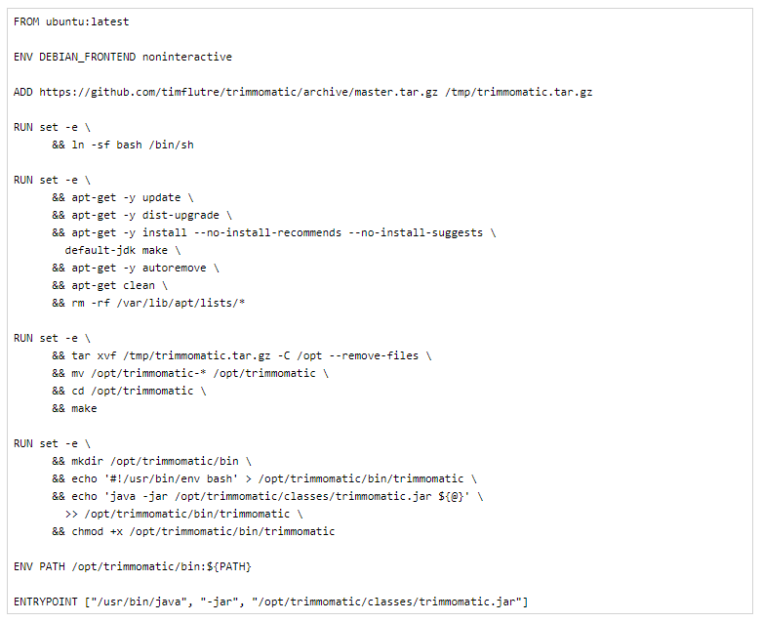

Slide 74
4.3 + challange
Inspect the image biocontainers/fastqc:0.11.9_cv7
Extract the working directory (WorkingDir) using grep.
HINT:
cmd | grep “keyword”

Slide 75
Summary of 1st part: Reusing containers
PULL
INSPECT
TAG
RUN --detach <>
-- name
-- publish
- it
IMAGES / PRUNE
PS / DF / RM / RMI
STOP
RESTART
MOUNT (--volume)
My computer
EXEC
Docker engine

Slide 76
Building your own
docker image
Building your own
docker image
Barcelona-2023_byBpiereck

Slide 77
Recipes
The default recipe is called Dockerfile
FROM ubuntu:18.04 RUN apt update && apt -y upgrade RUN apt install -y wget

Slide 78
Building images
Create a Dockerfile with the content below in a folder of your preference and save it.
FROM ubuntu:18.04 RUN apt update && apt -y upgrade RUN apt install -y wget
How many layers should be created?

Slide 79
Building images
Let’s test it and build the image with
docker build .
How many layers should be created?
docker history <id>

Slide 80
Building images
Create a Dockerfile with the content below in a folder of your preference and save it.
FROM ubuntu:18.04 LABEL org.opencontainers.image.authors=”training@vib.be"
WORKDIR ~ RUN apt update && apt -y upgrade RUN apt install -y wget ENTRYPOINT ["/usr/bin/wget"] CMD ["https://cdn-images-1.medium.com/max/1600/1*_NQN6_YnxS29m8vFzWYlEg.png"]
Build the image with and without caching.

Slide 81
Recipes
More advanced image building
Different ways to build images.
Know your base system and their packages. Popular ones:
Debian
CentOS
Alpine
Conda. Anaconda, Conda-forge, Bioconda, etc.

Slide 82
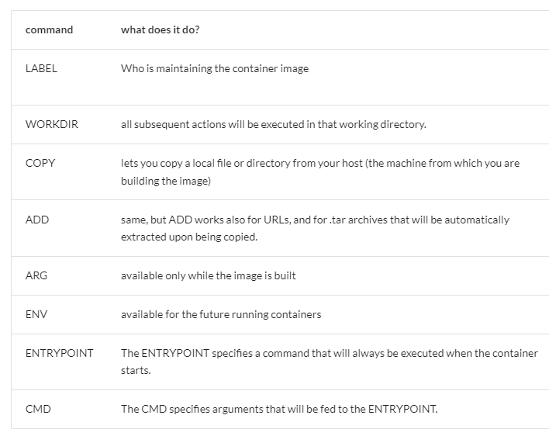

Slide 83
Recipes
One tool, one image or some tools, one image
Different ways to build images.
start from packages e.g. pip/PyPI, CPAN, or CRAN
use versions for tools and images
reduce size as much as possible
keep data outside the image/container
check the license
make your container discoverable e.g. biocontainers, quay.io, docker hub

Slide 84
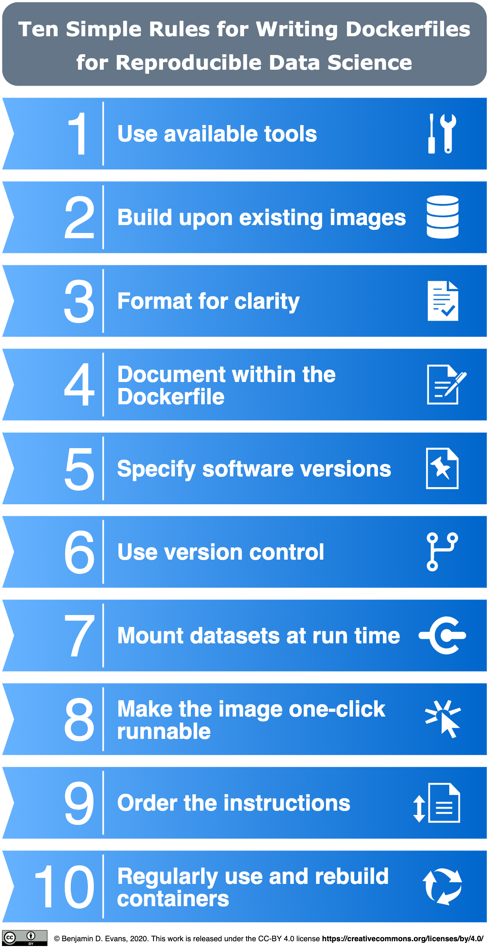
Published: November 10, 2020
https://doi.org/10.1371/journal.pcbi.1008316
Ten simple rules for writing Dockerfiles for reproducible data science
Daniel Nüst ,
Vanessa Sochat,
Ben Marwick,
Stephen J. Eglen,
Tim Head,
Tony Hirst,
Benjamin D. Evans
https://docs.docker.com/engine/userguide/eng-image/dockerfile_best-practices/

Slide 85
5
Exercise 5.2
Once you have built an image based on the corrected Dockerfile, run the script data/codereppy_min_batch.py with the Python version installed in the image.
Reach out to your neighbour(s) in case you need help.
Exercise 5.1
Imagine the following situation. To make a simple data analysis project as reproducible as possible, we propose to create a container environment using Docker which contains the necessary tools and scripts. We have two use cases:
a) we would like to run the Python scripts on the command line
b) we think that a Jupyterlab is useful environment to play around with the data analysis.
Look for the Dockerfile.play in the folder docker
Rearrange the statements and comments of the Dockerfile
Build the Docker image

Slide 86
Recipes
One tool, one image or some tools, one image
Different ways to build images.
start from packages e.g. pip/PyPI, CPAN, or CRAN
use versions for tools and images
reduce size as much as possible
keep data outside the image/container
check the license
make your container discoverable e.g. biocontainers, quay.io, docker hub

Slide 87
Know more
Short intro to HPC
preparing for Apptainer
Short intro to HPC
preparing for Apptainer

Slide 88
To be added

Slide 89
Know more
Introduction to Apptainer for
reproducible analysis
Introduction to Apptainer for
reproducible analysis

Slide 90
How does it work?
Important concepts
Text file: Your recipe
Apptainer image: Static file
Container: Running image (functional)
File you can ship ☺
your recipe to build the Apptainer image

Slide 91
Comparing from yesterday’s session
…
PULL
“INSPECT”
mv
ls / rm
EXEC
ps
SHELL
My computer
MOUNT (-B)

Slide 92
Docker vs Apptainer
Strengths
No dependency of a daemon
Can be run as a simple user
Avoid permission headaches and hacks
Image/container is a file (or directory)
More easily portable
Two type of images
Read-only (production)
Writable (development, via sandbox)
Weaknesses
At the time of writing only good support in Linux
For some features you need root account (or sudo)
by @Roundicons Premium
by @Freepik
by @Freepik
Notes:
https://www.freepik.com/icon/social_14051772 [Windows icon]
https://www.freepik.com/icon/apple_546060 [Apple icon]
https://www.freepik.com/icon/linux_546061 [Linux icon]

Slide 93
How does it work?
By default, Apptainer uses $HOME/.apptainer/cache as the location for the cache. This will not work on the VSC. You can change the location of the cache by setting the $APPTAINER_CACHEDIR environment variable to the cache location you want to use.
Please set the variable $APPTAINER_CACHEDIR to $VSC_SCRATCH.

Slide 94
1
Exercise 1
In the hello world container, try editing (for example using the editor vi which should be available in the container) the /rawr.sh file. What do you notice?
Exercise 2:
In your home directory within the container shell, try and create a simple text file. Is it possible to do this? If so, why? If not, why not?! If you can successfully create a file, what happens to it when you exit the shell and the container shuts down?

Slide 95
Downloading images
$ mkdir $VSC_DATA/apptainer-course
$ cd $VSC_DATA/apptainer-course
$ apptainer pull hello-world.sif shub://vsoch/hello-world $ apptainer pull --name fastqc-0.11.9--0.sif https://depot.galaxyproject.org/singularity/fastqc:0.11.9--0 $ file fastqc-0.11.9--0.cif

Slide 96
Binding folders
singularity shell -B /data/leuven/315/vsc315XX hello-world.sif Singularity> ls /data/leuven/315/vsc315XX
$ singularity shell -B /data/leuven/315/vsc315XX :/shared-data hello-world.sif Singularity> ls /shared-data

Slide 97
Downloading images or pulling or building images
Pulling images may take a while, so we need to run this as a job.
qsub pull-image.pbs
… APPTAINER_CACHEDIR=$VSC_SCRATCH \ APPTAINER_TMPDIR=$VSC_SCRATCH \ apptainer build --fakeroot $VSC_SCRATCH/tensorflow-23.06-tf2-py3.sif \ docker://nvcr.io/nvidia/tensorflow:23.06-tf2-py3 …

Slide 98
And now really building images
Pulling images may take a while, so we need to run this as a job.
qsub build-image.pbs
… APPTAINER_CACHEDIR=$VSC_SCRATCH \ APPTAINER_TMPDIR=$VSC_SCRATCH \ apptainer build --fakeroot $VSC_SCRATCH/test_image_ubuntu.sif \ $VSC_SCRATCH/test_image_ubuntu.def …

Slide 99
plan
Add quizzes!!!
Recipe
Docker vocabulary
Recipe - dockerfile
Built from existing images
(use &&)
(building cache)
Tips (base file – biocontainers)
Start build
Good practice
Instructions for recipe
1 tool = 1 image vs ++ tools = 1 image
Docker inspect
Back to reusing
Inspecting others
Singularity
Intro
Concepts
Organization
Advantages
Typical use cases
When not to use ???
Reuse
Docker hub and other registries |(biocontainers)
Getting images for reuse (pull)
List images
Using an image (Run) interactive & daemon
Tag (-t)
Check an running container
Stop
Clean up (rm)
Run vs exec
Handling input output (mounting volumes)
Ports = ???
Docker inspect exercise 4
ondemand.hpc.kuleuven.be
tier1.hpc.ugent.be/
login.hpc.ugent.be/
Should we add cases where Docker is not the best option?
Not sure what we say about ports ….
p.s: Commercial use of Docker Desktop requires a paid subscription

